Slide 1
PHY 341/641 Thermodynamics and Statistical Mechanics
MWF: Online at 12 PM & FTF at 2 PM
Discussion for Lecture 34:
Treatment of particle interactions in statistical mechanics; electron spin effects
Reading: Sections 8.2
(also, part of Section 6.2 concerning spin)
Simple model of magnetism without interactions
Effects of spin interactions – Heisenberg model
Effects of spin interactions – Ising model
Record!!!

Slide 2
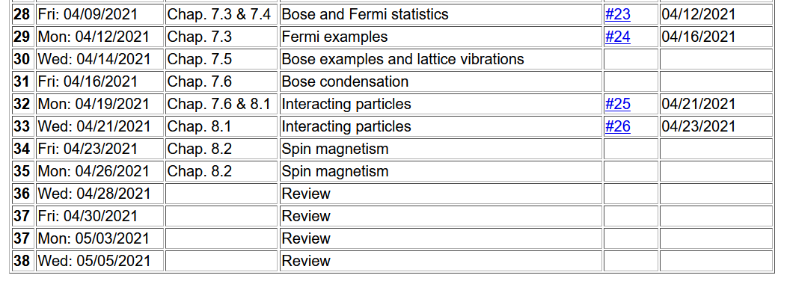
Important dates: Final exams available < May 6; due May 14
Outstanding work due May 14

Slide 3
Comment on homework assignment from Monday’s lecture

Slide 4
Your questions –
From Mike -- I'm assuming the Ising model is only an accurate approximation for ferromagnets. In this case, how do we deal with antiferromagnets?
From Kristen -- 1. How is it that the system discussed can become more ordered as the temperature gets higher, doesn't this violate entropy?
2. Could you go over how we get the average expected spin values (equation 8.49) from the partition function, just in this case especially?

Slide 5
Note: Your textbook focuses on the magnetism due to the intrinsic spin of an electron with spin s=½. Certainly, the magnetic phenomena are generally traced to that basic physics. However, very interesting magnetic effects are due to atoms which have multiple electrons in localized quantum states which can be well modelled in terms of a total electron spin which we will call S with the knowledge that S can have values larger than ½. Interesting magnetic materials can be described as paramagnetic or ferromagnetic and other more complicated phenomena such as anti ferromagnetic, etc.

Slide 6
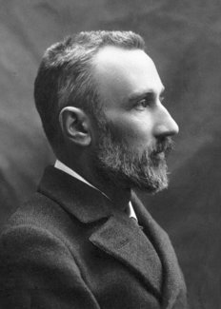
Pierre Curie 1859-1906
His name is associated with his work on magnetism at low temperatures
In 1903 he shared the Nobel Prize for work with Marie Curie and Henri Becquerel on radioactivity

Slide 7
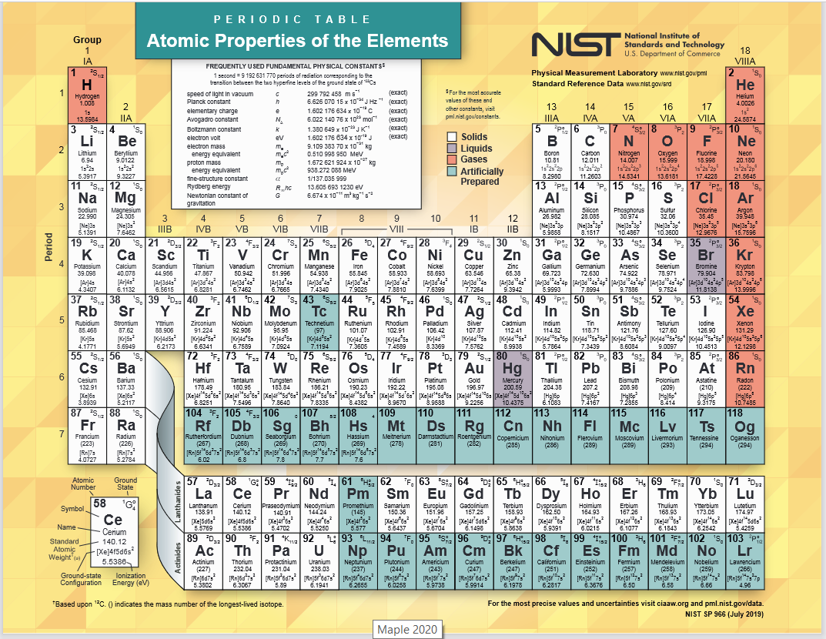

Slide 8
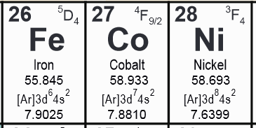
Elemental ferromagnetic materials
Multiple electrons available to make a net total spin S
Here J is an interaction energy determined from quantum mechanics.
i j

Slide 9
First, consider the effects of a magnetic field B on a single atom with spin S. The eigenvalue of the quantum operator S² is S(S+1). (Here we define spin to be the actual intrinsic spin divided by h/2p.) Since the atom may have multiple electrons involved, and because some orbital angular momentum may be involved, S may be a half integer or an integer.

Slide 10
Continued analysis for non-interacting case –
paramagnetic system

Slide 11
Continued analysis for non-interacting case –
paramagnetic system

Slide 12
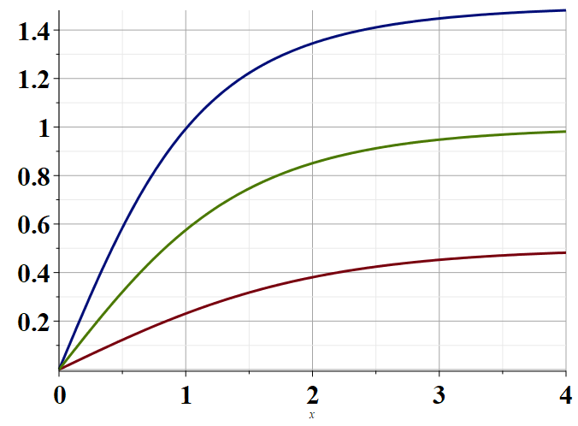
S=3/2
S=1
S=1/2
βμ_{a}B

Slide 14
Now consider a system in which the spins interact with an external magnetic field and also interact with neighboring spins according to the Heisenberg model
Note that depending upon the material, J>0 when spin alignment is favored (ferromagnetic case) or J<0 when spin anti alignment is energetically favored (antiferromagnetic case).
i j

Slide 15
The exact treatment of this system is difficult. We will make several approximations.
Assume that the spin contributions along the B field direction (z) dominates
Treat the neighboring spins in an average (mean field) approximation

Slide 16
Approximation continued --

Slide 17
Calculating the partition function for this approximation

Slide 18
How can we determine B_{neigh}?
Here n denotes the number of neighbors.

Slide 19
How can we determine B_{neigh}?
Obviously, B_{neigh} depends on B and T and must be
determined numerically.
Consider the case where the external field is 0.

Slide 20
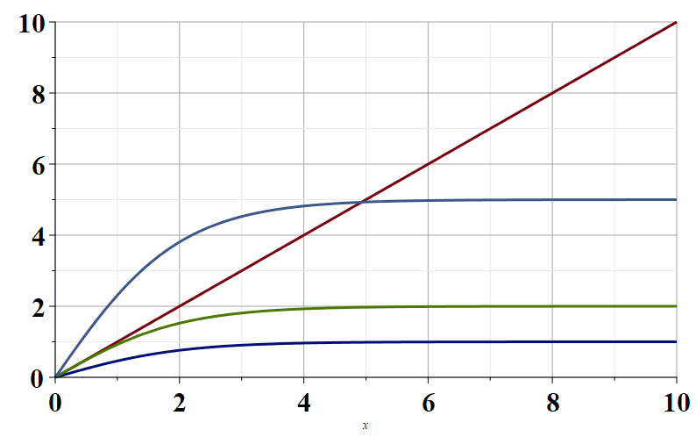
S=1/2
Note that for fixed nJ, there is a minimum value of β for which there is no solution.
x
RHS
2βnJ=10
2βnJ=4
2βnJ=1
x

Slide 21
For 2βnJ> 2β_{c}nJ Solutions exist
For 2βnJ< 2β_{c}nJ No solutions
This behavior is determined by the linear behavior
of the right hand side of the equation

Slide 22
 | T_{c}(K)
Fe | 1043
Co | 1388
Ni | 627
Ga | 293

