Slide 1
PHY 341/641 Thermodynamics and Statistical Mechanics
MWF: Online at 12 PM & FTF at 2 PM
Discussion for Lecture 35:
Treatment of particle interactions in statistical mechanics; electron spin effects
Reading: Sections 8.2
Effects of spin interactions – Ising model
Mean field solution
Exact solution for special cases
Record!!!

Slide 2
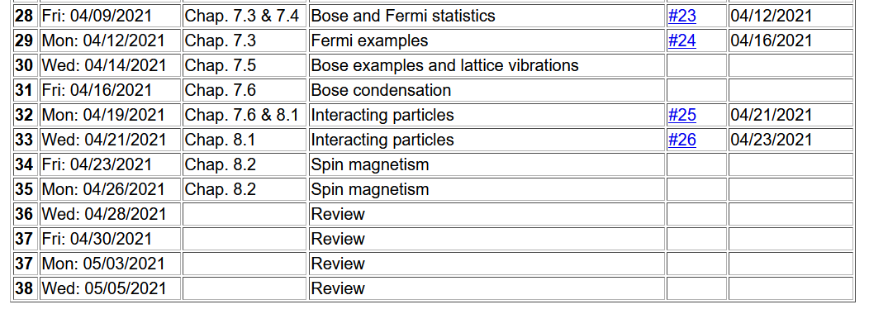
Instead of a HW set, please send me your thoughts on topics, examples, etc. that you would like to see in our review starting on Wed. 4/28/2021.
Important dates: Final exams available < May 6; due May 14
Outstanding work due May 14

Slide 3
Comment on homework (generally and also #26)
➔It is important to check your units when you are doing numerical evaluations.
Specifically for #26, you need to evaluate B(T) which modifies the ideal gas equation of state..
What are the units of B?

Slide 4
Your questions –
From Mike -- I'm assuming the Ising model is only an accurate approximation for ferromagnets. In this case, how do we deal with antiferromagnets?
From Kristen -- 1. How is it that the system discussed can become more ordered as the temperature gets higher, doesn't this violate entropy?
2. Could you go over how we get the average expected spin values (equation 8.49) from the partition function, just in this case especially?

Slide 5
Some results from Friday focusing on multi-electron atoms with net composite spin S (half integer or integer values) in the presence of a magnetic field B and nearest neighbor spin interactions (J) modeled according to the Heisenberg model:
i j

Slide 6
Note that in some equations presented Friday, J should have been written 2J. Apologies.

Slide 8
Comment on n neighbors --
Atoms in a line -- … …… n=2
Atoms in a plane -- … …… n=4
n=6

Slide 9
Note, that for some materials it is possible to find solutions for zero external magnetic field.
For T ≤ T_{c} the material is in a ferromagnetic phase.

Slide 11
Critical temperature for this case

Slide 12
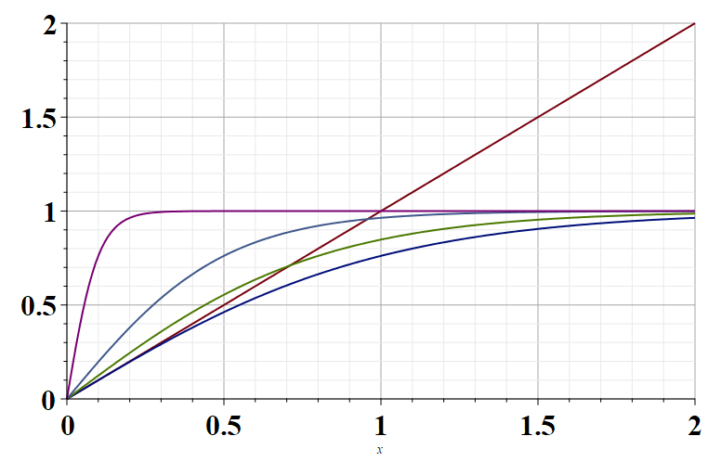
T=0.1T_{c}
T=0.5T_{c}
T=T_{c}

Slide 13
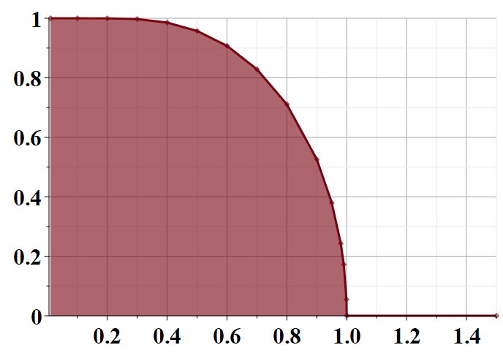
Self-consistent solutions to the mean field approximation to the Ising model in the absence of an external magnetic field.
T/T_{c}

Slide 14
How accurate is the mean field approximation?
The Ising model can be solved exactly in some cases and used to access the accuracy of the mean field approximation.
Answer – The mean field approximation is generally qualitatively correct except in certain cases
The following slides use material from previous course notes based on the textbook Statistical and Thermal Physics by Gould and Tobochnik

Slide 15
Some exact treatments using the Ising model
-ε-2H
-ε+2H
ε
ε

Slide 16
Exact solution for 2 particle Ising model -- continued

Slide 17
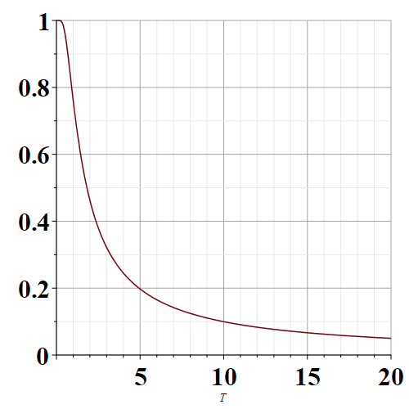
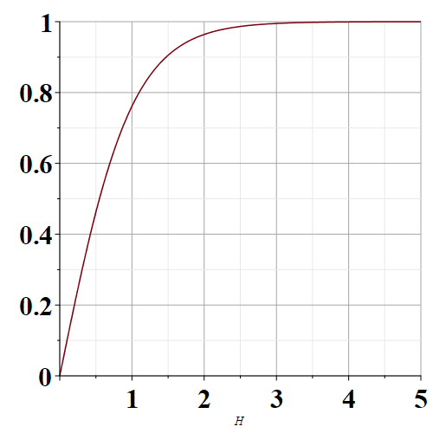
Exact solution for 2 particle Ising model -- continued
H/ε=1
kT/ε=1
kT/ε
H/ε

Slide 18
Now consider an infinite system where we treat N particles with periodic boundary conditions
………
………
………
i= 0 1 2 N-1 N N+1
The index i ranges between 1 and N; N+1 maps to 1
0 maps to N

Slide 19
One dimensional Ising model
Partition function for 1-dimensional Ising system of N spins with periodic boundary conditions (s_{N+1}=s₁)
Clever trick for performing sum over s_{i} – write f factors as 2x2 matrices and perform matrix multiplication

Slide 21
1-dimensional Ising system of N spins with periodic boundary conditions (s_{N+1}=s₁) (continued)

Slide 22
1-dimensional Ising system of N spins with periodic boundary conditions (s_{N+1}=s₁) (continued)

Slide 23
1-dimensional Ising system of N spins with periodic boundary conditions (s_{N+1}=s₁) (continued)

Slide 24
1-dimensional Ising system of N spins with periodic boundary conditions (s_{N+1}=s₁) (continued)

Slide 25
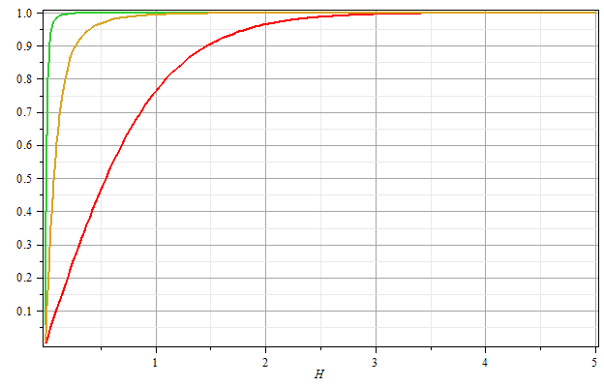
βε=2
βε=1
βε=0
Μ/Ν
βH

Slide 26
Mean field approximation for 1-dimensional Ising model

Slide 27
Mean field partition function and Free energy:

Slide 28
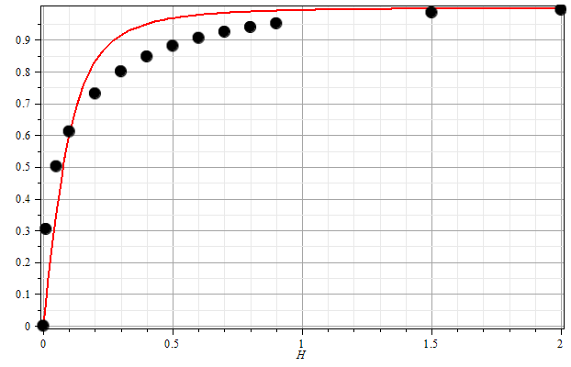
One dimensional Ising model with periodic boundary conditions:
β=1
ε=1
H
28

Slide 29
Comment, while the solution for H>0 is qualitatively similar for the exact and mean field solutions, the solution for H=0 is qualitatively different.
Exact solution in one dimension has no average spin for H=0 while the mean field solution has a finite average spin solution.

