Slide 1
PHY 341/641 Thermodynamics and Statistical Mechanics
MWF: Online at 12 PM & FTF at 2 PM
Discussion for Lecture 36:
Review Part 1
Overview
Variables and functions of thermodynamics
Various macroscopic and microscopic viewpoints
Record!!!

Slide 2
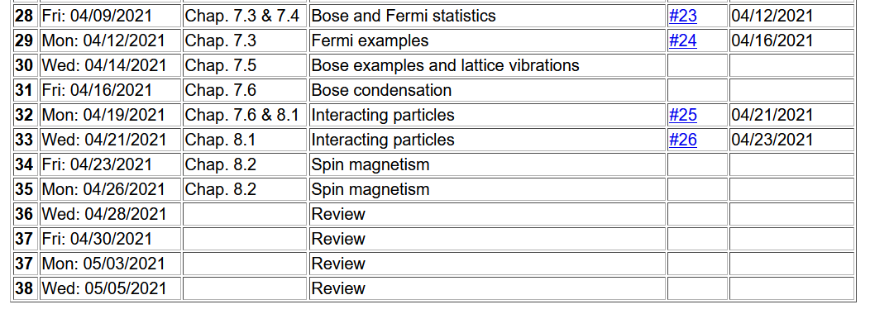
Important dates: Final exams available < May 6; due May 14
Outstanding work due May 14

Slide 3
Review 1 & 2 Summary of concepts/equations
Review 3 & 4 Examples
Timelines –
May 5 – Review 4 & take home exam available
May 14 – all course materials due; outstanding homework, and completed exams
Please note that the complete lecture slides are posted on the course webpage and the zoom recordings are available on the shared google drive.

Slide 4
Colloquium this week is joint with Chemistry on Wed. at 4 PM

Slide 5
Variables of thermodynamics
Temperature – T ≥ 0 in Kelvin scale
Volume – V in units of m³
Pressure – P in units of Pascals (Newtons/m²)
Entropy – S in units of Joules/K
Mass – M in units of kg
Number of particles – N
Chemical potential – μ in units of Joules

Slide 6
Various thermodynamic functions and their interrelationships

Slide 7
Summary of thermodynamic functions

Slide 8
Note that these relationships are in principle general; describing both the macroscopic and microscopic aspects of our thermodynamic systems. While all of the thermodynamic potentials are valid in general, there is usually one function that most expedient for a given situation.
The system that we spent a lot of time on is the mono atomic ideal gas.

Slide 9
Microcanonical ensemble for a mono atomic ideal gas. Here we have N particles of mass M in a volume V and internal energy U. Note that in the this and some following slides Ω denotes the microcanonical multiplicity function.
Phase space density, taken to be constant
Hamiltonian
Dirac delta function

Slide 10
Since the atoms are in a box of volume V:
For an ideal gas with N atoms of mass M:

Slide 11
delta function
step function

Slide 13
Using Stirling approximation
Sachur-Tetrode equation

Slide 14
Helmholtz free energy for monoatomic ideal gas

Slide 15
Gibbs free energy for monoatomic ideal gas
[We have only worked out the entropy for this case.]

Slide 16
One further comment about chemical potential using ideal gas example
Note that all of these results were derived from a knowledge of the entropy of our microcanonical mono atomic ideal gas

Slide 17
Now, we would like to extend the analysis of an isolated system to that of a system within a heat bath. The system within the heat bath will be analyzed in terms of a “canonical ensemble” --
Canonical ensemble:
E_{b},T_{b}
E_{s}

Slide 18
T_{b}
E_{s}

Slide 20
Analysis of a canonical ensemble for a mono atomic ideal gas
Stirling approx.

Slide 21
Analysis of a canonical ensemble for a mono atomic ideal gas -- continued
Note that these results are for a classical ideal gas without internal degrees of freedom. Additional considerations are needed when considering internal degrees of freedom and/or quantum particle (Fermi or Bose) effects.

Slide 22
Possible topics for next time –
Effects of internal degrees of freedom for classical ideal gas
Bose or Fermi ideal gas; grand partition function
Ideal gas systems in thermodynamic cycles (heat engines and refrigerators).
Magnetic/spin systems
Phase transitions and chemical reactions

