Slide 1
PHY 341/641 Thermodynamics and Statistical Mechanics
MWF: Online at 12 PM & FTF at 2 PM
Discussion for Lecture 37:
Review Part 2
Canonical ensemble of ideal gas, including with internal degrees of freedom
Bose and Fermi ideal gases
Record!!!

Slide 2
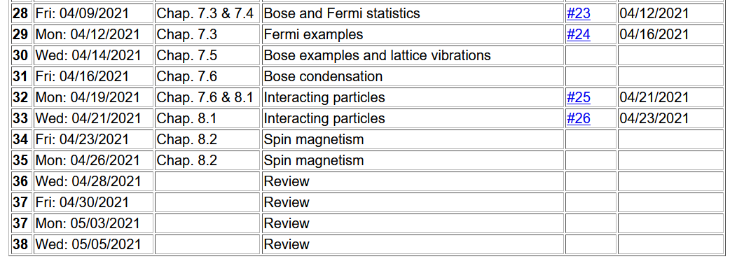
Important dates: Final exams available < May 6; due May 14
Outstanding work due May 14

Slide 3
Review 1 & 2 Summary of concepts/equations
Review 3 & 4 Examples
Timelines –
May 5 – Review 4 & take home exam available
May 14 – all course materials due; outstanding homework, and completed exams
Please note that the complete lecture slides are posted on the course webpage and the zoom recordings are available on the shared google drive.

Slide 4
Canonical ensemble --
T_{b}
E_{s}

Slide 6
Digression on notions of probability

Slide 7
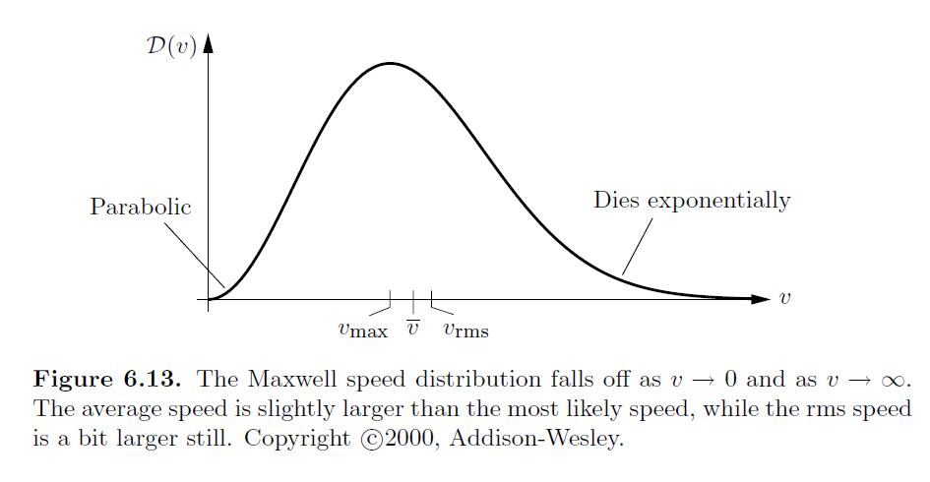

Slide 8
Back to the canonical distribution and the ideal gas
Now consider the motions of a more complicated system such as a diatomic molecule
Rotation
Translations of center of mass
Vibration

Slide 10
Analysis of a canonical ensemble for a molecular ideal gas
Considering rotations only, limit of “high” temperature

Slide 11
For our macroscopic treatment of the ideal gas, we have used the empirical parameter

Slide 12
Treatment of Bose and Fermi particles
Quantum mechanics introduces additional physics for particles of integer (Bose) and half integer (Fermi) intrinsic spin. Their treatment motivate the introduction of the grand canonical partition function.

Slide 15
For Bose particles, the summation over n_{s} is a geometric sum
resulting the analytic form:
For Fermi particles n_{s}=0 or n_{s}=1 only
The summation over s depends on the system. For a three dimensional Fermi or Bose ideal gas it is convenient to calculation the density of states

Slide 16
Note that this a bit different from your textbook;
L³=V
L
Spin degeneracy for spin ½ case

Slide 17
More general treatment for density of states for particle within a 3-dimensional box with volume V=L³

Slide 18
Evaluation for Fermi particles --

Slide 19
Fermi case --
Determination of chemical potential for T=0:

Slide 21
Summary of results for an ideal Fermi gas of s=1/2 particles in three dimensions evaluated in the limit that T→0 K

Slide 22
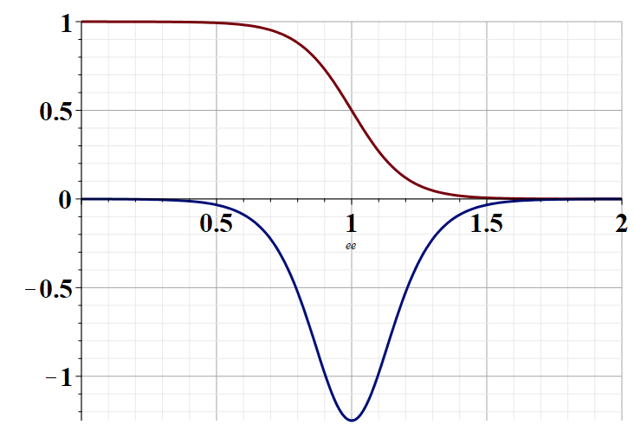
Evaluation of functions for T>0 --

