Slide 1
PHY 341/641 Thermodynamics and Statistical Mechanics
MWF: Online at 12 PM & FTF at 2 PM
Discussion for Lecture 38:
Review Part 3
Ideal gas containing a mixture of particles
Effects of particle interactions
Phase equilibria
Chemical equilibria
Record!!!

Slide 2
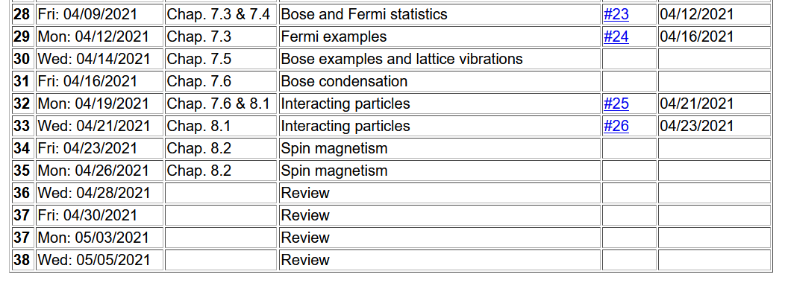
Important dates: Final exams available < May 6; due May 14
Outstanding work due May 14

Slide 3
Generalizing the thermodynamic functions for a single component system --

Slide 4
Generalizing thermodynamic functions to multi-component systems --

Slide 5
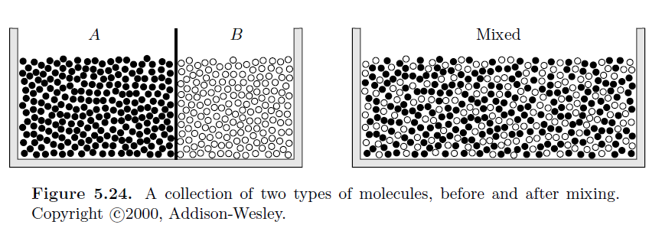
Thermodynamics of mixing -- first consider a two-component (binary) system N_{A}=N(1-x) N_{B}=xN
Mixed system depends on details of system even if no chemical reactions occur.

Slide 6
Possible mixing behaviors.
Consider the case of the monoatomic ideal gas for which we derived the Gibbs free energy expression:
P independent constant
For binary example -- system N_{A}=N(1-x) N_{B}=xN

Slide 8
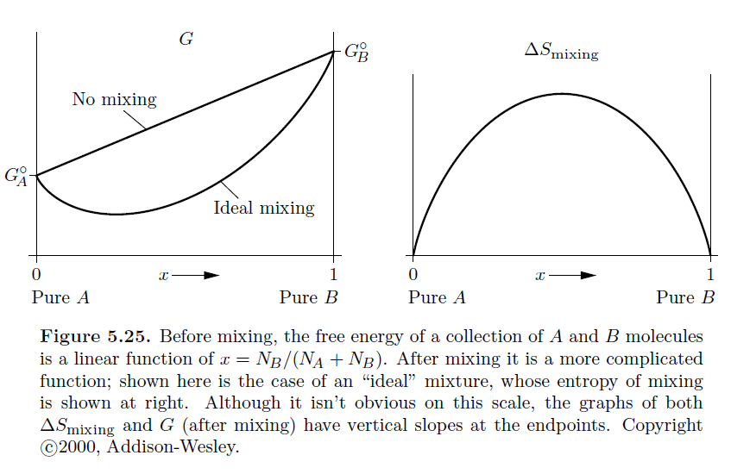
Ideal mixing of binary system --

Slide 9
Given this plots, which configuration is more favorable?
A and B separate
A and B ideally mixed
Question –
What might the analysis of the mixing differ for the Helmholtz free energy?

Slide 10
What physics is the ideal gas model missing?
At low density, pairwise potential effects can be estimated in terms of the virial coefficient
More generally, the potential effects can be treated with idealized models or numerically

Slide 11
Properties of matter due to particle interactions
Different phases of matter
Gas
Liquid
Solid (including various crystal forms)
Reactions between particles
Have discussed ideal gas and dilute gas approximations
Difficult for quantitative treatment
Reasonable analysis near equilibrium possible
Will discuss equilibrium reactions next time
Thermo(static) analysis follow from the notion that at equilibrium, the thermodynamic potential function take its minimum value.

Slide 12
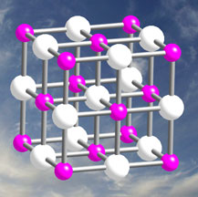
Treatment of the thermodynamics of lattice vibrations
Image of equilibrium geometry of crystal:

Slide 13
Note that thanks to the Born-Oppenheimer approximation, the classical treatment of the interaction potential can be
accomplished reasonably rigorously. However, the treatment of the atomic vibrations themselves should be treated quantum mechanically

Slide 14
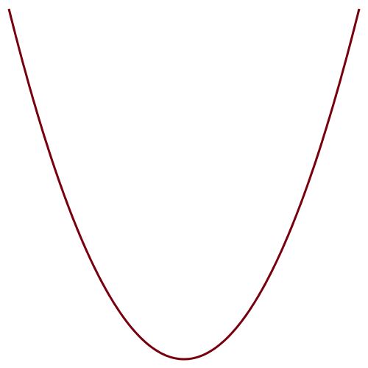
In practice, each of the 3N atoms in the crystal oscillates about its equilibrium position with various characteristic
frequencies ω^{ν}(k) depending on wavevector k mode number ν.

Slide 15
it is a good approximation to assume that mode ν at each wave vector k is independent. The quantum numbers for each mode n=0,1,2… are not constrained so that the canonical partition function involves a geometric summation
Note that even at T=0, vibrations contribute to the Helmholtz free energy. This is called zero point motion.

Slide 16
Thermodynamic functions for vibrations

Slide 17
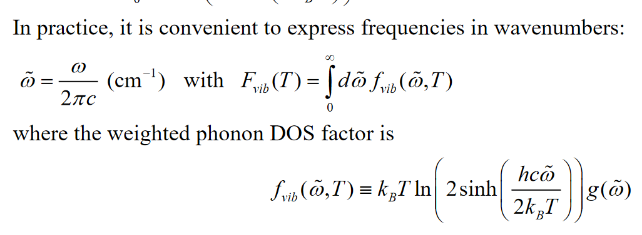
How can we evaluate these quantities? Again, it is convenient to calculate the density of states for the vibrational modes. For this various units can be used for the vibrational frequencies such as the following --

Slide 18
Plot of lattice vibration modes for diamond plotted for various wavevectors https://th.fhi-berlin.mpg.de/th/Meetings/DFT-workshop-Berlin2009/Talks/OnlinePublication/0630-4T_20090630-1_FH_-_phonon_tutorial_talk_web.pdf

Slide 19
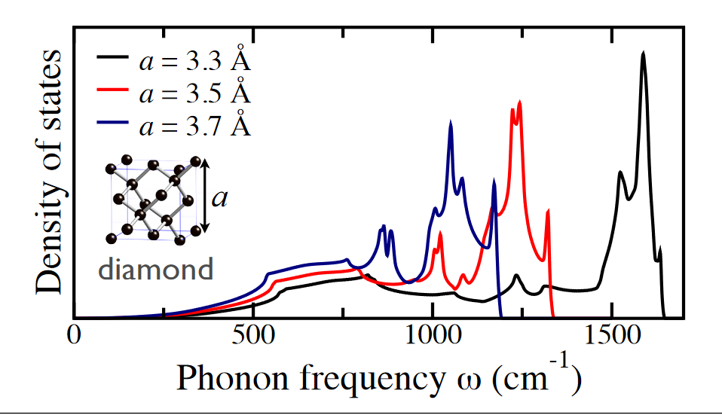
g(ε) plots from previously cited presentation showing how the density of states is very sensitive to volume (lattice constant)

Slide 20
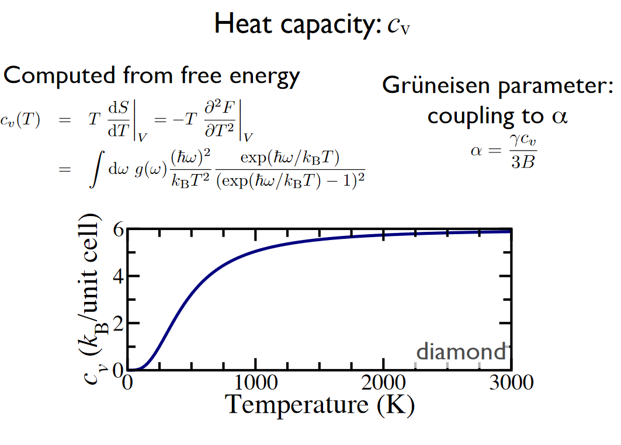
From Hanke & Fuckes (continued)

Slide 21
Simple approximation to density of vibrational states --
Debye model to approximate g(ε)
Based on the notion that at low frequency (ε) the vibrations behave like sound waves through the material with a characteristic speed c. (Note that this is the speed of sound not light!!!) In more detail sound waves in different directions of the material can have different speeds, but we will characterize the average by c.

Slide 22
Evaluation of heat capacity in the Debye model

Slide 23
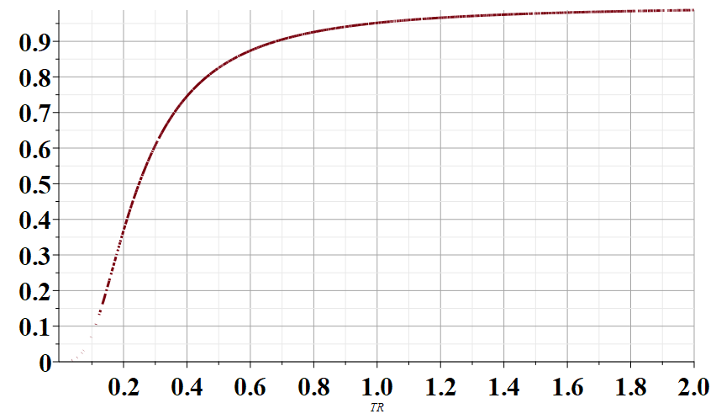
C_{V}/(3Nk)
T/T_{D}

Slide 24
Some typical values of T_{D}
Material | T_{D} (K)
Na (metal) | 150
C (diamond) | 1860
Fe (metal) | 420

Slide 25
While detailed analysis of interacting systems may not be always possible, the general rules of thermodynamics (thermostatics) still apply.
Some general principles of phase transitions --

Slide 26
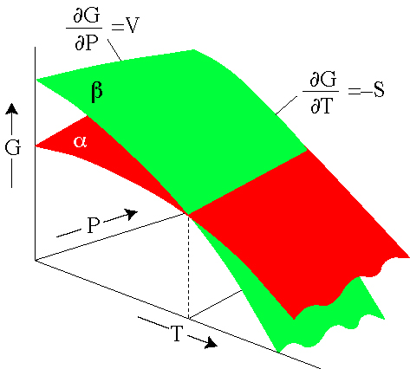
Behavior of Gibbs free energy for a material that changes phase http://hacker.faculty.geol.ucsb.edu/geo124T/lecture.html
coexistence line
Example material that has phases α and β --

Slide 27
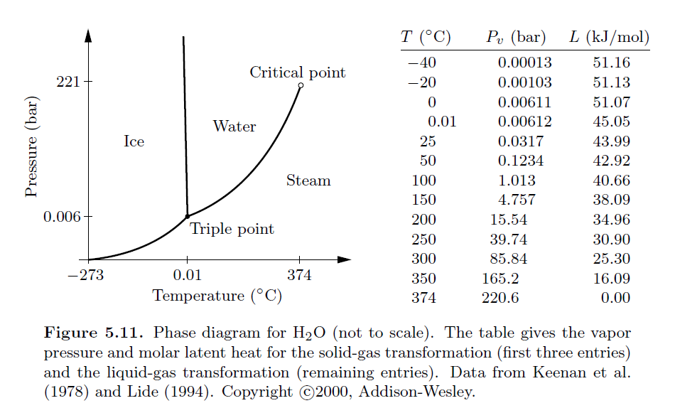
Coexistence lines as a function of T and P for phases of water

Slide 28
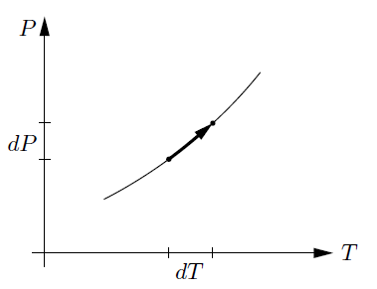
Analysis of coexistence curve – the Clausius-Clapeyron equation

Slide 29
Analysis of coexistence curve – the Clausius-Clapeyron equation
solid
gas
Clausius-Clapeyron equation

Slide 30
Example of Clausius-Clapeyron equation -- for water ice and liquid at T=273 K and P= 1 atm=1.01325 x 10⁵ Pa
For 1 kg of water:
L=333000 J
V_{solid}=1.091 x 10⁻³ m³ V_{liquid}=1.0 x 10⁻³ m³
Unusual property of ice
What temperature does ice under P> 1 atm melt?

