Slide 1
PHY 341/641 Thermodynamics and Statistical Mechanics
MWF: Online at 12 PM & FTF at 2 PM
Plan for Lecture 3:
Reading: Chapters 1.5-1.6
Evaluation of work for various processes on an ideal gas
Evaluation of heat for various processes on an ideal gas
Internal energy and enthalpy
Notes:
In this lecture we will discuss the concepts and values of heat and work for various processes on ideal gases.

Slide 2
Your questions
From Michael --How is the concept of enthalpy not a violation of the concept of conservation of matter? "To create a rabbit out of nothing" like the book states seems like this would be a violation of this law.
From Parker --How slow is considered "slow" in change of volume that is quasistatic for compression work?
From Kristen --I would like to discuss how the book arrived at equation 1.39 where the volume times the temperature to the f/2 power is constant. Also I am confused about the part of the book which discusses the heat capacity at constant pressure where there is additional heat added to compensate for the energy lost as work. If we could discuss that in more detail to clarify that would be great!
From Annelise --Can a compression be both quasistatic and adiabatic? I am confused about the difference between isothermal and quasistatic compressions? I am also confused on the concept of enthalpy. What is the significance of knowing the total energy needed to create a system out of nothing- what does that mean?
From Chao --While expressing the work done to the system, why is there a negative sign before the formula?
From Nick --can you go over again how the specific heat ratio, gamma, is related to degrees of freedom, f? I think my issue is still with the degrees of freedom bit, like why C_P and C_V have different degrees of freedom.

Slide 3
From Leon --Can you go over again how the specific heat ratio, gamma, is related to degrees of freedom, f? I think my issue is still with the degrees of freedom bit, like why C_P and C_V have different degrees of freedom.
From Rich -- If, as we discussed before, the equipartition theorem does not hold, are the derivations for the isothermal and adiabatic compression inaccurate as well? In the book's equation 1.54 for the first law of thermodynamics, where does the (-PV) come from?
From Zezhong -- For the equation 1.30, during a phase transformation, what happens on molecules that makes the concept of heat capacity does not make sense(to infinitely large).

Slide 4
One-on-one meetings
Tue 1 PM – Kristen (4:30 PM this week)
Office hours
Tue 10 AM

Slide 5
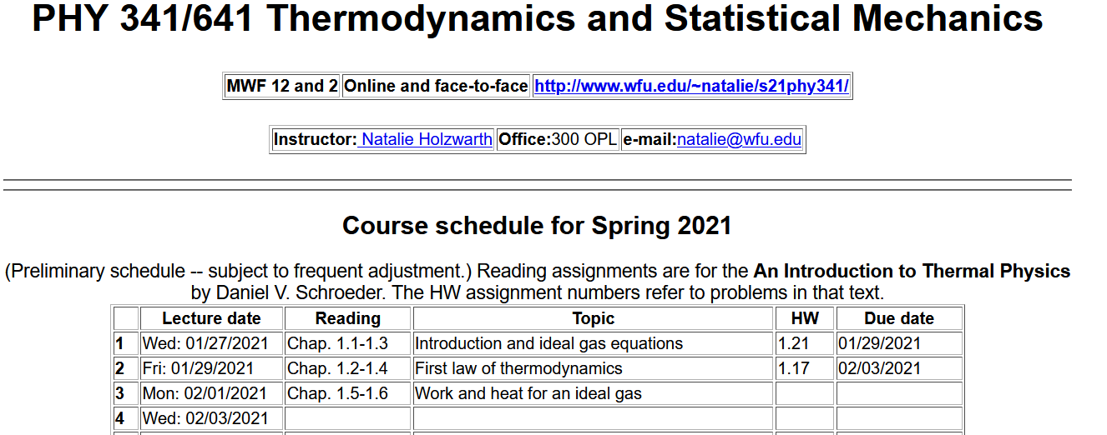
http://users.wfu.edu/natalie/s21phy341/homework/
Note – on Wed. it is likely that we will review Chap. 1 (skipping 1.7 and notions of phase transformations for now)
Notes:
There is no new homework for this lecture.

Slide 6
Basic equations
General principle – expected of all systems
Follows from notion that we can/should account for all energy
Special for an ideal gas system –
Equation of state
Internal energy
Notes:
Review of basic equations needed here.

Slide 7
Questions on “equipartition theorem” and what happen to degrees of freedom.
Comments --
Here f denotes the degrees of freedom for the N particles of the system. In my opinion f is often hard to estimate directly and prefer to use the experimentally accessible parameter γ in the equivalent relationship given on the RHS of the equation above. Note that both f and γ have
slight temperature dependences.

Slide 8
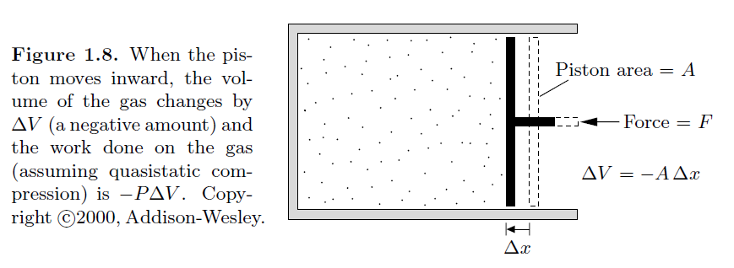
Calculation of work for various processes
Note that with our definition, work is positive when the system contracts.
Comment – the sign of work is just a convention, but it is essential to be consistent.
Notes:
Expression for work.

Slide 9
Work for various processes for an ideal gas
 | Initial | Final | W
Constant V | P₁ V₁ | P₂ V₁ | 0
Constant P | P₁ V₁ | P₁ V₂ | -P₁(V₂-V₁)
Notes:
Summary of results for simple cases.

Slide 10
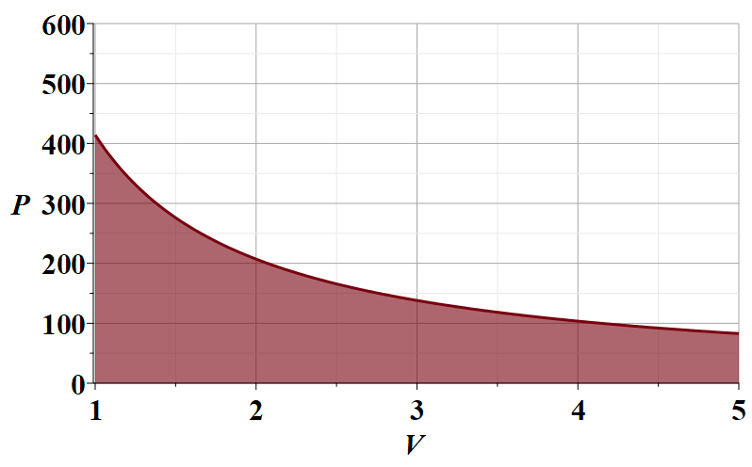
Work for various processes for an ideal gas
Now consider an isothermal process
In order to evaluate W, it is useful to consider a plot of P versus V
N=10²³
T=300 K
P (Pa)
V (m³ )
Notes:
Work for an isothermal process.

Slide 11
Work for an isothermal process in an ideal gas
N=10²³
T=300 K
Notes:
Performing the integral to evaluate work for an isothermal process.

Slide 12
Summary of results
 | Initial | Final | W
Constant V | P₁ V₁ | P₂ V₁ | 0
Constant P | P₁ V₁ | P₁ V₂ | -P₁(V₂-V₁)
Constant T | P₁ V₁ | P₁V₁/V₂ V₂ | -P₁V₁ ln(V₂/V₁)
Notes:
Updating the summary of results.

Slide 13
Now consider the effects of heat on the system
Special for an ideal gas system –
Equation of state
Internal energy
Notes:
Now consider heat for these and other processes.

Slide 14
Consider the ideal gas processes that we have just discussed:
Con. | Initial | Final | W | ΔU | Q
V | P₁ V₁ | P₂ V₁ | 0 |  | ΔU
P | P₁ V₁ | P₁ V₂ | -P₁(V₂-V₁) |  | ΔU-W
T | P₁ V₁ | P₁V₁/V₂ V₂ | -P₁V₁ ln(V₂/V₁) | 0 | -W
Notes:
Combining work and heat results while considering change in internal energy for the same processes.

Slide 15
Now consider the case where Q=0, termed an “adiabatic” process for a system described by an ideal gas equation of state.
Notes:
Now consider the situation when there is no heat added to the system. For the ideal gas, this leads to a modified equation of state in this case.

Slide 16
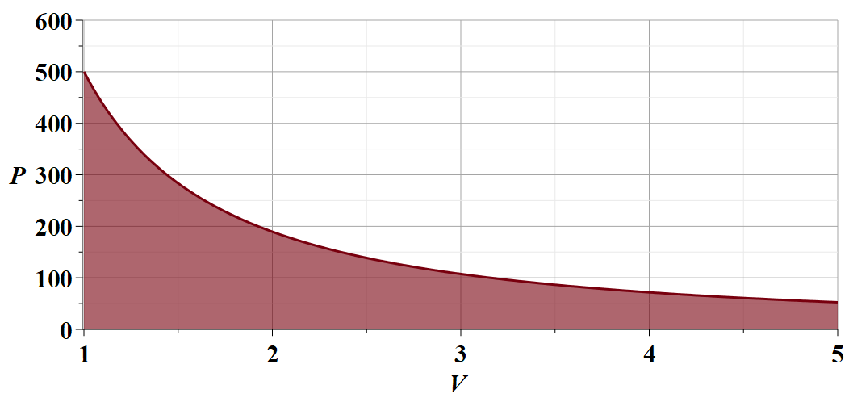
Notes:
Graph of adiabatic ideal gas equation of state and work integral.

Slide 17
The notion of heat capacity
The rate of heat increment per increment of temperature
Constant volume process
Note that γ is temperature dependent, but it that contribution is generally a small correction.
Notes:
Specific heat.

Slide 18
Constant pressure process
Notes:
Specific heat at constant pressure.

Slide 19
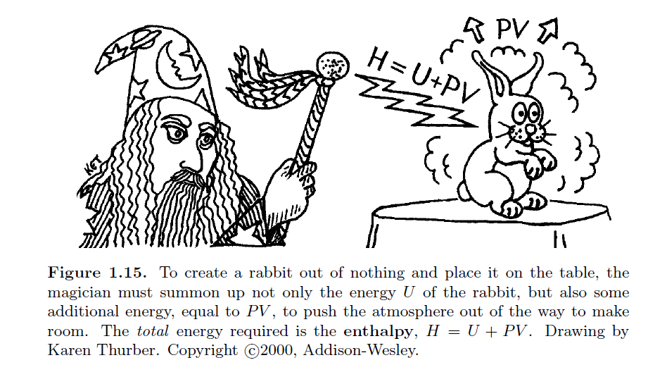
Comment on your textbook’s discussion of enthalpy --

Slide 20
Another approach is to recognize that the internal energy and the enthalpy are two types of energy among several others that we will want to study. The key to sorting these out is to recognize that the parameters of this field – N,V,T,P,U,H….. are interdependent. We can use mathematical constructs (Legendre transformations) to help.
Example of specific heat for a constant pressure process

Slide 21
Special for an ideal gas system –
Equation of state
Internal energy

Slide 23
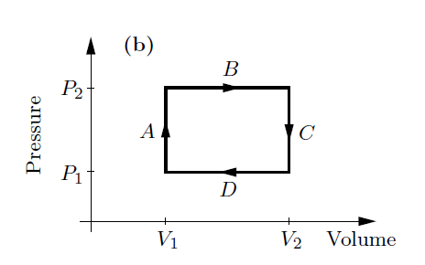
Net work done in a cyclic process
Consider the following 4 step cycle
A ➔ no work
B ➔ negative work
C ➔ no work
D ➔ positive work
net work
Notes:
Consider a set of processes that return the system to its beginning conditions – a complete cycle.

Slide 24
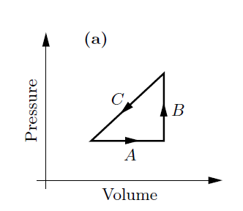
Net work done in a cyclic process -- continued
Consider the following 3 step cycle:
P₂
P₁
net work
V₁
V₂
Notes:
Another example of a complete cycle.

Slide 25
Question – What is ΔU for full cycle process?
Notes:
We saw examples of complete cycles with net work and net heat. What about the net change in internal energy?

