Slide 1
PHY 341/641 Thermodynamics and Statistical Mechanics
MWF: Online at 12 PM & FTF at 2 PM
Class notes for Lecture 4:
Review of energy, heat, and work
Reading: Chapters 1.1-1.6
Your questions
Basic concepts in thermal physics
Special results for an ideal gas
Examples
Notes:
In this lecture we will discuss the concepts and values of heat and work for various processes on ideal gases.

Slide 4
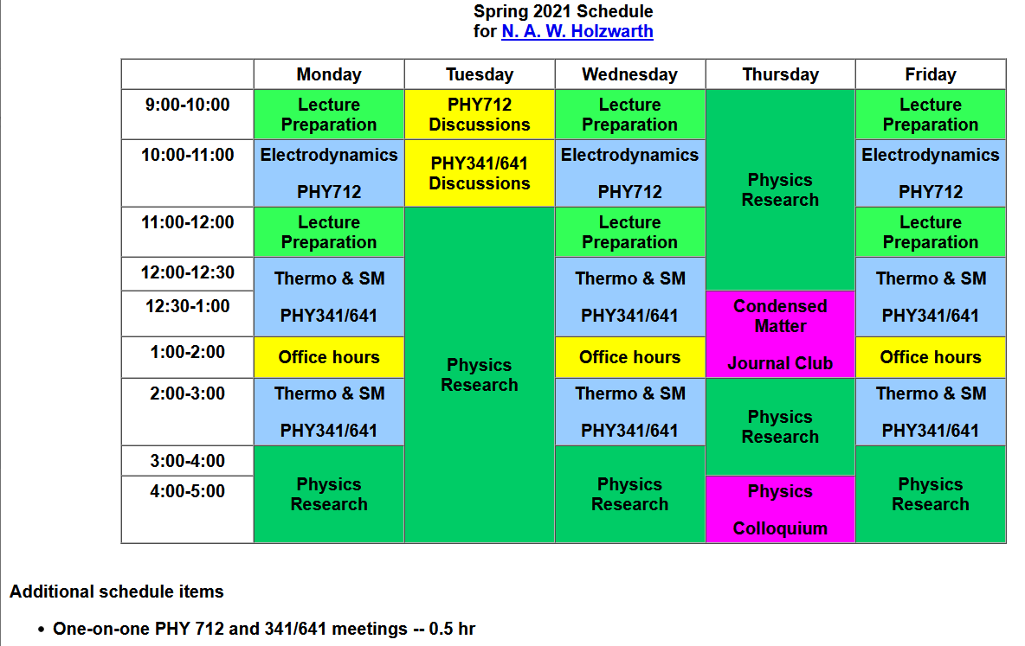

Slide 5
Your questions
From Kristen – 1.In lecture 2, on slides 11 and 12, we discussed the pressure on the piston. Could you explain why we still need to incorporate the 1/3 into the equation when we are already accounting for the average translational velocity? I thought the 1/3 was applied to just the velocity in the x direction to account for all the directions. 2. I am also still a bit confused about the applications of the equipartition theorem, if you could clarify what we need to know about it that would be helpful.
From Parker -- Why is temperature thought of as the ability of an object to quickly give up energy, why is this true and not the definition of temperature?
From Michael -- My question regarding unit one's information is this:
I am still confused how we determined that the net work done in the cyclic process for the rectangle was negative while the example with the triangle example was positive. Is this because more work must be done at a higher pressure in comparison to a lower pressure? It looks to me that for the rectangle example, the net work would be zero since you have both +W and -W cancelling each other out.
From Annelise --Can we review more about what enthalpy is and why it is important? In the table from the notes can we go over why the Work for Constant Volume is 0, why the internal energy for constant temperature is 0?
From Rich -- what does it mean when there are fractional degrees of freedom like for benzene?

Slide 6
From Noah --How well does the Dulong Petit rule actually describe heat capacity for a solid, and for what types of materials does it fail?
From Zezhong -- Why the work done process should be cyclic and what is the mathematical procedure to deduce the internal energy formula?

Slide 7
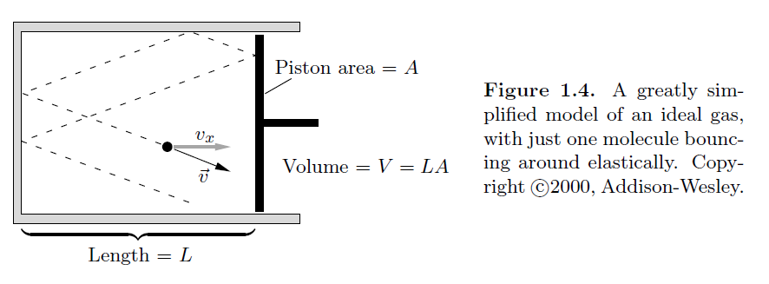
Question -- In lecture 2, on slides 11 and 12, we discussed the pressure on the piston. Could you explain why we still need to incorporate the 1/3 into the equation when we are already accounting for the average translational velocity? I thought the 1/3 was applied to just the velocity in the x direction to account for all the directions.
averaged over particles

Slide 8
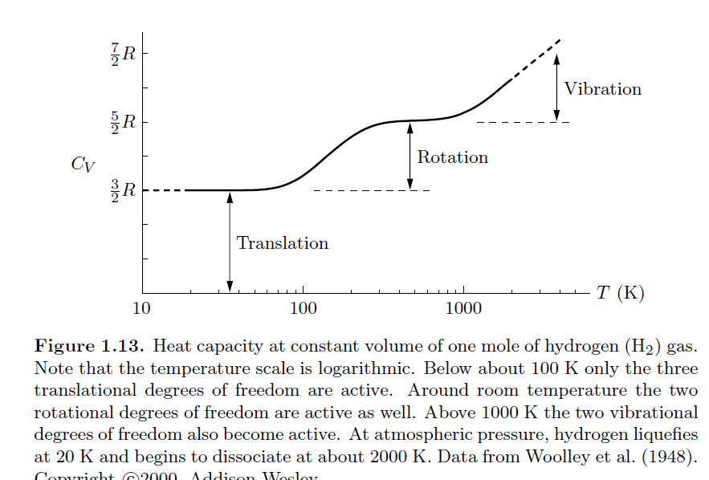
Question -- I am also still a bit confused about the applications of the equipartition theorem, if you could clarify what we need to know about it that would be helpful.
Comment – This deals with how we can model the temperature dependence of the internal energy of an ideal gas. For example, we can measure the heat capacity of a real gas. At constant volume ΔU=Q so that C_{V}=d ΔU/dT
Temperature dependence of C_{V} for H₂ (per mole)
f>5
f=5
f=3

Slide 9
Question -- Why is temperature thought of as the ability of an object to quickly give up energy, why is this true and not the definition of temperature?
Comment – I have no idea….

Slide 10
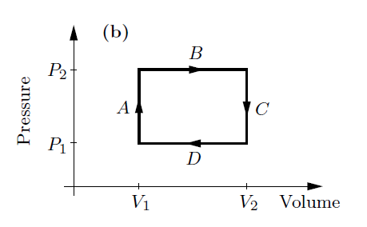
Question -- I am still confused how we determined that the net work done in the cyclic process for the rectangle was negative while the example with the triangle example was positive. Is this because more work must be done at a higher pressure in comparison to a lower pressure? It looks to me that for the rectangle example, the net work would be zero since you have both +W and -W cancelling each other out.

Slide 11
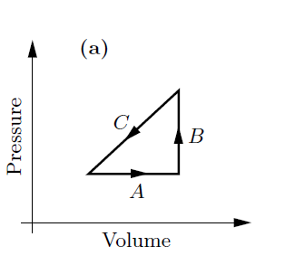
P₂
P₁
V₁
V₂

Slide 12
Question -- Can we review more about what enthalpy is and why it is important?
Comment -- U and H are two thermodynamic energies that we will discuss. Additionally, we will discuss the Helmholtz free energy F and the Gibbs free energy G. These differ in what are their “natural” variables.
Question -- In the table from the notes can we go over why the Work for Constant Volume is 0,

Slide 13
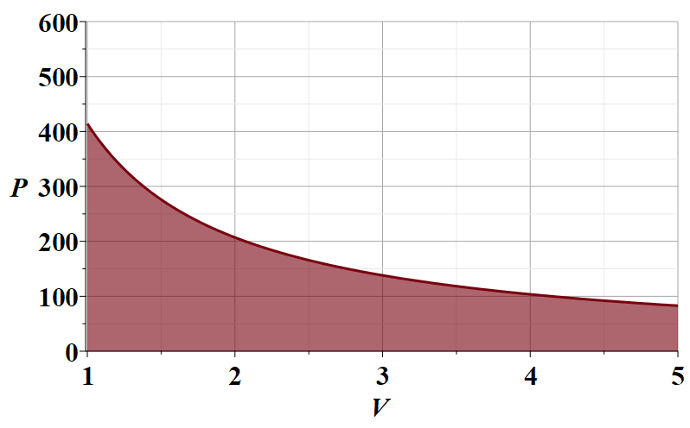
Example -- Work for an isothermal process in an ideal gas
N=10²³
T=300 K

Slide 14
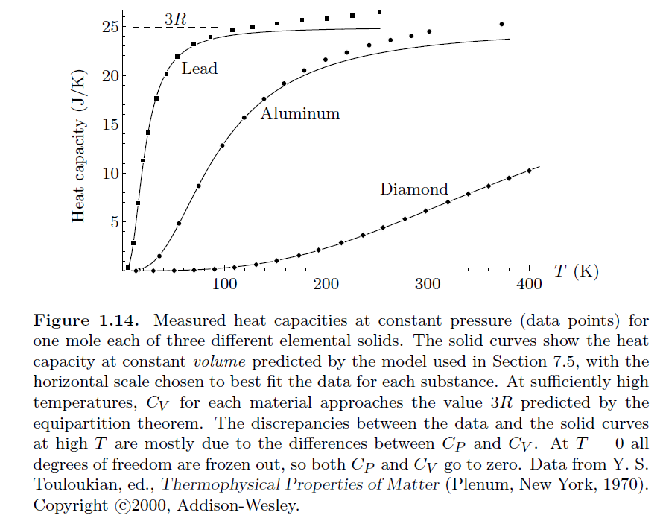
Question -- How well does the Dulong Petit rule actually describe heat capacity for a solid, and for what types of materials does it fail?
Comment – the “rule of Dulong and Petit” suggests that the molar heat capacity at constant volume should be C_{V}=3R
Rule is often not obeyed…..

Slide 15
Fundamental relationships – true in principle for all materials.

Slide 16
General concepts – continued –
Equilibrium – in fact, we will be mostly be studying equilibrium thermodynamics. It perhaps would be more honest to call our study thermostatics. Dynamic processes, such as those involving flow and time dependent processes, involve additional considerations.
Which of these situations are approximately equilibrium systems?
A student
An instructor
Soup in a bowl
Water in a cup
Liquid nitrogen in an insulated tank

Slide 17
Mathematical representation –
Thermodynamics involves a lot of functions and a lot of variables which can be nicely modeled using concepts of multivariable functions. Here we need to use the concept of partial derivatives and total derivatives.

Slide 19
Special relationships for an ideal gas

Slide 20
Example –
Problem 1.37. In a Diesel engine, atmospheric air is quickly compressed to about 1/20 of its original volume. Estimate the temperature of the air after compression and explain why a Diesel engine does not require spark plugs.
If T₁= 300 K, what is T₂?
Hotter than boiling water?

Slide 21
What would be the pressure in this case after the compression?

