Slide 1
PHY 341/641 Thermodynamics and Statistical Mechanics
MWF: Online at 12 PM & FTF at 2 PM
Class notes for Lecture 5:
Aspects of entropy
Reading: Chapters 2.1-2.2
Macroscopic picture
Microscopic picture
Notes:
In this lecture we will discuss the concepts and values of heat and work for various processes on ideal gases.

Slide 3
Variables of thermodynamics
Temperature – T ≥ 0 in Kelvin scale
Volume – V in units of m³
Pressure – P in units of Pascals (Newtons/m²)
Entropy – S in units of Joules/K
Mass – M in units of kg
Number of particles – N
Note that all of these variables are well-defined. Missing from this list are process quantities such as work (W) and heat (Q) both of which depend on the “path” of the process.

Slide 4
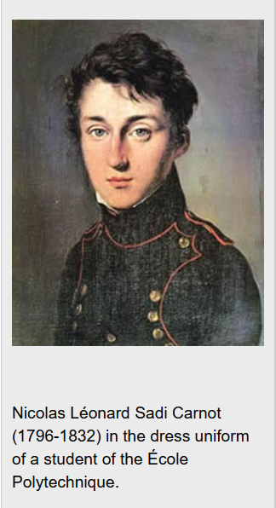
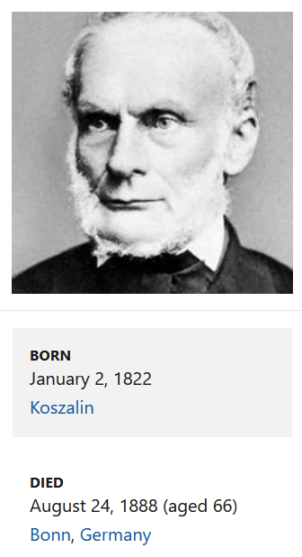
Nicholas Sadi Carnot
Rudolf Clausius
One of the founders of thermodynamics
Ahead of his time

Slide 5
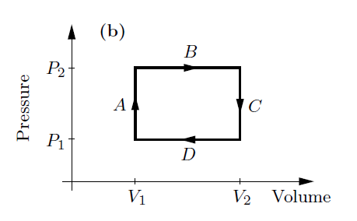
As an engineer, Sadi Carnot was interested in optimizing engine efficiency such as exemplified by a cyclic process.
Recall the simple 4 step process on an ideal gas that we previously discussed:

Slide 6
Carnot invented a very efficient ideal cycle which Clausius further analyzed as “entropy” S which is related to heat
according to
T
V₂
B
V₃
T₂
A
C
T₁
V₁
V₄
D
S
S₁
S₂

Slide 8
Summary of results
T
V₂
B
V₃
T₂
A
C
T₁
V₁
V₄
D
S
S₁
S₂

Slide 9
/

Slide 10
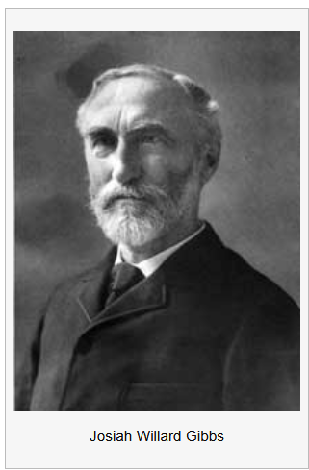
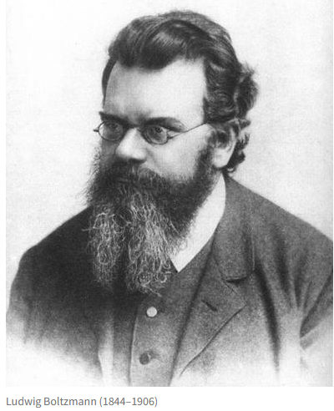
Giants of thermodynamics and statistical mechanics
Ludwig Boltzmann
1844-1906
Josiah Willard Gibbs
1839-1903

Slide 11
Boltzmann and Gibbs both developed ideas of how to reconcile the macroscopic heat aspects of entropy with the atomistic picture. There formulations differ somewhat from each other, but both are based on statistical notions of samples with large numbers of possibilities.
Microstates vs. Macrostates
Microstates – in modeling our systems we can specify a lot of parameters. For example, in a toss of 3 coins we can we can distinguish various possibilities – HHT, HTH, THH
Macrostates – in modeling a measurement of those coin tosses perhaps we would group those three microstates as a single microstate having 2H’s and 1T.

Slide 12
Your questions
From Kristen -- I am a bit confused about the concept of the multiplicity of a macro state because what exactly is omega (x) telling us about the state x in terms of a physical or countable characteristic.
From Parker -- Why does quantum mechanics only allow for the dipole moment vector to take on discrete and not continuous values?
From Michael -- In table 2.2 from the book, why is it that the energy group that has a separation of 2 0 0, has less energy than that of 1 1 0?
From Annelise -- My questions for tomorrow's class are about microstates, macrostates, and multiplicity. I am confused about what they are and how they are related to one another? The concept of dipoles also confuses me. What does the book mean by "individual magnetic particles"? With regards to entropy, I do not understand the concept of symmetry. The notion that symmetry is more conceptual than chaos and disorder also confuses me. How does one know where to put the axis for the symmetry?
From Leon -- I have a question about an equation in 2.2. How is the equation omega(N,q)=(q+N-1)!/(q!(N-1)!) derived?

Slide 13
From Chao --My question is that How does the multiplicity of the macrostate relate to its thermal dynamic character, such as Entropy and Enthalpy? Also, what thermal dynamic characters does the Einstein Solid have?
From Zezhong -- In figure 2.2 of section 2.2, it is said that "In quantum mechanics, any system with a quadratic potential energy function has evenly spaced energy levels separated in energy by hf". I wonder what is the meaning of this?
From Rich -- If entropy is not always a measure of disorder, then what is the most general, accurate definition? -Do symmetry constraints work by introducing order or by effectively limiting the number of particles by half?

Slide 14
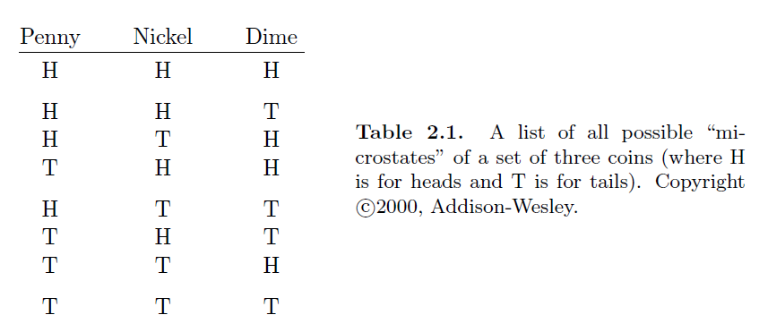
To start our conversation of analyzing possible states, let us consider 3 coins tossed on a surface and enumerating all possible outcomes heads (H) or tails (T)
Below are listed 8 possibilities – which are considered microstates:

Slide 15
To model the notion of microstate, we suppose that the relevant measure is how many heads and how many tails without regard to how the individual coins behave
3H,0T Ω=1
3H, 0T
2H,1T Ω=3
1H,2T Ω=3
0H,3T Ω=1

Slide 16
Estimating Ω – the number of microstates corresponding to a given macrostate

Slide 17
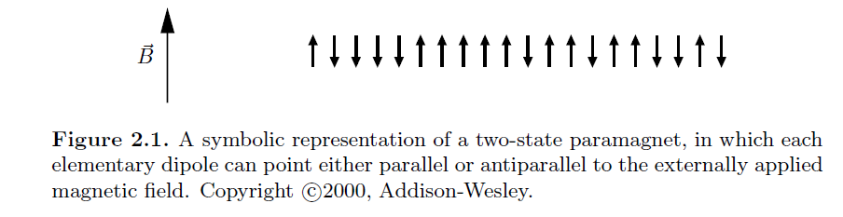
A more physical example –
Some particles, such as electrons or protons have intrinsic spins whose magnitudes measured along a given direction are proportional to +1/2 or -1/2. The accounting of these systems map exactly to the coin toss. When we talk about magnetism, we are thinking about the electron case.

Slide 18
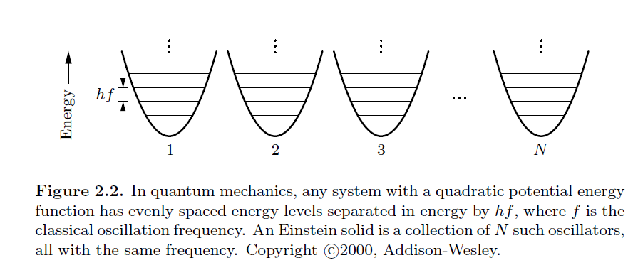
Another example of microstate and microstate modeling

Slide 19
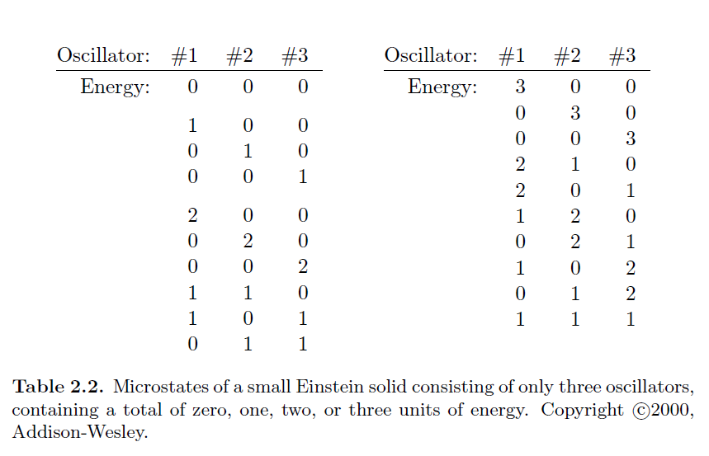
Microstates for 3 oscillators --

Slide 20
Macrostates for 3 oscillators --
Ω=1
Ω=3
Ω=10
Ω=6

