Slide 1
PHY 341/641 Thermodynamics and Statistical Mechanics
MWF: Online at 12 PM & FTF at 2 PM
Plan for Lecture 6:
Distribution of macrostates
Reading: Chapters 2.3-2.4
Binomial distribution for small and large samples
Probability, mean value, variance
Central limit theorem
Stirling’s approximation
Notes:
In this lecture we will continue our discussion of microstates and macrostates. The 2 state example can be described/generalized by use of the binomial distribution which will help us understand how to describe macroscopic systems.

Slide 3
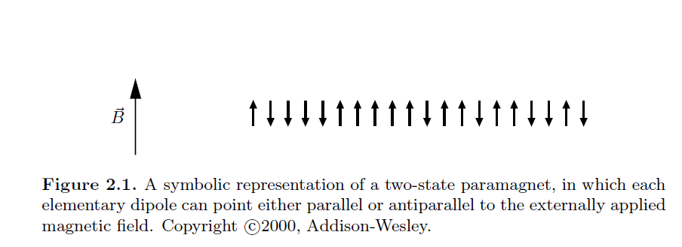
In the last lecture, we introduced the notion of microstates and macrostates, introducing the multiplicity distribution Ω(N,n). Here we will first focus on the example of a spin ½ system where an example
microstate may be

Slide 4
Example microstate

Slide 5
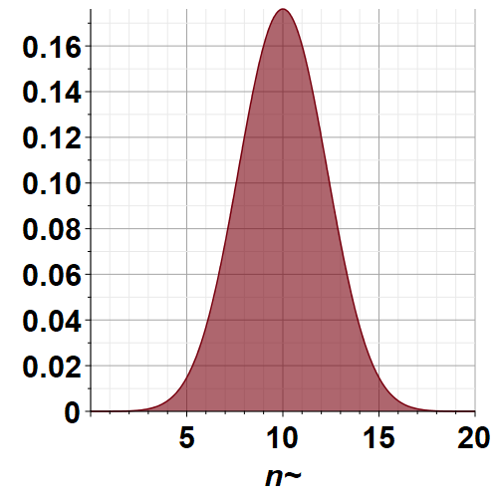
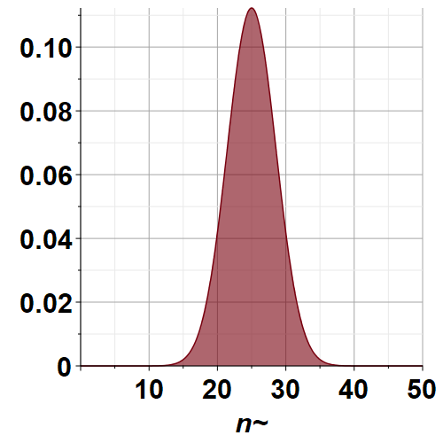
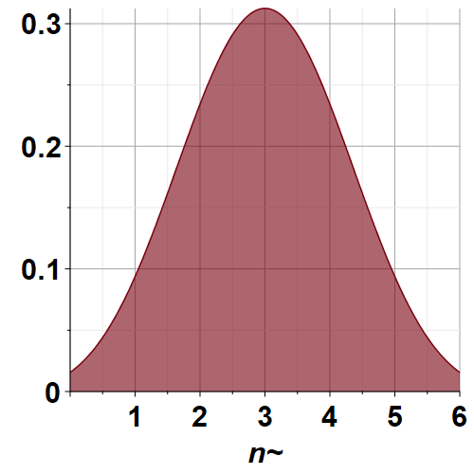
N=6
N=20
N=50

Slide 7
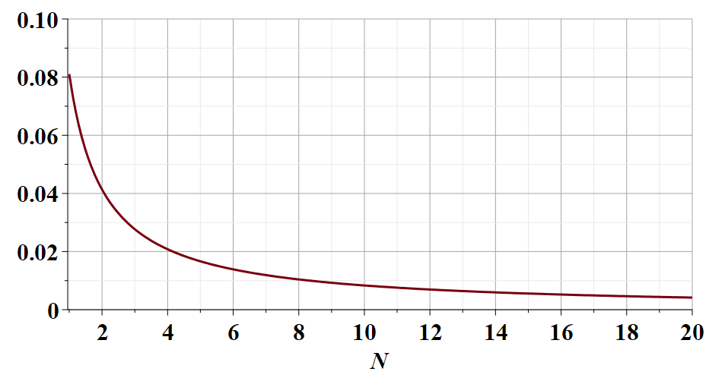
Small digression --

Slide 9
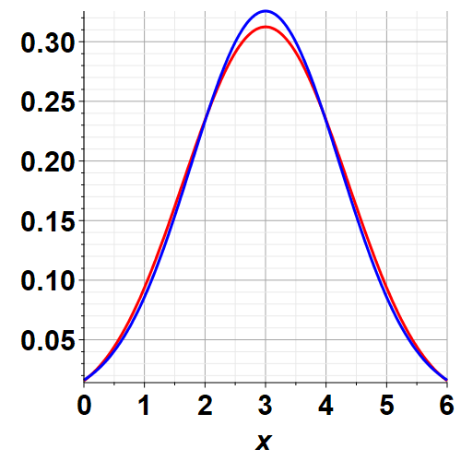
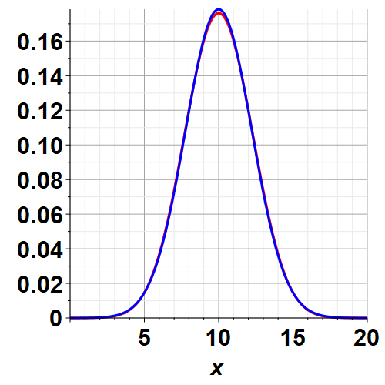
Comparison of binomial probability and Gaussian probability
Binomial
Gaussian
N=6
N=20

Slide 10
Is it an accident that for large samples the binomial distribution converges to the Gaussian distribution?
➔It is possible to prove that the probability density of a collection of N independent random variables with finite variance, summed together, is a Gaussian distribution in the limit that N→infinity. This is called the “Central Limit Theorem”.

Slide 11
Some details of the central limit theorem as explained by Essential Statistical Physics by Malcolm P. Kennett, Cambridge U. Press, 2021
Suppose that we have N random variables s_{i} that can take on multiple different values. These variables have a mean <s> and a variance σ_{s}² . We then determine their sum S and examine the probability distribution for the value of S.

Slide 12
Recap --
➔As the sample becomes very large, independent of the details of the system, the probability distribution of the variables becomes increasing peaked about the mean value.

Slide 13
Are these ideas generalizable to continuous variables such as found in the description of an ideal gas for example? This is the subject of Section 2.5 of your textbook which we will examine next time.

