Slide 1
PHY 341/641 Thermodynamics and Statistical Mechanics
MWF: Online at 12 PM & FTF at 2 PM
Plan for Lecture 6:
Distribution of macrostates
Reading: Chapters 2.3-2.4
Binomial distribution for small and large samples
Probability, mean value, variance
Central limit theorem
Stirling’s approximation
Record!!!
Notes:
In this lecture we will continue our discussion of microstates and macrostates. The 2 state example can be described/generalized by use of the binomial distribution which will help us understand how to describe macroscopic systems.

Slide 3
Your questions –
From Parker -- Why is it that at the microscopic level processes are reversible, I thought reversible processes were always an approximation? The principle of detailed balance lets this happen at microscopic, but I think not macroscopic levels.
From Kristen -- 1. For the example in 2.3, why is the multiplicity of the total system the product of the two solids, not the sum? (Figure 2.4) 2. I would love to go through some of the math to get to equation 2.22 because I am a bit confused.
From Annelise -- What is the significance of knowing which macrostate is most plausible? Why does that matter?
From Rich -- When would it be useful to use Sterling's approximation of a factorial?
From Leon -- So for large samples binomial distribution converges to the Gaussian distribution, but if it comes to a small sample can we still use this approximation or we should do something else?
From Zezhong -- I would how to get the final approximation of equation 2.26 and how to get equation 2.27? Also, I wonder what is the meaning of variance for Physics since I forget it.

Slide 4
Your questions – continued –
From Michael -- For a Gaussian function, how do we classify the probability of an energy outside that of the width of (qN^-.5) from the omega maximum occurring? How far outside this width is it a realistic estimation that this solution could occur?

Slide 5
Some discussion –
Question -- Why is it that at the microscopic level processes are reversible, I thought reversible processes were always an approximation? The principle of detailed balance lets this happen at microscopic, but I think not macroscopic levels.
Comment – At the atomic level, we expect that basic reversible physics applies, such as Newton’s laws, quantum mechanics, etc. At the macroscopic level, we cannot know all of the details of each particle motion and we are dealing with averages of properties. How exactly irreversisiblity comes into this story is an active intellectual challenge even today.

Slide 6
Some discussion –
Your question -- What is the significance of knowing which macrostate is most plausible? Why does that matter?
Comment – In this treatment, we are preparing for how to reconcile the atomic and macroscopic viewpoints. At the atomic level, we can solve Newton’s equations if we know initial of boundary values. At the macroscopic, we cannot know the initial or boundary values of 10²³ particles; the best we can do is estimate averages based on some macroscopic measurements such as T, P, V, S…… But because there are so many particles, even the averaging is difficult and in these sections we are finding that there are some simplifying patterns that can help us. In particular, for some macrostate property, there is a small range of values that have a very large multiplicity and the others are much smaller multiplicities.

Slide 7
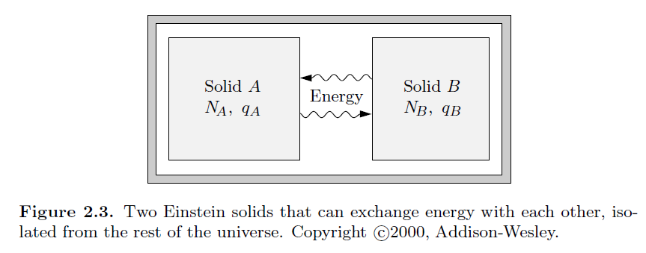
Discussion –
Question -- When would it be useful to use Sterling's approximation of a factorial?
Comment – 10!~10⁶
Question -- For the example in 2.3, why is the multiplicity of the total system the product of the two solids, not the sum? (Figure 2.4)

Slide 8
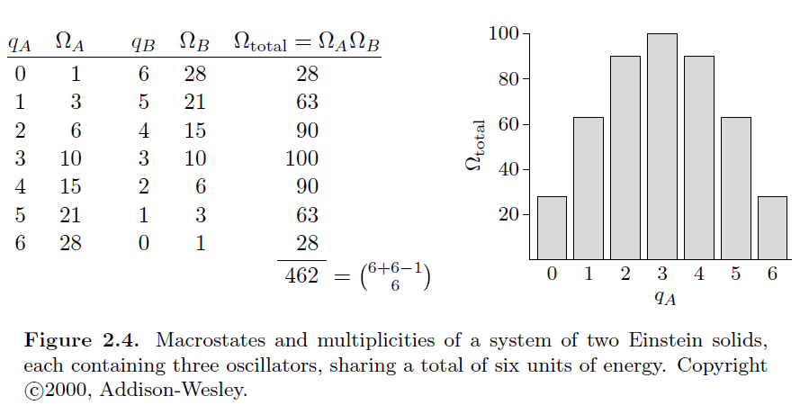

Slide 9
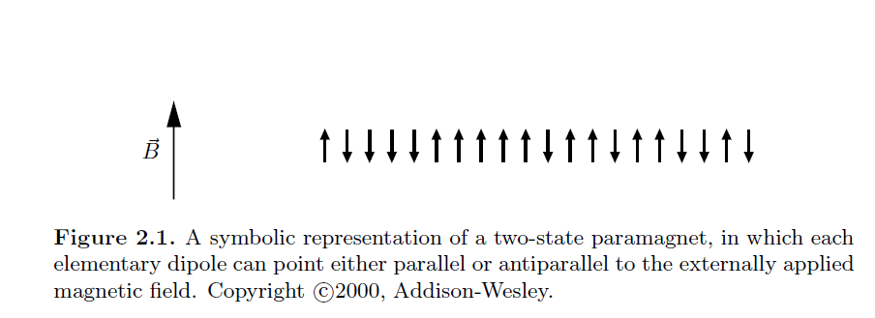
In the last lecture, we introduced the notion of microstates and macrostates, introducing the multiplicity distribution Ω(N,n). Here we will first focus on the example of a spin ½ system where an example
microstate may be

Slide 10
Example microstate

Slide 11
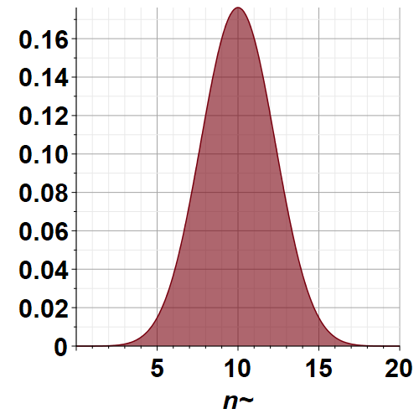
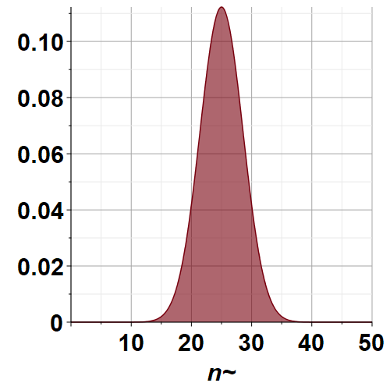
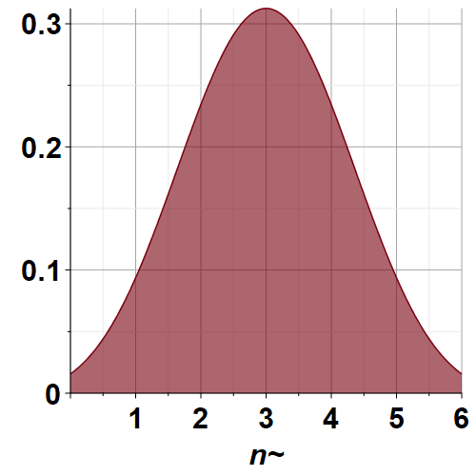
N=6
N=20
N=50

Slide 13
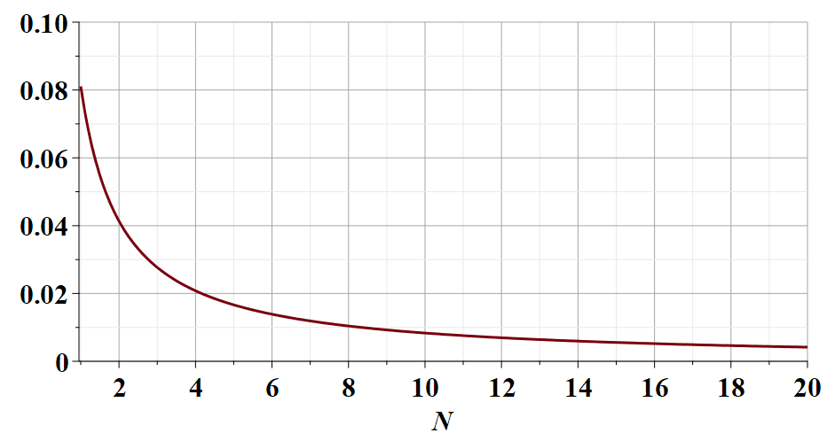
Small digression --

Slide 15
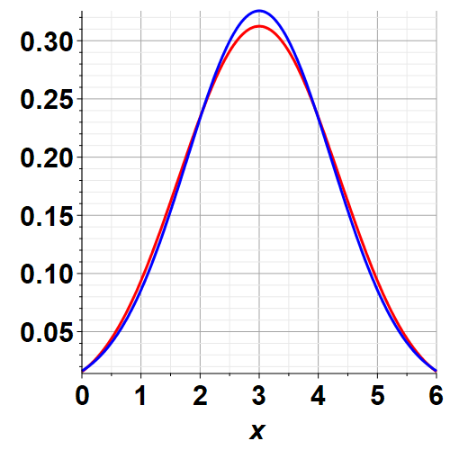
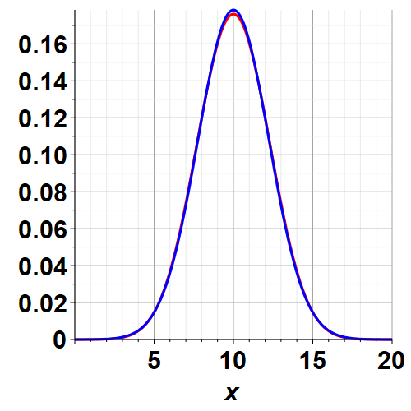
Comparison of binomial probability and Gaussian probability
Binomial
Gaussian
N=6
N=20

Slide 16
Is it an accident that for large samples the binomial distribution converges to the Gaussian distribution?
➔It is possible to prove that the probability density of a collection of N independent random variables with finite variance, summed together, is a Gaussian distribution in the limit that N→infinity. This is called the “Central Limit Theorem”.

Slide 17
Some details of the central limit theorem as explained by Essential Statistical Physics by Malcolm P. Kennett, Cambridge U. Press, 2021
Suppose that we have N random variables s_{i} that can take on multiple different values. These variables have a mean <s> and a variance σ_{s}² . We then determine their sum S and examine the probability distribution for the value of S.

Slide 18
Recap --
➔As the sample becomes very large, independent of the details of the system, the probability distribution of the variables becomes increasing peaked about the mean value.

Slide 19
Are these ideas generalizable to continuous variables such as found in the description of an ideal gas for example? This is the subject of Section 2.5 of your textbook which we will examine next time.

Slide 20
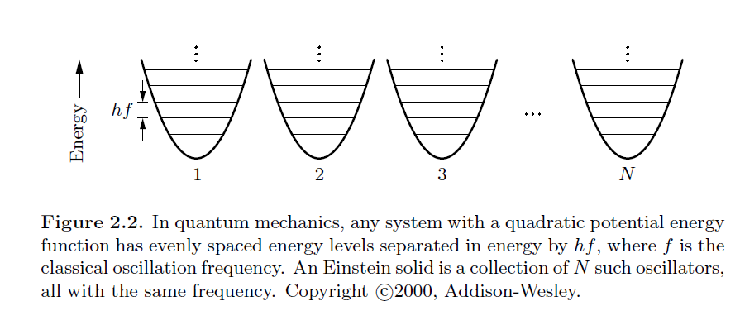
Another example of microstate ←→ microstate analysis – the Einstein oscillators model
Another example of microstate and microstate modeling
In the following we will use “q” instead of “n” --

Slide 21
Thanks to Stirling approximation

Slide 22
When the dust clears --

