Slide 1
PHY 341/641 Thermodynamics and Statistical Mechanics
MWF: Online at 12 PM & FTF at 2 PM
Discussion for Lecture 7:
Entropy and microstate multiplicity
Reading: Chapters 2.5-2.6
Micro and macro states of an ideal gas
Entropy and microstate multiplicity
Record!!!
Notes:
In this lecture we will continue our discussion of microstates and macrostates. The 2 state example can be described/generalized by use of the binomial distribution which will help us understand how to describe macroscopic systems.

Slide 2
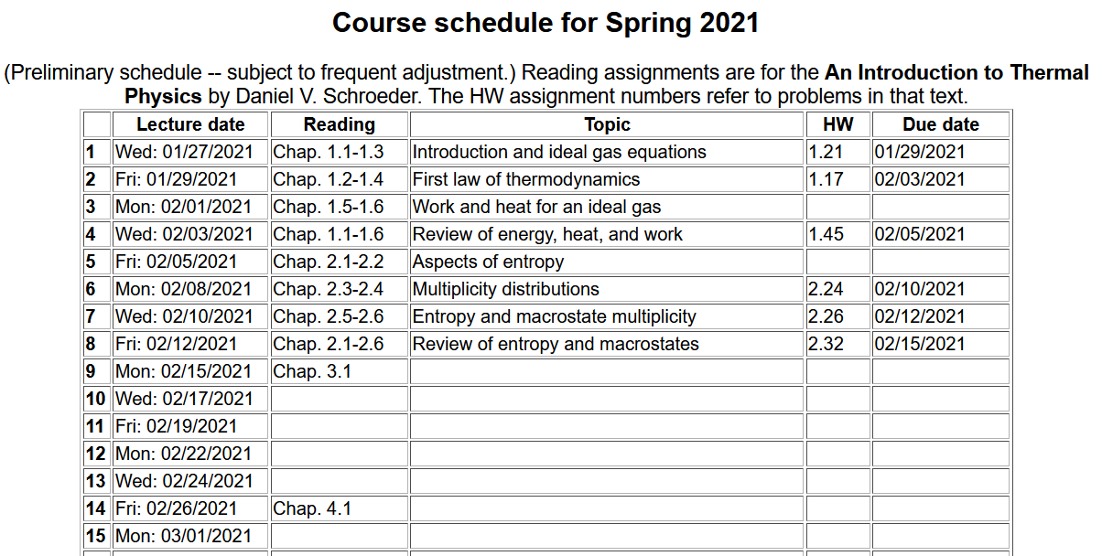

Slide 3
Your questions –
From Kristen -- 1. Could we discuss what we would use equation 2.41 in, is it important we know how to derive it or will we be given the values of the variables in the equation? 2. I am confused when the book talks about free expansion what they mean by "we have manufactured new entropy, right here on the spot". How can you manufacture new entropy?
From Parker -- The second law of thermodynamics states that the total entropy of the universe tends to increase, do we say it is not a fundamental law in one sense because of the probabilistic nature of it? The first law (that the change in internal energy is the work done on the system plus heat) is fundamental in the sense that it is a deterministic not probabilistic phenomenon. From Chao -- Can you explain more on the relationship between multiplicity function and area of momentum hypersphere?
From Rich -- How do you distinguish between reversible and irreversible processes? For example, wouldn't melting ice increase entropy yet this is still reversible?

Slide 4
From Annelise -- Why does heat flow from warm to cold if the warmer something is the more entropy it has?
From Michael -- Is the reason that entropy is always increasing is because the universe is constantly increasing?
From Zezhong -- Is the reason that entropy is always increasing is because the universe is constantly increasing?

Slide 5
Estimating the multiplicity function for a monoatomic ideal gas.
From classical mechanics, assuming each atom is labeled (“distinguishable”)
Suppose there are N atoms within volume V, each having coordinates
and momenta --
V
This 6N dimensional space is called phase space

Slide 6
Phase space
The notion of density of particles in phase space is simply the ratio of the number of particles per unit phase space volume. It seems reasonable that under conditions where there are no sources or sinks for the particles, that the density should remain constant in time.
Notes:
Notion of phase space

Slide 7
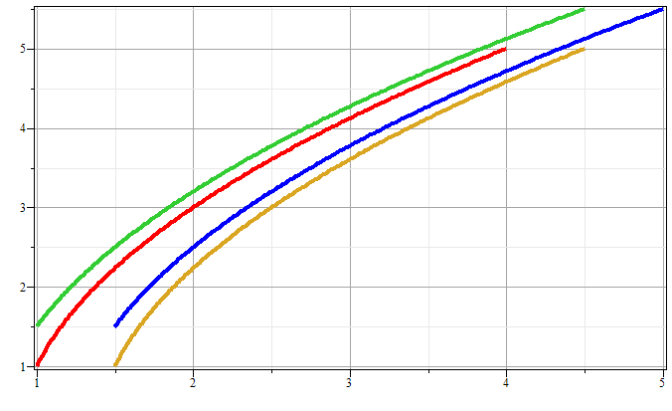
Phase space diagram for one-dimensional motion due to constant force
p
x
Notes:
Example of time evolution of phase space.

Slide 8
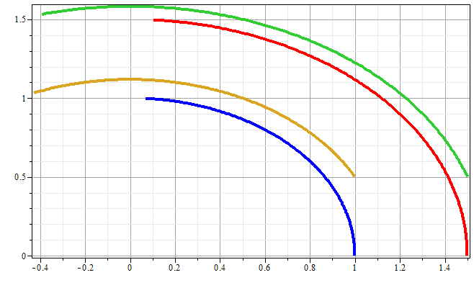
Phase space diagram for one-dimensional motion due to spring force
p
x
Notes:
Another example of time evolution of phase space.

Slide 9
Liouville’s Theorem (1838)
The density of representative points in phase space corresponding to the motion of a system of particles remains constant during the motion.
Notes:
Application to the density of phase space – Liouville theorm.

Slide 10
Liouville’s theorem
(x,p+Δp)
(x+Δx,p+Δp)
p
(x,p)
(x+Δx,p)
x
Notes:
Diagram of flow in phase space.

Slide 11
Liouville’s theorem -- continued
(x,p+Δp)
(x+Δx,p+Δp)
p
(x,p)
(x+Δx,p)
x
Notes:
Some details.

Slide 12
Liouville’s theorem -- continued
(x,p+Δp)
(x+Δx,p+Δp)
p
(x,p)
(x+Δx,p)
x
Notes:
More details.

Slide 13
Review:
Liouville’s theorem:
Imagine a collection of particles obeying the Canonical equations of motion in phase space.
Note that we are assuming that no particles are created or destroyed in these processes.
Notes:
Summary of Liouville theorem.

Slide 14
Why is the Liouville theorem significant?
We are about to analyze the microstates of an ideal gas by enumerate the possible coordinates and momenta independent of their time dependence. The Liouville theorem suggests that is a good thing to do.

Slide 15
Dirac delta function
Hamiltonian
constant
In practice, we will assume that D is uniform.

Slide 16
Since the atoms are in a box of volume V:
For an ideal gas with N atoms of mass M:

Slide 17
delta function
step function

Slide 19
Multiplicity function for an ideal gas in volume V and internal energy U:
So what?

Slide 20
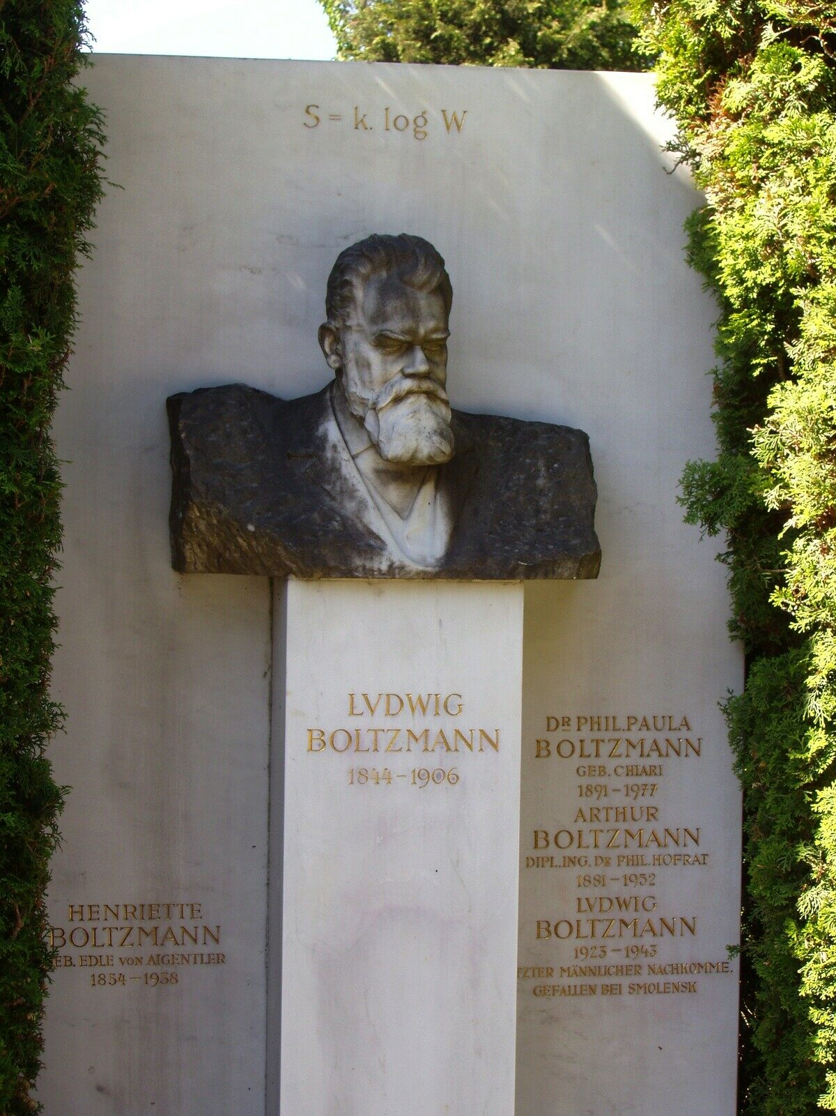

Slide 22
Sackur-Tetrode equation --
Does it make any sense?

Slide 23
Some ideas about the second law of thermodynamics
Kelvin-Planck: It is impossible to construct an engine which, operation in a cycle, will produce no other effect than the extraction of energy from a reservoir and the performance of an equivalent amount of work.
Clausius: No process is possible whose sole result is cooling a colder body and heating a hotter body.
Gould-Tobochnik:There exists an additive function of state known as the entropy S that can never decrease in an isolated system.
Schoeder: Any large system in equilibrium will be found in the microstate with the greatest multiplicity (aside from fluctuations that are normally too small to measure.)

