Slide 1
PHY 341/641 Thermodynamics and Statistical Mechanics
MWF: Online at 12 PM & FTF at 2 PM
Discussion for Lecture 8:
Entropy and microstate multiplicity
Reading: Chapters 2.1-2.6
Micro and macro states; microstate multiplicity
Basic ideas of probability; large samples
Ideal gas example
Entropy and microstate multiplicity
Record!!!
Notes:
In this lecture we will continue our discussion of microstates and macrostates. The 2 state example can be described/generalized by use of the binomial distribution which will help us understand how to describe macroscopic systems.

Slide 2
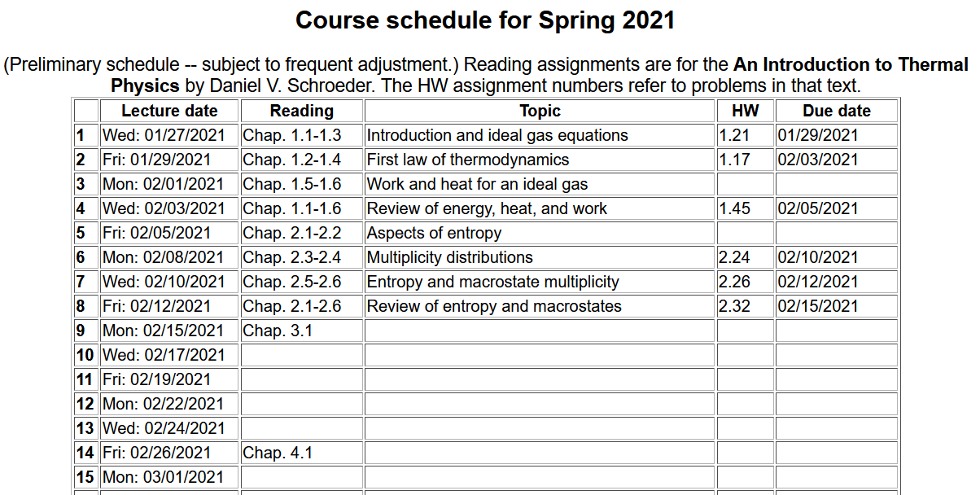

Slide 3
Your questions – Including some from last time --
From Kristen -- Could we discuss what we would use equation 2.41 in, is it important we know how to derive it or will we be given the values of the variables in the equation? I am confused when the book talks about free expansion what they mean by "we have manufactured new entropy, right here on the spot". How can you manufacture new entropy? Why is it important to know the macrostate multiplicity versus the microstate multiplicity? Why can you use the multiplicity to determine the entropy, what is this really telling us about how they are related? In the lecture from Wednesday, slide 21, why at the top is kB not multiplied by N but at the bottom it is?
From Parker -- The second law of thermodynamics states that the total entropy of the universe tends to increase, do we say it is not a fundamental law in one sense because of the probabilistic nature of it? The first law (that the change in internal energy is the work done on the system plus heat) is fundamental in the sense that it is a deterministic not probabilistic phenomenon. what sort of processed can be approximated as reversible on a macroscopic scale? Everyday life examples mostly, and why?
From Chao -- Can you explain more on the relationship between multiplicity function and area of momentum hypersphere? What does the volume of momentums stand for, and while we can calculate it, why it can use the area of a hypersphere to stand for it?

Slide 4
From Rich -- How do you distinguish between reversible and irreversible processes? For example, wouldn't melting ice increase entropy yet this is still reversible? I am still confused how processes that create entropy are irreversible? For example, melting ice increases entropy but this is not irreversible? Similar to the first question, I know the formula for Gibb's Free Energy is G=H-TS. Does this show entropy can be converted to enthalpy, and does this violate the second law of thermodynamics?
From Annelise -- Why does heat flow from warm to cold if the warmer something is the more entropy it has?
From Michael -- Is the reason that entropy is always increasing is because the universe is constantly increasing? When calculating the multiplicity of a gas such as we did for our homework, is the radius we are using always going to be sqrt(2mU). If so why/why not?
From Zezhong -- Is the reason that entropy is always increasing is because the universe is constantly increasing? I still get confused about the Gibbs Paradox, I wonder how this paradox works since the description in the textbook seems vague for me
From Leon -- Could we review a bit on the multiplicity of a monatomic ideal gas? I'm still a bit confused with the concept of momentum space and the sphere, and other equations associated with them.

Slide 5
Variables of thermodynamics
Temperature – T ≥ 0 in Kelvin scale
Volume – V in units of m³
Pressure – P in units of Pascals (Newtons/m²)
Entropy – S in units of Joules/K
Mass – M in units of kg
Number of particles – N
Energies of thermodynamics (in units of Joules)
Internal energy U
Enthalpy H
Helmholtz free energy F
Gibbs free energy G

Slide 6
From last Friday’s lecture --
Carnot invented a very efficient ideal cycle which Clausius further analyzed as “entropy” S which is related to heat
according to
T
V₂
B
V₃
T₂
A
C
T₁
V₁
V₄
D
S
S₁
S₂

Slide 8
Summary of results
T
V₂
B
V₃
T₂
A
C
T₁
V₁
V₄
D
S
S₁
S₂

Slide 9
From Wednesday’s lecture --
Sackur-Tetrode equation --

Slide 10
Some details from “derivation” of Sackur-Tetrode equation
Dirac delta function
Hamiltonian
constant
In practice, we will assume that D is uniform.

Slide 11
Since the atoms are in a box of volume V:
For an ideal gas with N atoms of mass M:

Slide 12
delta function
step function

Slide 15
Sackur-Tetrode equation --

Slide 16
Digression on δ and Θ functions

Slide 17
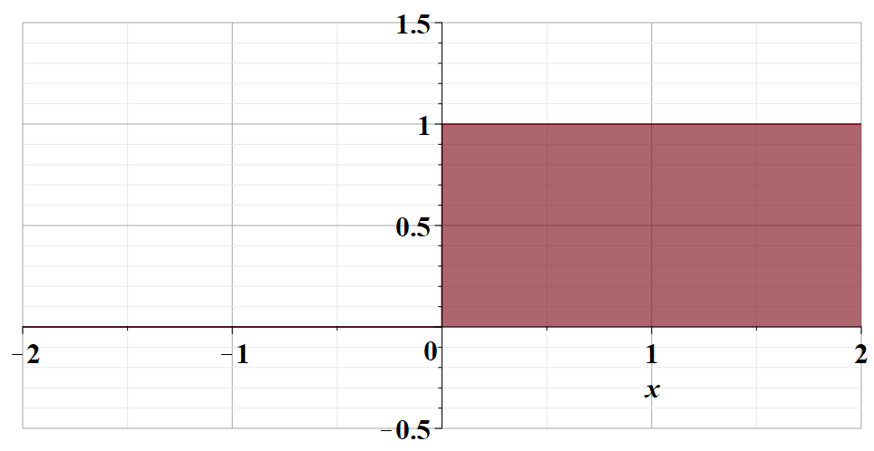
Θ

Slide 18
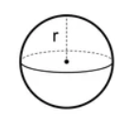
Volume and surface integrals --
Example “hypersphere” for three dimensions --

Slide 19
Other points to remember
Basic ideas of probability theory mean (average) value and variance.

Slide 20
Some ideas about the second law of thermodynamics
Kelvin-Planck: It is impossible to construct an engine which, operation in a cycle, will produce no other effect than the extraction of energy from a reservoir and the performance of an equivalent amount of work.
Clausius: No process is possible whose sole result is cooling a colder body and heating a hotter body.
Gould-Tobochnik:There exists an additive function of state known as the entropy S that can never decrease in an isolated system.
Schoeder: Any large system in equilibrium will be found in the microstate with the greatest multiplicity (aside from fluctuations that are normally too small to measure.)

Slide 21
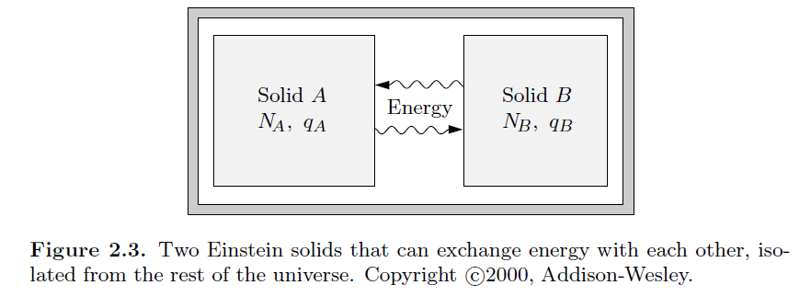
Up to now, we have focused on describing a single isolated sample. What happens when we have 2 samples that are somehow related to eachother?

Slide 22
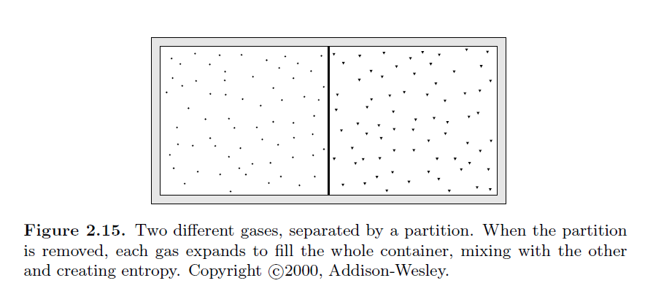
Mixing of two gases, initially partitioned --

