Slide 1
PHY 341/641 Thermodynamics and Statistical Mechanics
MWF: Online at 12 PM & FTF at 2 PM
Discussion for Lecture 9:
Entropy and microstate multiplicity
Reading: Chapters 3.1-3.2
Temperature and entropy
Heat and entropy
Record!!!

Slide 2
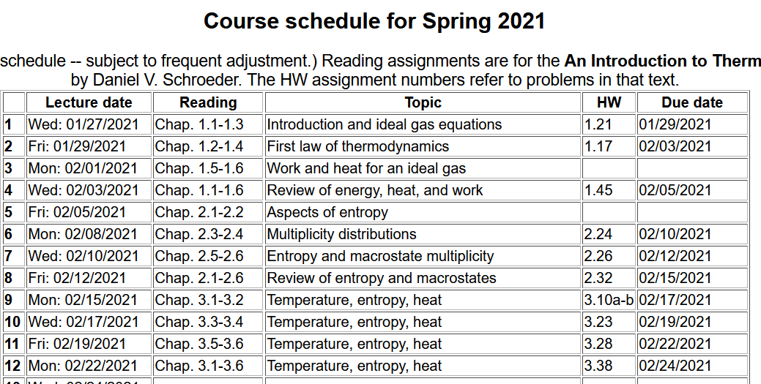

Slide 3
Your questions –
From Parker -- Is there much significant difference between the classical definition of entropy dS=Q/T and the microscopic Boltzman view S=k ln omega? Are they equivalent in some sense, or not? Doesn't the classical view not say anything about what entropy actually is, but does the microscopic view?
From Rich -- What are some examples of systems that operate with increasing or negative dS/dU graphs, what the book would call "Miserly" or "Enlightened" Systems?
-When is it best to use dS= Q/T and when is it best to use dS=(integral of dT)?
From Annelise -- This means that if a bit of energy passes from solid B to solid A, the entropy gained by A will be greater than the entropy lost by B”. How is this possible? Later in section 3.3 the book says that sometimes the entropy will increase as it goes from one object to the next, but how is that possible? Where does that entropy come from?
From Kristen -- 1. Why is it that for a S versus U graph (Figure 3.1) a steep slope must correspond to a low temperature and a shallow slope to a high temperature? 2. Could you explain how the author used equation 3.6 to get to 3.7, I cannot follow his work. 3. Why does Cv go to zero when T goes to zero?
From Zezhong -- I wonder if there is a formal equation to transform epsilon/k to regular temperature units, also, I wonder if there is another way to understand temperature except entropy vs energy graph.
From Noah -- Does the residual entropy of a solid increase as the complexity of the solid increases, e.g. would a metal organic framework have a higher residual entropy than a diamond crystal?

Slide 4
Variables of thermodynamics
Temperature – T ≥ 0 in Kelvin scale
Volume – V in units of m³
Pressure – P in units of Pascals (Newtons/m²)
Entropy – S in units of Joules/K
Mass – M in units of kg
Number of particles – N
Energies of thermodynamics (in units of Joules)
Internal energy U
Enthalpy H
Helmholtz free energy F
Gibbs free energy G

Slide 5
Example of monoatomic ideal gas with energy U, volume V, N atoms:
Does this make sense?

Slide 6
Example of monoatomic ideal gas with energy U, volume V, N atoms: -- continued
How is this related to heat and heat capacity?

Slide 7
Question – is it reasonable to to use the entropy-heat relationship
(assuming “reversible” conditions)
Consider the monoatomic ideal gas:

Slide 8
Question – is it reasonable to to use the entropy-heat relationship
(assuming “reversible” conditions)
Consider the monoatomic ideal gas:
Does this really work?

Slide 9
Consider the isobaric case more carefully --
Exercise: What is S_{f} – S_{i} for an adiabatic or an isothermal process?

Slide 11
More examples –
Empirically we know of examples of matter changing phase at constant temperature and often with little change in volume. The heat involved with such a phase change is called the “latent” heat. The latent heat associated with
the phase change of ice to water is 3.34 x 10⁵ J/kg at 273 K

Slide 12
More discussion about thermodynamic variables, particularly entropy.
Most of our discussion in class has focused on the behavior of an isolated system and the notions of the thermodynamic variables and measures assume that the system is in equilibrium. What happens when we have two systems?
N,V,P,T,U,S
N,V,P,T,U,S

Slide 13
What happens when the two systems can exchange energy?
N,V,P,T,U,S
N,V,P,T,U,S
➔
N,V,P,T,U,S

Slide 14
Summary of ideas on entropy and macrostate multiplicity
If an isolated system with many molecules is permitted to change, then, with overwhelming probability, the system will evolve to the macrostate of largest entropy and will subsequently remain in that macrostate.

