Slide 1
PHY 712 Electrodynamics
10-10:50 AM MWF Online
Plan for Lecture 1:
    Reading: Appendix 1 and Chapters I&1
      Course structure and expectations
      Units – SI vs Gaussian
      Electrostatics – Poisson equation
Notes:
Welcome to Electrodynamics. In this lecture we will discuss the course structure and jump right in to Chapters I (introduction) and 1 (electrostatics).

Slide 2

Physics Colloquium series – Thursdays 4-5 PM online
Notes:
First – an advertisement for Physics Colloquia at 4 PM on Thursdays. You should get mailings from Kittyae McBride each week.

Slide 3
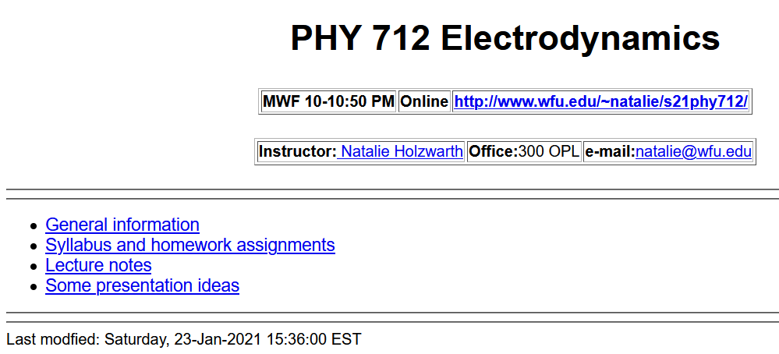
http://users.wfu.edu/natalie/s21phy712/
Notes:
Back to our regularly scheduled program. Our webpage is set up and is the source of all information about the course.

Slide 4


Textbook
Optional supplement
Third edition
Notes:
The text book is the 3rd addition of the classic textbook by John David Jackson. (Please note that you will need the 3rd edition in order to follow the lectures.) Some of you may want another (perhaps less mathematically focused) and will find that the textbook by Andrew Zangwill to be helpful. Personally, I find that Jackson’s text has served me well to understand the basics of electrodynamics.

Slide 5
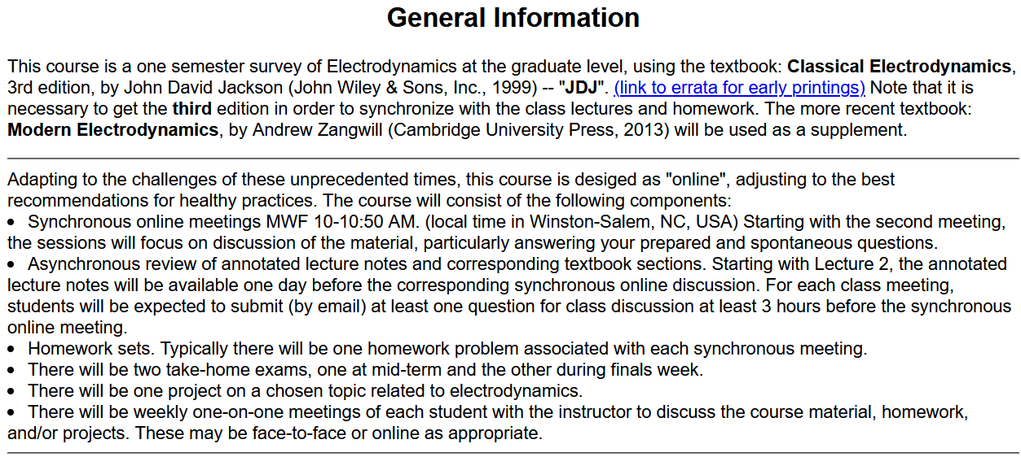
http://users.wfu.edu/natalie/s21phy712/info
Notes:
Information about the course structure is on our web page. The structure of the course is very much like the structure we used last semester for PHY 711. We want to focus class time on discussing your questions. Please prepare at least one question 3 hours before (preferably the night before) each class. We will use your questions as well as spontaneous questions to form the basis of the class discussions. Again, there will typically be one homework per class, nominally due the day of the next class meeting.

Slide 6
Links to WFU pandemic policies – Since this class is online, however, it is possible that some of the one-on-one meetings can be face-to-face.
Wake Forest University's Standard Operating Procedure for Class Sessions Following Public Health Guidance (Policy 2.A.02). This is an updated version of our policies and procedures. Please note the clarification on our masking requirement for classes regardless of location (indoors or outdoors), a revision that makes this policy consistent with our current University masking policy.
Spring 2021 College COVID-19 Classrooms FAQs and Syllabus Statement. As in the fall, the Office of the Dean of the College expects the Spring 2021 COVID-19 Syllabus Statement to be on syllabi for any classes taught in-person (face to face or blended) to communicate clear expectations around masking, physical distancing, and illness from the very first day of class. Our COVID-19 Classroom FAQs includes classroom cleaning protocols; guidance on how to reserve space for out-of-class academic activities like masked and physically distanced office hours, small group workshops, film screenings, and language conversation hours through DeaconSpace; and assistance for anyone teaching in a less familiar space this semester.
Notes:
This content is required by the Dean’s office to help the university keep our physical environment safe. Please visit the links as needed.

Slide 7
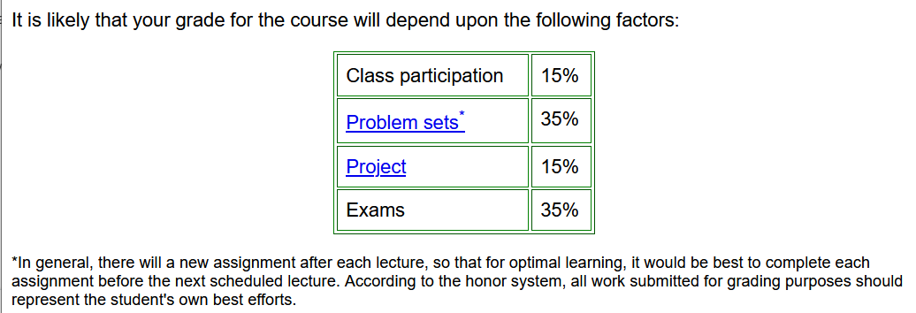
➔ Schedule weekly one-on-one meetings
Notes:
This is the expected grade distribution. Last semester the weekly one-on-one meetings seemed to be mostly productive, particularly for improving the completely online format. We will try to continue this during the spring semester. I need information from you to set up the appropriate timing.

Slide 8
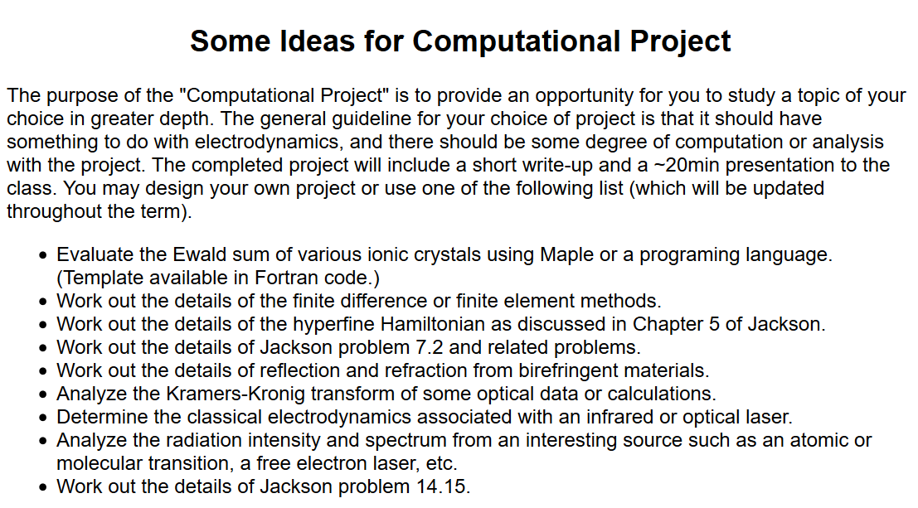
Notes:
This semester we will also have individual projects due at the end of the semester. Here is a list from last year. During the course, please keep your eye out for topics that interest you worthy of your extra attention.

Slide 9
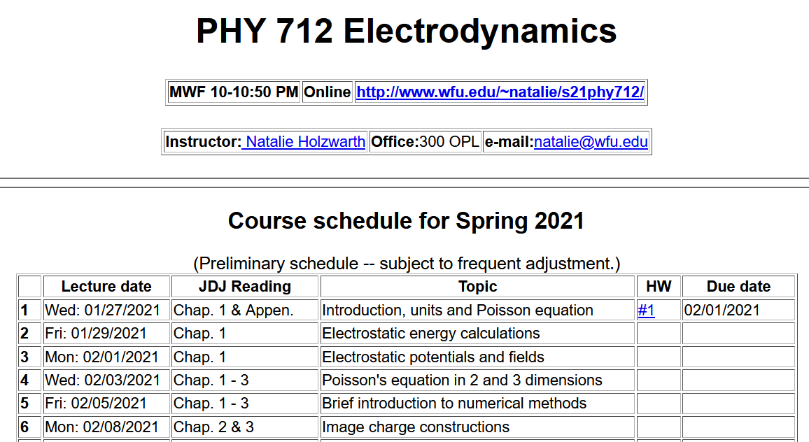
http://users.wfu.edu/natalie/s21phy712/homework/
Notes:
The class schedule is available on the webpage and except for today’s lecture topic, subject to change. (The schedule is based on the topics we covered last year.)

Slide 10
Comment about HW #1: (Jackson problem 1.5)
The time-averaged potential of a neutral hydrogen atom is given by:
where q denotes the magnitude of the elementary charge of an electron or proton and where a₀ denotes the Bohr radius. Find the distribution of charge (both continuous and discrete) that will give this potential and interpret your results physically.
Be careful to take into account the behavior of the potential for r→0.
Notes:
The homework for today’s lecture is from the textbook and the content is listed here. It is an interesting problem relating the electrostatic potential of a neutral hydrogen atom. The result should be consistent with things you learned in Quantum Mechanics class.

Slide 11
Additional information –
  Mid-term exam March 15-19
  Presentations for E&M will be in late April and early May
Notes:
This semester, we are starting the course late and there will be no spring break. The plan is to have a week where you will work on the mid term take home exam and there will be no lecture. (This happens to be the week when I plan to attend the March Meeting of the American Physical Society (virtually).

Slide 12

Remember to check your algebraic manipulation software --
https://software.wfu.edu/audience/students/
Notes:
It is expected that some of your homework will need to use algebraic manipulation software such as Maple or Mathematica which are available at the website mentioned above.

Slide 13
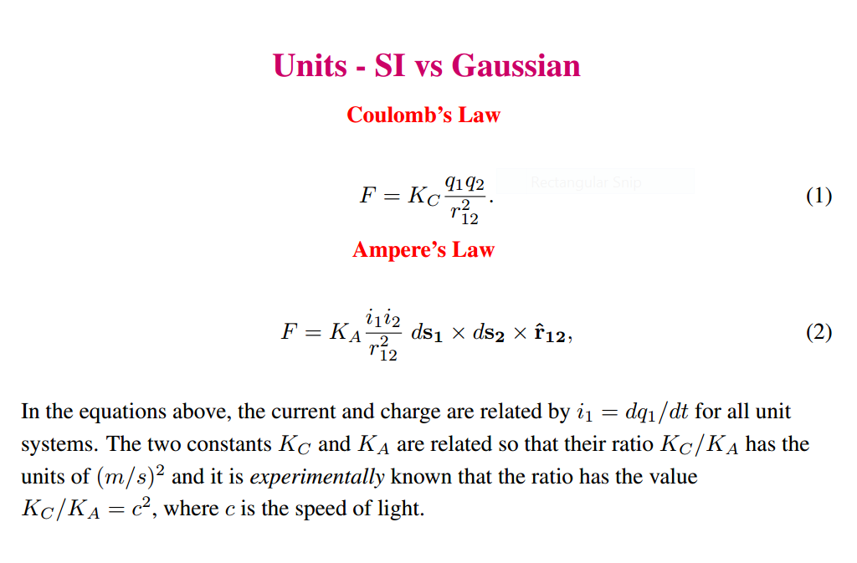
Material discussed in Appendix of textbook --
Notes:
Now for some discussion of our favorite topic. First we need to be clear about units. In general, the standard unit system is “SI”. The appendix discusses alternative unit systems found in the literature and IN THE SECOND HALF OF THIS TEXTBOOK!!!!! While for mechanics this is not such a big deal, for E & M it causes great pain and suffering.

Slide 14
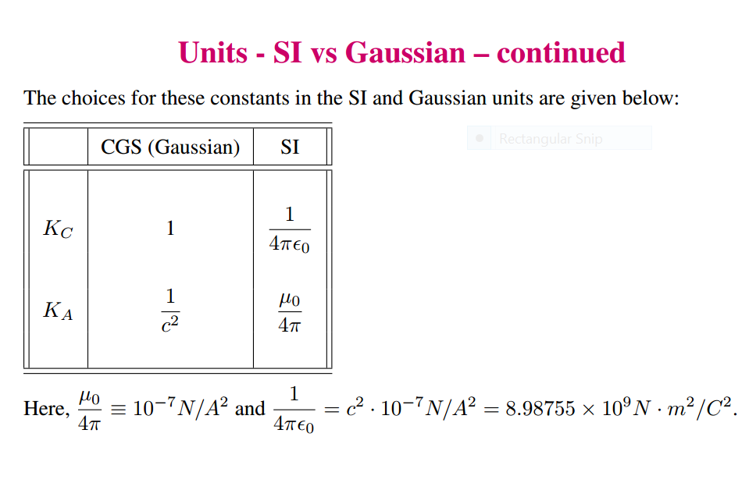
Notes:
Here are some relationships between the two unit systems used in this text.

Slide 15
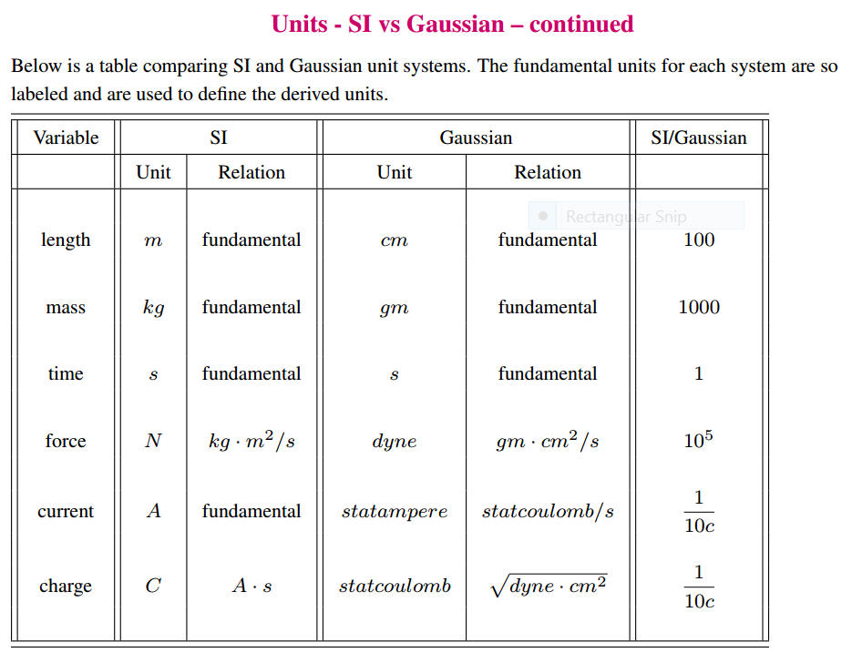
Notes:
More about units

Slide 16
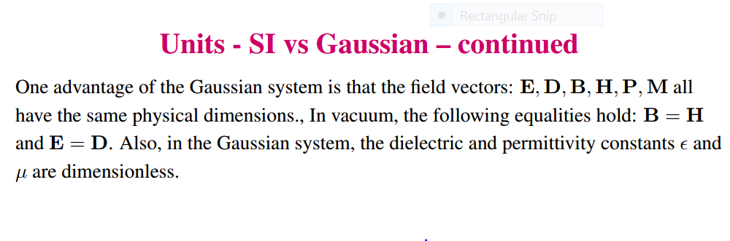
Notes:
More about units. Note that while SI units are the current “standard”, many papers in the literature and older textbooks use other unit systems.

Slide 17
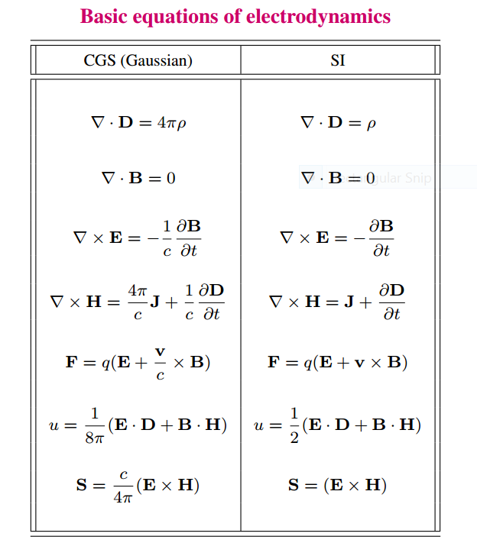
Notes:
Maxwell’s equations and other relationships that we will see during this course in the two unit systems.

Slide 18
Units choice for this course:
SI units for Jackson in Chapters 1-10
Gaussian units for Jackson in Chapters 11-16
Electrostatics
q₂
q₁
q₃
q₄
Notes:
Starting review of electrostatics both for a discrete collection of charges and for a continuous distribution of charge.

Slide 19
Electrostatics
Discrete versus continuous charge distributions
Notes:
Note that we can use a Dirac delta function to express discrete charges in terms of a distribution. The digression lists some useful relationships for various coordinate systems.

Slide 20
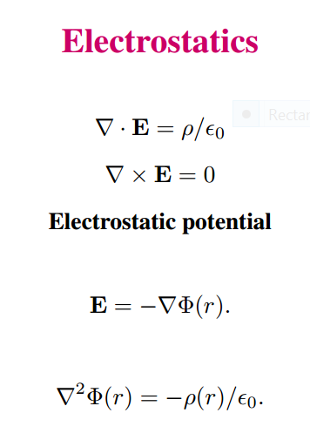
Differential equations --
Notes:
In addition to the integral relationships, electrostatics can also be expressed in terms of differential forms. Mathematically, the electrostatic potential is a convenient form in which to analyze electrostatic systems.

Slide 21
Relationship between integral and differential forms of electrostatics --
Notes:
Comparison of differential and integral relationships.

Slide 22
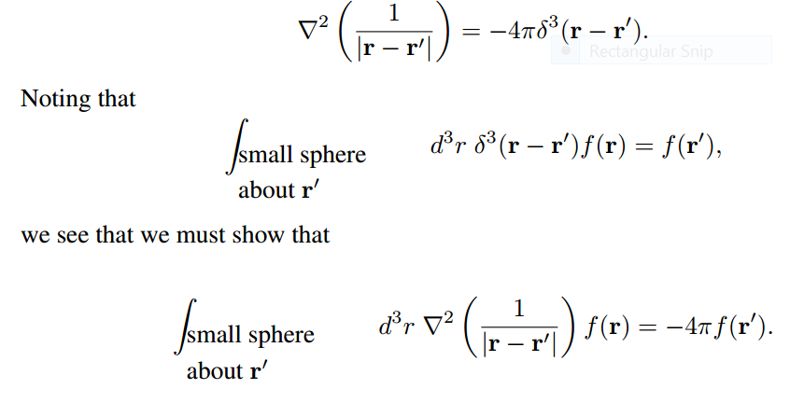
Relationship between integral and differential forms of electrostatics --
Need to show:
Notes:
The identity of the differential and integral forms follows from the singular behavior of the Coulomb kernel expressed on the top line. We need to “prove” this identity.

Slide 23
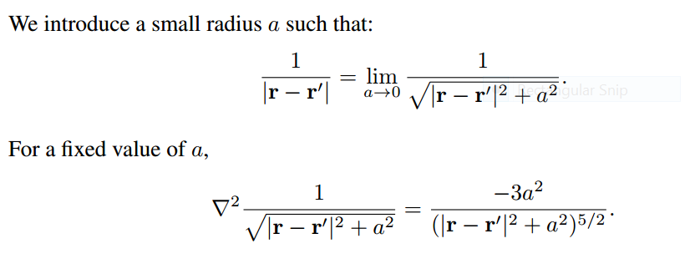
Notes:
Proof using the limit of an expression for a→0.

Slide 24
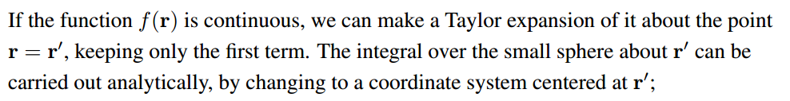
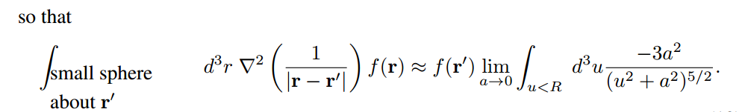

Notes:
Analytic results for finite a.

Slide 25
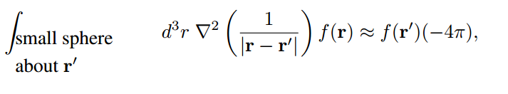

➔
➔
Notes:
From analytic result, evaluate for fixed R and a→0. Find that the result is independent of R and the identity is found to be justified.

Slide 26
Example in HW1
Notes:
Comment about homework problem.

