Slide 1
PHY 712 Electrodynamics
10-10:50 AM MWF Online
Plan for Lecture 10:
Continue reading Chapter 4
Dipolar fields and dielectrics
Electric field due to a dipole
Electric polarization P
Electric displacement D and dielectric functions

Slide 2
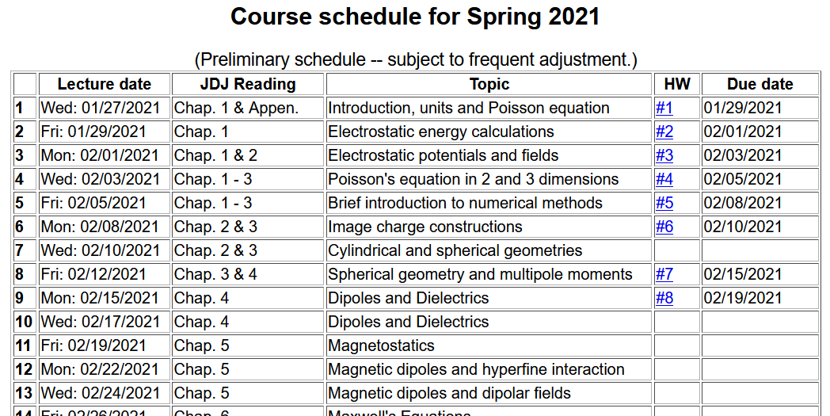

Slide 3
Colloquium tomorrow --

Slide 4
Notion of multipole moment:

Slide 5
General form of electrostatic potential in terms of multipole moments:

Slide 6
Focus on dipolar contributions:
This result was “derived” in Lecture 9.

Slide 7
Summary of key argument:
z
r₂
r₁
y
x

Slide 8
Now consider a complicated distribution of charges --
Coarse grain representation of macroscopic distribution of dipoles:

Slide 9
Coarse grain representation of macroscopic distribution of dipoles -- continued:

Slide 10
Coarse grain representation of macroscopic distribution of dipoles -- continued:

Slide 11
Coarse grain representation of macroscopic distribution of dipoles -- continued:
Boundary value problems in dielectric materials

Slide 12
Boundary value problems in the presence of dielectrics – example:
ε₁
ε₂
E₁
E₂
D₁
D₂
For isotropic dielectrics:

Slide 13
Boundary value problems in the presence of dielectrics – example:
E₀
a
E
θ
z
ε
ε₀

Slide 14
Boundary value problems in the presence of dielectrics – example -- continued:

Slide 15
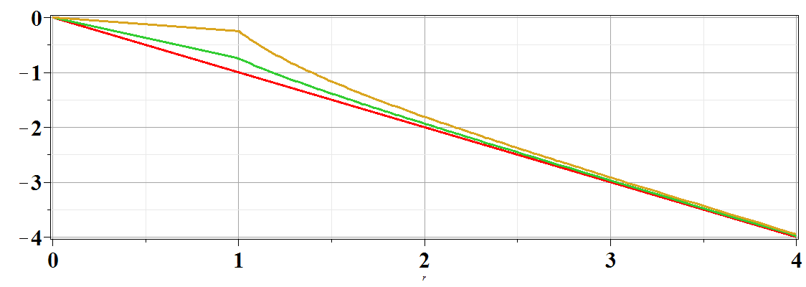
Boundary value problems in the presence of dielectrics – example -- continued:
Φ(r,θ=0)
ε/ε₀=
10
2
1
r/a

