Slide 1
PHY 712 Electrodynamics
10-10:50 AM MWF Online
Class discussion for Lecture 10:
Continue reading Chapter 4
Dipolar fields and dielectrics
Electric field due to a dipole
Electric polarization P
Electric displacement D and dielectric functions

Slide 2
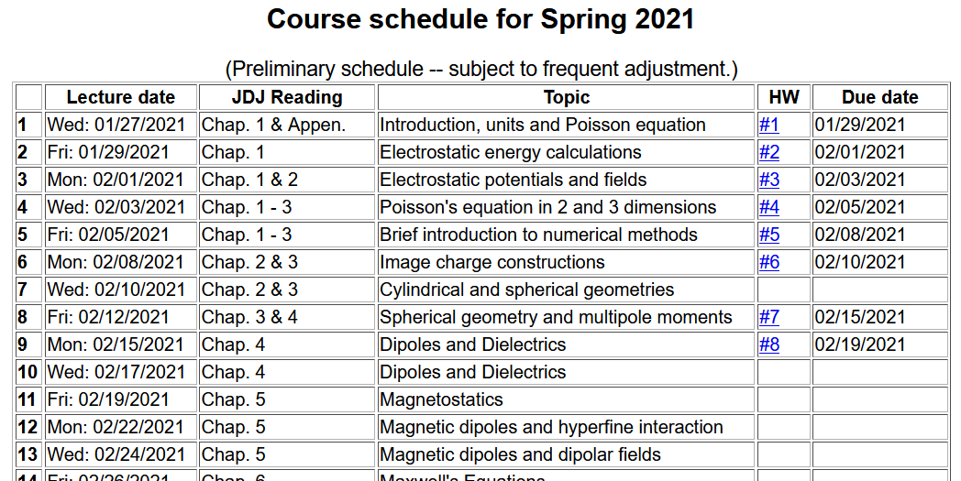

Slide 4
Colloquium tomorrow --

Slide 5
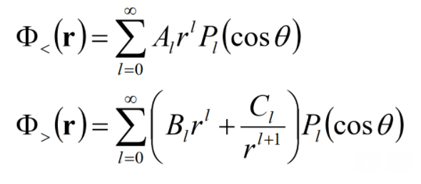
Your questions –
From Tim -- On slide 5 you call the multipole expansion the "Cartesian expansion". I see that it is in terms of r which is usually used in spherical coordinates. Is it normally used just in terms of r? Is it possible to get a divergence of the displacement field D = 0 even when you have polarizations, but the polarization is only due to dipoles?
From Gao -- Could you go over how these solutions come?

Slide 6
Notion of multipole moment:

Slide 7
General form of electrostatic potential in terms of multipole moments:

Slide 8
Focus on dipolar contributions:
This result was “derived” in Lecture 9.

Slide 9
Summary of key argument:
z
r₂
r₁
y
x

Slide 10
Now consider a complicated distribution of charges --
Coarse grain representation of macroscopic distribution of dipoles:

Slide 11
Coarse grain representation of macroscopic distribution of dipoles -- continued:

Slide 12
Coarse grain representation of macroscopic distribution of dipoles -- continued:

Slide 13
Coarse grain representation of macroscopic distribution of dipoles -- continued:
Boundary value problems in dielectric materials

Slide 14
Some details --
Under electrostatic conditions, these equations are true everywhere, including at the boundary between two materials.

Slide 15
Boundary value problems in the presence of dielectrics – example:
ε₁
ε₂
E₁
E₂
D₁
D₂
For isotropic dielectrics:

Slide 16
Boundary value problems in the presence of dielectrics – example:
E₀
a
E
θ
z
ε
ε₀

Slide 18
Boundary value problems in the presence of dielectrics – example -- continued:

Slide 19
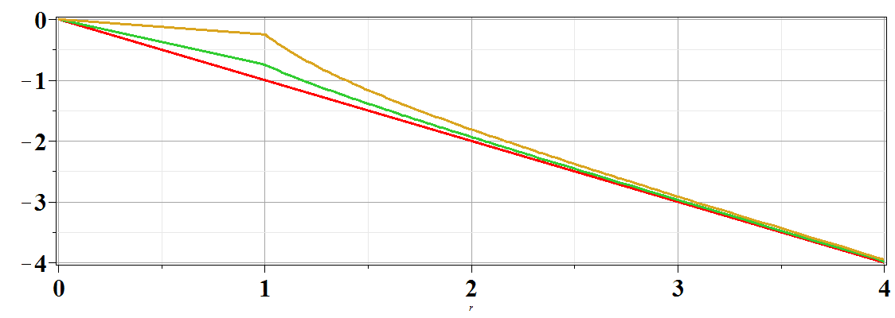
Boundary value problems in the presence of dielectrics – example -- continued:
Φ(r,θ=0)
ε/ε₀=
10
2
1
r/a

