Slide 1
PHY 712 Electrodynamics
10-10:50 AM MWF Online
Class discussion for Lecture 12:
Start reading Chapter 5
Magnetostatics
Vector potential
Example: current loop

Slide 2
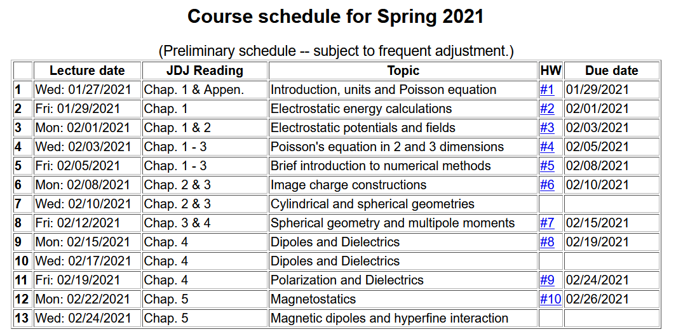

Slide 4
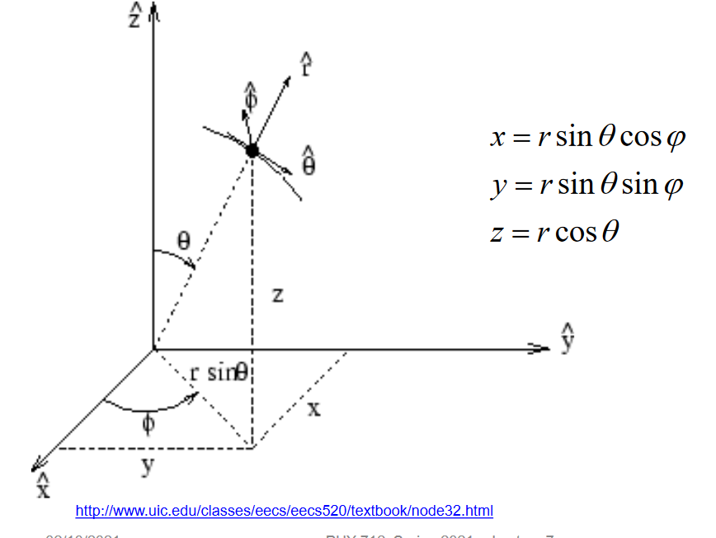
Your questions –
From Gao -- In quantum mechanics, only J is defined differently, but A still has the same definition, right? Also some question about the direction of the \phi unit vector --

Slide 5
Magnetostatics
Magnetic flux density or magnetic induction field B
Steady state (constant in time) current density J
y
q_{i}
v_{i}
r_{i}
x

Slide 6
Comparison of electrostatics and magnetostatics

Slide 7
Alternative forms magnetostatic equations

Slide 9
Alternative forms magnetostatic equations -- continued

Slide 10
Differential forms of magnetostatic equations:
Magnetostatic vector potential

Slide 11
Non uniqueness of the magnetostatic vector potential

Slide 12
Differential form of Ampere’s law in terms of vector potential:

Slide 14
Magnetostatics example: current loop
z
r
y
x

Slide 15
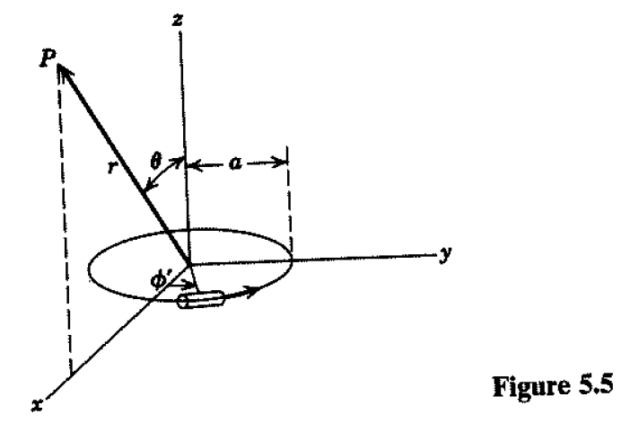
Magnetostatics example: current loop -- continued

Slide 16
Magnetostatics example: current loop -- continued

Slide 17
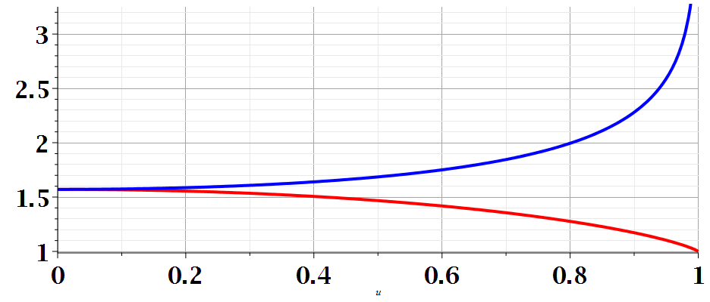
m

Slide 18
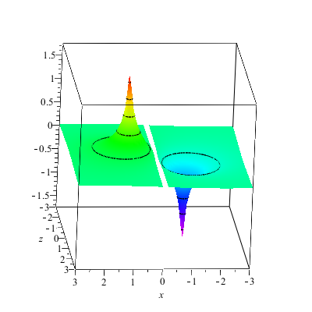
Magnetostatics example: current loop -- continued
A_{y}(x,z)

Slide 19
Magnetostatics example: current loop -- continued
Evaluation for special cases

Slide 20
Evaluation for special case k² → 0

Slide 21
Evaluation for special case k² → 0

Slide 22
Magnetostatics example: current loop -- continued

Slide 23
Other examples of current density sources:

Slide 24
Magnetic vector potential for this case:

