Slide 1
PHY 712 Electrodynamics
10-10:50 AM MWF Online
Plan for Lecture 13:
Continue reading Chapter 5
Examples of magnetostatic fields
Magnetic dipoles
Hyperfine interaction

Slide 2
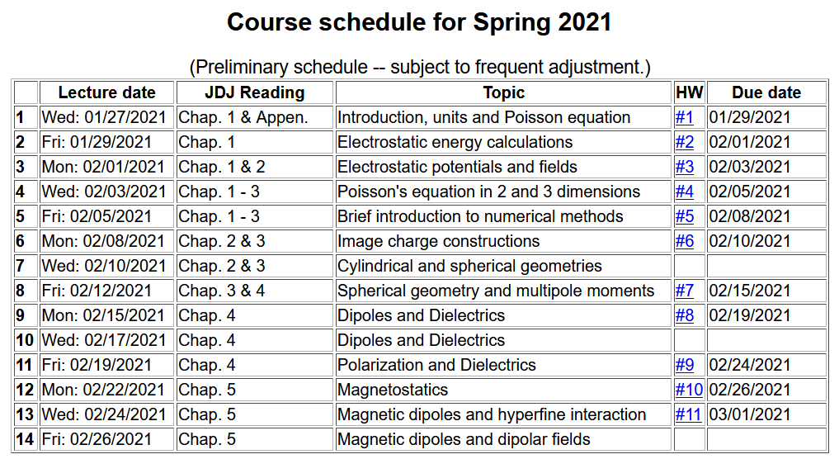

Slide 4
Various forms of Ampere’s law :

Slide 5
Other examples of current density sources:

Slide 6
Details of the electron orbital magnetic dipole moment
Note that:

Slide 7
Summary of magnetic field generated by point magnetic dipole moment:

Slide 8
