Slide 1
PHY 712 Electrodynamics
10-10:50 AM MWF Online
Class discussion for Lecture 13:
Continue reading Chapter 5
Examples of magnetostatic fields
Magnetic dipoles
Hyperfine interaction

Slide 2
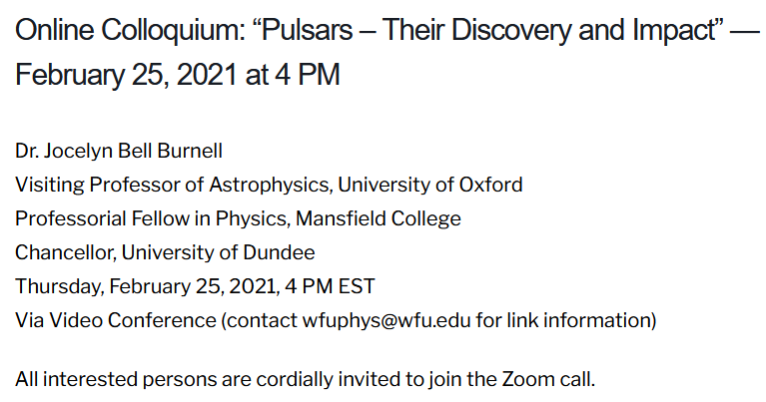
Thursday’s Physics Colloquium --

Slide 3
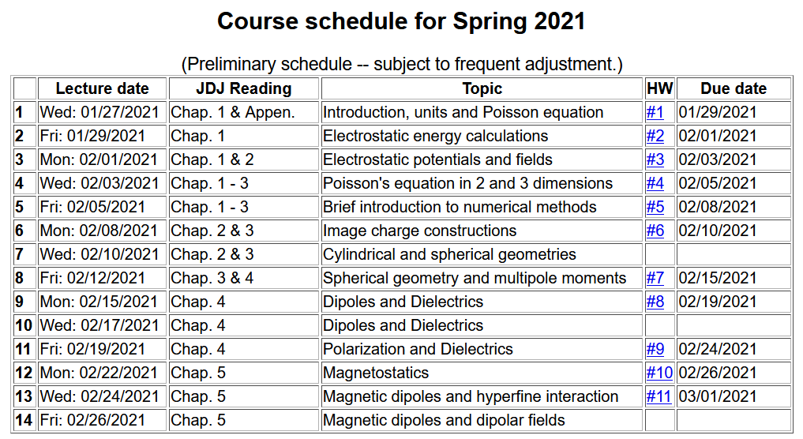

Slide 5
Your questions –
From Nick -- Can you discuss briefly how to transition unit vectors among coordinate systems. You gave us phi-hat last time, but this time we have theta-hat and I can't quite see it. Also, what is the meaning of the bracket notation we're using?
From Gao -- What is fermi contact?

Slide 6
Comment about spherical polar coordinates
Ref: https://www.cpp.edu/~ajm/materials/delsph.pdf

Slide 7
Various forms of Ampere’s law :

Slide 8
Other examples of current density sources:

Slide 9
Details of the electron orbital magnetic dipole moment
Note that:

Slide 10
Summary of magnetic field generated by point magnetic dipole moment:

Slide 11
