Slide 1
PHY 712 Electrodynamics
10-10:50 AM MWF Online
Discussion for Lecture 15:
    Start reading Chapter 6
      Maxwell’s full equations; effects of time varying fields and sources
      Gauge choices and transformations
      Green’s function for vector and scalar potentials

Slide 2
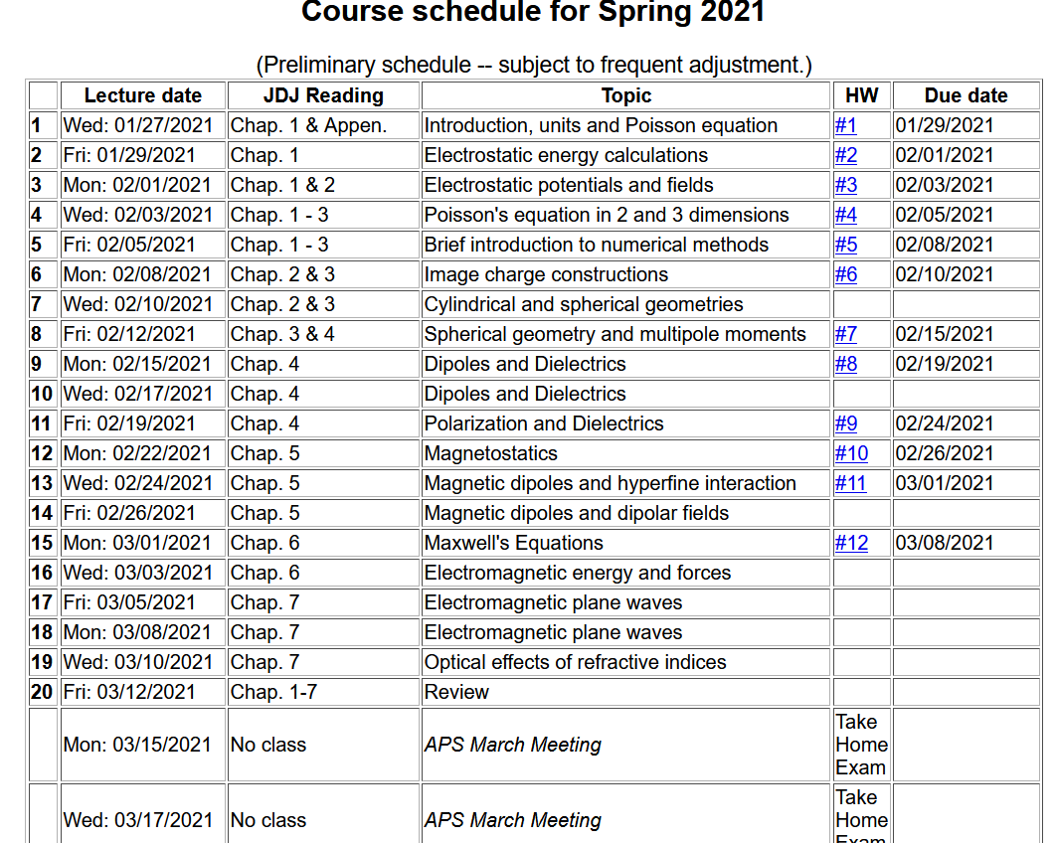

Slide 3
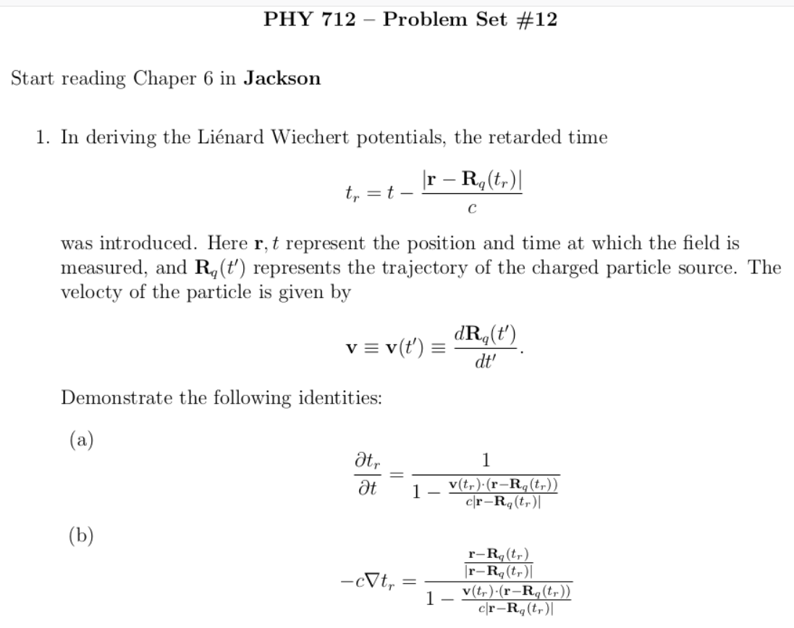

Slide 4
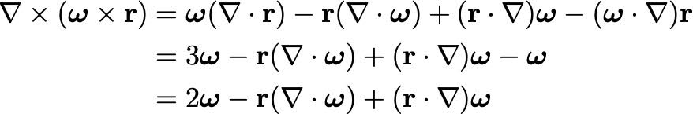
Your questions –
From Nick – Concerning HW 11 -- For example, I can only reduce the following and I don't understand exactly what the Div(omega). Moreover, I don't see how you did the first part of Eq 8.

Slide 5
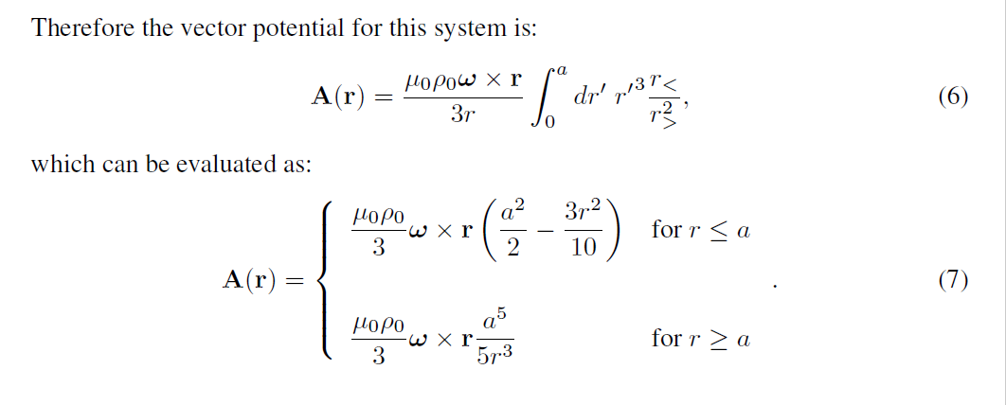
From example problem -- (uniformly charged sphere)
Note that ω is a constant vector representing angular velocity

Slide 6
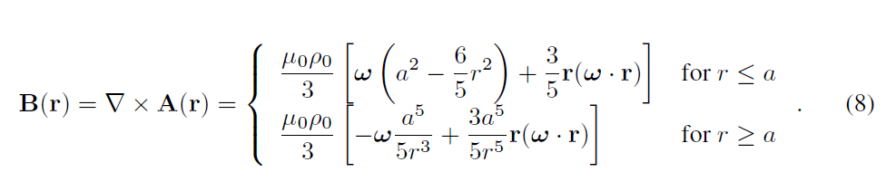
When the dust clears --

Slide 7
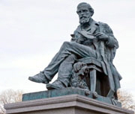
Full electrodynamics with time varying fields and sources
Maxwell’s equations
"From a long view of the history of mankind - seen from, say, ten thousand years from now - there can be little doubt that the most significant event of the 19th century will be judged as Maxwell's discovery of the laws of electrodynamics"
Richard P Feynman
Image of statue of James Clerk-Maxwell
(1831-1879) in Edinburgh
http://www.clerkmaxwellfoundation.org/

Slide 8
Maxwell’s equations

Slide 9
Maxwell’s equations

Slide 10
Formulation of Maxwell’s equations in terms of vector and scalar potentials

Slide 11
Formulation of Maxwell’s equations in terms of vector and scalar potentials -- continued

Slide 12
Formulation of Maxwell’s equations in terms of vector and scalar potentials -- continued

Slide 13
Formulation of Maxwell’s equations in terms of vector and scalar potentials -- continued

Slide 14
Formulation of Maxwell’s equations in terms of vector and scalar potentials -- continued

Slide 15
Formulation of Maxwell’s equations in terms of vector and scalar potentials -- continued

Slide 16
Solution of Maxwell’s equations in the Lorentz gauge

Slide 17
Solution of Maxwell’s equations in the Lorentz gauge -- continued

Slide 18
Solution of Maxwell’s equations in the Lorentz gauge -- continued

Slide 19
Solution of Maxwell’s equations in the Lorentz gauge -- continued

Slide 20
Solution of Maxwell’s equations in the Lorentz gauge -- continued

Slide 21
Solution of Maxwell’s equations in the Lorentz gauge -- continued

Slide 22
Solution of Maxwell’s equations in the Lorentz gauge -- continued

Slide 23
Solution of Maxwell’s equations in the Lorentz gauge -- continued
Liènard-Wiechert potentials and fields --
Determination of the scalar and vector potentials for a moving point particle (also see Landau and Lifshitz The Classical Theory of Fields, Chapter 8.)
Consider the fields produced by the following source: a point charge q moving on a trajectory R_{q}(t).
R_{q}(t)
q

Slide 24
Solution of Maxwell’s equations in the Lorentz gauge -- continued
We performing the integrations over first d³r’ and then dt’
making use of the fact that for any function of t’,
where the ``retarded time'' is defined to be

Slide 25
Solution of Maxwell’s equations in the Lorentz gauge -- continued
Resulting scalar and vector potentials:
Notation:

Slide 26
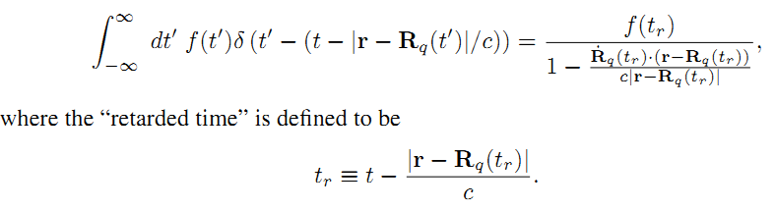
Comment on Lienard-Wiechert potential results

Slide 27
Comment on Lienard-Wiechert potential results -- continued

Slide 28
Summary of results for fields due to moving charge –
Liénard Wiechert potentials
Resulting scalar and vector potentials:
Notation:

