Slide 1
PHY 712 Electrodynamics
10-10:50 AM MWF Online
Class discussion for Lecture 16:
Finish reading Chapter 6
Some details of Liénard-Wiechert results
Energy density and flux associated with electromagnetic fields
Time harmonic fields

Slide 3
Your questions –
From Tim -- What is the difference between E_field and E_mech?Are E and H orthogonal?
From Nick -- Question about how t_r is defined with R(t_r)? It's like t_r is inside the definition of itself.

Slide 4
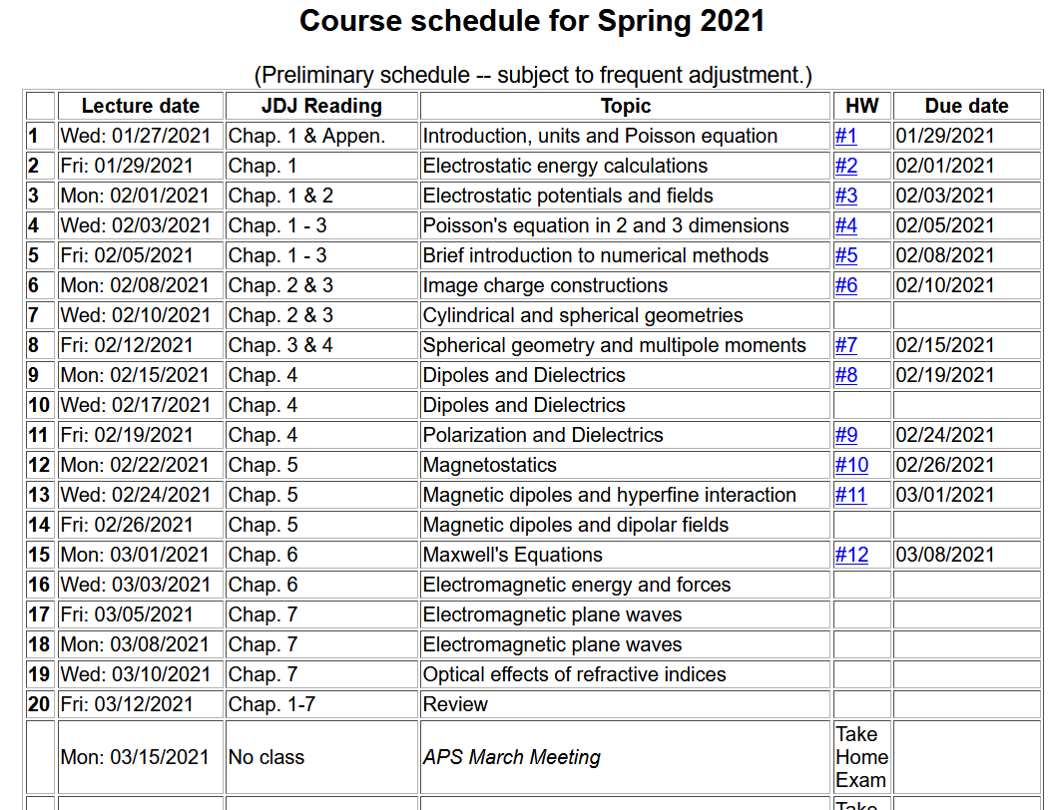

Slide 5
Solution of Maxwell’s equations in the Lorentz gauge – Review from previous lecture --
Liénard-Wiechert potentials and fields --
Determination of the scalar and vector potentials for a moving point particle (also see Landau and Lifshitz The Classical Theory of Fields, Chapter 8.)
Consider the fields produced by the following source: a point charge q moving on a trajectory R_{q}(t).
R_{q}(t)
q

Slide 6
Solution of Maxwell’s equations in the Lorentz gauge -- continued
We performing the integrations over first d³r’ and then dt’
making use of the fact that for any function of t’,
where the ``retarded time'' is defined to be

Slide 7
Solution of Maxwell’s equations in the Lorentz gauge -- continued
Resulting scalar and vector potentials:
Notation:

Slide 8
Solution of Maxwell’s equations in the Lorentz gauge -- continued
In order to find the electric and magnetic fields, we need to evaluate
The trick of evaluating these derivatives is that the retarded time t_{r} depends on position r and on itself. We can show the following results using the shorthand notation:
and

Slide 9
Solution of Maxwell’s equations in the Lorentz gauge -- continued

Slide 10
Maxwell’s equations
Energy analysis of electromagnetic fields and sources

Slide 11
Energy analysis of electromagnetic fields and sources - continued

Slide 12
Energy analysis of electromagnetic fields and sources - continued

Slide 13
Momentum analysis of electromagnetic fields and sources

Slide 14
Summary -- By considering a complete system involving self-contained sources and fields, we examined the energy and force relationships and introduce energy and force equivalents of the electromagnetic fields

Slide 16
Comment on treatment of time-harmonic fields

Slide 17
Comment on treatment of time-harmonic fields -- continued
Equations in time domain in frequency domain
Note -- in all of these, the real part is taken at the end of the calculation.

Slide 18
Comment on treatment of time-harmonic fields -- continued

Slide 19
Summary and review
Maxwell’s equations

Slide 20
Maxwell’s equations

Slide 21
Analysis of Maxwell’s equations without sources -- continued:

Slide 22
Analysis of Maxwell’s equations without sources -- continued:
Both E and B fields are solutions to a wave equation:

Slide 23
Analysis of Maxwell’s equations without sources -- continued:
Note: ε, μ, n, k can all be complex; for the moment we will assume that they are all real (no dissipation).

Slide 24
Analysis of Maxwell’s equations without sources -- continued:

Slide 25
Analysis of Maxwell’s equations without sources -- continued:
Transverse Electric and Magnetic (TEM) waves

