Slide 1
PHY 712 Electrodynamics
10-10:50 AM Online
Discussion about Lecture 17:
Read Chapter 7
Plane polarized electromagnetic waves
Reflectance and transmittance of electromagnetic waves – extension to anisotropy and complexity

Slide 2
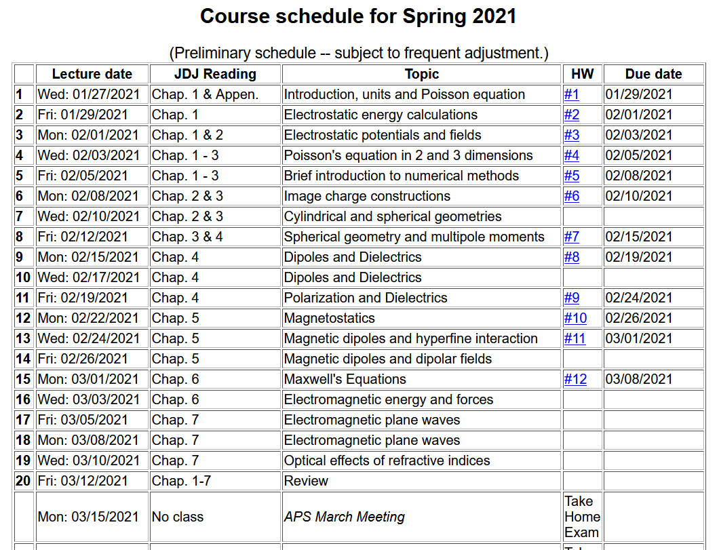

Slide 3
Maxwell’s equations

Slide 4
Analysis of Maxwell’s equations without sources -- continued:

Slide 5
Analysis of Maxwell’s equations without sources -- continued:
Both E and B fields are solutions to a wave equation:

Slide 6
Analysis of Maxwell’s equations without sources -- continued:
Note: ε, μ, n, k can all be complex; for the moment we will assume that they are all real (no dissipation).

Slide 7
Analysis of Maxwell’s equations without sources -- continued:
E₀
B₀
k

Slide 8
Reflection and refraction of plane electromagnetic waves at a plane interface between dielectrics (assumed to be lossless)
μ’ ε’
k’
θ
μ ε
k_{R}
k_{i}
i
R

Slide 9
Reflection and refraction -- continued
μ’ ε’
θ
k’
μ ε
k_{i}
k_{R}
i
R

Slide 10
Reflection and refraction -- continued
Snell’s law – matching phase factors at boundary plane z=0.
μ’ ε’
θ
k’
μ ε
k_{i}
k_{R}
i
R

Slide 11
Reflection and refraction -- continued
μ’ ε’
θ
k’
μ ε
k_{i}
k_{R}
i
R

Slide 12
Reflection and refraction -- continued
μ’ ε’
θ
k’
μ ε
k_{i}
k_{R}
i
R

Slide 13
Reflection and refraction -- continued
s-polarization – E field “polarized” perpendicular to plane of incidence
μ’ ε’
θ
k’
μ ε
k_{i}
k_{R}
i
R

Slide 14
Reflection and refraction -- continued
p-polarization – E field “polarized” parallel to plane of incidence
μ’ ε’
θ
k’
μ ε
k_{i}
k_{R}
i
R

Slide 15
Reflection and refraction -- continued
μ’ ε’
θ
k’
μ ε
k_{i}
k_{R}
i
R

Slide 16
For s-polarization

Slide 17
For p-polarization

Slide 18
Special case: normal incidence (i=0, θ=0)

Slide 19
Multilayer dielectrics (Problem #7.2)
n₁
n₂
n₃
k_{a}
k_{i}
k_{t}
k_{b}
k_{R}
d

Slide 20
Extension of analysis to anisotropic media --

Slide 21
Consider the problem of determining the reflectance from an anisotropic medium with isotropic permeability μ₀ and anisotropic permittivity ε₀ κ where:
By assumption, the wave vector in the medium is
confined to the x-y plane and will be denoted by
The electric field inside the medium is given by:

Slide 22
Inside the anisotropic medium, Maxwell’s equations are:
After some algebra, the equation for E is:
From E, H can be determined from

Slide 23
The fields for the incident and reflected waves are the same as for the isotropic case.
Note that, consistent with Snell’s law:
Continuity conditions at the y=0 plane must be applied for the following fields:
There will be two different solutions, depending of the polarization of the incident field.

Slide 24
Solution for s-polarization

Slide 25
Solution for p-polarization

Slide 26
Extension of analysis to complex dielectric functions

