Slide 1
PHY 712 Electrodynamics
10-10:50 AM Online
Discussion of Lecture 18:
Continue reading Chapter 7
Real and imaginary contributions to electromagnetic response
Frequency dependence of dielectric materials; Drude model
Kramers-Kronig relationships

Slide 2
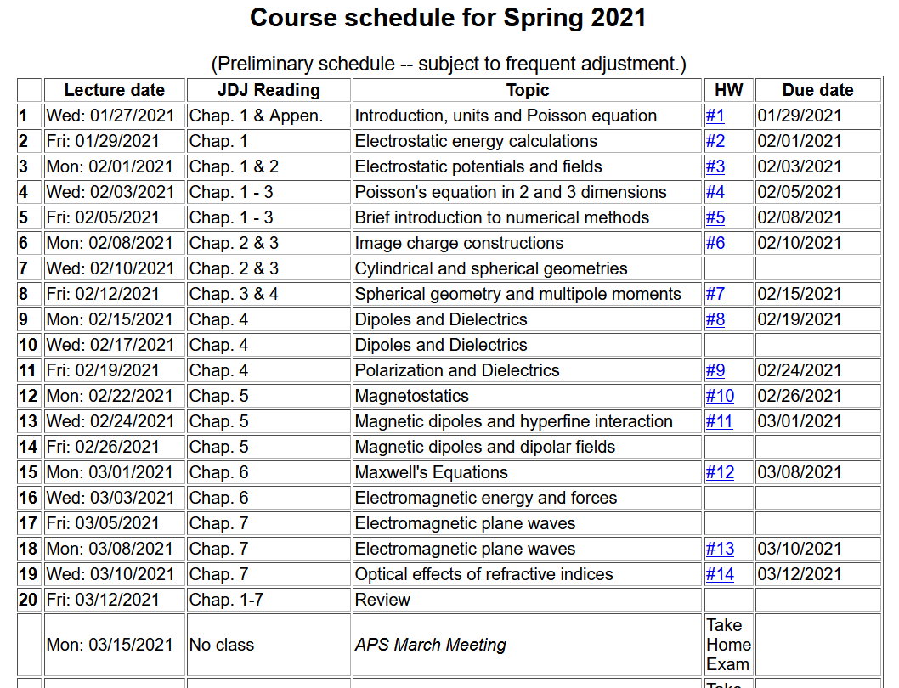

Slide 4
Your questions –
From Gao -- Where does this equation come from? and How is it solved?
From Tim -- What is gamma? Is E_o an external electric field?
Several questions concerning the homework problem --

Slide 5
Hint continued

Slide 6
Maxwell’s equations

Slide 7
Plane wave solutions to sourceless Maxwell’s equations; extension of analysis to complex dielectric functions

Slide 8
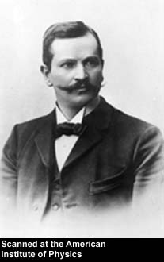
Paul Karl Ludwig Drude 1863-1906
http://photos.aip.org/history/Thumbnails/drude_paul_a1.jpg

Slide 9
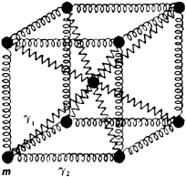
Drude model:
Vibrations of charged particles near equilibrium:
δr
http://img.tfd.com/ggse/d6/gsed_0001_0012_0_img2972.png

Slide 10
Drude model:
Vibration of particle of charge q and mass m near equilibrium:
δr
http://img.tfd.com/ggse/d6/gsed_0001_0012_0_img2972.png
Note that:
γ > 0 represents dissipation of energy.
ω₀ represents the natural frequency of the vibration; ω₀=0 would represent a free (unbound) particle

Slide 11
Drude model:
Vibration of particle of charge q and mass m near equilibrium:
δr
http://img.tfd.com/ggse/d6/gsed_0001_0012_0_img2972.png

Slide 12
Drude model:
Vibration of particle of charge q and mass m near equilibrium:
δr
http://img.tfd.com/ggse/d6/gsed_0001_0012_0_img2972.png

Slide 13
Drude model:
Vibration of particle of charge q and mass m near equilibrium:
δr
http://img.tfd.com/ggse/d6/gsed_0001_0012_0_img2972.png

Slide 14
Drude model dielectric function:

Slide 15
Drude model dielectric function:

Slide 16
Drude model dielectric function – some analytic properties:

Slide 17
Drude model dielectric function – some analytic properties:

Slide 18
Analytic properties of the dielectric function (in the Drude model or from “first principles” -- Kramers-Kronig transform
Im(z)
α
Re(z)

Slide 19
Kramers-Kronig transform -- continued
Im(z)
α
Re(z)
=0

Slide 20
Kramers-Kronig transform -- continued

Slide 21
Kramers-Kronig transform -- continued

Slide 22
u
a u_{s} b

Slide 24
Analysis for Drude model dielectric function:

Slide 25
Analysis for Drude model dielectric function – continued --
Analytic properties:

Slide 27
Because of these analytic properties, Cauchy’s integral theorem results in:
Kramers-Kronig transform – for dielectric function:

Slide 28
Further comments on analytic behavior of dielectric function

Slide 29
Further comments on analytic behavior of dielectric function

Slide 30
Some details

Slide 31
z_{P}

