Slide 1
PHY 712 Electrodynamics
10-10:50 AM Online
Discussion for Lecture 19:
Complete reading of Chapter 7
Comments on reflectivity of plane waves
Summary of complex response functions for electromagnetic fields
Comment on spectral properties of electromagnetic waves

Slide 2
Physics Colloquium – 4 PM 3/11/2021

Slide 3
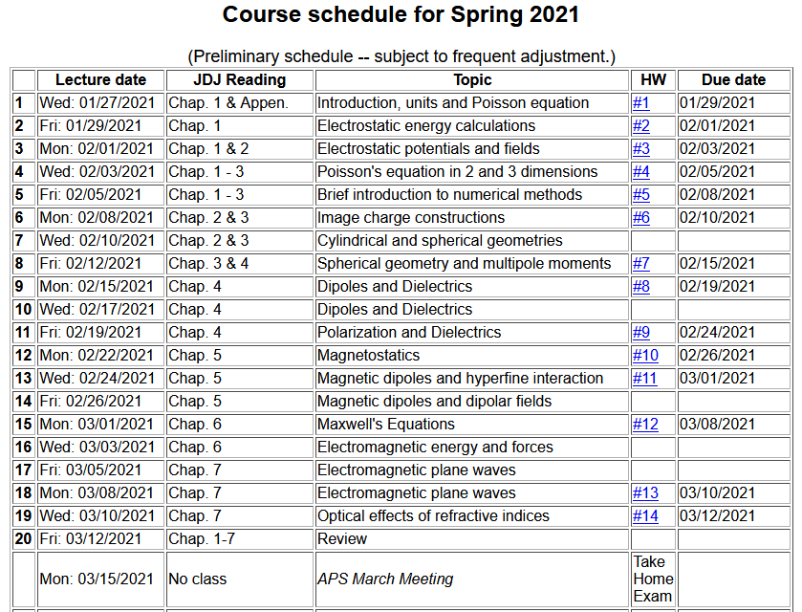

Slide 4
Please submit topic suggestions for Friday’s review –
Questions for today—
From Nick -- Can you go over how we proved the [dielectric] function was analytic?
From Derick – (Paraphrased) How do the Fresnel equations for isotropic and anisotropic materials compare?
From Tim -- In slide 20 are permittivity function and dielectric function the same function?In slide 31 how are we able to split the integral of f(z) into f(z_r) and f(z). What is the difference between z_r and z?
From Gao -- Why do we study Kramers-Kronig transform? Do you have application examples?

Slide 5
Extension of reflection/refractionanalysis to anisotropic media --
assume

Slide 6
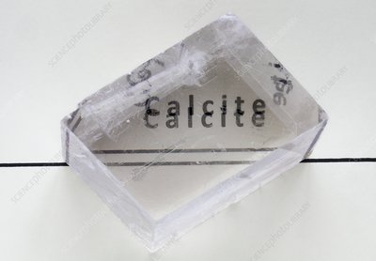
For s-polarization (E fields along z-axis)
For p-polarization (E fields in x-y plane)
Example of a birefringent crystal --

Slide 7
Some comments on the Fresnel Equations
Different behaviors of s and p polarization
Brewster’s angle
Total internal reflection

Slide 8
Review: Electromagnetic plane waves in isotropic medium with linear and real permeability and permittivity: μ ε.

Slide 9
Review:
Reflection and refraction of plane electromagnetic waves at a plane interface between dielectrics (assumed to be lossless)
μ’ ε’
k’
θ
μ ε
k_{R}
k_{i}
i
R

Slide 10
Review:
Reflection and refraction between two isotropic media
μ’ ε’
θ
k’
μ ε
k_{i}
k_{R}
i
R

Slide 11
For s-polarization (E perpendicular to plane of incidence)
For p-polarization (E in plane of incidence)

Slide 12
Reflectance for s-polarization
Reflectance for p-polarization

Slide 13
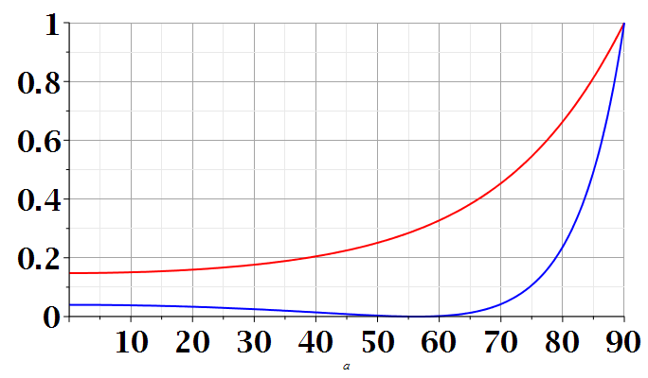
s-polarization
p-polarization
i
i

Slide 14
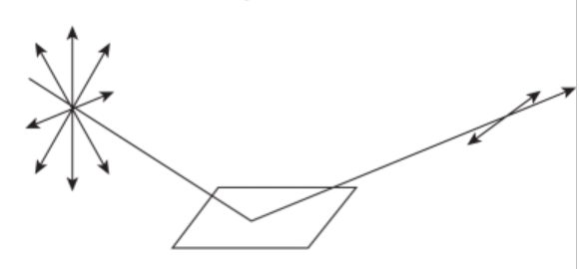
n=1
surface normal
k_{i}
k_{R}
i
n’>1
Polarization due to reflection from a refracting surface

Slide 15
Reflection and refraction between two isotropic media -- continued
μ’ ε’
θ
k’
μ ε
k_{i}
k_{R}
i
R
Total internal reflection:
For i > i₀

Slide 16
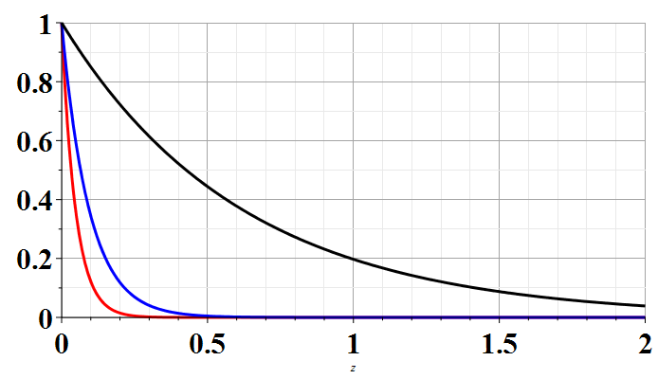
Example of total internal reflection
n’=1 and n=1.5 ➔ i₀ = sin⁻¹(1/1.5)=41.81º
Relative transmitted intensity
i=42º
i=50º
i=90º
z/λ
Transmitted illumination confined within a few wavelengths of the surface.

Slide 17
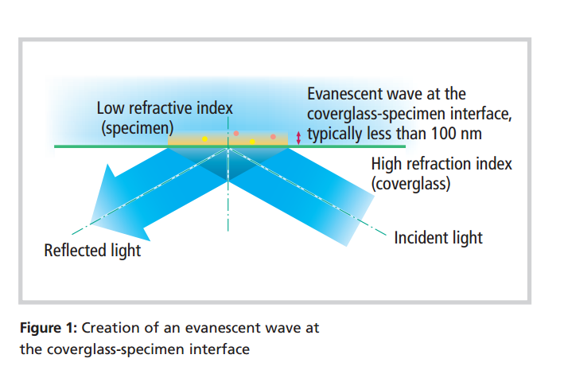
TIRF (total internal reflection fluorescence)
www.nikon.com/products/microscope-solutions/bioscience.../nikon_note_10_lr.pdf

Slide 18
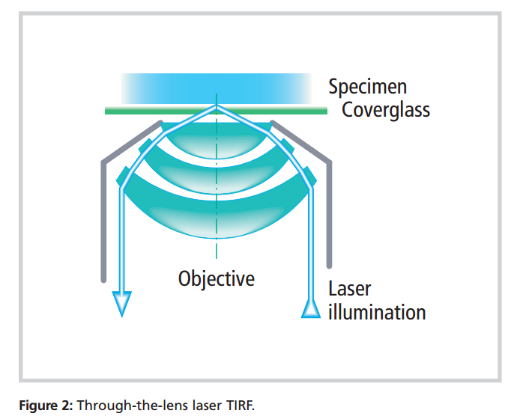
Design of TIRF device using laser and high power lens

Slide 19
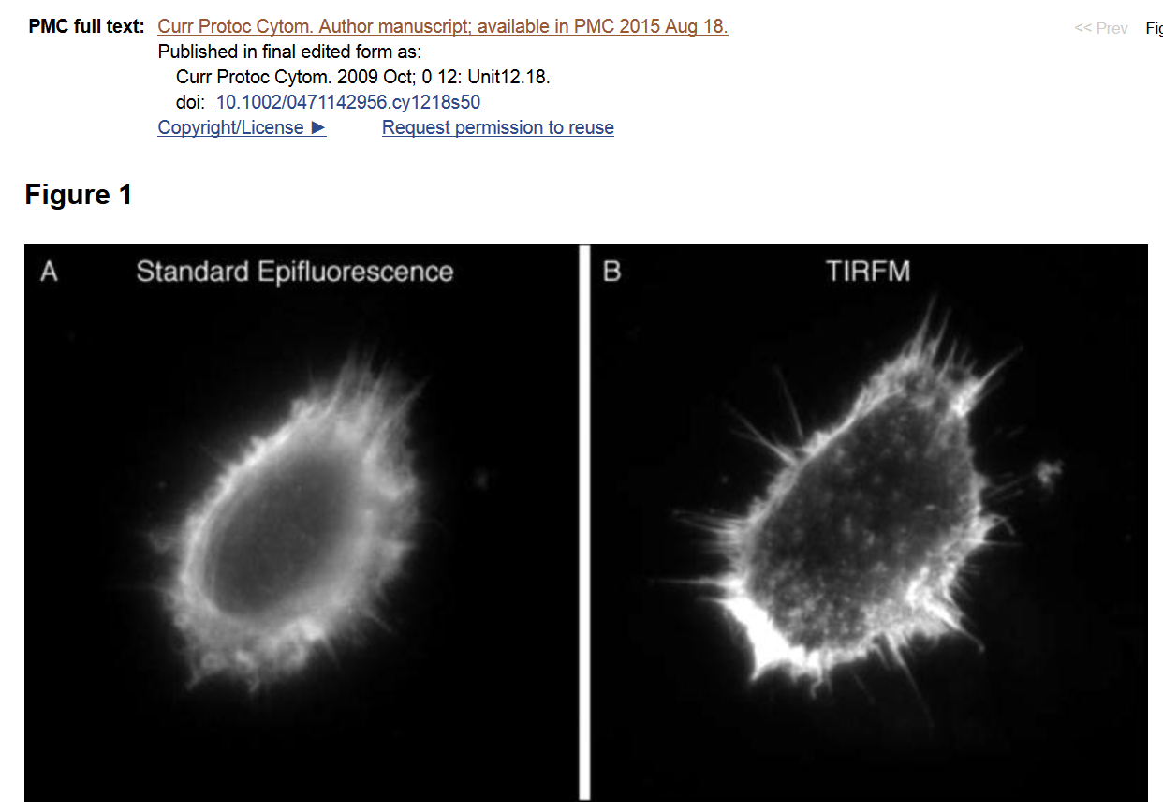

Slide 20
Special case: normal incidence (i=0, θ=0)
PHY 712 Spring 2013 -- Lecture 19
20

Slide 21
Extension to complex refractive index n= n_{R} + i n_{I}

Slide 22
Origin of imaginary contributions to permittivity --
Review: Drude model dielectric function:

Slide 23
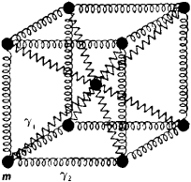
Extensions of the Drude model for lattice vibrations
In principle, the ideas of the Drude model apply both to the ionic vibrations which occur at low frequency (~10¹² Hz) contributing to the so called static permittivity function ε_{s} and to the electronic vibrations which occur at high frequency (~10¹⁵ Hz) contributing to the so called high frequency permittivity function ε∞.
δr

Slide 24
Drude model dielectric function:

Slide 25
Drude model dielectric function – some analytic properties:

Slide 26
Further comments on analytic behavior of dielectric function

Slide 27
Further comments on analytic behavior of dielectric function

Slide 28
Some details
Note that numerically, Im(z_{P})<0

Slide 29
z_{P}

Slide 31
Analysis for Drude model dielectric function – continued --
Analytic properties:

Slide 32
Because of these analytic properties, Cauchy’s integral theorem results in:
Kramers-Kronig transform – for dielectric function:

Slide 33
Analytic properties of the dielectric function (in the Drude model or from “first principles” -- Kramers-Kronig transform
Im(z)
α
Re(z)

Slide 34
Kramers-Kronig transform -- continued
Im(z)
α
Re(z)
=0

Slide 35
Im(z)
Some details
α
Re(z)

Slide 36
Kramers-Kronig transform -- continued

Slide 37
Kramers-Kronig transform -- continued

Slide 38
Analysis for Drude model dielectric function:

Slide 39
Analysis for Drude model dielectric function – continued --
Analytic properties:

Slide 41
Summary –
Kramers-Kronig transform – for dielectric function:
Practical applications -- It is often possible/more convenient to calculate the imaginary response and use KK to deduce the real response or visa versa.

Slide 42
Analysis of Maxwell’s equations without sources -- continued:
E₀
B₀
k

Slide 43
Transverse electric and magnetic waves (TEM)
TEM modes describe electromagnetic waves in lossless media and vacuum
E₀
B₀
For real
ε, μ, n, k
k

Slide 44
Effects of complex dielectric; fields near the surface on an ideal conductor

Slide 45
Some details:

Slide 46
Fields near the surface on an ideal conductor -- continued

Slide 47
Some representative values of skin depth
Ref: Lorrain² and Corson
 | σ (10⁷ S/m) | μ/μ₀ | δ (0.001m) at 60 Hz | δ (0.001m) at 1 MHz
Al | 3.54 | 1 | 10.9 | 84.6
Cu | 5.80 | 1 | 8.5 | 66.1
Fe | 1.00 | 100 | 1.0 | 10.0
Mumetal | 0.16 | 2000 | 0.4 | 3.0
Zn | 1.86 | 1 | 15.1 | 117

Slide 48
Relative energies associated with field

Slide 49
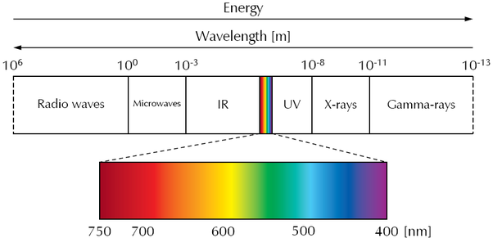
Various wavelengths λ --

