Slide 1
PHY 712 Electrodynamics
12-12:50 AM MWF Olin 103
Plan for Lecture 2:
Reading: Chapter 1 (especially 1.11) in JDJ;
Ewald summation methods
Motivation
Expression to evaluate the electrostatic energy of an extended periodic system
Examples
Notes:
This lecture details some special properties of the electrostatic energy of an extended system. It illustrates some special properties of the long range nature of the Coulomb interaction. Ewald summation methods may or may not be important for your particular field of study. However, it is at least important to be aware of the ideas.

Slide 2
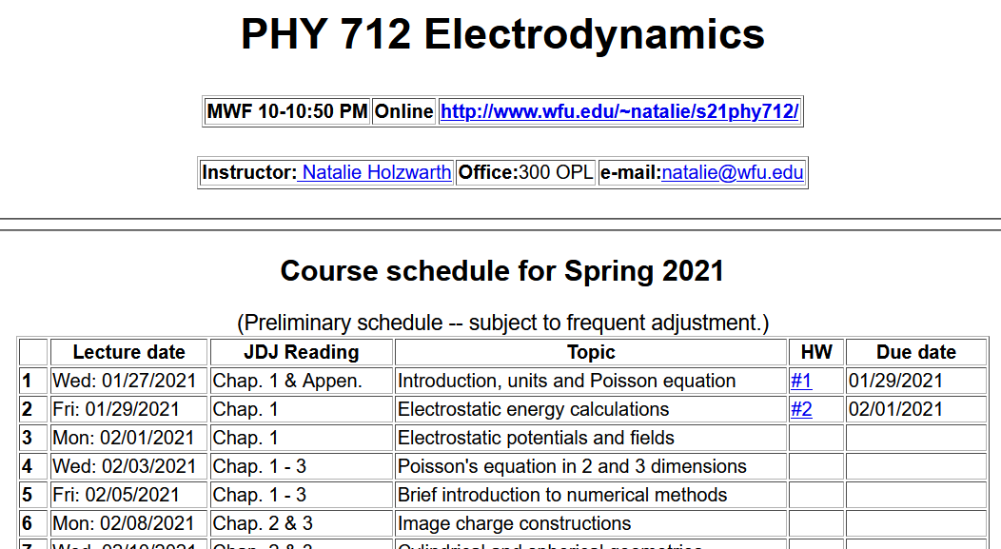
Notes:
The homework problem assigned this time exercises the ideas presented in this lecture.

Slide 3
Ewald summation methods -- motivation

Slide 4
Example finite charge system for which electrostatic energy W can be calculated --
2
3
Charge -e
1
5
4
Charge +e
6
(particles moves off to infinity)
Notes:
Summation for a finite number of particles is straightforward, but extension to an infinite system runs into difficulty.

Slide 5
Evaluation of the electrostatic energy for N point charges:
Ewald summation methods – exact results for periodic systems
See lecture notes for details.
Notes:
In the Extra lecture notes this expression will be derived and illustrated.

Slide 6
Slight digression:
Comment on electrostatic energy evaluation --
When the discrete charge distribution becomes a continuous charge density: the electrostatic energy
becomes
Notice, in this case, it is not possible to exclude the ``self-interaction''.
Previous expression can be rewritten in terms of the electrostatic potential or field:
Notes:
We will see and used these expressions. However, the so-called self energy often leads to difficulties….

