Slide 1
PHY 712 Electrodynamics
10-10:50 AM Online
Discussion for Lecture 20
    Review for mid-term
      Comments on exam and schedule
      Your suggestions
      Review of Chapters 1-7

Slide 2
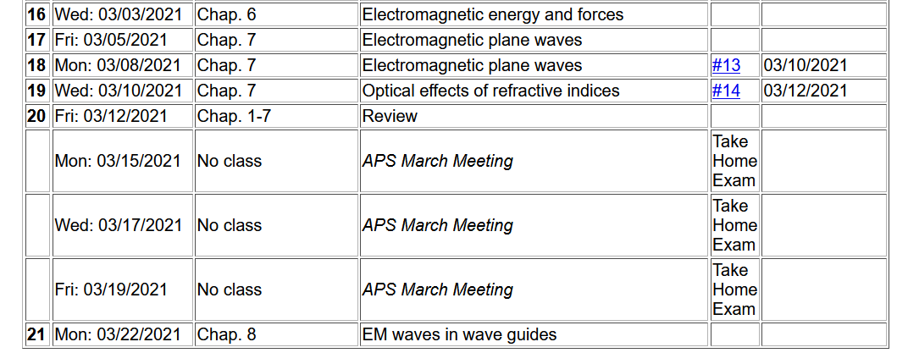
Schedule
Exam available by 9 AM
Exam due at 5 PM
Note that mid term grades are due at 12 noon on Monday, March 22, 2021
“Due” means receiving your exam submission electronically by that time. If you prefer paper submission, please slide the exam under my office door and let me know that you have done so.

Slide 3
Comments about exam –
According to the honor code, your exam submission must be your own work. In completing this take-home exam, you may consult your textbook, and other course materials, particularly those posted on the class webpage. You may consult other texts (within reason) as long as these are acknowledged and documented. Should questions arise about the exam, please email natalie@wfu.edu but no one else.
Exams will be graded on the basis of correct reasoning as well as correct answers. It is expected that you will use Maple, Mathematica, or Wolfram and these should be included in your exam submission.

Slide 4
Suggestions —
From Nick –
  permittivity and permeability
  Electric fields and forces
  Coulomb's Law
  Poisson Eqn
  Green's relation
  when to use the Wronskian
  numerical evaluation (esp. if on exam)
  Method of Images (definitely this)
  Bessel Functions
  Spherical Harmonics & Legendre relation
  multipoles
  Magnetic fields and fluxes
  scalar and vector potentials
  useful mathematical tricks (definitely this)
  Maxwell's equations and what each means
  Poynting vector? I don't know why it's important
  Drude summary

Slide 5
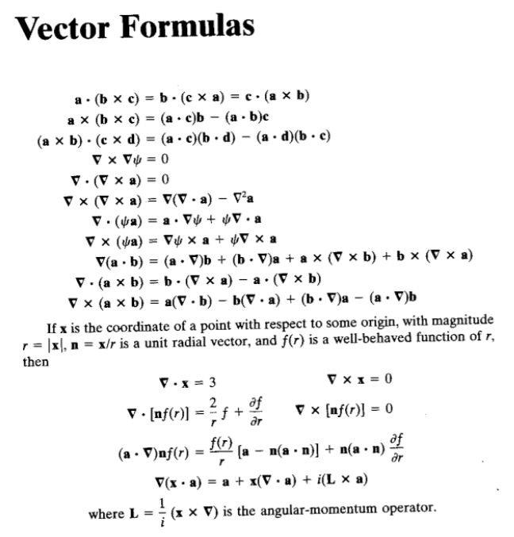
Some useful
identities –
(not complete)

Slide 6
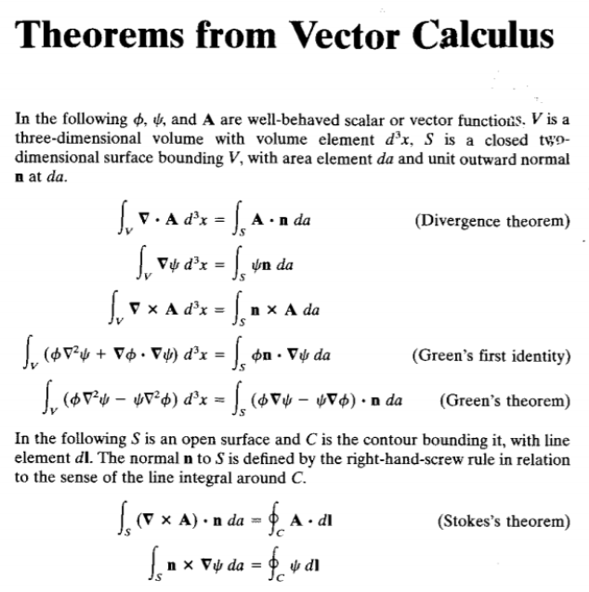

Slide 7
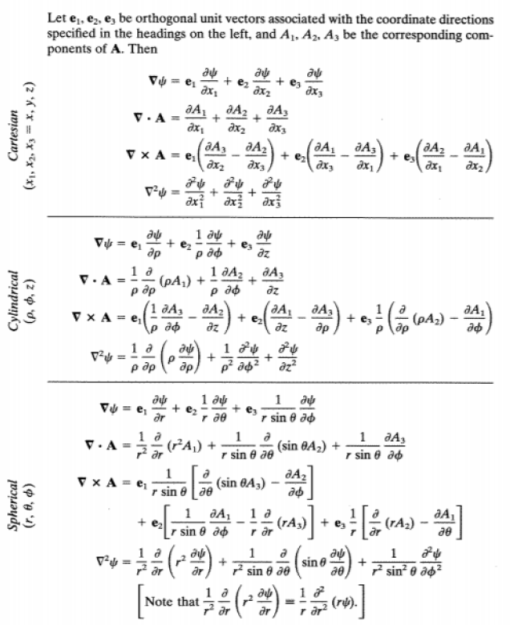

Slide 9
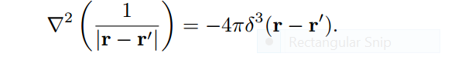
Special relationships and identities

Slide 11
Some spherical harmonic functions:

Slide 12
One of Natalie’s favorite equations
r
r’

Slide 13
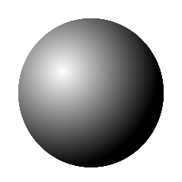

Application – crystal field splitting – combining quantum mechanics with electrostatics
Atom in a spherical environment
Atom in a crystal, surrounded by ions
+
+
+
+

Slide 14
Maxwell’s equations
Including displacement field D and magnetic field H --

Slide 15
Maxwell’s equations

Slide 16
Formulation of Maxwell’s equations in terms of vector and scalar potentials

Slide 17
Formulation of Maxwell’s equations in terms of vector and scalar potentials -- continued

Slide 18
Formulation of Maxwell’s equations in terms of vector and scalar potentials -- continued

Slide 19
Summary -- By considering a complete system involving self-contained sources and fields, we examined the energy and force relationships and introduce energy and force equivalents of the electromagnetic fields

Slide 20
Maxwell’s equations at boundaries --
Boundary value problems in dielectric materials

Slide 21
Boundaries in electrostatics
ε₁
ε₂
E₁
E₂
D₁
D₂
For isotropic dielectrics:
21

Slide 22
Reflection and refraction of plane electromagnetic waves at a plane interface between dielectrics (assumed to be lossless)
μ’ ε’
k’
θ
μ ε
k_{R}
k_{i}
i
R

Slide 23
Analysis of Maxwell’s equations without sources in each medium
E₀
B₀

Slide 24
Reflection and refraction -- continued
Snell’s law – matching phase factors at boundary plane z=0.
μ’ ε’
θ
k’
μ ε
k_{i}
k_{R}
i
R

Slide 25
Reflection and refraction -- continued
μ’ ε’
θ
k’
μ ε
k_{i}
k_{R}
i
R

Slide 26
Fresnel equations for reflectance and transmission of plane polarizes electromagnetic waves --
For s-polarization (E perpendicular to plane of incidence)
For p-polarization (E in plane of incidence)

