Slide 1
PHY 712 Electrodynamics
10-10:50 AM MWF Online
Notes for Lecture 22:
Sources of radiation
Start reading Chap. 9
Electromagnetic waves due to specific sources
Dipole radiation patterns

Slide 2
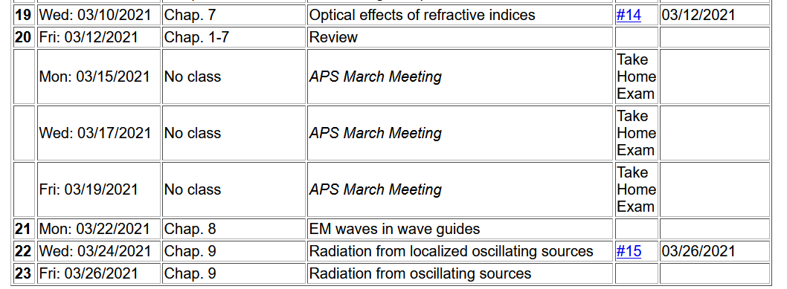

Slide 3
Maxwell’s equations
Notes:
Since Maxwell’s equations were introduced and used in Chapters 6-8, we have focused on the properties of the fields themselves. Now we will begin to study how these fields are produced by particular sources. The sources that we will consider are harmonic in time and their spatial form (considered to be localized in space) is represented by a multiplicative factor. More generally, we are considering one component in the Fourier transform for the source function. The results are quite different from the Liénard-Wiechert potentials discussed a few weeks ago. In this slide, Maxwell’s equations are presented for the case that the sources are completely represented by the charge and current densities.

Slide 4
Formulation of Maxwell’s equations in terms of vector and scalar potentials
Notes:
It is convenient to express the coupled vector fields in terms of the scalar and vector potentials as we have discussed previously.

Slide 5
Formulation of Maxwell’s equations in terms of vector and scalar potentials -- continued
Notes:
We will focus our attention on the Lorentz Gauge representations. In this case, the scalar potential and each of the three Cartesian components of the vector potential each have to solve an inhomogeneous differential equation of the same form.

Slide 6
Solution of Maxwell’s equations in the Lorentz gauge -- continued
Notes:
For a spatially localized source, the physically meaningful solution can be written as an integral over the source time t’ and space r’ as discussed previously before.

Slide 7
Electromagnetic waves from time harmonic sources
Notes:
Now we specialize to the pure harmonic time dependence. Mathematically, we will evaluate the sources with the complex function exp(-iωt), taking the real part at the end of the analysis. Note that because we need to conserve charge, the continuity equation must satisfied which consequently means that the current and charge densities are functionally related.

Slide 8
Electromagnetic waves from time harmonic sources – continued:
Notes:
Putting the form of the source term in the integral, we can first perform the integral over the source time t’, resulting in the last equation of the slide. Notice that the full solution of the differential equation also may have a solution to the inhomogeneous equation as represented by the last term.

Slide 9
Electromagnetic waves from time harmonic sources – continued:
Notes:
From the results on the previous slide, we can explicitly write out the solutions for the scalar and vector potentials in terms of the charge and current densities.

Slide 10
Electromagnetic waves from time harmonic sources – continued:
Notes:
In order to evaluate the equations on the previous slide, we can make use an exact expansion in terms of spherical harmonic functions and spherical Bessel and Hankel functions. The proof of this expansion is not trivial, but some details are available in Jackson (near Eq. 9.98) and from the NIST website https://dlmf.nist.gov/10.60. It naturally follows that the scalar potential can be expressed as a sum of spherical harmonic functions time corresponding radial forms.

Slide 11
Electromagnetic waves from time harmonic sources – continued:
Notes:
It naturally follows that the vector potential can be expressed as a sum of spherical harmonic functions time corresponding radial forms.

Slide 12
Forms of spherical Bessel and Hankel functions:
Notes:
These relationships of spherical Bessel functions are given on page 426 of Jackson.

Slide 13
Notes:
This material summarizes some of the results from Seciont 9.6 of Jackson

Slide 14
Electromagnetic waves from time harmonic sources – continued:
Notes:
What is the rational/significance of the last two equations?

Slide 15
Some details:
Notes:
Do you agree with these results?

Slide 16
Electromagnetic waves from time harmonic sources – continued -- some details:
Notes:
From this analysis, for a source confined within a sphere of radius R, the radiation field for the lm component of the field has a radial form proportional to a spherical Hankel function.

Slide 17
Electromagnetic waves from time harmonic sources – continued:
Notes:
Some further relations can be derived due to the continuity equation for the current density and the charge density.

Slide 18
Electromagnetic waves from time harmonic sources – continued:
Notes:
The previous slides gave rigorous results far from the source. In this slide we consider further approximations. The kr’<<1 case is also referenced as the long wavelength approximation.

Slide 19
Some details -- continued:
(assuming confined source)
Notes:
Dipole approximation continued.

Slide 20
Electromagnetic waves from time harmonic sources – continued:
Note: in this case we have assumed a restricted extent of the source such that kr’<<1.
Notes:
Dipole approximation continued.

Slide 21
Electromagnetic waves from time harmonic sources – continued:
Notes:
Dipole approximation continued.

Slide 22
Example of dipole radiation source
Notes:
Comparison of exact asymptotic results with dipole approximation.

Slide 23
Example of dipole radiation source -- continued
Relationship to pure dipole approximation (exact when kR➔0)
Notes:
Comparison of exact asymptotic results with dipole approximation – continued.

