Slide 1
PHY 712 Electrodynamics
10-10:50 AM MWF Online
Notes for Lecture 23:
Continue reading Chap. 9 & 10
Electromagnetic waves due to specific sources
Dipole radiation examples
Scattered radiation

Slide 3
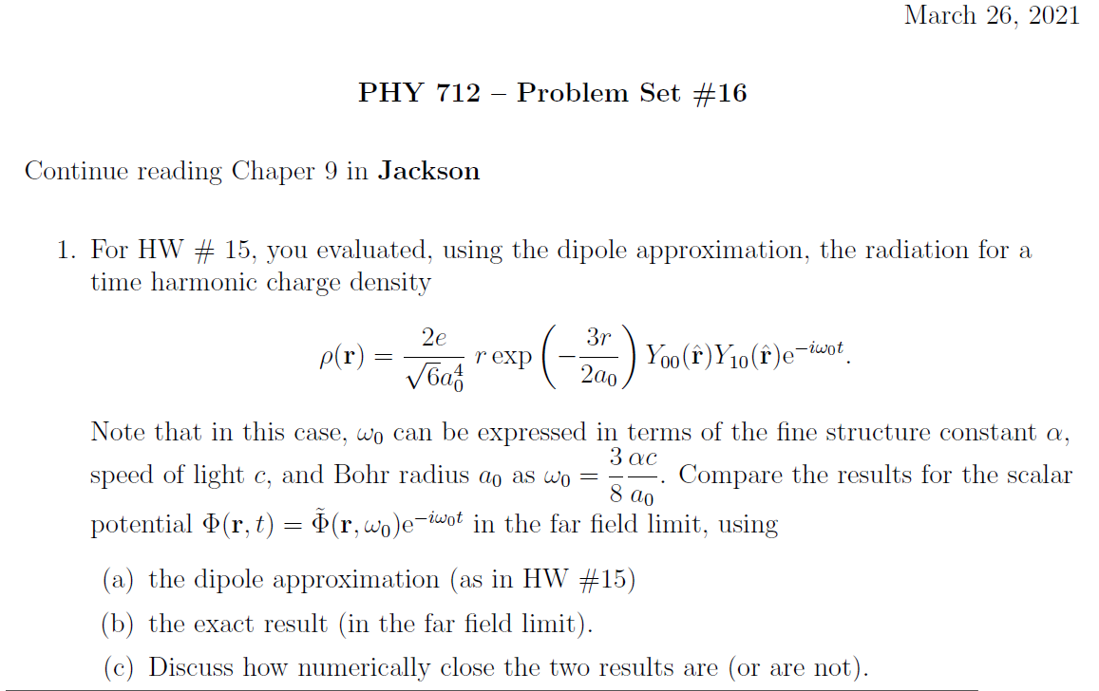

Slide 4
Your questions –
From Gao -- How to generate two situations: 1 Einc polarized perpendicular to scattering plane and 2 Einc polarized in scattering plane? What physical mechanism leads to two different results?

Slide 5
Important results from last time – EM waves from time harmonic sources – open isotropic boundaries

Slide 7
Example of dipole radiation source
Note that the continuity of charge and current must be satisfied. For the Fourier amplitudes, the relations are as bellow:
Jackson’s clever trick!

Slide 8
Example of dipole radiation source
From the analysis valid for kr>>1 and kR<<1:

Slide 9
Example of dipole radiation source -- exact results for r>>R:
Agrees with dipole approximation for kR<<1.

Slide 10
More details --
Notes:
An example of using the spherical harmonic expansion to analyze “exact” expressions for the scalar and vector potentials.

Slide 11
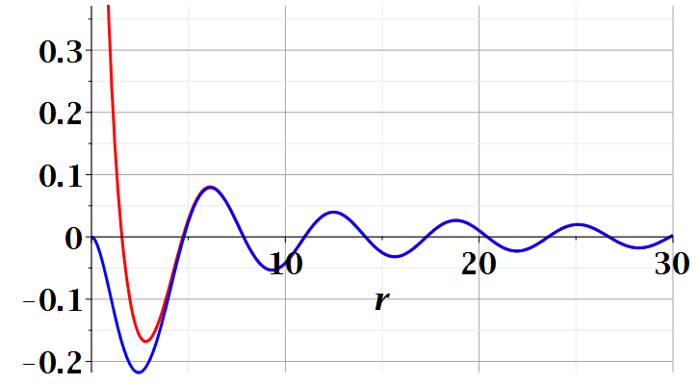
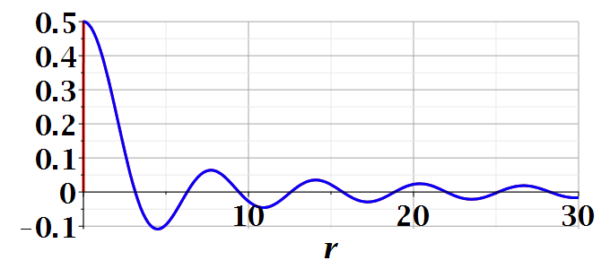
Example continued
Dipole approximation
Re(Ã(r,ω))
exact
Im(Ã(r,ω))
Notes:
Comparing the values of the vector potential calculated using the asymptotic expansion (r→infinity) with the exact evaluation. You see that the difference occurs only within the source extent.

Slide 12
Continued review of dipole results --

Slide 13
Review:
Electromagnetic waves from time harmonic sources – continued:
Notes:
In the long wavelength limit, the dipole approximation is numerically close to the physical situation.

Slide 14
Review:
Electromagnetic waves from time harmonic sources – continued:
Notes:
Continued analysis of vector and scalar potential fields following Jackson Section 9.2.

Slide 15
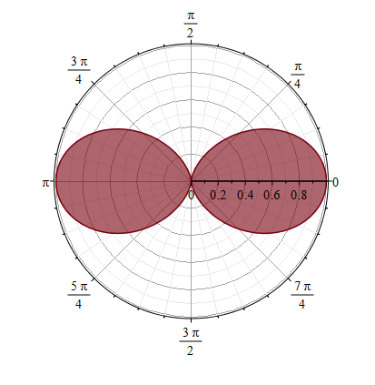
Properties of dipole radiation field for kr >>1:
z
Example:
r
θ
p
E
Note that vectors r, E, B are mutually orthogonal
y
x
B
Notes:
Geometric properties of dipolar fields.

Slide 16
Alternative approach
Notes:
Up to now, we have worked with the exact spherical harmonic expansion, evaluating the results in certain limits. Now consider analyzing the Green’s function integral directly without use of Bessel functions. You may recognize this treatment as the Born approximation encountered in quantum mechanical scattering theory.

Slide 17
For our example:
➔Results equivalent to Bessel function expansion in the limit kr → ∞.
Notes:
This approach is similar to the Bessel function expansion if more terms were used.

Slide 18
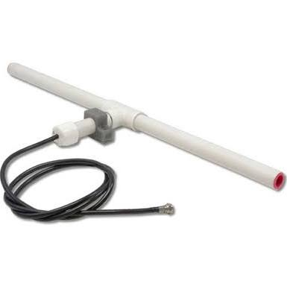
r
Other radiation sources using
``alternative approach’’
z
Linear center-fed antenna
θ
d/2
Notes:
Up to now, we have been thinking about sources on the atomic scale. The analysis also works for macroscopic sources such as antennas. This example which follows your textbook is called a center fed antenna.

Slide 19
Alternative approach – linear center-fed antenna continued
Notes:
Analyzing the vector potential in this “Born” approximation, we obtain an analytic result for the radiation distribution.

Slide 20
Alternative approach – linear center-fed antenna continued
Notes:
The radiation pattern is quite sensitive to the relationship between the antenna length d and the wavelength of the radiation.

Slide 21
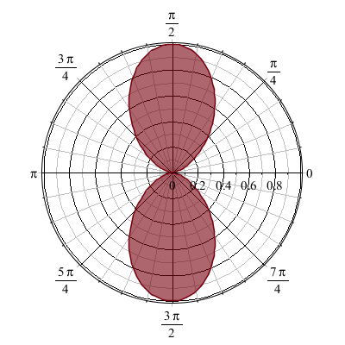
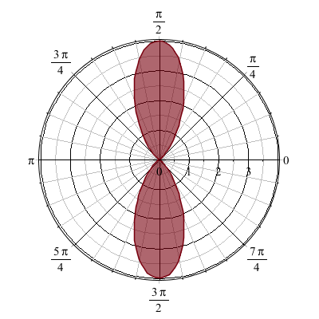
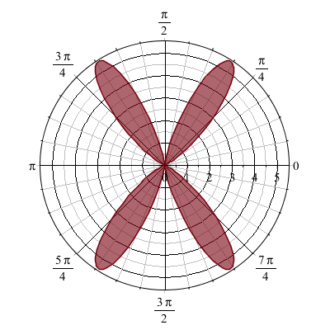
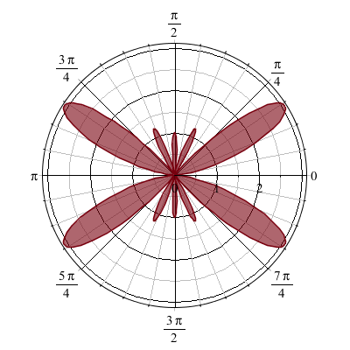
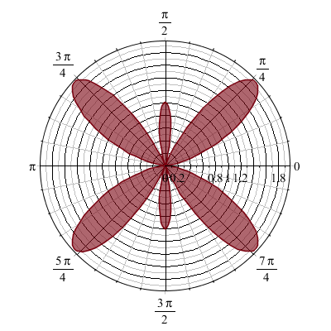
Alternative approach – linear center-fed antenna continued
kd=π 2π 3π 4π 5π
Notes:
Here are some polar plots of the radiation patterns for various cases.

Slide 22
Some details --
kd=π 2π 3π 4π 5π
Polar plot:
Angle indicates values of theta
Radius indicates value scaled to 1.
θ

Slide 23
Another source of radiation –
Radiation due particles reacting to incident electromagnetic waves – scattering processes Chapter 10 in Jackson
Notes:
Now consider another radiation source – scattered light. We will introduce the topic (covered in Chapter 10) today, but discuss it more thoroughly on Friday.

Slide 24
Dipole radiation in light scattering by small (dielectric) particles
E_{sc}
H_{sc}
E_{inc}
H_{inc}
Notes:
Imagine a plane wave of light incident on a sphere. The incident light produces oscillating dipoles within the sphere which in turn produce dipole radiation.

Slide 25
Dipole radiation in light scattering by small (dielectric) particles
E_{sc}
H_{sc}
E_{inc}
H_{inc}
Notes:
The radiation depends on the initial polarization of the scattered polarization.

Slide 26
Estimation of scattering dipole moment:
Suppose the scattering particle is a dielectric sphere with permittivity ε and radius a:
Notes:
Using results from the electrostatic polarization analysis, we can deduce the polarization amplitude.

Slide 27
Scattering by dielectric sphere with permittivity ε and radius a:
For E_{inc} polarized in scattering plane:
θ
θ
Notes:
We will continue this discussion on Friday, considering the geometrical effects.

Slide 28
Scattering by dielectric sphere with permittivity ε and radius a:
For E_{inc} polarized perpendicular to scattering plane:
θ

Slide 29
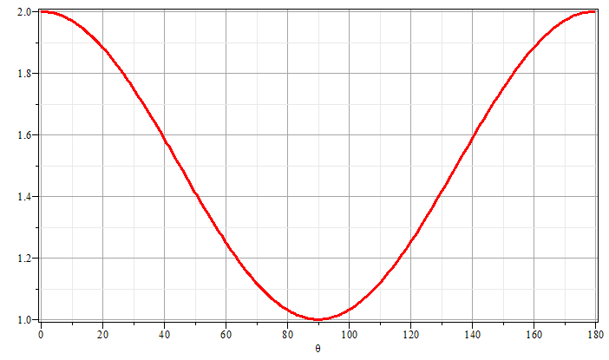
Scattering by dielectric sphere with permittivity ε and radius a:
θ
θ

