Slide 1
PHY 712 Electrodynamics
10-10:50 AM MWF Online
Notes for Lecture 24:
    Complete reading of Chap. 9 & 10
      Superposition of radiation
      Scattered radiation
Notes:
In this lecture, we will continue to focus on radiation from sources with pure harmonic time dependence with frequency omega, considering effects of superposition of multiple such sources (leading to interference) and also considering (re)radiation due to scattering of electromagnetic waves.

Slide 2
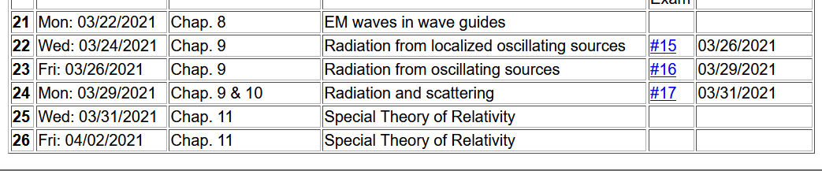
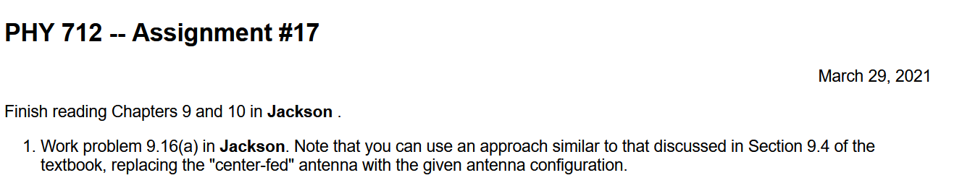
Notes:
The assigned homework deals with radiation from an antenna with a slightly different configuration than covered in the textbook and in the lecture notes.

Slide 3


Slide 4
Electromagnetic waves from time harmonic sources – review:
Notes:
Review of equations that we have been using for the time Fourier transforms of the scalar and vector potentials due to their corresponding Fourier transforms of the charge and current densities.

Slide 5
Consider antenna source (center-fed)
Note – these notes differ from previous formulation d/2 ←→ d
r
z
d
θ
φ
y
d
x
5
Notes:
Specifically, consider an antenna. For convenience, we are using a slightly different notation from the previous lecture as noted at the top of the slide.

Slide 6
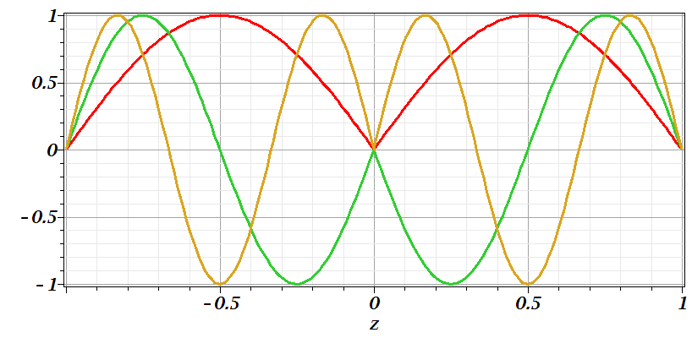
Consider antenna source -- continued
n=1
n=2
n=3
Notes:
The plot indicates how the current varies along the z axis of the antenna for the center-fed configuration.

Slide 7
Consider antenna source -- continued
Notes:
Evaluation of the vector potential far from the antenna.

Slide 8
Consider antenna source -- continued
Notes:
Some details for evaluating the power per unit solid angle.

Slide 9
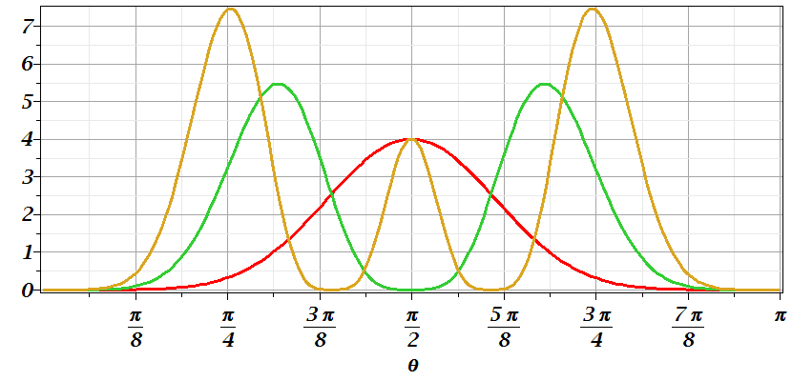
Consider antenna source -- continued
n=2
n=1
n=3
Notes:
Plot of the power distribution as a function of angle for this case.

Slide 10
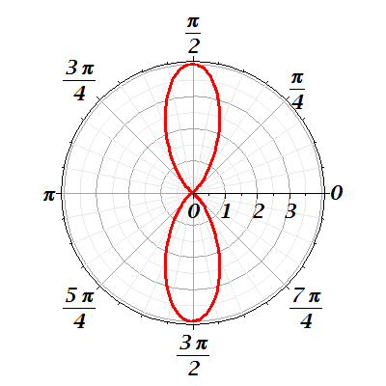
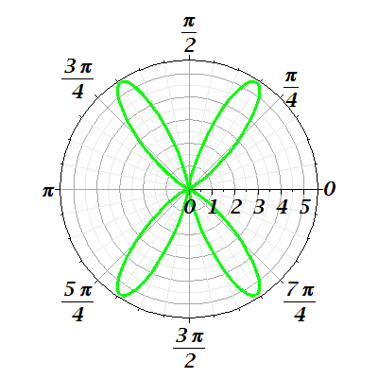
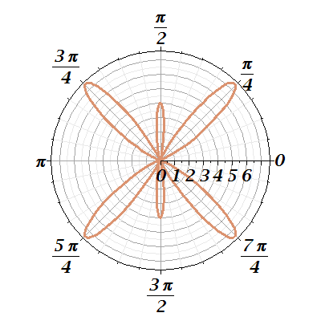
Consider antenna source -- continued
n=1
n=2
n=3
Notes:
Polar plots of the power distribution.

Slide 11
Radiation from antenna arrays
z
y
θ
φ
2d
x
a
Notes:
Now consider the case of several antennas, in this case each antenna is oriented along the z-axis and 2N+1 of them are arranged in a line along the x-axis.

Slide 12
Radiation from antenna arrays -- continued
Notes:
Analyzing the same equations as before, keeping the leading terms for the limit that kr→infinity. Here we see that the x-axis dependence involves evaluating a geometric series which can be done analytically as shown.

Slide 13
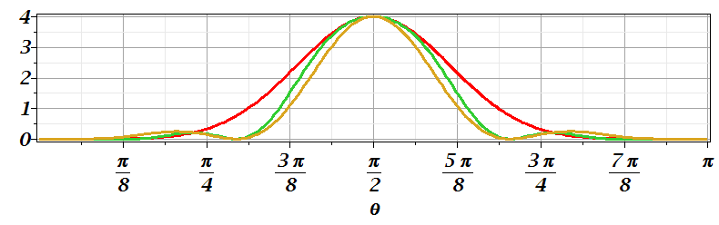
Radiation from antenna arrays -- continued
N=2;a=d/2; φ=0
N=0
N=2;a=d; φ=0
Notes:
Carrying out the integrations and simplifying the expressions, we get the results. The plots here refer to phi=0, which corresponds to the observation of the radiation along the x-axis.

Slide 14
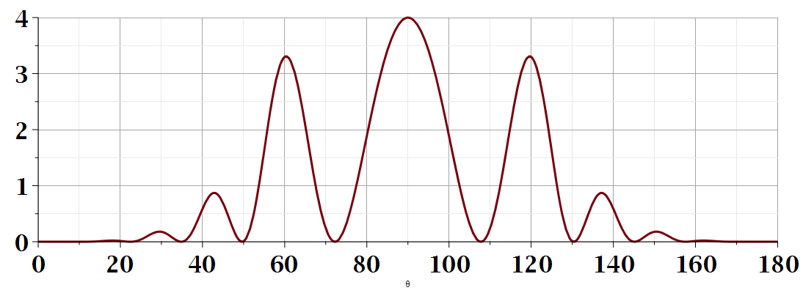
θ
Additional amplitude patterns can be obtained by controlling relative phases of antennas.
Notes:
Plot of the power for another case. Obviously, there is a lot of variety with antenna arrays which are used extensively for communications and other technologies.

Slide 15
Dipole radiation in light scattering by small (dielectric) particles
E_{sc}
H_{sc}
E_{inc}
H_{inc}
Notes:
Now consider a different radiation source – that is re-radiation from matter interacting with light (such as sunlight). Here we will simplify the analysis and assume that the matter is in the form of uniform sphere. This topic is covered in Chapter 10 of Jackson.

Slide 16
Dipole radiation in light scattering by small (dielectric) particles
E_{sc}
H_{sc}
E_{inc}
H_{inc}
Notes:
We will assume that the incident light is in the form of an ideal plane wave, and analyze the re-radiated light as a spherical wave far from the particle itself. The unit vectors epsilon_0 and epsilon reference the incident polarization of the light and the scattered polarization direction of the light, respectively. The cross section is defined as the scattered power per unit incident power.

Slide 17
Recall previous analysis for electrostatic case:
Boundary value problems in the presence of dielectrics – example:
E₀
a
E
θ
z
ε
ε₀
Notes:
Analyzing the source of re-radiation, we need to recall how a spherical dielectric of radius a interacts with a constant electric field. We can use the results we obtained in Chapter 4 when we considered the situation as an electrostatic boundary value problem. Here the z direction is the direction of the incident electric field, not the wave vector direction.

Slide 18
Boundary value problems in the presence of dielectrics – example -- continued:
Notes:
These are the results from the electrostatic case discussed previously.

Slide 19
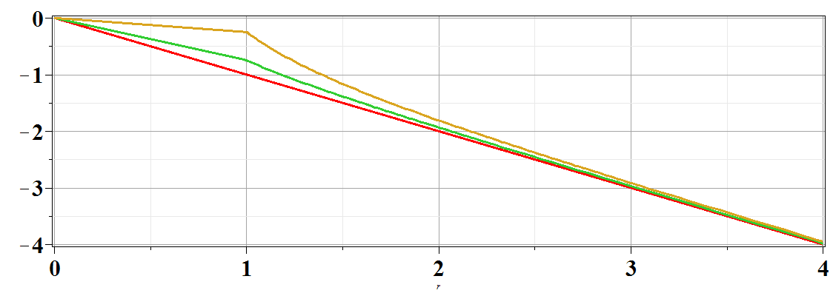
Boundary value problems in the presence of dielectrics – example -- continued:
Φ(r,θ=0)
ε/ε₀=
10
2
1
r/a
Notes:
Continued results obtained previously for the electrostatic problem.

Slide 20
Estimation of scattering dipole moment:
  Suppose the scattering particle is a dielectric sphere with permittivity ε and radius a:
Notes:
Jumping back to the scattering problem, assuming that the same mathematics can be translated to this case -- Here we have used bold epsilon to reference the polarization directions. These directions are always perpendicular to the light propagation directions. The not bold epsilons indicate the permittivity functions which are functions of the harmonic frequency of the light involved. The final result was derived by Lord Raleigh.

Slide 21
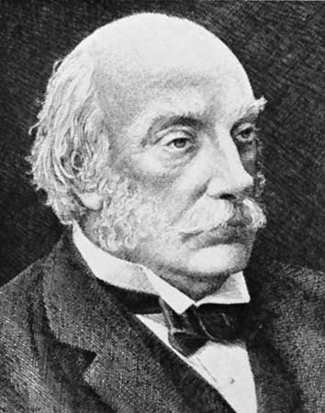
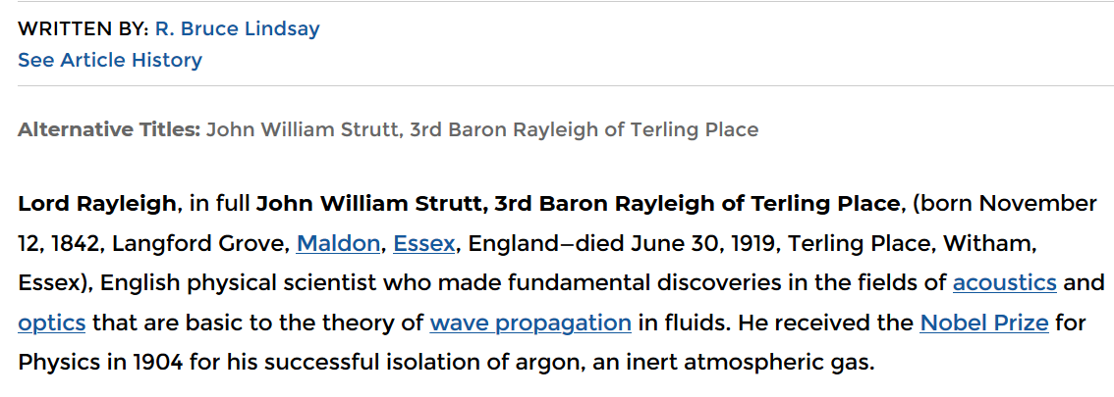
https://www.britannica.com/biography/John-William-Strutt-3rd-Baron-Rayleigh
Notes:
Some information about Lord Rayleigh on the web.

Slide 22
Scattering by dielectric sphere with permittivity ε and radius a:
For E_{inc} polarized in scattering plane:
θ
θ
Notes:
In this analysis, we consider the case where the incident wavevector (along the vertical axis) and the polarization direction (epsilon0) are in the same plane as the observed scattered light (direction of \hat{r}). In this case , the dot product of the incident and scattered polarizations give a factor of cos(theta) as show.

Slide 23
Scattering by dielectric sphere with permittivity ε and radius a:
For E_{inc} polarized perpendicular to scattering plane:
θ
Notes:
In this case, the incident wavevector (along the vertical axis) and the observed scattered light (direction of \hat{r}) are as before and again define the scattering plane. However, the polarization direction of incident light (epsilon0) and the polarization direction of the scattered light (epsilon) are both perpendicular to the scattering plane and thus are parallel to each other, given 1 for their dot product. The last result indicates the cross section of the total scattered light assuming both polarizations are equally likely.

Slide 24
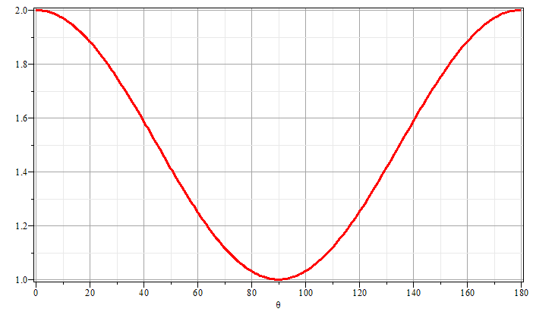
Scattering by dielectric sphere with permittivity ε and radius a:
θ
θ
Notes:
The plot shows the angular dependence of the scattered light as a function of the angle theta.

Slide 25
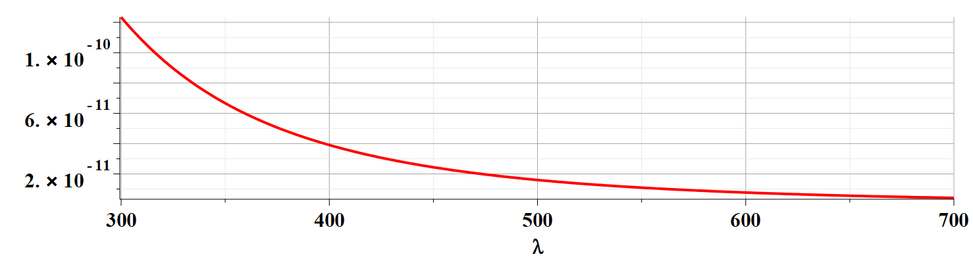
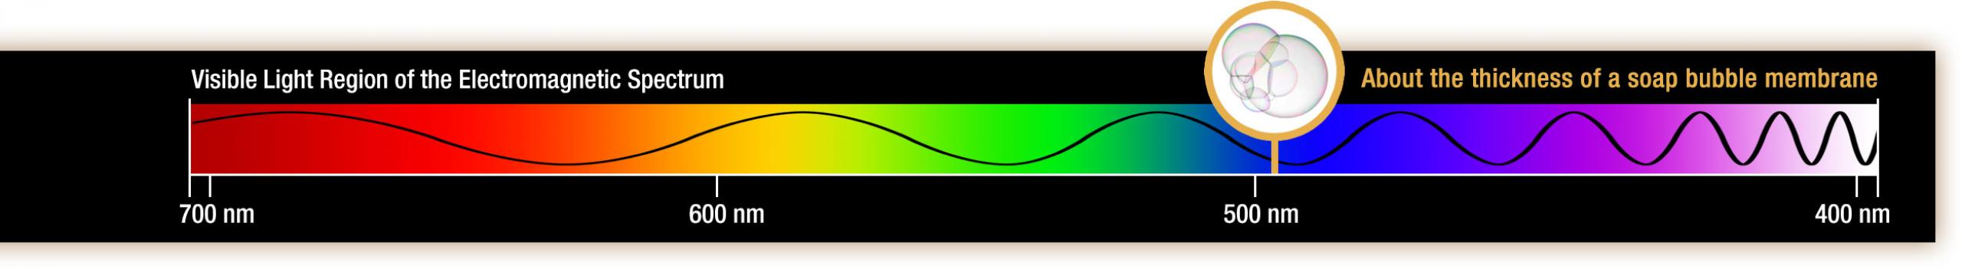
Notes:
In addition to the angular dependence of the scattered light, Raleigh scattering depends of the wavevector as k⁴ which has the corresponding wavelength dependence indicated on this slide. The figure from the web shows the variation of wavelength for visible light. The analysis of Raleigh scattering thus tells us why the sky at mid day is blue and why it tends to be red at sun rise and sunset.

Slide 26
Brief introduction to multipole expansion of electromagnetic fields (Chap. 9.7)
Notes:
In the next few slides, we go over material presented in Section 9.7 of your textbook. I have personally never used this formalism, but recognize it as a powerful tool for analyzing fields from localized sources in terms of the fields themselves rather than using scalar and vector and scalar potentials. Please review this material as time permits.

Slide 27
Multipole expansion of electromagnetic fields -- continued

Slide 28
Multipole expansion of electromagnetic fields -- continued
spherical Bessel function
spherical Bessel function

Slide 29
Multipole expansion of electromagnetic fields -- continued

Slide 30
Multipole expansion of electromagnetic fields -- continued

Slide 31
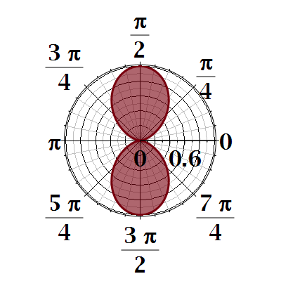
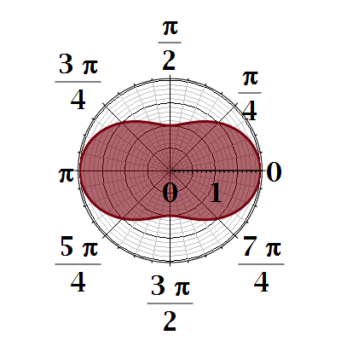

Slide 32
