Slide 1
PHY 712 Electrodynamics
10-10:50 AM MWF Online
Discussion for Lecture 28:
    Start reading Chap. 14 –
    Radiation by moving charges
          Motion in a line
          Motion in a circle
          Spectral analysis of radiation
Notes:
In this lecture, we will continue discussing the material presented in Chap. 14 of Jackson’s textbook on the subject of radiation from moving charged particles.

Slide 2
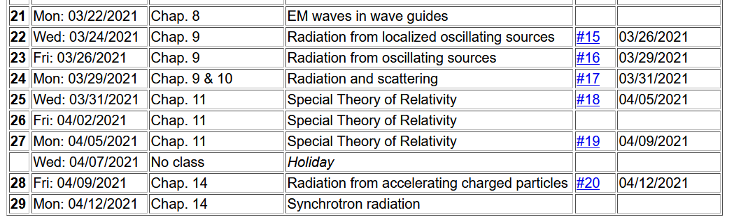
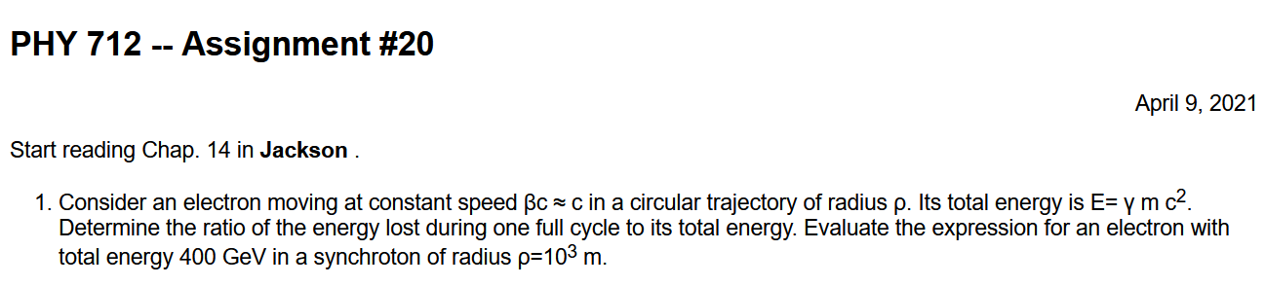
Notes:
The homework problem for this time asks you to estimate the power radiated by a particle moving in a circular trajectory.

Slide 3
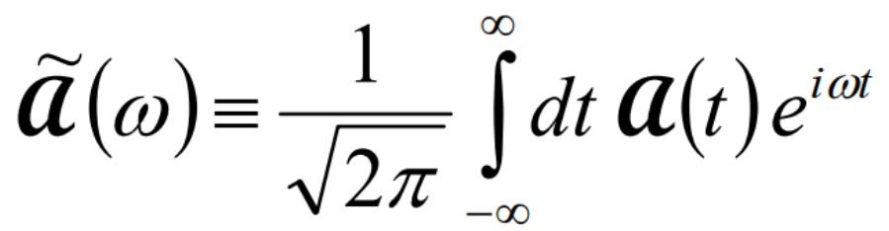
Your questions –
From Gao -- Do different frequencies stand for different wavelengths? How can it produce lots of wavelengths in a single process?

Slide 4
Radiation from a moving
charged particle
z
r-R_{q}(t)
q
r
R_{q}(t)
y
x
Notes:
Here is the general diagram we have been using to denote the field point r and the trajectory R_q(t).

Slide 5
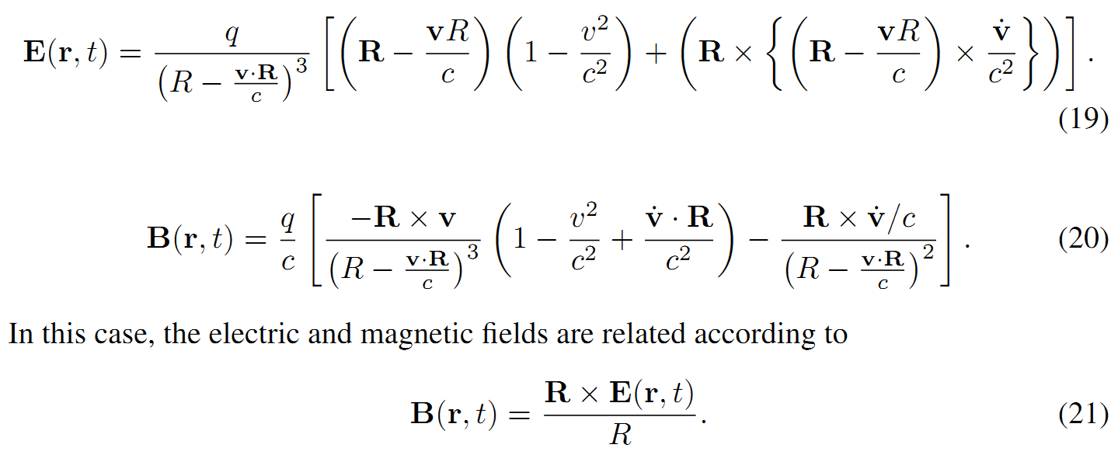
Liénard-Wiechert fields (cgs Gaussian units):
Notes:
Review of the E and B fields produced by the moving charged particle.

Slide 6
Comment --
Note that (21) can be demonstrated by evaluating R x E(r,t)
Other helpful identities: ax(bxc)=b(a⋅c)-c(a⋅b)
a⋅(bxc) = b⋅(cxa) = c⋅(axb)

Slide 7
Electric field far from source:
Note that all of the variables on the right hand side of the equations depend on t_{r} .
Notes:
Specializing the equations to fields in the radiation zone.

Slide 8
Poynting vector:
Notes:
Evaluating the Poynting vector for the radiation zone.

Slide 9
Power radiated
Notes:
The general expression for the power per unit solid angle. The last expression represents the result in the non-relativistic limit.

Slide 10
Radiation from a moving charged particle
z
.
v
r-R_{q}(t_{r})=R
q
Θ
r
R_{q}(t)
When v<<c:
y
x
Notes:
Diagram showing geometry of previous equations.

Slide 11
Radiation power in non-relativistic case -- continued
Notes:
Integrating the expression for the power over solid angle gives the total power. On this slide, the non-relativistic expressions are given..

Slide 12
Radiation distribution in the relativistic case
This expression gives us the energy per unit field time t. We are often interested in the power per unit retarded time t_{r}=t-R/c:
Notes:
What happens to the complete expression, particularly when the relativistic effects are numerically significant? For this, we follow Jackson’s approach and measure the power with respect to the retarded time. Please make sure that you check the derivation of the equations on this slide.

Slide 13
Some details –

Slide 14
More comments
➔

Slide 15
Why do you think it useful to measure the power as energy per unit retarded time P_{r}?
  Jackson likes to torture us.
  There should be no difference.
  ???
Notes:
What do you think?

Slide 16
Radiation distribution in the relativistic case -- continued
For linear acceleration:
Notes:
First we will consider the case of linear acceleration. Since the velocity of the particle and its acceleration are in the same direction, the cross product is 0. The retarded time power distribution can be shown to have the form given in the last equation of the slide.

Slide 17
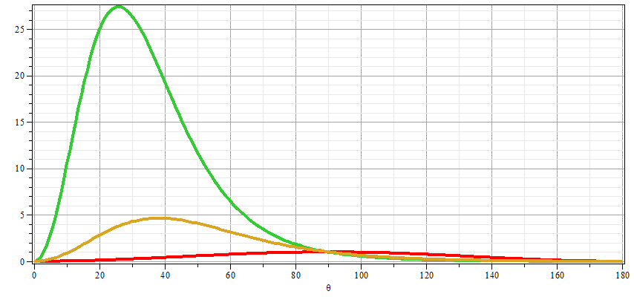
Power from linearly accelerating particle
β=0.7
β=0.5
β=0
Notes:
This plot illustrates the sensitivity of the retarded time power distribution to the value of beta.

Slide 18
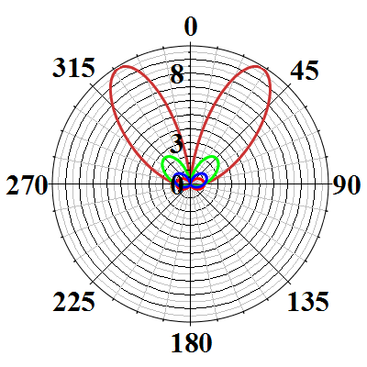
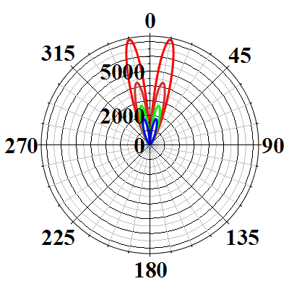
Polar plots:
β=0.93
β=0.6
β=0.90
β=0
Note – two separate plots are introduced in order to see the drastic change of scale at values of β close to 1.
Notes:
Polar plot of the previous results.

Slide 19
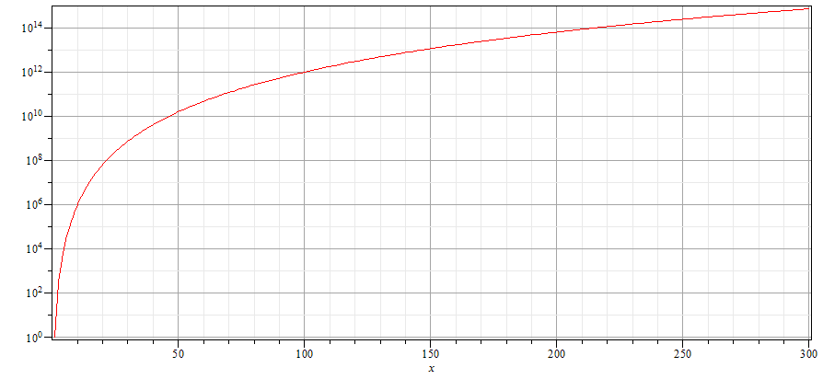
Power from linearly accelerating particle
Notes:
Integrating over solid angle, we obtain the total retarded time power radiated, finding it to vary as gamma⁶. The logarithmic plot shows the gamma dependence.

Slide 20
Power distribution for linear acceleration -- continued
z
r
.
β
θ
y
β
x
Notes:
Summary of results for the linear acceleration case.

Slide 21
Power distribution for circular acceleration
z
r
.
θ
β
y
β
x
Notes:
Now consider the case where the acceleration is perpendicular to the instantaneous velocity as in the case of circular motion. In this case, the retarded time power depends on gamma⁴. Check whether you agree with this result (or not). Note that in this diagram the polar angle is not the conventional one.

Slide 22
Summary of results --For linear acceleration --
z
r
.
β
θ
y
β
x

Slide 23
Power distribution for circular acceleration
z
r
.
θ
β
y
β
φ
x

Slide 24
Angular integrals for the two cases –
Linear acceleration
Circular acceleration

Slide 25
Power distribution for circular acceleration
z
r
.
θ
β
y
β
φ
x
Notes:
Some more details. This concludes the discussion of the geometry of the radiation. In the next several slides, we will start to discuss another aspect of the radiation, namely its spectral distribution.

Slide 26
Spectral composition of electromagnetic radiation
Previously we determined the power distribution from
a charged particle:
Notes:
Now we will return to the power measured with respect to the field time (as opposed to the retarded time). In this way will be able to use the beautiful mathematics of Fourier transforms to analyze the spectral properties of the radiation. Here we imagine that the radiation is measured at a given location for a long period of time so that we will want to evaluate the time integrated power W.

Slide 27
Spectral composition of electromagnetic radiation -- continued
Parseval’s theorem
Marc-Antoine Parseval des Chênes 1755-1836
http://www-history.mcs.st-andrews.ac.uk/Biographies/Parseval.html
Notes:
Here we make use of the Parseval’s theorem which allows us to relate the time integral of the power to the frequency integral of its Fourier transform.

Slide 28
Spectral composition of electromagnetic radiation -- continued
Notes:
Mathematically, the theorem involves integrals over all frequencies, while physically negative frequencies are not measured. By using the fact that the power amplitude must be real (mathematically), we can then derive a formula for the intensity I as a function of frequency and solid angle.

Slide 29
It is purely a mathematical construct
It can be measured

Slide 30
Spectral composition of electromagnetic radiation -- continued
Notes:
Here we analyze the power amplitude in order to take its Fourier transform. Apparently, if we can evaluate this integral, we can determine the intensity spectrum.

Slide 31
Spectral composition of electromagnetic radiation -- continued
Notes:
The integral must be performed over the field time, but the argument of the integral is expressed in terms of the retarded time. Fortunately, we can use the relationship between the two in order to perform the actual integral in terms of the retarded time.

Slide 32
Spectral composition of electromagnetic radiation -- continued
Notes:
Here we make use of some approximations valid far from the source.

Slide 33
Spectral composition of electromagnetic radiation -- continued
Notes:
Summarizing the approximations.

Slide 34
Example – radiation from a collinear acceleration burst
Notes:
Here we consider an example of motion due to an abrupt collision. This example is actually discussed at the beginning of Chapter 15 of Jackson.

Slide 35
Example:
r
θ
Δv
Example: “Bremsstrahlung” radiation
Notes:
This radiation is for example caused by a fast moving charged particle coming to an abrupt stop such as when it smashes into matter. The value of tau depends on the matter and the particle.

Slide 36
Spectral composition of electromagnetic radiation -- continued
Notes:
Next time we will evaluate this expression for synchrotron radiation.

