Slide 1
PHY 712 Electrodynamics
10-10:50 AM MWF Online
Plan for Lecture 29:
Continue reading Chap. 14 –
Radiation by moving charges
Angular dependence of radiation from an accelerating particle
Spectral analysis of radiation
Detailed analysis of synchrotron radiation
Notes:
In this lecture, we will continue discussing the material presented in Chap. 14 of Jackson’s textbook on the subject of radiation from moving charged particles.

Slide 2
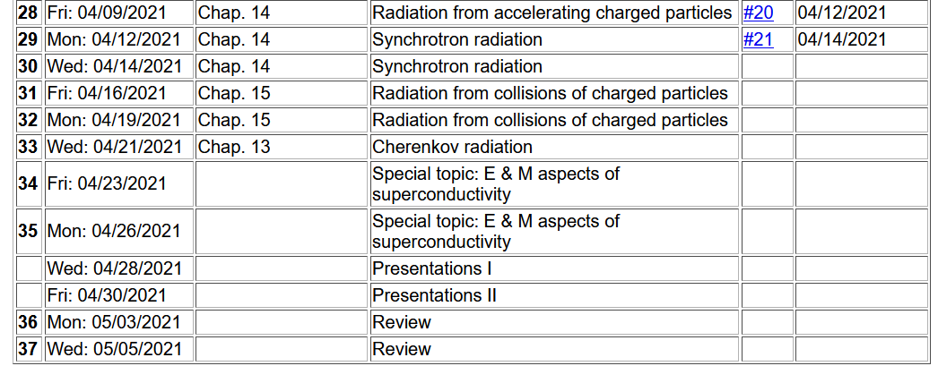

Slide 3
Radiation from a moving
charged particle
z
r-R_{q}(t)
q
r
R_{q}(t)
y
x
Notes:
Here is the general diagram we have been using to denote the field point r and the trajectory R_q(t).

Slide 4
Electric field far from source:
Note that all of the variables on the right hand side of the equations depend on t_{r} .
Notes:
Specializing the equations to fields in the radiation zone.

Slide 5
Poynting vector:
Notes:
Evaluating the Poynting vector for the radiation zone.

Slide 6
Power radiated
Notes:
The general expression for the power per unit solid angle.

Slide 7
Spectral composition of electromagnetic radiation
Previously we determined the power distribution from
a charged particle:
Notes:
Now we will return to the power measured with respect to the field time (as opposed to the retarded time). In this way will be able to use the beautiful mathematics of Fourier transforms to analyze the spectral properties of the radiation. Here we imagine that the radiation is measured at a given location for a long period of time so that we will want to evaluate the time integrated power W.

Slide 8
Spectral composition of electromagnetic radiation -- continued
Parseval’s theorem
Marc-Antoine Parseval des Chênes 1755-1836
http://www-history.mcs.st-andrews.ac.uk/Biographies/Parseval.html
Notes:
Here we make use of the Parseval’s theorem which allows us to relate the time integral of the power to the frequency integral of its Fourier transform.

Slide 9
Spectral composition of electromagnetic radiation -- continued
Notes:
Mathematically, the theorem involves integrals over all frequencies, while physically negative frequencies are not measured. By using the fact that the power amplitude must be real (mathematically), we can then derive a formula for the intensity I as a function of frequency and solid angle.

Slide 10
Spectral composition of electromagnetic radiation -- continued
Notes:
Here we analyze the power amplitude in order to take its Fourier transform. Apparently, if we can evaluate this integral, we can determine the intensity spectrum.

Slide 11
Spectral composition of electromagnetic radiation -- continued
Notes:
The integral must be performed over the field time, but the argument of the integral is expressed in terms of the retarded time. Fortunately, we can use the relationship between the two in order to perform the actual integral in terms of the retarded time.

Slide 12
Spectral composition of electromagnetic radiation -- continued
Notes:
Here we make use of some approximations valid far from the source.

Slide 13
Spectral composition of electromagnetic radiation -- continued
Notes:
Summarizing the approximations.

Slide 14
Spectral composition of electromagnetic radiation -- continued
Notes:
We will evaluate this expression for synchrotron radiation.

Slide 15
Spectral composition of electromagnetic radiation -- continued
Notes:
Some details of the approximate equations.

Slide 16
Spectral composition of electromagnetic radiation -- continued
Notes:
From the tope identity, the intensity expression can be further simplified.

Slide 17
Some details --
0

Slide 18
Spectral composition of electromagnetic radiation -- continued
Notes:
Summary of equations that need to be avaluated.

Slide 19
Synchrotron radiation light source installations
Synchrotron at Brookhaven National Lab, NY
E_{c}= 3 GeV X-ray radiation
https://www.bnl.gov/ps/
Notes:
Before we start to evaluate the expressions, we will first consider some the large synchrotron radiation installations currently available today. (Actually some of these facilities have shutdown due to the pandemic unless they are being used for studying certain viruses. This is an arial photo of the facility on Long Island, NY.

Slide 20
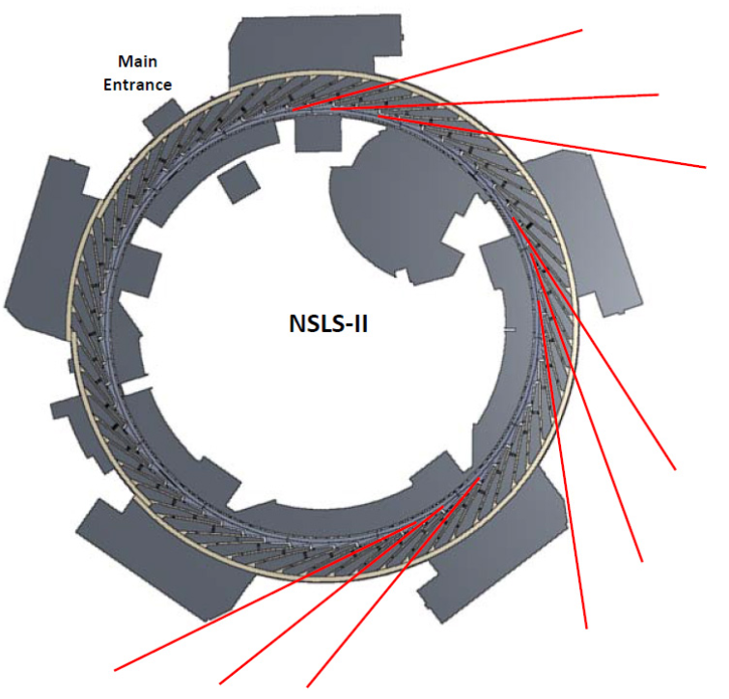
Spectrometer and sample
Notes:
Diagram showing the positioning of the experimental ports in red where the radiation from the circulating electrons is used.

Slide 21
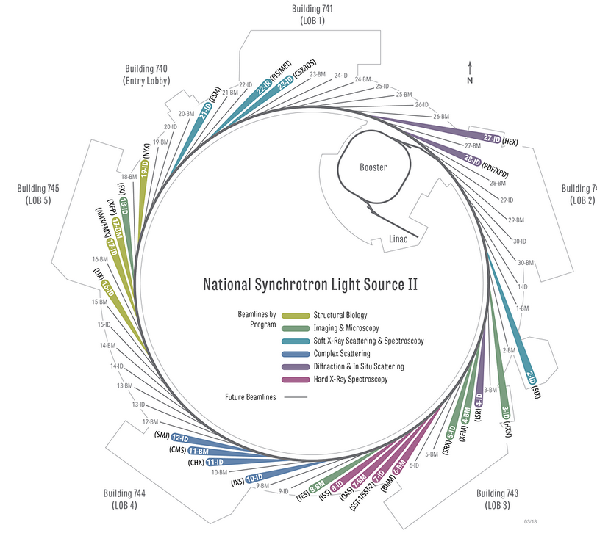
Overview of developed beamlines.
Notes:
More detail with indications of particular experiments.

Slide 22
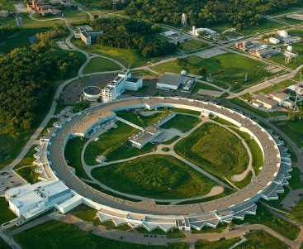
Advanced photon source, Argonne National Laboratory
https://www.aps.anl.gov/
Notes:
Arial photo of the facility of Argonne National Laboratory

Slide 23
z
r
.
θ
β
y
β
Top view:
x
ρ
y
x
Notes:
Setup of the coordinate system to analyze the particle trajectory. Here rho denotes the circular radius and v denotes the particle speed (assumed to be constant).

Slide 24
z
r
.
θ
β
y
β
x
Notes:
For this analysis we will assume that the radiation is detected in the x-z plane. The angle theta is defined with respect to the x axis. Two polarization vectors denoted with epsilonparallel and epsilonperpendicular (both perpendicular to r) are defined.

Slide 25
z
r
.
θ
β
y
β
x
Notes:
Here the two amplitudes C for parallel and perpendicular polarizations are defined in terms of the trajectory parameters.

Slide 26
Notes:
Following Jackson’s derivations, we arrive at the expression given on the slide that is equivalent to Jackson’s Eq. 14.79. The two terms represent the two different polarization contributions. Both terms are expressed in terms of Bessel function of the third kind of order 1/3 or 2/3.

Slide 27
Some details:
Modified Bessel functions
Exponential factor
Notes:
Here are some of the details. It is assumed that the integrands are dominated by contributions for tr near 0, theta near 0 and speeds v close to the speed of light.

Slide 28
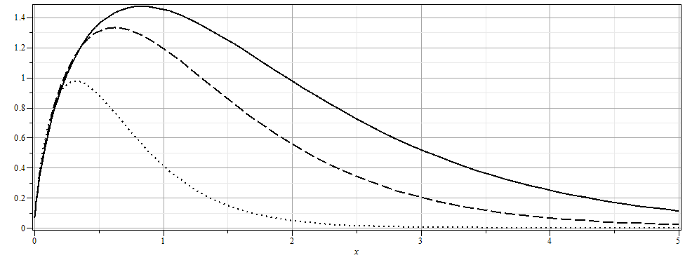
Notes:
From the expression, we can plot the intensity as a function of the scaled frequency scaled by the critical frequency defined on the previous slide for various angles theta.

Slide 29
More details
Notes:
More plots. The fact that the frequency scales with the critical frequency means that by designing facilities with different radii and gamma factors, the spectral range can be controlled.

Slide 30
The above analysis applies to a class of man-made facilities dedicated to producing intense radiation in the continuous spectrum. For more specific information on man-made synchrotron sources, the following web page is useful: http://www.als.lbl.gov/als/synchrotron_sources.html.

