Slide 1
PHY 712 Electrodynamics
12-12:50 AM MWF Olin 103
Class notes for Lecture 2:
    Reading: Chapter 1 (especially 1.11) in JDJ;
    Ewald summation methods
      Motivation
      Expression to evaluate the electrostatic energy of an extended periodic system
      Examples
Notes:
This lecture details some special properties of the electrostatic energy of an extended system. It illustrates some special properties of the long range nature of the Coulomb interaction. Ewald summation methods may or may not be important for your particular field of study. However, it is at least important to be aware of the ideas.

Slide 2
Comment on HW #1

Slide 3
Your questions –
From Nick –
1) When you say the results should not depend on /eta., is it that /eta doesn't matter or that there's something intrinsic about the energy that shouldn't matter what eta is? Will you walk through the calculations to show why they are slightly different?
2) On the last slide, is this 2 triple integrals? Why do we have d^3r and d^3r' ?
From Gao –
How can the expression of electrostatic energy show its justification in the continuous case as it can not exclude the "self-interaction"?
From Tim –
In the extra notes section on page six you say "there are two kinds of sites...." What do you mean by sites?

Slide 4
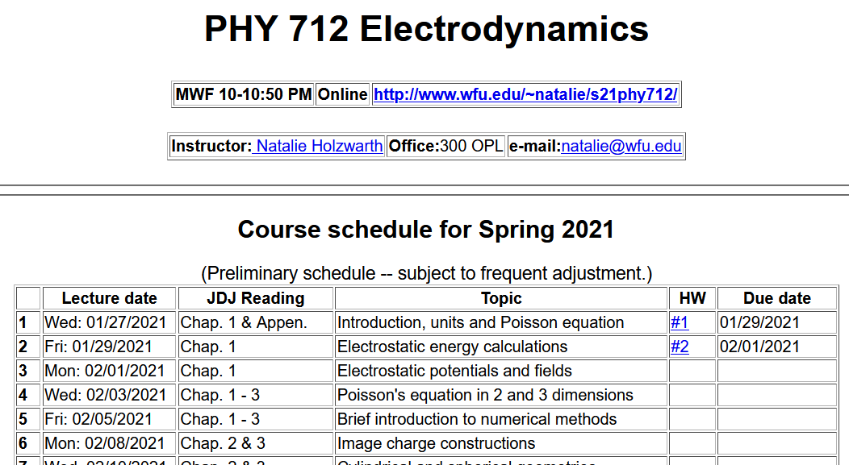
Notes:
The homework problem assigned this time exercises the ideas presented in this lecture.

Slide 5
Ewald summation methods -- motivation

Slide 6
Example finite charge system for which electrostatic energy W can be calculated in a straightforward way
2
3
Charge -e
1
5
4
Charge +e
6
(particles moves off to infinity)
Notes:
Summation for a finite number of particles is straightforward, but extension to an infinite system runs into difficulty.

Slide 7
Evaluation of the electrostatic energy for N point charges:
Ewald summation methods – exact results for periodic systems
See lecture notes for details.
Notes:
In the Extra lecture notes this expression will be derived and illustrated.

Slide 8
Your question – How is it that the Ewald summation does
not depend upon η?
Comment – This is because of the genius of Ewald (assuming that the summation terms are well converged).

Slide 9
Slight digression:
Comment on electrostatic energy evaluation --
When the discrete charge distribution becomes a continuous charge density: the electrostatic energy
becomes
Notice, in this case, it is not possible to exclude the ``self-interaction''.
Previous expression can be rewritten in terms of the electrostatic potential or field:
Notes:
We will see and used these expressions. However, the so-called self energy often leads to difficulties….

Slide 10
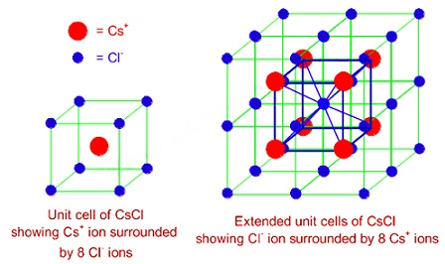
Your question – What happens to the electrostatic case for continuous charge densities with respect to the self energy contribution.
Comment – It sometimes causes trouble.
Now consider the electrostatic energy of a periodic crystal of CsCl

