Slide 1
PHY 712 Electrodynamics
10-10:50 AM MWF Online
Plan for Lecture 3:
Reading: Chapter 1 in JDJ
Review of electrostatics with one-dimensional examples
Poisson and Laplace Equations
Green’s Theorem and its use in electrostatics
Notes:
In this lecture, we will return to the materials presented in our textbook. Some of the ideas were presented in PHY 711.

Slide 2
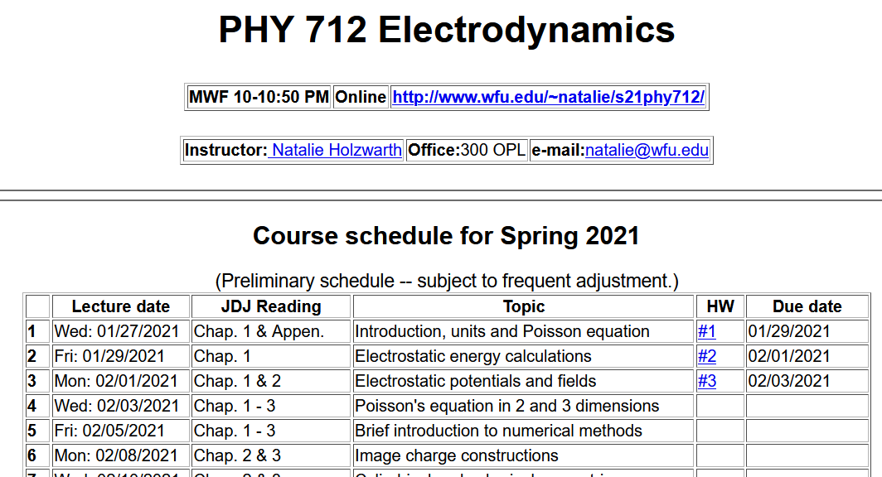
Notes:
Updated schedule. Note new homework assignment which follows from today’s lecture.

Slide 3
Notes:
Content of lHW 3.

Slide 4
Poisson and Laplace Equations
We are concerned with finding solutions to the Poisson equation:
and the Laplace equation:
The Laplace equation is the “homogeneous” version of the Poisson equation. The Green's theorem allows us to determine the electrostatic potential from volume and surface integrals:
Notes:
Here we start our systematic derivations of solution of the electrostatic equation for a potential with a given charge source and the associated homogeneous equation.

Slide 5
Poisson equation -- continued
Notes:
What we discussed last week is still true for isolated charges. Now we consider the case where the charges are within a volume V whose surface may have some imposed restrictions (boundary condisions).

Slide 6
General comments on Green’s theorem
This general form can be used in 1, 2, or 3 dimensions. In general, the Green's function must be constructed to satisfy the appropriate (Dirichlet or Neumann) boundary conditions. Alternatively or in addition, boundary conditions can be adjusted using the fact that for any solution to the Poisson equation, other solutions may be generated by use of solutions of the Laplace equation
Notes:
Comment about how the boundary conditions may or may not work.

Slide 7
“Derivation” of Green’s Theorem
Notes:
Here we derive the equations stated on the previous slides.

Slide 8
“Derivation” of Green’s Theorem
Notes:
Derivation continued.

Slide 9
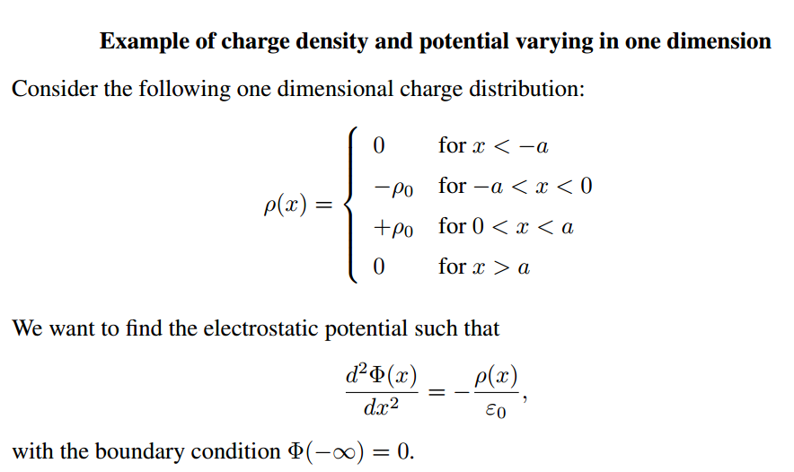
Notes:
Simple one-dimensional example of a particular charge distribution.

Slide 10
Notes:
Resultant potential and electric field.

Slide 11
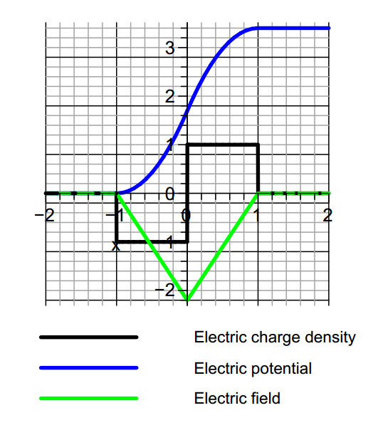
Notes:
Graph of results for this example

Slide 12
Comment about the example and solution
This particular example is one that is used to model semiconductor junctions where the charge density is controlled by introducing charged impurities near
the junction.
The solution of the Poisson equation for this case can be determined by piecewise solution within each of the four regions. Alternatively, from Green's theorem in one-dimension, one can use the Green's function
Notes:
Comment and generalization.

Slide 13
Notes on the one-dimensional Green’s function
Notes:
Some details.

Slide 14
Construction of a Green’s function in one dimension
Notes:
Details continued for one dimensional Poisson equation.

Slide 15
Summary
Notes:
Summary for one dimensional Poisson equation.

Slide 16
One dimensional Green’s function in practice
This expression gives the same result as previously obtained for the example ρ(x) and more generally is appropriate for any neutral charge distribution.
Notes:
Some general comments.

Slide 17
Notes:
Now we will discuss another approach to analyzing Green’s functions based on expansion in terms of a complete set of orthogonal functions.

Slide 18
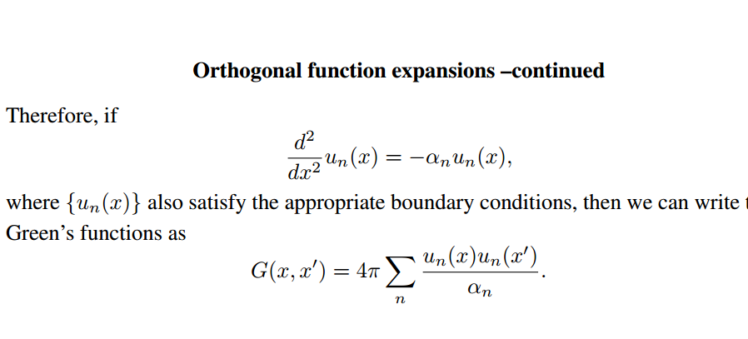
Notes:
Some details for orthogonal function expansion method.

Slide 19
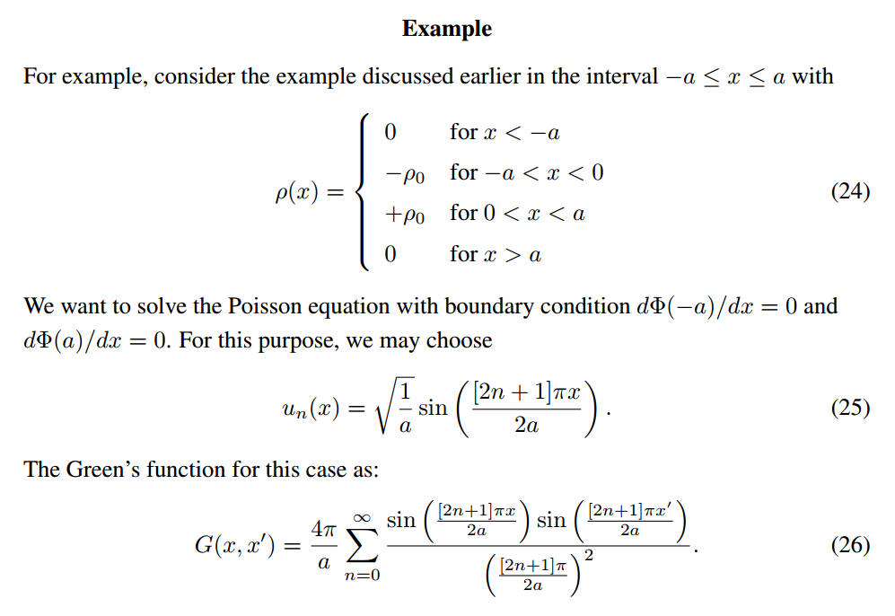
Notes:
Application to our example.

Slide 20
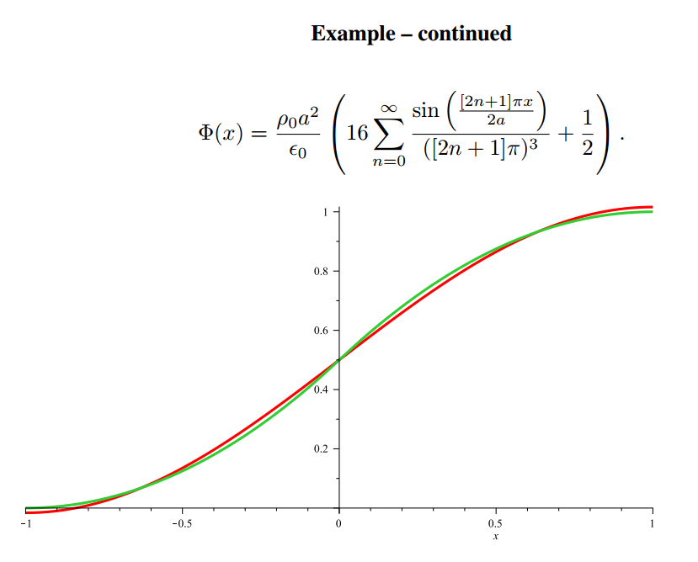
Notes:
Graph of potential (green) and expansion for a few terms. Note that it was necessary to shift the potential by a constant.

