Slide 1
PHY 712 Electrodynamics
10-10:50 AM MWF Online
Discussion for Lecture 30:
Continue reading Chap. 14 –
Radiation by moving charges
Recap of results for synchrotron radiation from land based sources
Synchrotron radiation from astronomical sources
Compton scattering
Notes:
In this lecture, we will continue discussing the material presented in Chap. 14 of Jackson’s textbook on the subject of radiation from moving charged particles.

Slide 2
4 PM

Slide 3
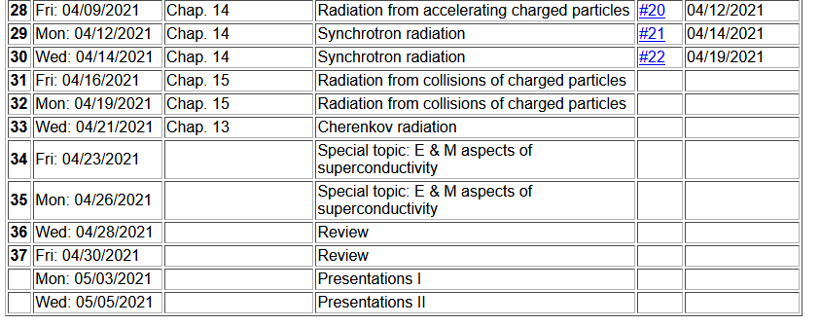

Slide 4
Your questions –
From Gao: In my sense, energy level transition radiation is easy to understand for me. From EM, we know that a moving charge also radiates. But I am not sure what mechanism leads to this radiation? Even though we have known how to calculate its intensity already. Could you give some hints?
Comment: While it may not be intuitive, the analysis says that radiation occurs whenever a charged particle accelerates. For quantum systems, other factors occur.

Slide 5
Comment about units
e measured in Statcoulombs
Length measured in cm
Energy measured in ergs
e measured in Coulombs
Length measured in m
Energy measured in joules
Main results from synchrotron radiation spectra from man made sources --

Slide 6
z
r
.
θ
β
y
β
Top view:
x
ρ
y
x
Notes:
Setup of the coordinate system to analyze the particle trajectory. Here rho denotes the circular radius and v denotes the particle speed (assumed to be constant).

Slide 7
z
r
.
θ
β
y
β
x
Notes:
For this analysis we will assume that the radiation is detected in the x-z plane. The angle theta is defined with respect to the x axis. Two polarization vectors denoted with epsilonparallel and epsilonperpendicular (both perpendicular to r) are defined.

Slide 8
z
r
.
θ
β
y
β
x
Notes:
Here the two amplitudes C for parallel and perpendicular polarizations are defined in terms of the trajectory parameters.

Slide 9
Notes:
Following Jackson’s derivations, we arrive at the expression given on the slide that is equivalent to Jackson’s Eq. 14.79. The two terms represent the two different polarization contributions. Both terms are expressed in terms of Bessel function of the third kind of order 1/3 or 2/3.

Slide 10
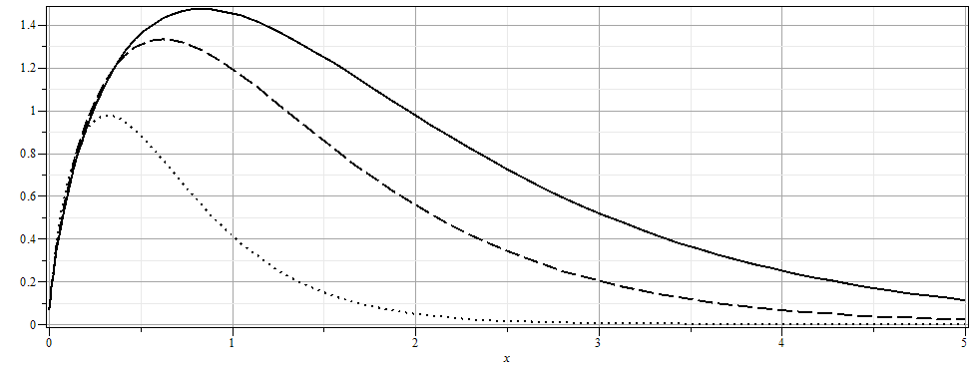
Notes:
From the expression, we can plot the intensity as a function of the scaled frequency scaled by the critical frequency defined on the previous slide for various angles theta.

Slide 11
More details
Notes:
More plots. The fact that the frequency scales with the critical frequency means that by designing facilities with different radii and gamma factors, the spectral range can be controlled.

Slide 12
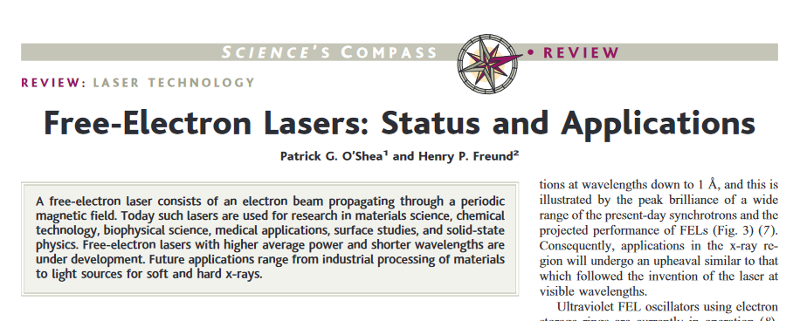
Comment on light source facilities and the newer free electron laser technology
DOI: 10.1126/science.1055718

Slide 13
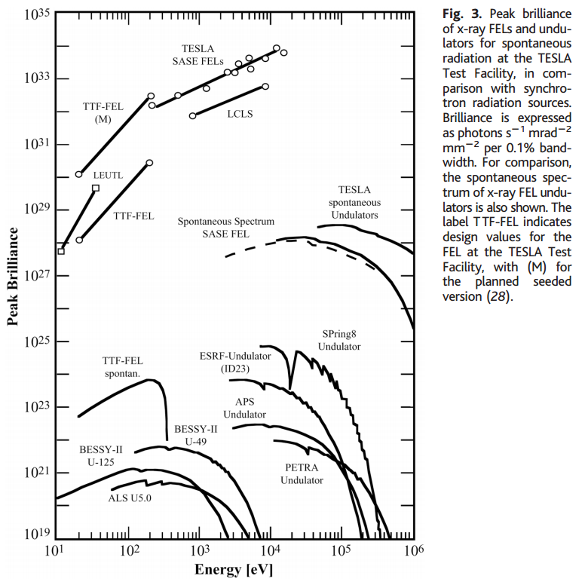
Notes:
Data from a review article on Free Electron Lasers

Slide 14
The above analysis applies to a class of man-made facilities dedicated to producing intense radiation in the continuous spectrum. For more specific information on man-made synchrotron sources, the following web page is useful: http://www.als.lbl.gov/als/synchrotron_sources.html.
Synchrotron radiation is also produced by astronomical sources as analyzed by Julian Schwinger –

Slide 15
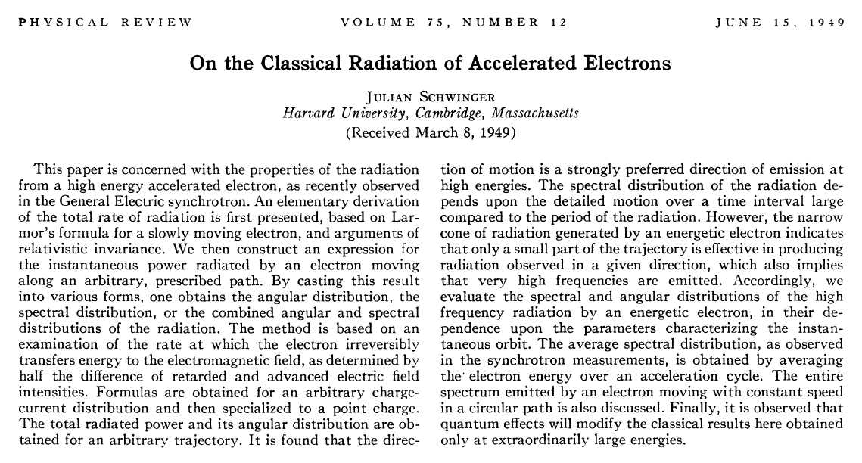
DOI:https://doi.org/10.1103/PhysRev.75.1912

Slide 16
z
Recalling general results of analysis --
r
.
θ
β
y
β
x
Notes:
Here the two amplitudes C for parallel and perpendicular polarizations are defined in terms of the trajectory parameters.

Slide 17
Useful identity involving Bessel functions
Notes:
Some of the identities repeated from last time.

Slide 18
Some details for last step --
Notes:
Some of the identities repeated from last time.

Slide 19
Astronomical synchrotron radiation -- continued:
Notes:
More details.

Slide 20
Astronomical synchrotron radiation -- continued:
In both of the expressions, the sum over m includes both negative and positive values. However, only the positive values of ω and therefore positive values of m are of interest. Using the identity: the
result becomes:
These results were derived by Julian Schwinger (Phys. Rev. 75, 1912-1925 (1949)). The discrete case is similar to the result quoted in Problem 14.15 in Jackson's text.
Notes:
Comment on the relevance of the results.

Slide 21
Back to fundamental processes – Thompson and Compton scattering (see section 14.8 in Jackson)
Some details of scattering of electromagnetic waves incident on a particle of charge q and mass m_{q}
r
k₀
θ
ε₂
ε₀
φ
ε₁
Notes:
For next time.

