Slide 1
PHY 712 Electrodynamics
10-10:50 AM MWF online
Discussion for Lecture 31:
    Finish reading Chap. 14 and start Chap. 15 –
    Radiation from scattering charged particles
        Thompson and Compton scattering
        Radiation from particle collisions
Notes:
In this lecture we will discuss radiation due to collions.

Slide 2
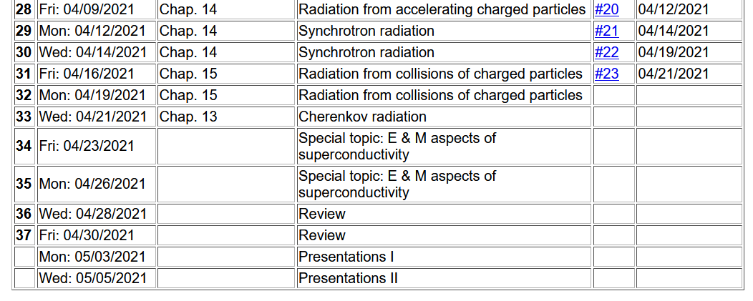
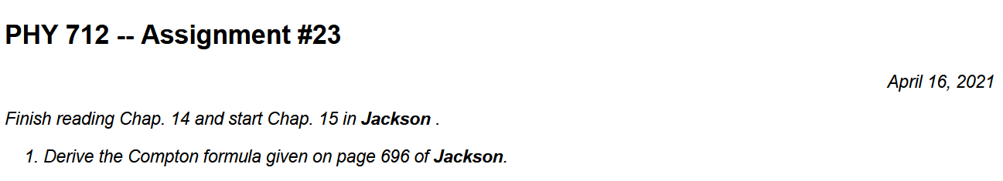
Notes:
Last homework set for the semester.

Slide 3
Your questions –
From Nick -- Can you review how an electric field (or magnetic) can accelerate a particle. What are the fields actually doing (beyond the mathematics)? Where do the forces come into play? My undergraduate E&M is rusty.
From Gao -- How is the Compton effect added into Thompson scattering?
Also comment on typo from Lecture 25

Slide 4
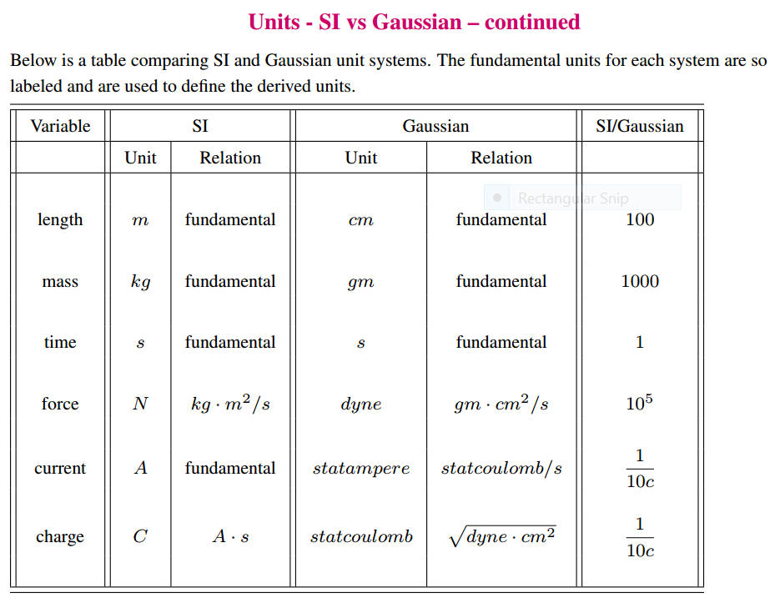

Slide 5
Corrected
2
2

Slide 6
Thompson scattering --
Some details of scattering of electromagnetic waves incident on a particle of charge q and mass m_{q}
r
k₀
θ
ε₂
ε₀
φ
ε₁
Notes:
Consider the effects of a charged particle encountering an electromagnetic wave.

Slide 7
Thompson scattering – non relativistic approximation
Notes:
The power generated in the far field approximated by the non-relativistic limit, is given here. Now we consider that the particle acceleration is due to the oscillating electric field. The power of the radiation of the particle is then given here.

Slide 8
What assumptions are made to conclude that
Is it always true?

Slide 9
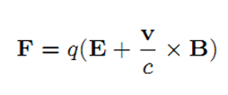
Comment on acceleration
Lorentz force:

Slide 10
Thompson scattering – non relativistic approximation -- continued
z
r
k₀
θ
ε₂
y
ε₀
φ
x
ε₁
Are these polarizations unique?
Notes:
By evaluating the radiation geometry, we can determine the power distribution.

Slide 11
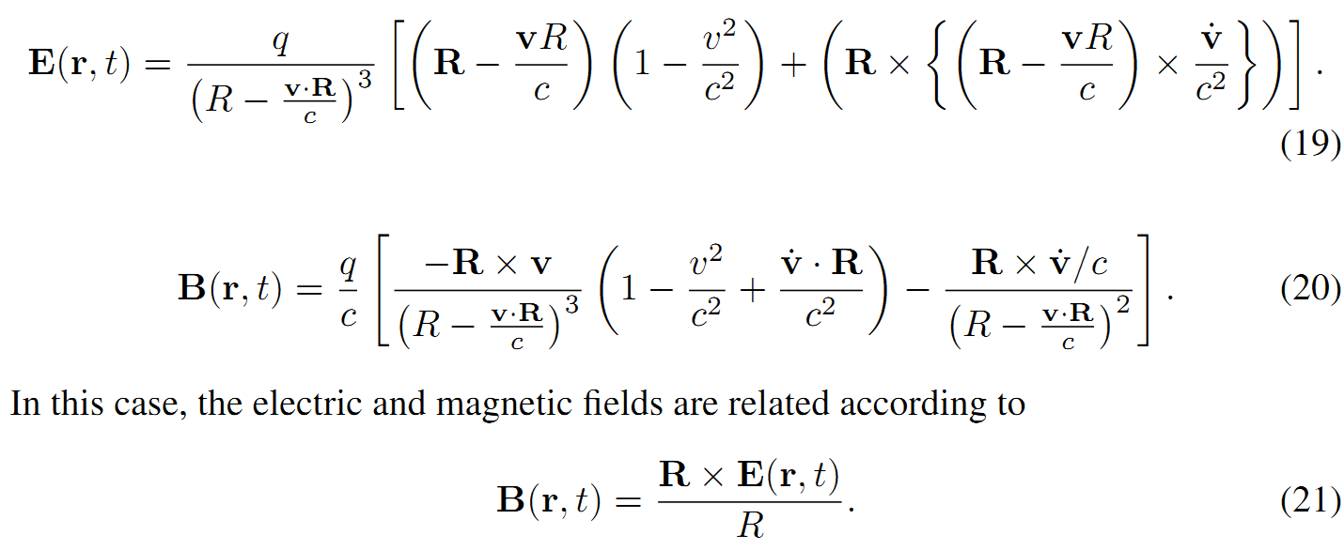
Note that we are associating the vector
with the polarization of the light. Why?
Liénard-Wiechert fields (cgs Gaussian units):

Slide 12
Thompson scattering – non relativistic approximation -- continued
z
r
k₀
θ
ε₂
y
ε₀
φ
x
ε₁
Notes:
The radiated field is polarized perpendicularly to the propagation direction so that the power depends on the dot product of radiation polarization and the incident polarization.

Slide 13
Thompson scattering – non relativistic approximation -- continued
z
r
k₀
θ
ε₂
y
ε₀
φ
x
ε₁
Notes:
Evaluating the dot products for this geometry.

Slide 14
Thompson scattering – non relativistic approximation -- continued
Scattered light may be polarized parallel to incident field or polarized with an angle θ so that the time and polarization averaged cross section is given by:
This formula is appropriate in the X-ray scattering of electrons or soft γ-ray scattering of protons
Notes:
Summary of results in the non-relativistic limit.

Slide 15
Thompson scattering – relativistic and quantum modifications
p_{q}
incident photon
α
p
θ
p’
scattered
photon
04/08/2013
15
Notes:
When the photon energy is comparable to the rest mass energy of the charged particle, we have to consider momentum and energy conservation. This was ferst analyzed by Compton. Your homework asks you to examine the Compton scattering relationships.

Slide 16
Thompson scattering – relativistic and quantum modifications
p_{q}
incident photon
α
p
θ
p’
scattered
photon
Notes:
The effects of the Compton scattering change the cross section.

Slide 17
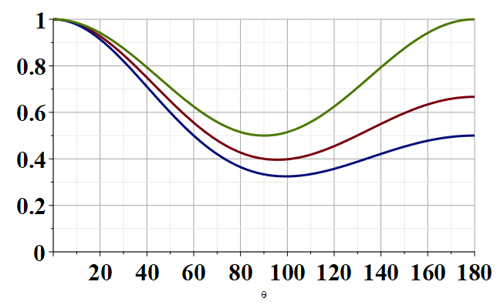
Modified Thompson scattering cross section
θ
Notes:
Plot of the changes to the Thompson cross section due to the Compton effect.

Slide 18
In fact, the more accurate treatment by Klein and Nishina
gives

Slide 19
Up to now, we have been considering (re)radiation due to a charged particle interacting with an electromagnetic field. Next time we will consider radiation due to interactions (collisions) of charged particles themselves.

Slide 20
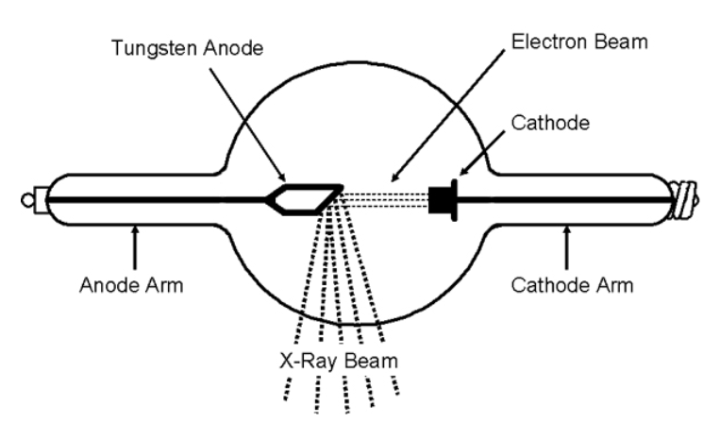
Radiation produced by collisions of charged particles
Generation of X-rays in a Coolidge tube
https://www.orau.org/ptp/collection/xraytubescoolidge/coolidgeinformation.htm
Notes:
Next time we will consider more generally the properties of radiation produced by charged particle collisions.

Slide 21
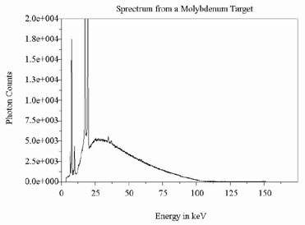
http://www.ndt-ed.org/EducationResources/CommunityCollege/Radiography/Physics/xrays.htm
Quantum effects – due to the release of core electrons
Notes:
Example of x-ray spectrum .

