Slide 1
PHY 712 Electrodynamics
10-10:50 AM MWF Online
Discussion for Lecture 33:
    Special Topics in Electrodynamics:
    Cherenkov radiation
        References: Jackson Chapter 13.4
        Zangwill Chapter 23.7
        Smith Chapter 6.4
Notes:
In this lecture we will consider the phenomenon of Cherenkov radiation. The discussion follows the treatment of Zangwill and Smith.

Slide 2
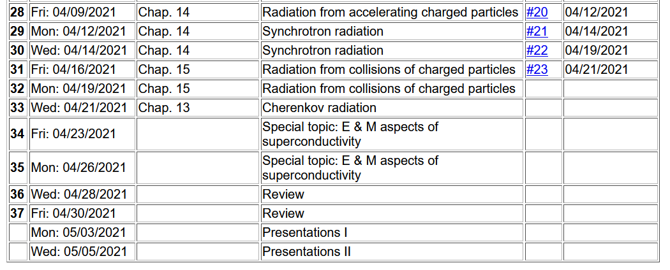
Notes:
Reminder of the schedule. No new homework is assigned; leaving time for your work on your projects.

Slide 3
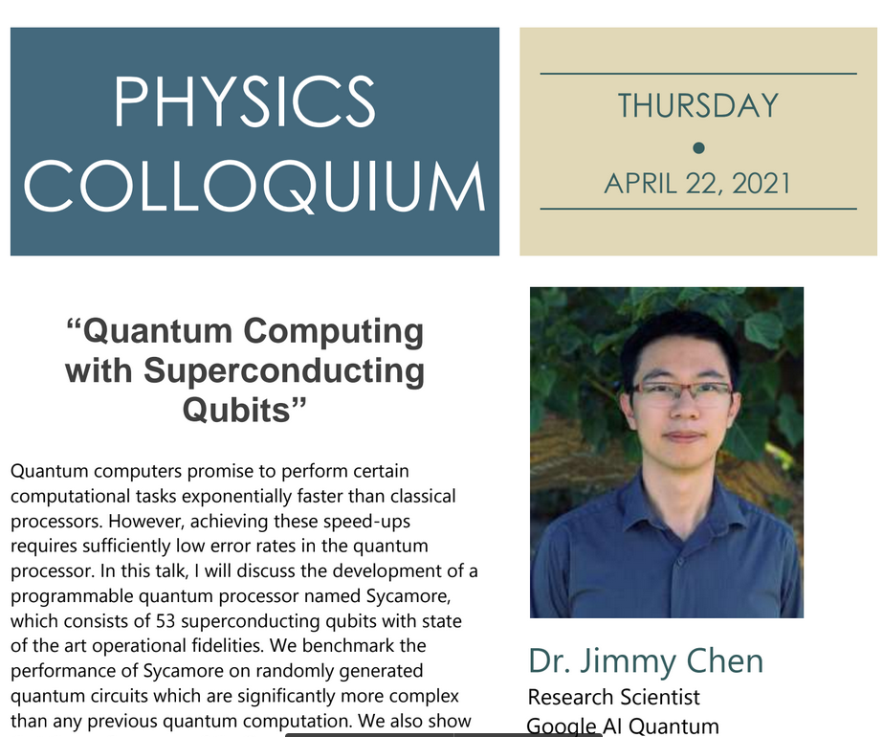
4 PM

Slide 4
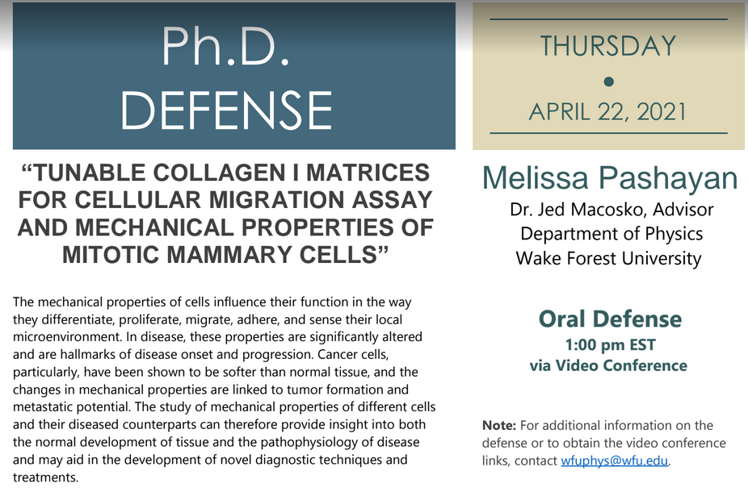

Slide 5
Your questions –
From Gao -- What will happen if the material has a negative refractive index?
Comment – This is a very interesting question that has been topic of recent research, usually associated with radar and the notion of “cloaking”. The equations are even more complicated….

Slide 6
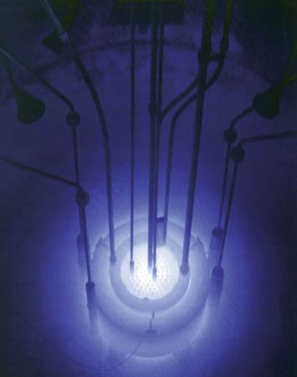
Cherenkov radiation
Cherenkov radiation emitted by the core of the Reed Research Reactor located at Reed College in Portland, Oregon, U.S.
Cherenkov radiation. Photograph. Encyclopædia Britannica Online. Web. 12 Apr. 2013. http://www.britannica.com/EBchecked/media/174732
Notes:
This is a view of Cherenkov radiation with its typical blue glow.

Slide 7
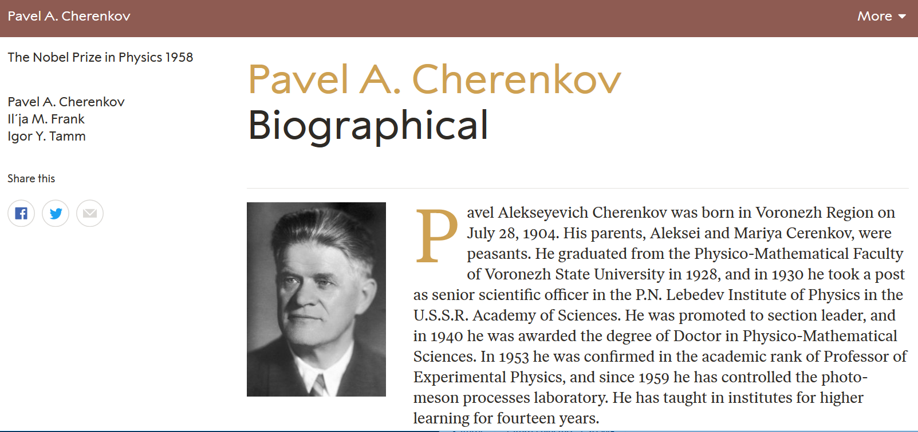
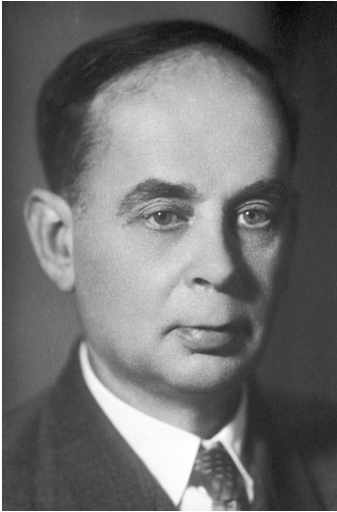
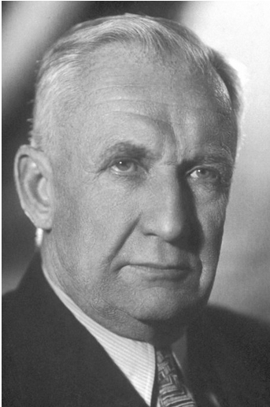
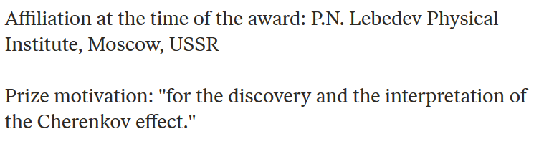
https://www.nobelprize.org/prizes/physics/1958/ceremony-speech/
Notes:
A Nobel prize was awarded for the discovery and explanation of this phenomenon.

Slide 8
References for notes: Glenn S. Smith, An Introduction to Electromagnetic Radiation (Cambridge UP, 1997), Andrew Zangwill, Modern Electrodynamics (Cambridge UP, 2013)
Cherenkov radiation
Discovered ~1930; bluish light emitted by energetic charged particles traveling within dielectric materials
Note that some treatments give the critical angle as θ_{c}-π/2.
θ_{c}
q
Notes:
A diagram describing the phenomenon.

Slide 9
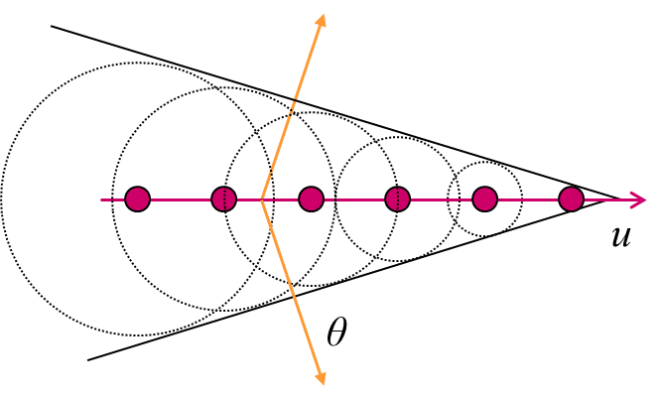
From: http://large.stanford.edu/courses/2014/ph241/alaeian2/
Electric field direction
Particle velocity
Notes:
Snapshots of the particle as it moves through the medium and of the wave fronts generated.

Slide 10
Here the values of μ and ε depend on the material and on frequency.
R_{q}(t)
q
Notes:
Analysis of the scalar and vector potentials in the dielectric medium due to the particle of charge q.

Slide 11
Liénard-Wiechert potential solutions:
Notes:
Find the Lienard Wiechert solutions within the medium. Here, the major difference from previous solutions is that the wave speed c_{n} depends on the refractive index of the medium.

Slide 12
Which of these particles could produce Cherenkov radiation?
  A neutron with speed c?
  An electron with speed 0.6c?
  A proton with speed 0.6c?
  An electron with speed 0.8c?
  An alpha particle with speed 0.8c?
  None of these?

Slide 13
Further comment –
As discussed particularly in Chap. 13 of Jackson, a particle moving within a medium is likely to be slowed down so that the Cherenkov effect will only happen while β_{n}>1.

Slide 14
r
R(t)
R(t_{r})
vt_{r}
vt
Notes:
For the vacuum case v<c, but not it is possible for v>c_{n}. Here we can solve the quadratic equation for the variables of the problem. The physical solution must be positive.

Slide 15
For β_{n}>1, how can the equality be satisfied?
  No problem
  It cannot be satisfied.
  It can only be satisfied for special conditions

Slide 16
r
Original diagram:
R(t)
R(t_{r})
vt_{r}
vt
What is the significance of changing the diagram?
r
New diagram:
R(t_{r})
R(t)
vt_{r}
vt
Notes:
For the vacuum case v<c, but not it is possible for v>c_{n}. Here we can solve the quadratic equation for the variables of the problem. The physical solution must be positive.

Slide 17
r
R(t)
R(t_{r})
θ(t)
vt_{r}
vt
Notes:
Continuing the analysis for the variables needed to determine the scalar and vector potentials.

Slide 18
Recall the Liénard-Wiechert potential solutions:
Notes:
Find the Lienard Wiechert solutions within the medium. Here, the major difference from previous solutions is that the wave speed c_{n} depends on the refractive index of the medium.

Slide 19
Liénard-Wiechert potentials for two
solutions:
r
R(t)
R(t_{r})
θ(t)
vt_{r}
vt
Notes:
In order for the analysis to be consistent, cos(theta)<0 and sin(theta)<1/beta.

Slide 20
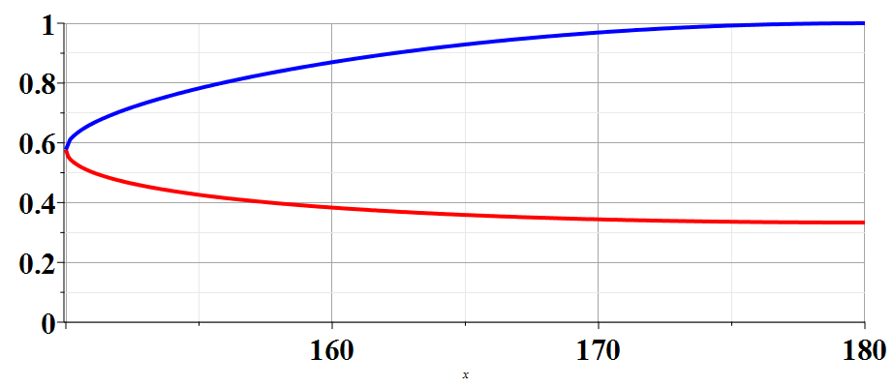
R(t_{r})/R(t)
β_{n}=2
150
θ
Notes:
Plot showing two solutions as a function of theta for a particular beta.

Slide 21
Physical fields for β_{n} > 1 -- two retarded solutions contribute
r
R(t)
R(t_{r})
θ(t)
vt_{r}
vt
Notes:
Here we use the Heaviside step function to ensure that the angle theta is in the correct range.

Slide 22
Physical fields for β_{n} > 1
Notes:
Summary of results for potentials and the corresponding electric and magnetic fields.

Slide 23
Intermediate steps:
r
R(t)
R(t+Δt)
θ(t)
θ(t+Δt)
vt
vΔt
Notes:
Some details for finding the fields.

Slide 24
Power radiated:

Slide 25
r
R(t)
R(t+Δt)
θ(t)
θ(t+Δt)
vt
vΔt

Slide 27
When the dust clears --
From this expression, how would you explain that Cherenkov radiation is typically observed as a blue glow?
  It is still a mystery.
  It is obvious from the result.

