Slide 1
PHY 712 Electrodynamics
10-10:50 AM MWF Online
Discussion for Lecture 34:
    Special Topics in Electrodynamics:
    Electromagnetic aspects of superconductivity
Notes:
In this lecture we will discuss some of the aspects of superconductivity that involve electromagnetism, without getting into the quantum mechanical mechanisms.

Slide 2
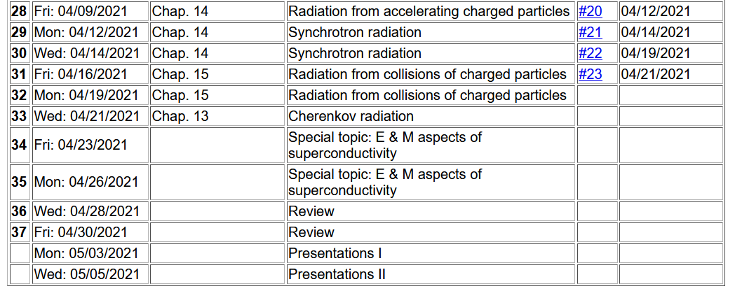
Important dates: Final exams available May 6; due May 14
Outstanding work due May 14
Notes:
Please note the important dates.

Slide 3
Advice about presentations
  Each presentation should be roughly ~ 10 minutes using power point or the equivalent
  It should contain the following
    Introduction and motivation
    Some detailed derivation and/or numerical work
    Conclusions and summary of what you learned
    Bibliography including any possible online sources.
  Materials to turn in
    Presentation slides (or pdf version)
    If you have chosen to review a literature paper, please include its pdf file if possible.
    Maple, Mathematica, or other software files that were used in the project
Notes:
Hopefully this is manageable…

Slide 4
What will you do after May 14?
    Relax a minute or two
    Several of you will want to start preparing for the Qualifier Exams which will be administered (tentative dates):
    Monday, June 21 to Thursday, June 24 during the hours 9:00 am - 12 pm.

Slide 5
Your questions –
From Tim -- How come on slide 11 the magnetic field is only changing in the z direction? Is that just how they prepared the magnetic field in the superconducting material?
From Gao -- You gave some comparison between type 1 and 2 superconductors in lecture notes. Could you introduce the mechanism leads to these two types of superconductors.

Slide 6
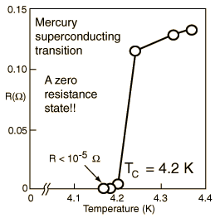
Special topic: Electromagnetic properties of superconductors
Ref:D. Teplitz, editor, Electromagnetism – paths to research,
Plenum Press (1982); Chapter 1 written by Brian Schwartz and Sonia Frota-Pessoa
History:
  1908 H. Kamerlingh Onnes successfully liquified He
  1911 H. Kamerlingh Onnes discovered that Hg at 4.2 K has vanishing resistance
  1957 Theory of superconductivity by Bardeen, Cooper, and Schrieffer
The surprising observation was that electrical resistivity abruptly dropped when the temperature of the material was lowered below a critical temperature T_{c}.
Notes:
These notes are partly based on the Teplitz textbook and other sources. Interestingly this is an example of a physical phenomenon stumping the theorists for nearly 50 years. The theorists are still arguing.

Slide 7
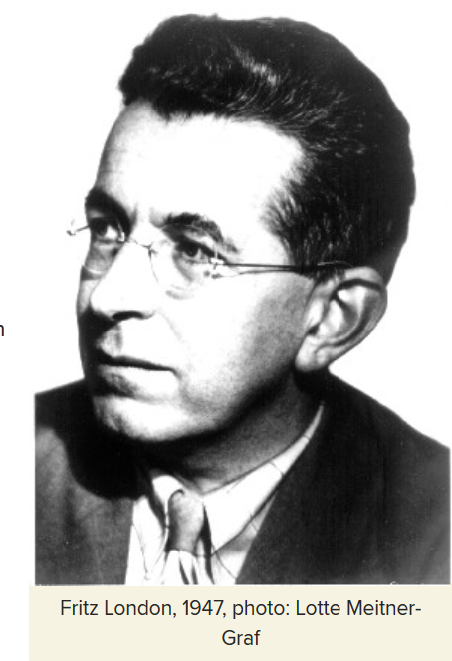
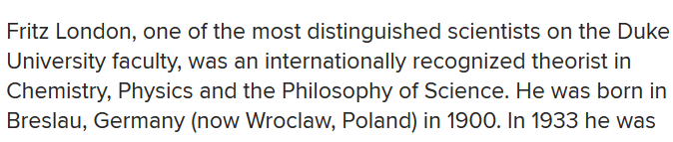
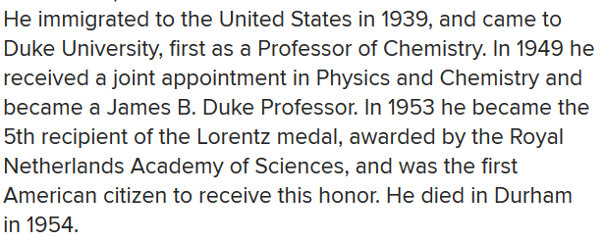
Fritz London 1900-1954
https://phy.duke.edu/about/history/historical-faculty/fritz-london
Notes:
The ideas we will discuss are largely due to Fritz London who developed a phenomenological theory before the microscopic materials mechanisms were developed by Bardeen, Cooper, and Schrieffer a few years after he died.

Slide 8
Some phenomenological theories < 1957 thanks to F. London
Note: Equations are in cgs Gaussian units.
Notes:
These equations represent models of idealized electrons in metals, starting with the Drude model which we previously discussed. The symbol tau represents a “relaxation” time; n represents the number density.

Slide 9
Properties of a normal metal
Does this model allow for any temperature dependence on the resistivity?
  No.
  Yes.
  Maybe.

Slide 10
How is the London model different from the Drude model?
  Subtle difference.
  Big difference.

Slide 11
Some phenomenological theories < 1957
Are these equations
  Exact?
  Approximate?
  Wrong?
Notes:
Following the logic of London’s equations. Here lambda which comes out of the analysis is a parameter with units of length.

Slide 12
London model – continued
Here we assume we know the boundary value at x=0.
Notes:
Fancy thinking with the time dependence. The result shows that the B field decays within the material within a distance lambda. Similarly, the current density also decays within the material.

Slide 13
London model – continued
λ_{L}
x
Notes:
The conclusion is that the current and magnetic field are excluded from the bulk of the superconductor; they are confined within a length lambda at the surface.

Slide 14
Behavior of superconducting material – exclusion of magnetic field according to the London model
λ_{L}
x
Notes:
Lambda is also called the London penetration length.

Slide 15
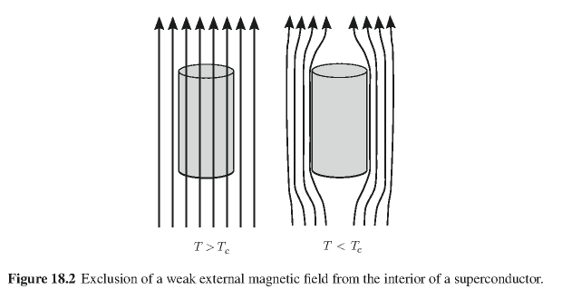
Behavior of magnetic field lines near superconductor
normal
state:
superconducting state:
Notes:
An illustration of the phenomenon in three dimensions.

Slide 16
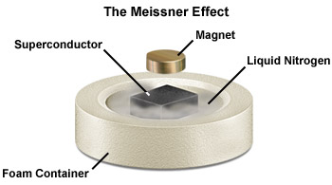
Notes:
Demonstration of the magnetic field effects when a small permanent magnetic is put above a superconducting magnetic. In this case the liquid N2 is needed to produce the superconducting phase of the material.

Slide 17
Need to consider phase equilibria between “normal” and superconducting state as a function of temperature and applied magnetic fields.
Notes:
Interesting properties of the magnetization field of a superconductor.

Slide 18
Magnetization field
Here H is thought of in terms of an applied field.
At T=0K
Notes:
Here we need to consider thermodynamics of phase change. The Gibbs free energy of the superconducting state can be estimated. An applied magnetic field can raise the Gibbs free energy so that the superconducting phase is less favorable than the normal phase.

Slide 19

Magnetization field (for “type I” superconductor)
B
H
H_{C}
-4πM
H
H_{C}
G_{S}-G_{N}
H_{C}
H
Notes:
Plets of fields and Gibbs energy as a function of the applied field H.

Slide 20
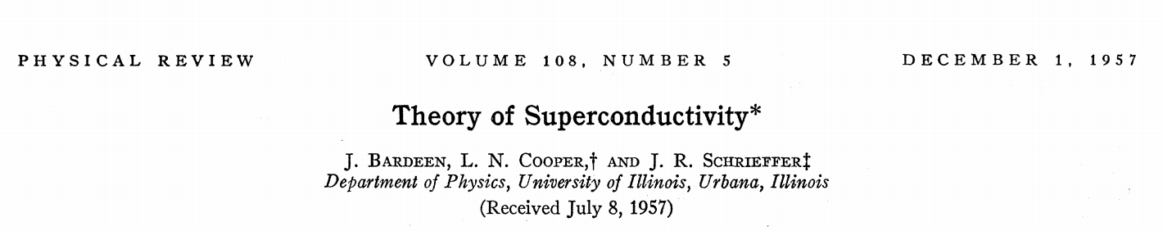
characteristic phonon energy
density of electron states at E_{F}
attraction potential between electron pairs
Notes:
Briefly, BCS theory estimated the energy of a superconductor relative to a normal metal at room temperature

Slide 21
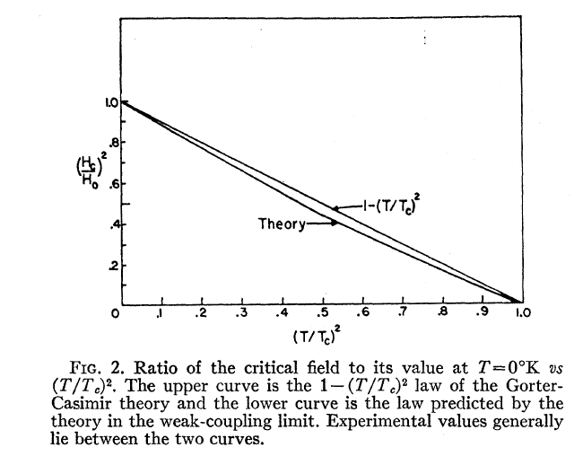
Temperature dependence of critical field
From PR 108, 1175 (1957)
  Bardeen, Cooper, and Schrieffer, “Theory of Superconductivity”
characteristic phonon energy
density of electron states at E_{F}
attraction potential between electron pairs
Notes:
The energy and critical field depends on temperature in a characteristic way predicted by the theory.

Slide 22
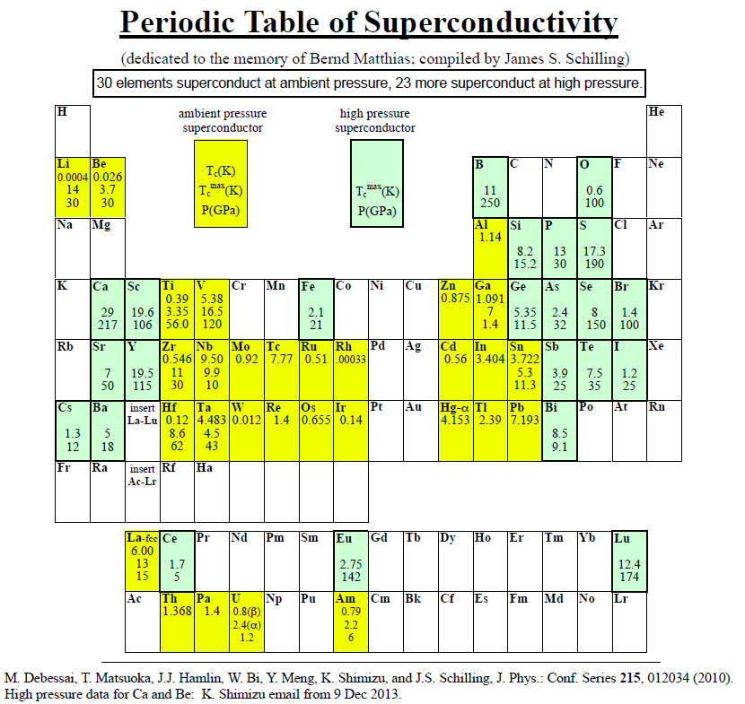
Type I elemental superconductors
http://wuphys.wustl.edu/~jss/NewPeriodicTable.pdf
Notes:
Some elemental super conductors.

Slide 23

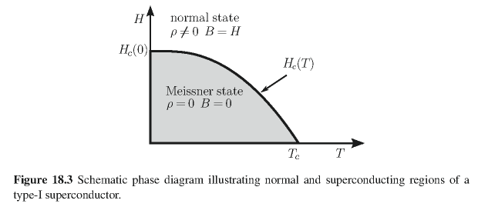
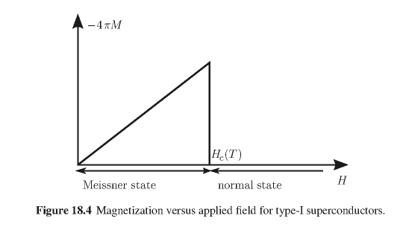
Type I superconductors:
Notes:
This discussion is relevant to “type I” superconductors.

Slide 24
The following slides give a quick look of some of the intriguing aspects of superconducting materials and their properties --

Slide 25
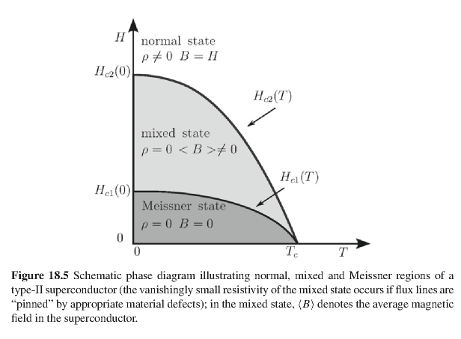
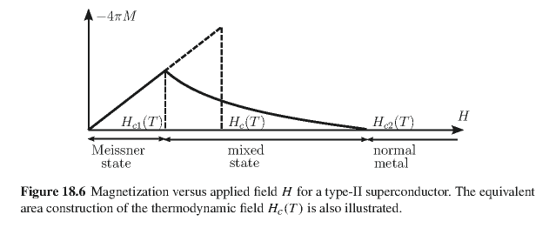
Type II superconductors
Notes:
Type II superconductors are more complicated. This model is more consistent with the so called high temperature superconductors.

Slide 26
Quantization of current flux associated with the superconducting state (Ref: Ashcroft and Mermin, Solid State Physics)
Notes:
Part of the story is that there can be (quantized) fields (vortices) within type II superconductors. This slide discusses some aspects of the currents.

Slide 27
Quantization of current flux associated with the superconducting state -- continued
Suppose a superconducting material has a cylindrical void. Evaluate the integral of the current in a closed path within the superconductor containing the void.
dl
Such “vortex” fields can exist within type II superconductors.
Notes:
The analysis follows from the notion that the wavefunction of the superconducting “particle” has a non-trivial phase factor.

Slide 28
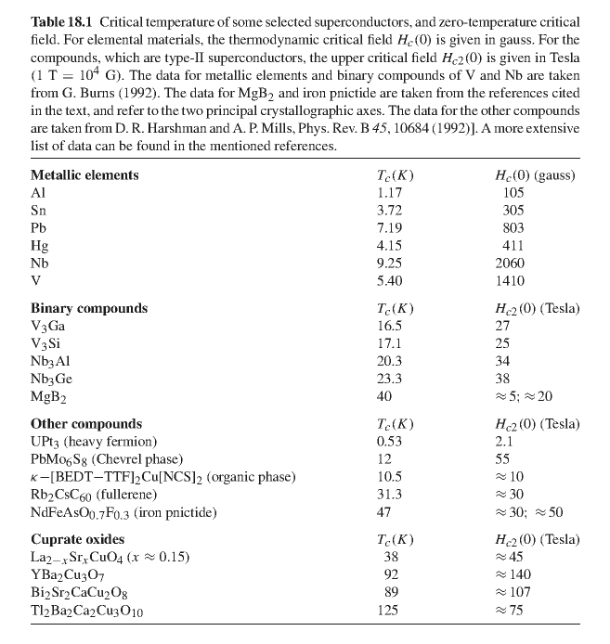
Notes:
Some superconducting materials listed on the web.

Slide 29
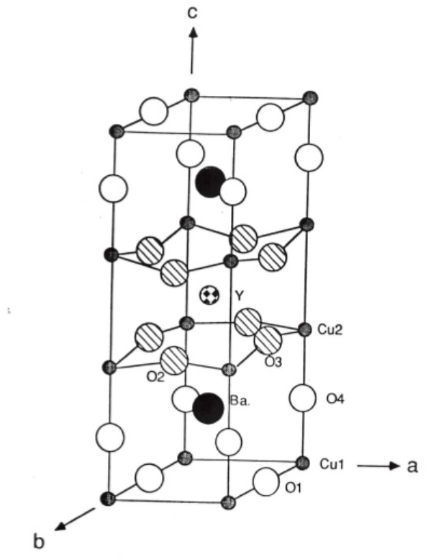
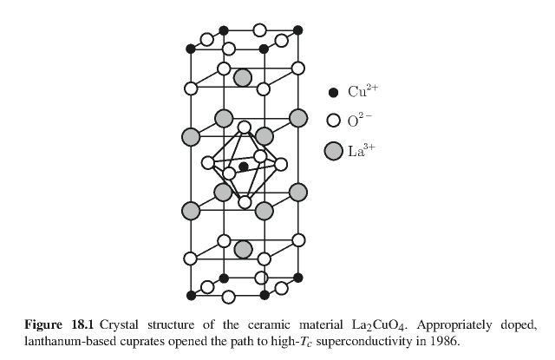
Crystal structure of one of the high temperature superconductors
YBa₂Cu₃O₇
From MS thesis of Brent Howe (Minn State U, 2014)
Notes:
One of the high temperature superconducting materials.

Slide 30
Some details of single vortex in type II superconductor
Notes:
Equations demonstrating that vortex solutions are consistent with London’s model.

Slide 31
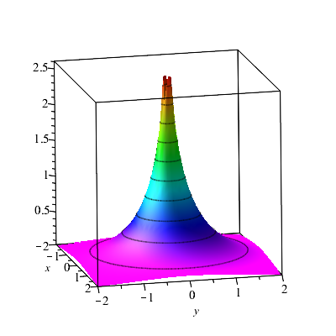
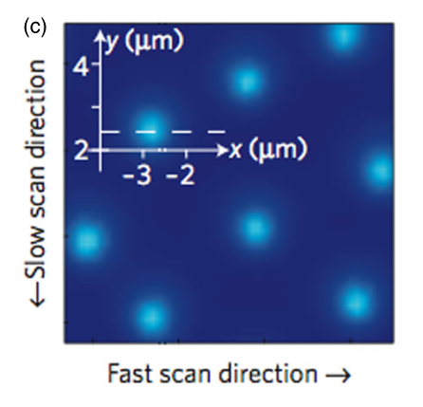
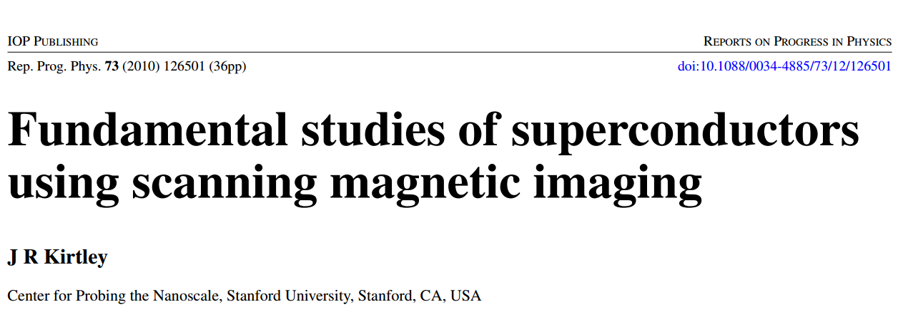
Scanning probe images of vortices in YBCO at 22 K
Based on physics of the Josephson junction.
Notes:
Scanning probe techniques can be used to visualize the magnetic vortices.

Slide 32
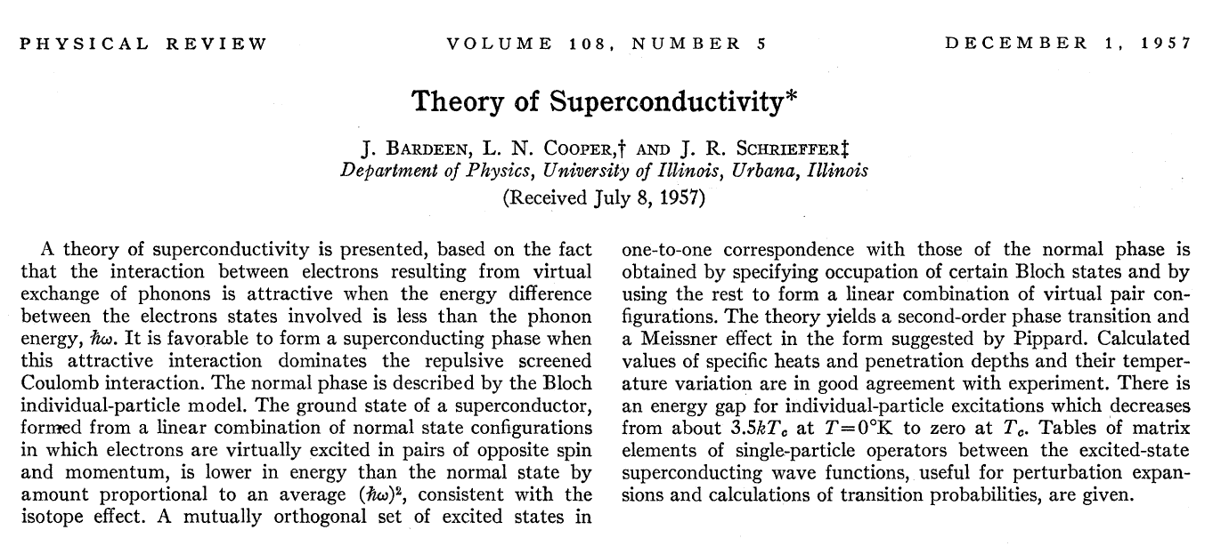
What we have not yet discussed is the microscopic mechanism for the phenomenon. --- to be continued on Monday 4/26/2021 (starting later due to QM exam)

