Slide 1
PHY 712 Electrodynamics
10-10:50 AM MWF Online
Discussion for Lecture 35:
    Special Topics in Electrodynamics:
    Some optical properties of materials**
  **previously advertised as more details on superconductors
Notes:
In this lecture we will examine some optical properties of crystalline materials.

Slide 2
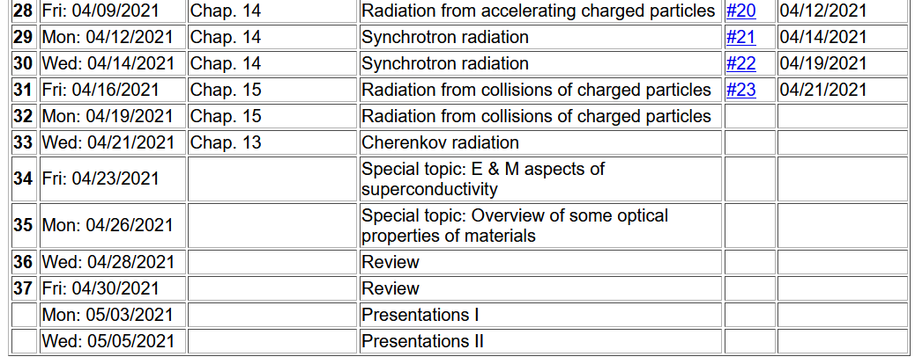
Notes:
Reminder about the schedule. Please send me topics for the review next week.

Slide 3
Timelines –
  May 6 – take home exam available
  May 14 – all course materials due; outstanding homework, projects, and completed exams

Slide 4
Aspects of optical properties of solids
Quantum effects cause discrete energy levels for electrons; EM radiation can couple the ground state of a material to its excited states
In solid materials with ~10²³ atoms, discrete states become bands of states
  Metals
  Insulators
Anisotropic effects
Note: We can analyze effectively single particle systems with high accuracy. Analysis of several/many particle systems can be accomplished with a series of approximations. We will also use a linear combination of atomic orbital approach to get the qualitative picture.
Notes:
Outline.

Slide 5
Electronic structure of an atom
For simplicity we will first consider a single electron system; a H-like ion with atomic charge of +Ze and one electron of charge –e:
According to Quantum Mechanics:
E₁₀₀=-13. 60569253 Z² eV
a₀ = 0. 52917721092 Å
Notes:
Starting with the ground state of an hydrogen-like atom.

Slide 6
The following few slides address the question of the expected distribution of energy levels of materials.
Note that isolated atoms and molecules have discrete and continuum states while solids have only continuum states.
How is the distribution of states of materials related to their spectra?
  Optical properties of materials are determined by transitions between states.
  Transitions between discrete states → discrete spectral features.
  Transitions between continuum states → broad spectral features.

Slide 7
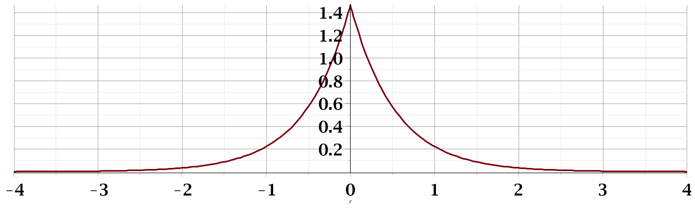
Probability amplitude for electron in the ground state of H atom:
Notes:
Ground state wavefunction.

Slide 8
Now consider one electron in the presence of two H-like ions:
Electronic structure of H-like molecular ion
(within Born-Oppenheimer approximation)
-e
r_{B}
r_{A}
R_{AB}
Z_{A}e
Z_{B}e
Notes:
Now consider what happens when you have two atoms. Find the approximate ground state using a linear combination of atomic orbitals.

Slide 9
Electronic structure of H-like molecular ion – continued
Ref. Pauling and Wilson, Introduction to Quantum Mechanics (1935) (now published by Dover)
Notes:
Finding two solutions for the linear coefficients corresponding to two approximate states.

Slide 10
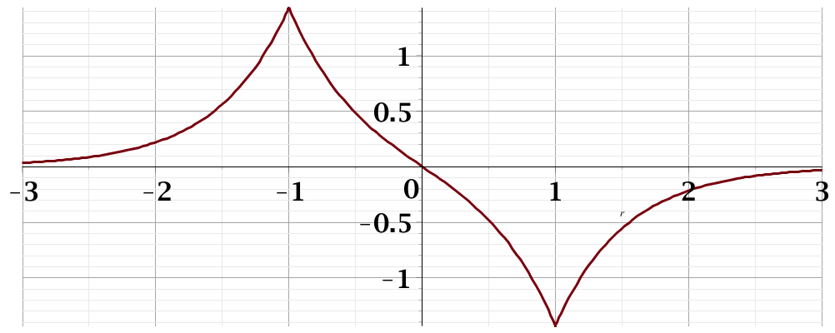
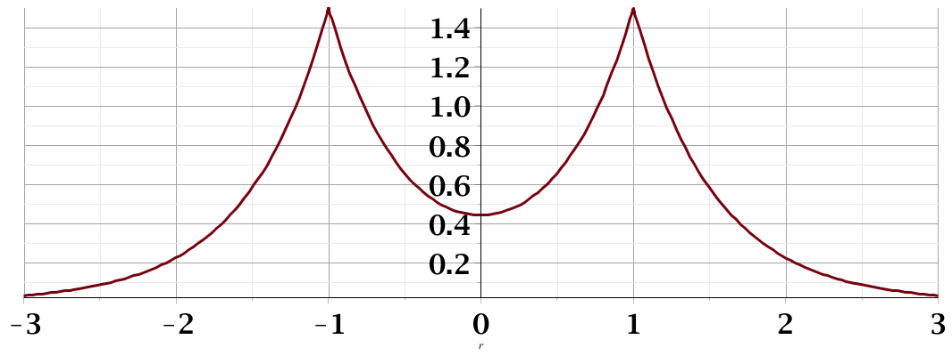
Electronic structure of H-like molecular ion – continued
E₋
Ψ₋
H_{AA}
H_{BB}
E₊
Ψ₊
Notes:
Energy levels and their corresponding eigenstates. Note that there are many more states for this system than these.

Slide 11
In the previous slide, we showed two states for the H₂⁺ molecular ion. Are these the only states?
  Yes
  No

Slide 12
Formation of “energy bands” with a large number of atoms --
Extension of approximate “linear combination of atomic orbital” idea to larger systems
N=2
N=3
N=4
4β
…………….
Notes:
Now imagine extending this type of analysis to a chain of N atoms. There are more and more states asymptotically leading to a continuum. In this way, we can understand why the states of solid materials correspond to continua of states.

Slide 13
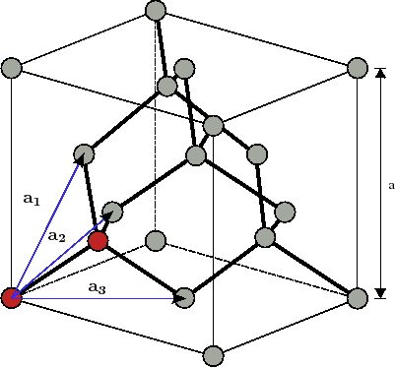
In practice, the “energy band” structure of materials is affected by competing effects of structure and composition
Example: Diamond lattice (2 C atoms per primitive unit cell)
Notes:
Consider first an ideal crystal of carbon in the diamond structure. There are two atoms per primitive unit cell and ? atoms in the cubic cell.

Slide 14
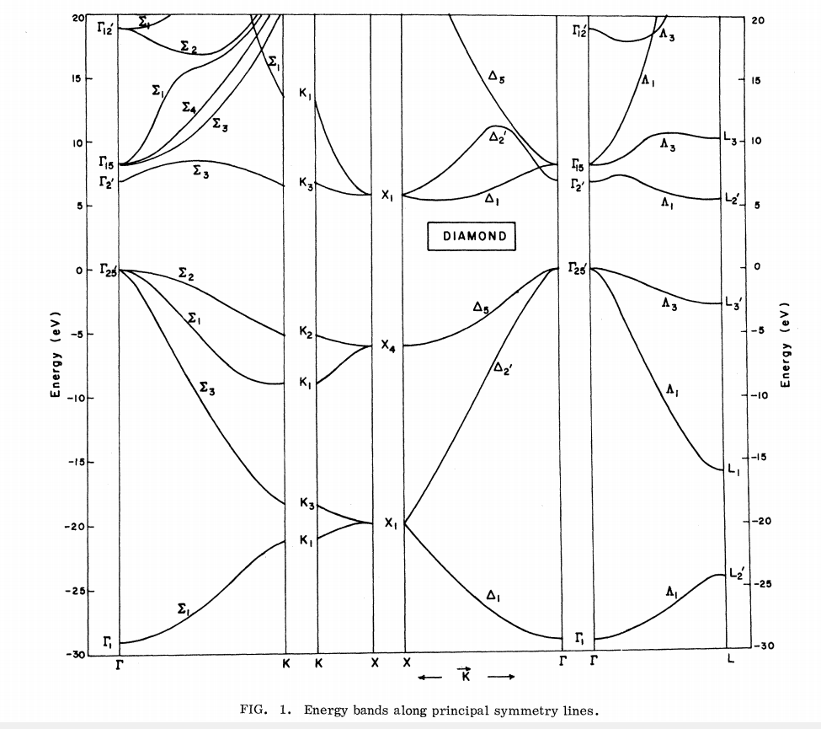
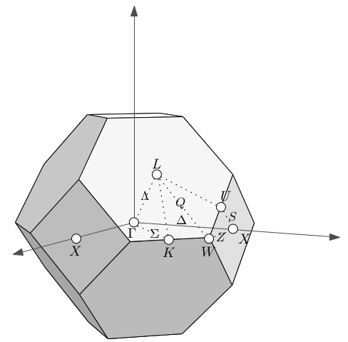
Ref. PRB 2, 2054 (1970)
E_{n}(k)
Note: Valence bands must accommodate 8 valence electrons from two C 1s²2s²2p² atoms per unit cell
Notes:
This is a plot of the band structure of diamond. The valence band spans ~ 30 eV. The conduction band is separated from the occupied states by ~5.1 eV.

Slide 15
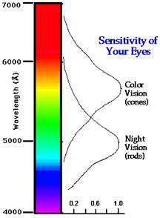
Visible light for humans
2 eV
3 eV
Notes:
Before asking what you might see when viewing a diamond crystal, here is reminder about the visible light and its energy equivalent.

Slide 16
How do you expect a diamond crystal to look when illuminated by visible light?
  It will be opaque.
  It will be completely transparent
  It will be partially transparent.

Slide 17
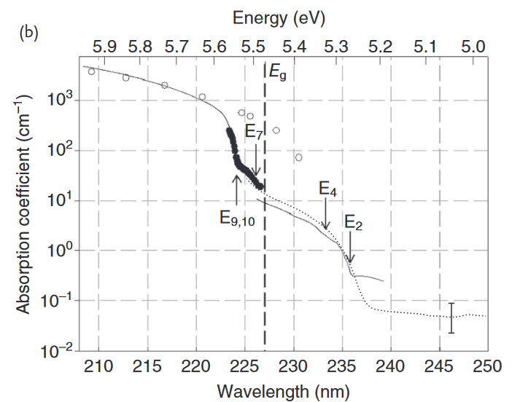
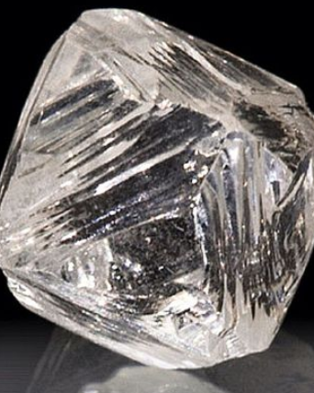
Absorption spectrum of diamond
Notes:
Here is an absorption spectrum for diamond. The image on the right is that of a natural diamond crystal.

Slide 18
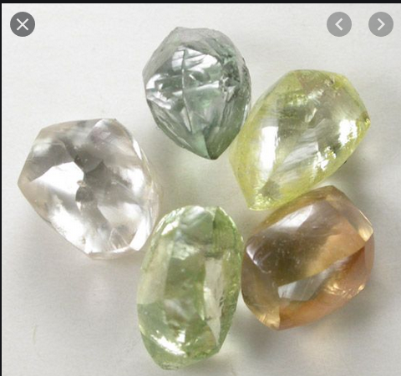
Images of natural diamonds
How is it possible for these diamonds to have absorption in the visible spectrum?
Notes:
Here is an image of diamond crystal that are not completely transparent. How can this happen?

Slide 19
E_{n}(k)
Possible impurity states in band gap
Notes:
From the viewpoint of the band structure, it is not possible to absorb sub band gap light. Impurity states do not fit into the band picture since they are not part of the periodic structure.

Slide 20
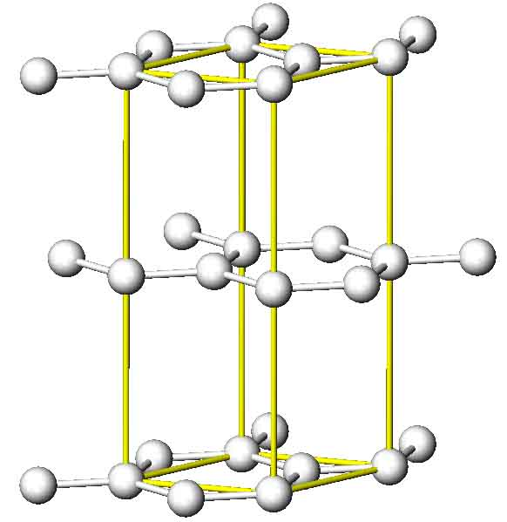
Another example --
Example: Graphite (4 C atoms per unit cell)
Notes:
Now consider another form of carbon in the graphite structure.

Slide 21
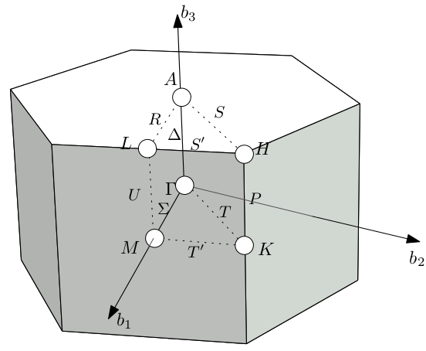
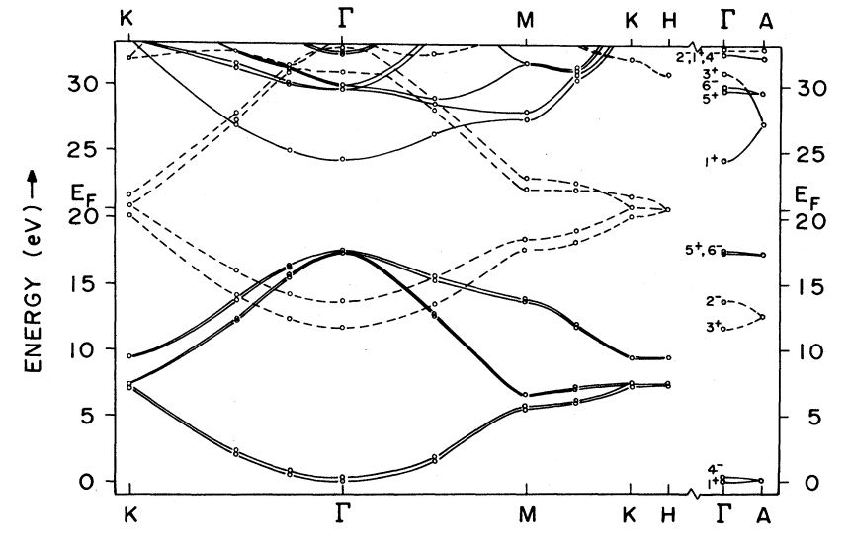
Note: Valence bands must accommodate 16 valence electrons from four C 1s²2s²2p² atoms per unit cell
Ref. PRB 26, 5382 (1982)
Band diagram for graphite
Notes:
This is a band diagram of the electronic states of graphite. What do you think that graphite would look like?

Slide 22
How different is the band structure of diamond and graphite?
  They look slightly different, but it is hard to tell because they were analyzed using different approximations.
  They look drastically different because ….

Slide 23
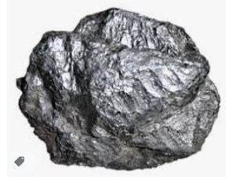
Image of natural graphite (semi metal)
Notes:
This looks similar to the sample in my office. Graphite is called a semi metal.

Slide 24
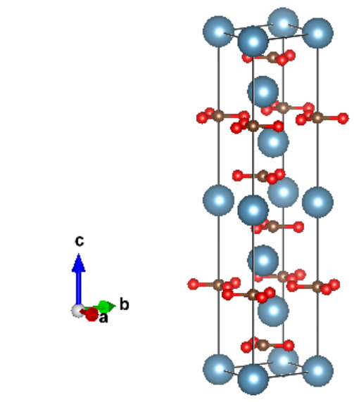
Another example --
Example: Calcite CaCO₃
Notes:
Now consider another example of a transparent but anisotropic material, calcite.

Slide 25
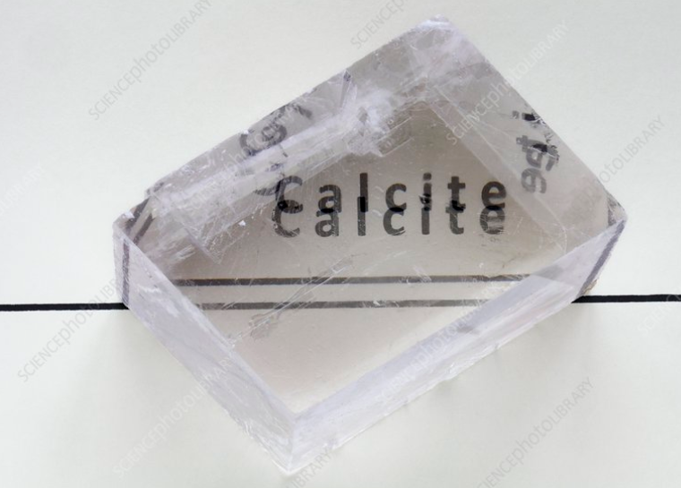
Notes:
Image of a calcite crystal

Slide 26

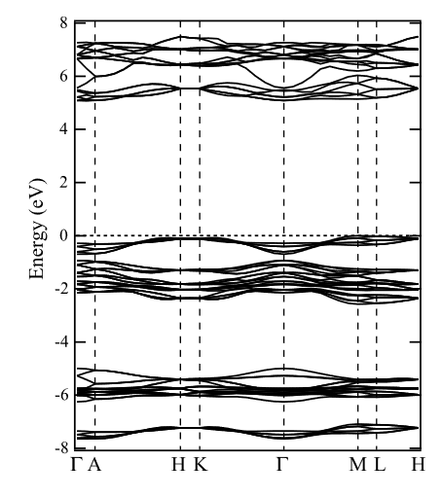
Notes:
Band structure of calcite

Slide 27
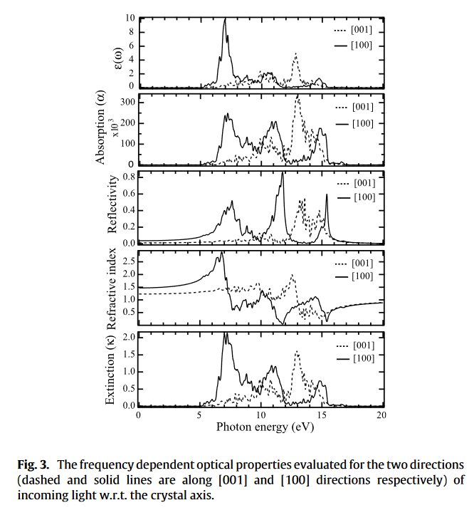
CaCO₃
Calculated optical properties
2 eV
n_{o}=1.7
n_{e}=1.5
3 eV
Notes:
Calculated optical properties.

Slide 28
How are the results on the previous slide related to each other?
  They are all independent of eachother
  Some of them are related because …
What determines the birefringence that we observe?

Slide 29
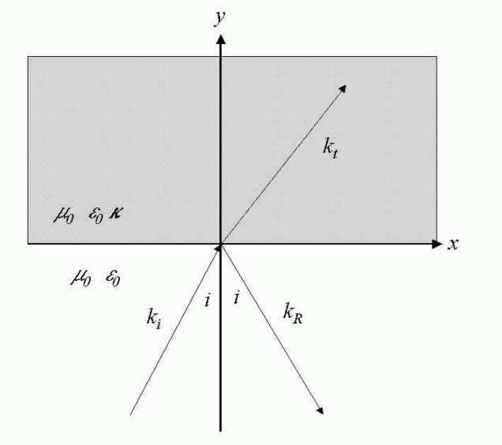
Reflectance and transmittance in an anisotropic crystal --
Here we assume that the birefringence is expressed in the κ matrix.
Notes:
Analysis of the reflectivity and transmittance of a birefringent crystal. This was covered briefly when we discussed the isotropic case in Chapter 7.

Slide 30
Consider the problem of determining the reflectance from an anisotropic medium with isotropic permeability μ₀ and anisotropic permittivity ε₀ κ where:
By assumption, the wave vector in the medium is
confined to the x-y plane and will be denoted by
The electric field inside the medium is given by:

Slide 31
Inside the anisotropic medium, Maxwell’s equations are:
After some algebra, the equation for E is:
From E, H can be determined from

Slide 32
The fields for the incident and reflected waves are the same as for the isotropic case.
Note that, consistent with Snell’s law:
Continuity conditions at the y=0 plane must be applied for the following fields:
There will be two different solutions, depending of the polarization of the incident field.

Slide 33
Solution for s-polarization

Slide 34
Some details for s-polarization

Slide 35
Notes:
Here we identify the s polarization with the “ordinary” wave.

Slide 36
Solution for p-polarization

Slide 37
Some details for p-polarization
Conventionally this is called the extraordinary wave since it does not necessarily satisfy Snell’s law.
Notes:
Here we identify the “extraordinary” wave with p polarization.

