Slide 1
PHY 712 Electrodynamics
10-10:50 AM MWF Online
Discussion for Lecture 36:
Review of Electrodynamics --
Part I
Notes:
In this lecture we will examine some optical properties of crystalline materials.

Slide 2
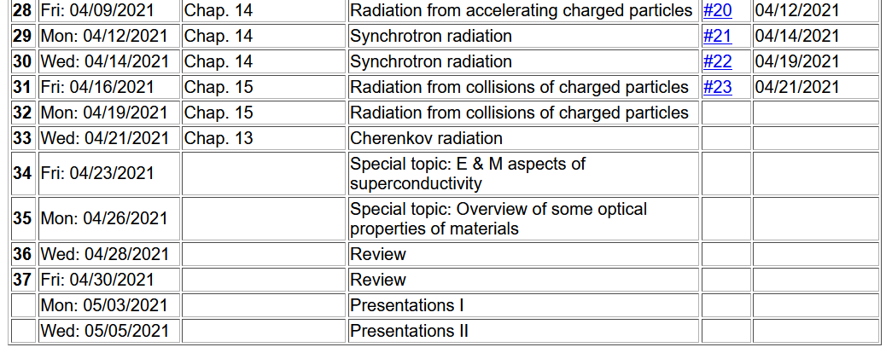
Notes:
Reminder about the schedule. Please send me topics for the review next week.

Slide 3
Review I Summary of concepts/equations
Review II Example problems
Timelines –
April 30 – sign up for presentations
May 3 – Presentations I
May 5 – Presentations II
May 6 – take home exam available
May 14 – all course materials due; outstanding homework, projects, and completed exams

Slide 4
Colloquium this week is joint with Chemistry on Wed. at 4 PM

Slide 5
2
2

Slide 6
Some unit relationships
Elementary charge e
in SI units: 1.602176634x10⁻¹⁹ C
in cgs Gaussian units: 4.80320424x10⁻¹⁰ stat-C
Comment on eV as an energy unit
Joule is the SI energy unit
Volt is the SI electrostatic potential unit
1 eV= 1.602176634x10⁻¹⁹ J

Slide 7
More relationships

Slide 8
More relationships

Slide 9
Memorable equations from electrostatics
Poisson and Laplace Equations
We are concerned with finding solutions to the Poisson equation:
and the Laplace equation:
The Laplace equation is the “homogeneous” version of the Poisson equation. The Green's theorem allows us to determine the electrostatic potential from volume and surface integrals:

Slide 10
Memorable equations from electrostaticsb
Boundary value effects

Slide 11
Useful identity:

Slide 12
A similar technique can be used to analyze solutions to the full time dependent Maxwell’s equations for perfectly harmonic sources --
This choice decouples the equations for the scalar and vector potentials.

Slide 13
Solution of Maxwell’s equations in the Lorentz gauge -- continued

Slide 14
Electromagnetic waves from time harmonic sources

Slide 15
Electromagnetic waves from time harmonic sources – continued:

Slide 16
Electromagnetic waves from time harmonic sources – continued:

Slide 17
Electromagnetic waves from time harmonic sources – continued:

Slide 18
Electromagnetic waves from time harmonic sources – continued:

Slide 19
Note that this pure time harmonic treatment is different from the case of the Lienard-Wiechert potentials
Liènard-Wiechert potentials and fields --
Determination of the scalar and vector potentials for a moving point particle (also see Landau and Lifshitz The Classical Theory of Fields, Chapter 8.)
Consider the fields produced by the following source: a point charge q moving on a trajectory R_{q}(t).
R_{q}(t)
q

Slide 20
Solution of Maxwell’s equations in the Lorentz gauge -- continued
Resulting scalar and vector potentials:
Notation:

Slide 21
Some aspects of the special theory of relativity
Lorentz transformations
y
y’
v
x
x’
y’
y
x’
x

Slide 23
More 4-vectors:

Slide 24
Lorentz transformations
Repeated index summation convention

Slide 25
4-vector relationships

Slide 26
For stationary frame
For moving frame

Slide 27
➔ This analysis shows that the E and B fields must be treated as components of the field strength tensor and that in order to transform between inertial frames, we need to use the tensor transformation relationships:
Transformation of field strength tensor

Slide 28
Inverse transformation of field strength tensor

