Slide 1
PHY 712 Electrodynamics
10-10:50 AM MWF Online
Discussion for Lecture 37:
Review of Electrodynamics --
Part 2
Notes:
In this lecture we will examine some optical properties of crystalline materials.

Slide 2
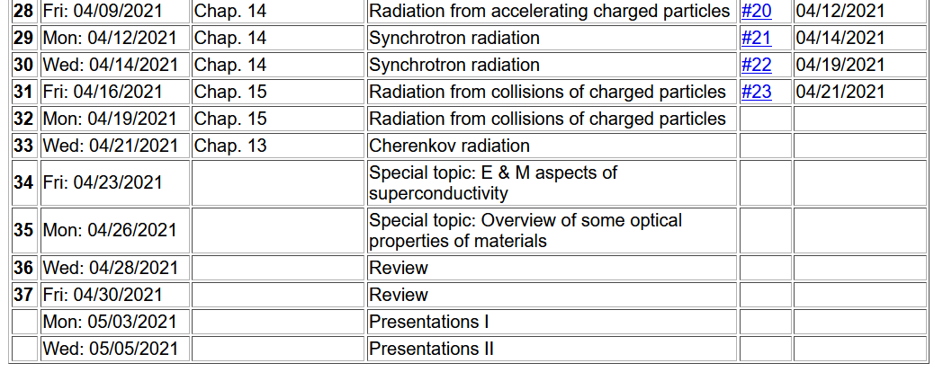
Notes:
Reminder about the schedule. Please send me topics for the review next week.

Slide 3
Review I Summary of concepts/equations
Review II Example problems
Timelines –
April 30 – sign up for presentations
May 3 – Presentations I
May 5 – Presentations II
May 6 – take home exam available
May 14 – all course materials due; outstanding homework, projects, and completed exams

Slide 4
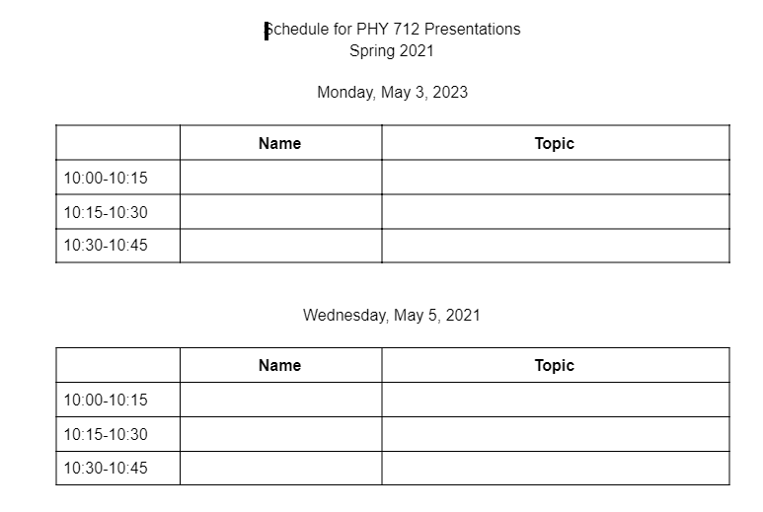

Slide 5
Review – Chapter 8 – waveguides and other boundary value situations for electromagnetic waves

Slide 6
Some details:

Slide 7
Fields near the surface on an ideal conductor -- continued
“skin depth”

Slide 8
Fields near the surface on an ideal conductor
r||
0
z

Slide 9
Fields near the surface on an ideal conductor -- continued
r||
0
z

Slide 10
Boundary values for ideal conductor
At the boundary of an ideal conductor, the E and H fields decay in the direction normal to the interface.
H₀

Slide 11
Wave guides – dielectric media with one or more metal boundary
H₀
Waveguide terminology
TEM: transverse electric and magnetic (both E and H fields are perpendicular to wave propagation direction)
TM: transverse magnetic (H field is perpendicular to wave propagation direction)
TE: transverse electric (E field is perpendicular to wave propagation direction)

Slide 12
Analysis of rectangular waveguide
Boundary conditions at surface of waveguide:
E_{tangential}=0, B_{normal}=0
y
x
z
Cross section view
b
a

Slide 13
Analysis of rectangular waveguide
y
x
z

Slide 14
Solution of Maxwell’s equations within the pipe:

Slide 15
Maxwell’s equations within the pipe in terms of all 6 components:

Slide 16
TE modes for rectangular wave guide continued:

Slide 17
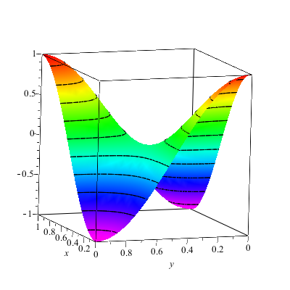
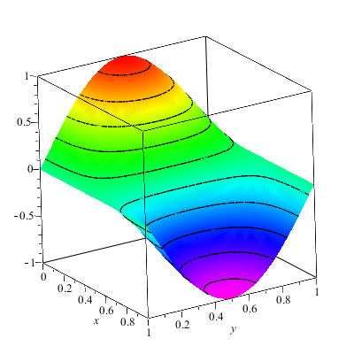
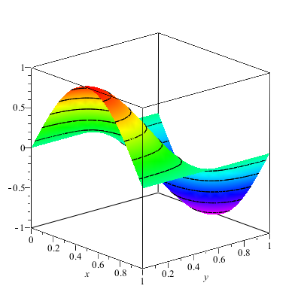
Solution for m=n=1

Slide 18
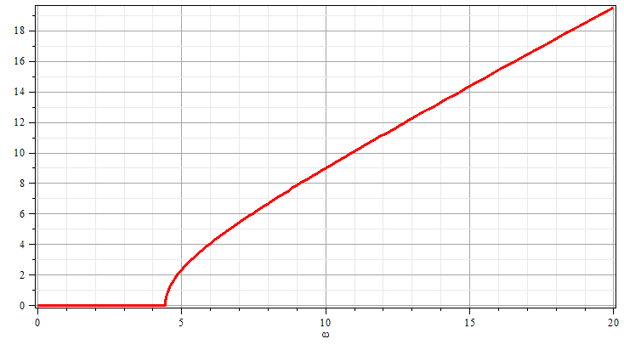
Solution for m=n=1
k
ω

Slide 19
TE modes for rectangular wave guide continued:

Slide 20
TE modes for rectangular wave guide continued:

