Slide 1
PHY 712 Electrodynamics
10-10:50 AM MWF Online
Class notes for Lecture 3:
Reading: Chapter 1 in JDJ
Review of electrostatics with one-dimensional examples
Poisson and Laplace Equations
Green’s Theorem and its use in electrostatics
Notes:
In this lecture, we will return to the materials presented in our textbook. Some of the ideas were presented in PHY 711.

Slide 2
Your questions –
From Nick -- When we choose f and g to be Phi and G, where does that intuition come from in plugging into divergence theorem? On slide 16, how do we know which one of x and x' is the x_< term?
From Tim -- On page 10, for both the top and bottom electric potentials, you solved the Laplace Equation, correct? Because there is no charge density when x>a or x<-a.
From Gao -- We use the Green theorem to get the potential. In this formula, is phi (r prime) a known condition? If not, how can we use this theorem to get the potential as we have to know potential first to calculate the integral?

Slide 3
One-on-one meetings
Tues 9 PM – Gao
Office hours
Tues 9 AM ????

Slide 4
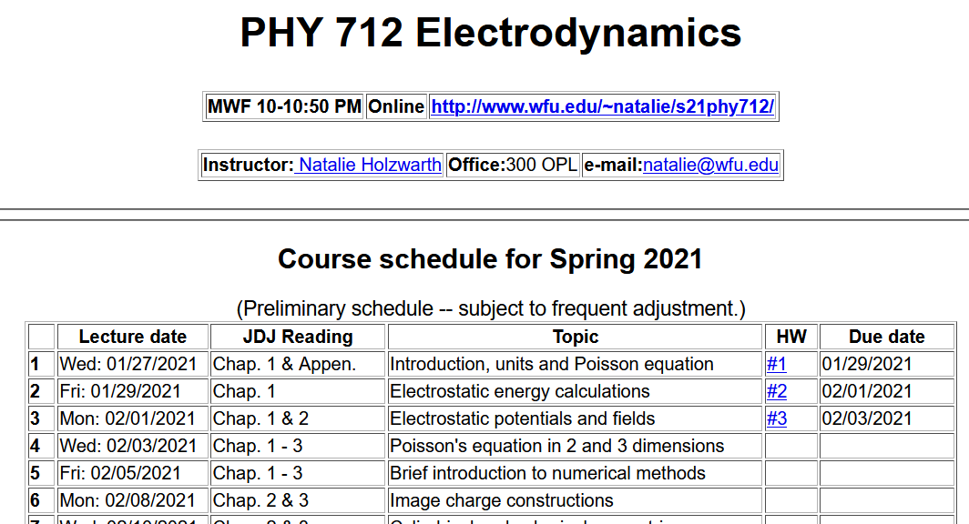
Notes:
Updated schedule. Note new homework assignment which follows from today’s lecture.

Slide 5
Notes:
Content of lHW 3.

Slide 6
Poisson and Laplace Equations
We are concerned with finding solutions to the Poisson equation:
and the Laplace equation:
The Laplace equation is the “homogeneous” version of the Poisson equation. The Green's theorem allows us to determine the electrostatic potential from volume and surface integrals:
Notes:
Here we start our systematic derivations of solution of the electrostatic equation for a potential with a given charge source and the associated homogeneous equation.

Slide 7
Poisson equation -- continued
Notes:
What we discussed last week is still true for isolated charges. Now we consider the case where the charges are within a volume V whose surface may have some imposed restrictions (boundary condisions).

Slide 8
General comments on Green’s theorem
This general form can be used in 1, 2, or 3 dimensions. In general, the Green's function must be constructed to satisfy the appropriate (Dirichlet or Neumann) boundary conditions. Alternatively or in addition, boundary conditions can be adjusted using the fact that for any solution to the Poisson equation, other solutions may be generated by use of solutions of the Laplace equation
Notes:
Comment about how the boundary conditions may or may not work.

Slide 9
Question -- We use the Green theorem to get the potential. In this formula, is phi (r prime) a known condition? If not, how can we use this theorem to get the potential as we have to know potential first to calculate the integral?
Comment – You are correct; it is assumed that we know the potential or its derivative on the boundary. As mentioned previously, in general we cannot know both or in other ways over specify the problem.

Slide 10
“Derivation” of Green’s Theorem
Notes:
Here we derive the equations stated on the previous slides.

Slide 11
Your question -- When we choose f and g to be Phi and G, where does that intuition come from in plugging into divergence theorem?
Comment – I assume this was the genius of Green (perhaps with the help of Jackson).
Another comment – Ideally the Green’s function will be designed to take into account the boundary conditions for your given problem. In some cases, further adjustments may be needed.

Slide 12
“Derivation” of Green’s Theorem
Notes:
Derivation continued.

Slide 13
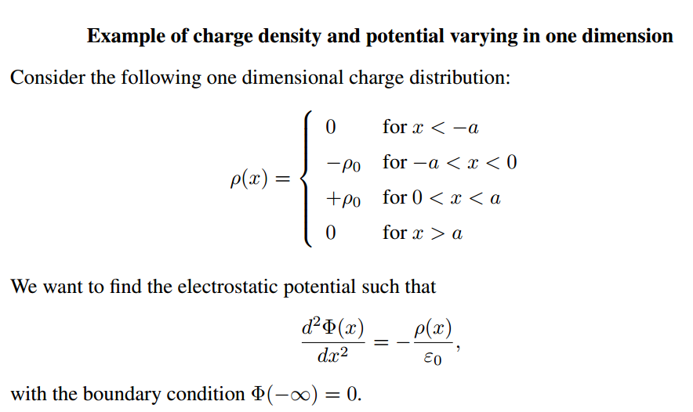
Notes:
Simple one-dimensional example of a particular charge distribution.

Slide 14
Laplace
Poisson
Poisson
Laplace
Notes:
Resultant potential and electric field.

Slide 15
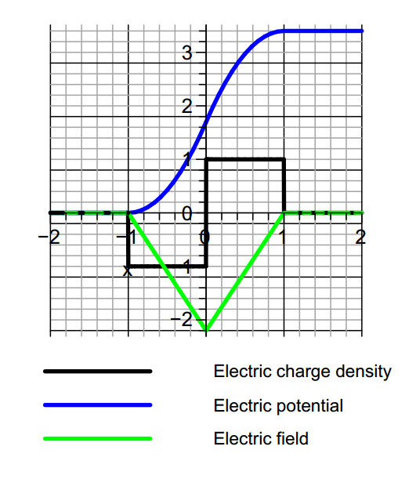
Notes:
Graph of results for this example

Slide 16
Comment about the example and solution
This particular example is one that is used to model semiconductor junctions where the charge density is controlled by introducing charged impurities near
the junction.
The solution of the Poisson equation for this case can be determined by piecewise solution within each of the four regions. Alternatively, from Green's theorem in one-dimension, one can use the Green's function
Notes:
Comment and generalization.

Slide 17
Notes on the one-dimensional Green’s function
Notes:
Some details.

Slide 18
Construction of a Green’s function in one dimension
Notes:
Details continued for one dimensional Poisson equation.

Slide 19
Summary
Notes:
Summary for one dimensional Poisson equation.

Slide 20
One dimensional Green’s function in practice
This expression gives the same result as previously obtained for the example ρ(x) and more generally is appropriate for any neutral charge distribution.
Notes:
Some general comments.

Slide 21
Question -- On slide 16, how do we know which one of x and x' is the x_< term?
x’<x
x’>x

Slide 22
Notes:
Now we will discuss another approach to analyzing Green’s functions based on expansion in terms of a complete set of orthogonal functions.

Slide 23
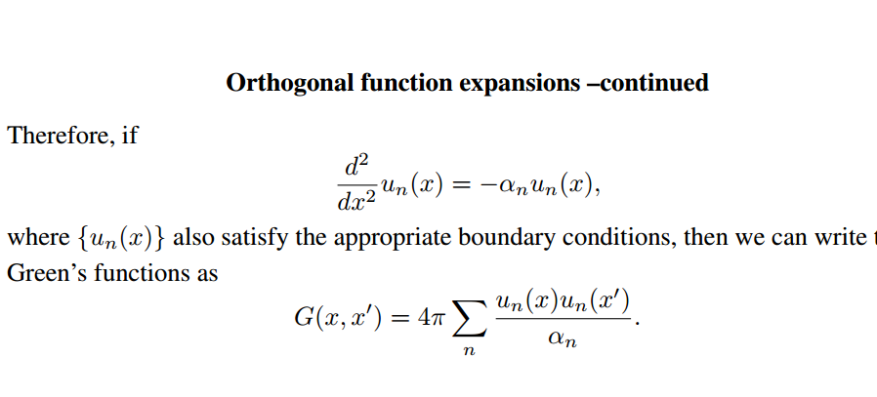
Notes:
Some details for orthogonal function expansion method.

Slide 24
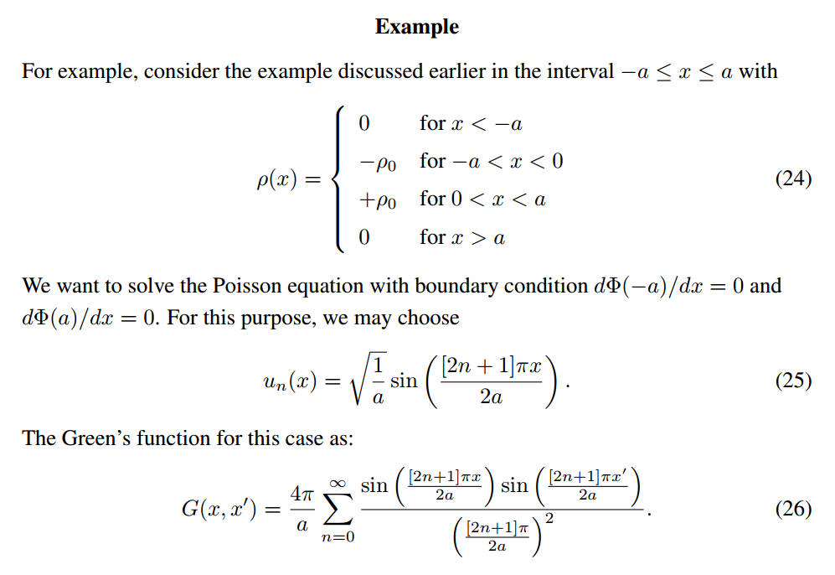
Notes:
Application to our example.

Slide 25
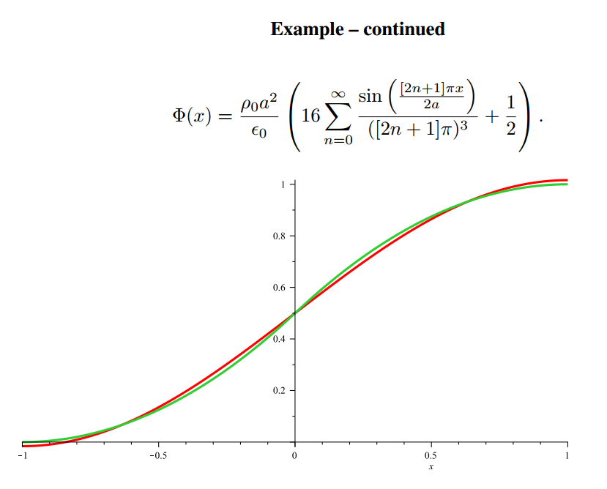
Notes:
Graph of potential (green) and expansion for a few terms. Note that it was necessary to shift the potential by a constant.

