Slide 1
PHY 712 Electrodynamics
10-10:50 AM MWF Online
Plan for Lecture 4:
Reading: Chapter 1 - 3 in JDJ
Electrostatic potentials
One, two, and three dimensions (Cartesian coordinates)
Mean value theorem for the electrostatic potential
Notes:
In this lecture, we will continue to develop solution methods for solving electrostatic problems.

Slide 2
Notes:
Tomorrow’s colloquium

Slide 3
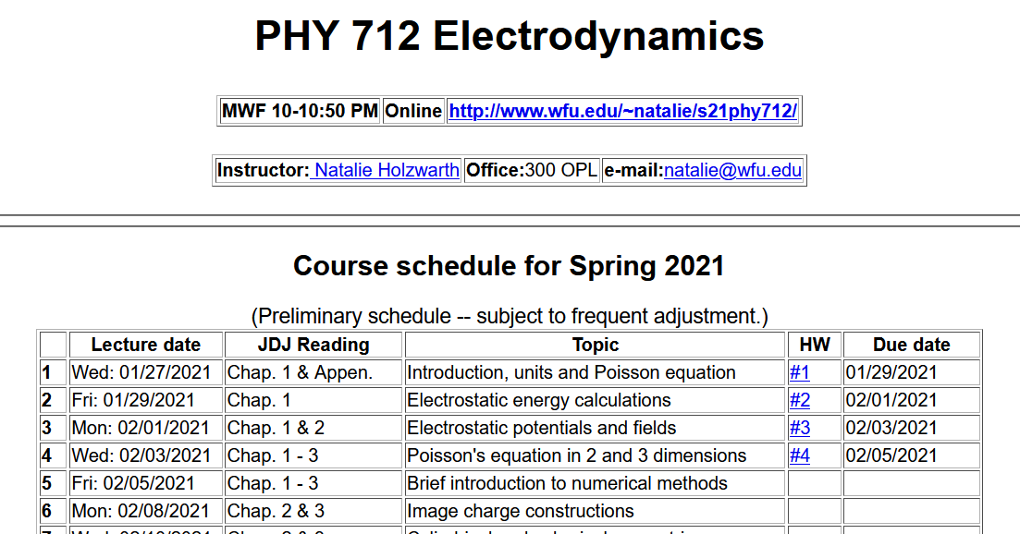
Notes:
Updated schedule

Slide 4
Poisson Equation
Notes:
Review of the general methods for solving the Poisson equation in various dimensions and geometries.

Slide 5
Poisson equation for one-dimensional system
Notes:
For one Cartesian dimension – reviewing previously discussed results.

Slide 6
General procedure for constructing Green’s function for one-dimensional system using 2 independent solutions of the homogeneous equations
Beautiful method; but only works in one dimension.
Notes:
Some details

Slide 7
Notes:
Review of orthogonal function expansions.

Slide 8
Orthogonal function expansion -- continued
Notes:
Construction of Green’s function for one dimensional case.

Slide 9
Example
Notes:
Reviewing our “favorite” example.

Slide 10
Example -- continued
Notes:
Some details.

Slide 11
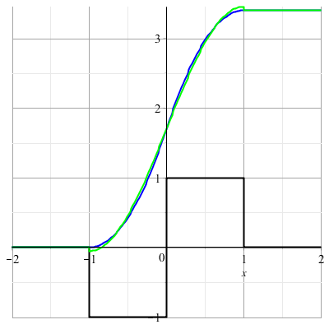
Example -- continued
Notes:
Summary.

Slide 12
Orthogonal function expansions in 2 and 3 dimensions
(See Eq. 3.167 in Jackson for example.)
Notes:
Extension of the ideas to multiple dimensions.

Slide 13
Details of a two-dimensional example --
Example:
b
a
Two dimensional box with sides a and b with boundary conditions: Φ(0,y)=Φ(a,y)=Φ(x,0)=Φ(x,b)=0
Notes:
Analyzing in detail the two dimensional case.

Slide 14
Two dimensional example continued --
b
a
Notes:
Two dimensional case, using orthogonal functions in both x and y dimensions.

Slide 15
Example two-dimensional system continued --
Two dimensional box with sides a and b with boundary conditions: Φ(0,y)=Φ(a,y)=Φ(x,0)=Φ(x,b)=0
b
a
Don’t know this term
Know this term=0
➔By design G(r,r’) vanishes on boundary.
Notes:
Specific example.

Slide 16
Notes:
Two examples.

Slide 17
Combined orthogonal function expansion and homogeneous solution construction of Green’s function
in 2 and 3 dimensions.
For the two and three dimensional cases, we can use this technique in one of the dimensions in order to reduce the number of summation terms. These ideas are discussed in Section 3.11 of Jackson.
Notes:
Now consider using orthogonal function expansion in the x dimension and the homogeneous solution construction in the y dimension.

Slide 18
Green’s function construction -- continued
Notes:
Some details.

Slide 19
Notes:
More details.

Slide 20
Example:
b
a
Two dimensional box with sides a and b with boundary conditions: Φ(0,y)=Φ(a,y)=Φ(x,0)=Φ(x,b)=0
Don’t know this term
Know this term
Notes:
More details.

Slide 21
Example:
b
a
Two dimensional box with sides a and b with boundary conditions: Φ(0,y)=Φ(a,y)=Φ(x,0)=Φ(x,b)=0
Notes:
Checking boundary values.

Slide 22
$$,$$
Notes:
More details.

Slide 23
Green’s function construction -- continued
b
a
Notes:
Resultant effective Green’s function for this case.

Slide 24
b
a
=0
Notes:
Checking boundary values.

Slide 25
Notes:
Application to previously discussed examples (also your homework examples).

Slide 26
Notes:
Changing gears slightly -- discussion of the mean value theorem for electrostatics.

Slide 27
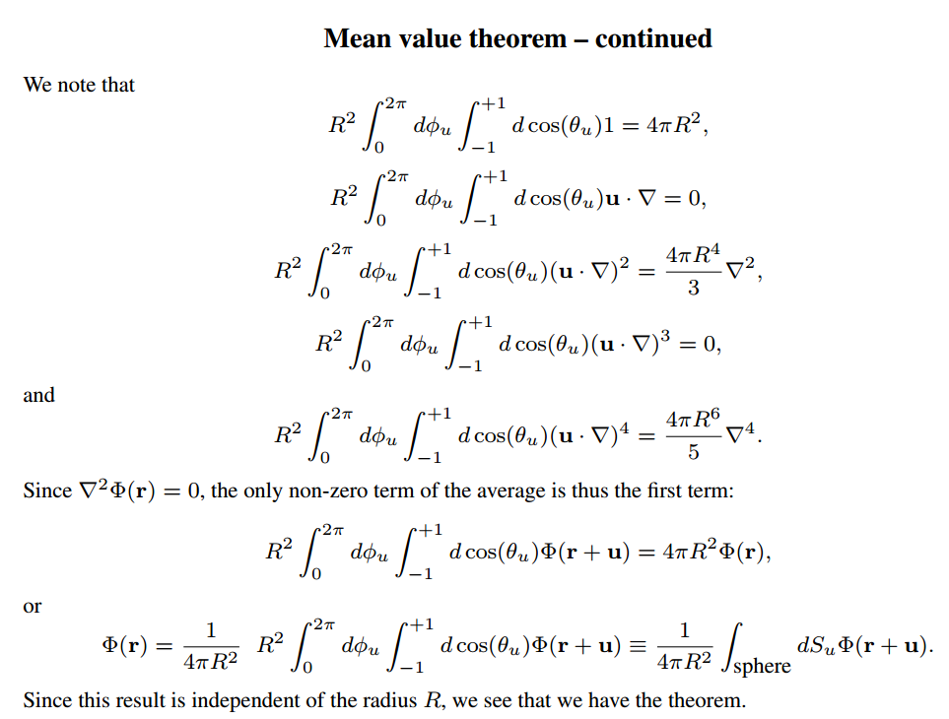
Notes:
Some details

Slide 28
Summary: Mean value theorem
Notes:
Summary of results.

