Slide 1
PHY 712 Electrodynamics
10-10:50 AM MWF Online
Class notes for Lecture 4:
Reading: Chapter 1 - 3 in JDJ
    Electrostatic potentials
    One, two, and three dimensions (Cartesian coordinates)
    Mean value theorem for the electrostatic potential
Notes:
In this lecture, we will continue to develop solution methods for solving electrostatic problems.

Slide 2
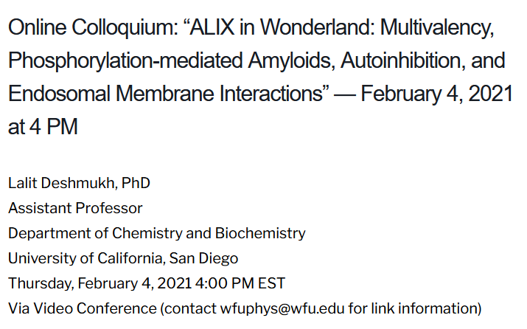
Notes:
Tomorrow’s colloquium

Slide 3
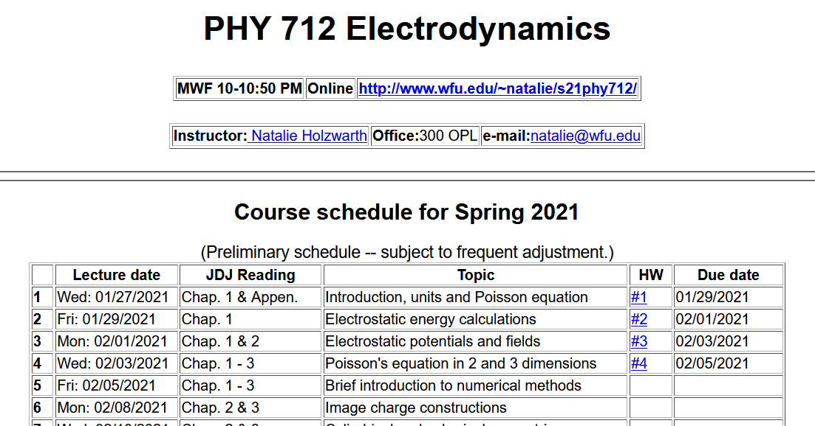
Notes:
Updated schedule

Slide 4
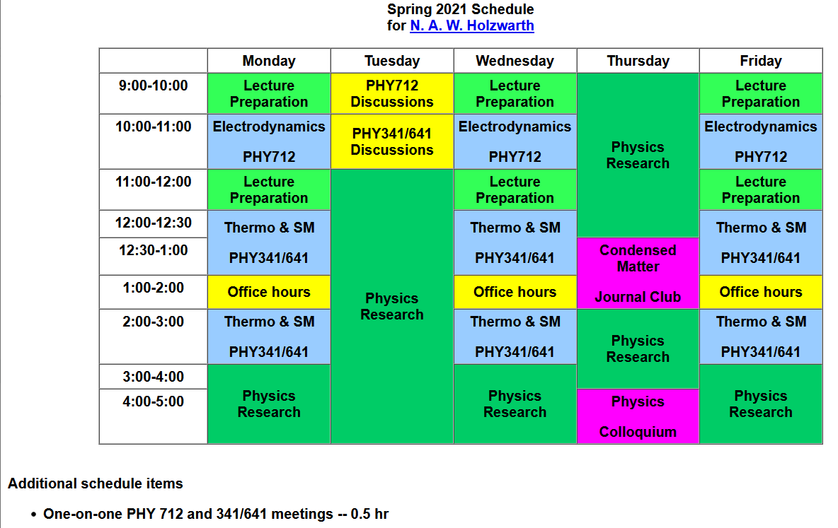

Slide 5
Poisson Equation
Notes:
Review of the general methods for solving the Poisson equation in various dimensions and geometries.

Slide 6
Poisson equation for one-dimensional system
Notes:
For one Cartesian dimension – reviewing previously discussed results.

Slide 8
Question
Why these extra terms?

Slide 9
General procedure for constructing Green’s function for one-dimensional system using 2 independent solutions of the homogeneous equations
Beautiful method; but only works in one dimension.
Notes:
Some details

Slide 10
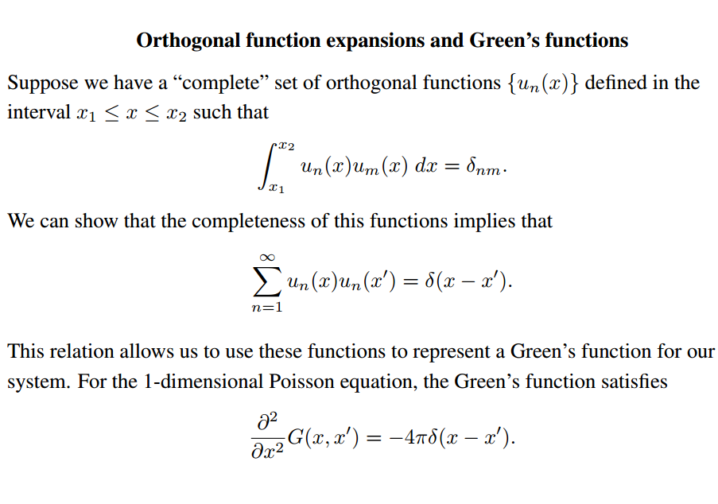
Notes:
Review of orthogonal function expansions.

Slide 11
Orthogonal function expansion -- continued
Notes:
Construction of Green’s function for one dimensional case.

Slide 12
Example
Notes:
Reviewing our “favorite” example.

Slide 13
Example -- continued
Notes:
Some details.

Slide 14
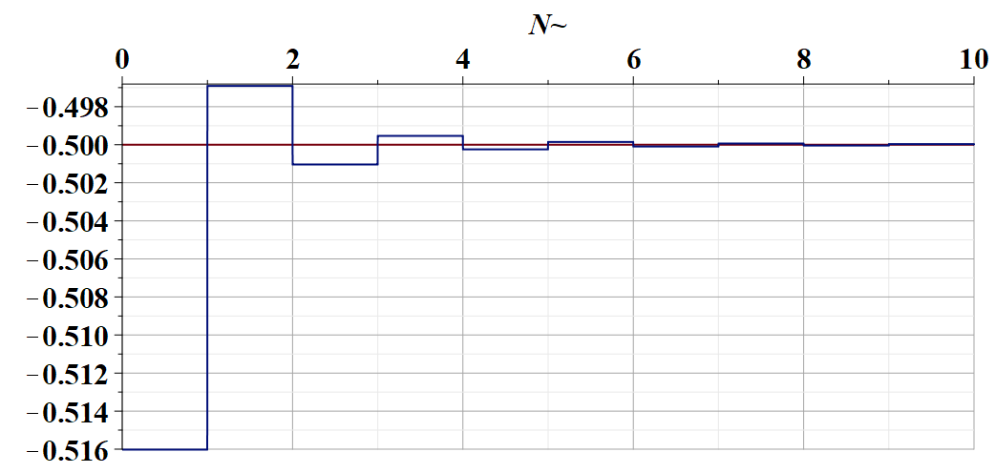
Some details --

Slide 15
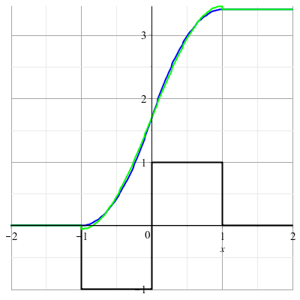
Example -- continued
Notes:
Summary.

Slide 16
Is the eigenfunction expansion for constructing Green’s functions unique?
  Yes
  No
Assuming that there are more than one possible eigenfunction expansion, how do you choose?

Slide 17
Orthogonal function expansions in 2 and 3 dimensions
(See Eq. 3.167 in Jackson for example.)
Notes:
Extension of the ideas to multiple dimensions.

Slide 18
Details of a two-dimensional example --
Example:
b
a
Two dimensional box with sides a and b with boundary conditions: Φ(0,y)=Φ(a,y)=Φ(x,0)=Φ(x,b)=0
Notes:
Analyzing in detail the two dimensional case.

Slide 19
Two dimensional example continued --
b
a
Notes:
Two dimensional case, using orthogonal functions in both x and y dimensions.

Slide 20
Example two-dimensional system continued --
Two dimensional box with sides a and b with boundary conditions: Φ(0,y)=Φ(a,y)=Φ(x,0)=Φ(x,b)=0
b
a
Don’t know this term
Know this term=0
➔By design G(r,r’) vanishes on boundary.
Notes:
Specific example.

Slide 21
Notes:
Two examples.

Slide 22
Combined orthogonal function expansion and homogeneous solution construction of Green’s function
in 2 and 3 dimensions.
For the two and three dimensional cases, we can use this technique in one of the dimensions in order to reduce the number of summation terms. These ideas are discussed in Section 3.11 of Jackson.
Notes:
Now consider using orthogonal function expansion in the x dimension and the homogeneous solution construction in the y dimension.

Slide 23
Green’s function construction -- continued
Notes:
Some details.

Slide 24
Notes:
More details.

Slide 25
Example:
b
a
Two dimensional box with sides a and b with boundary conditions: Φ(0,y)=Φ(a,y)=Φ(x,0)=Φ(x,b)=0
Don’t know this term
Know this term
Notes:
More details.

Slide 26
Example:
b
a
Two dimensional box with sides a and b with boundary conditions: Φ(0,y)=Φ(a,y)=Φ(x,0)=Φ(x,b)=0
Notes:
Checking boundary values.

Slide 27

$$,$$
Notes:
More details.

Slide 28
Green’s function construction -- continued
b
a
Notes:
Resultant effective Green’s function for this case.

Slide 29
b
a
=0
Notes:
Checking boundary values.

Slide 30
*a lot of dust!
Notes:
Application to previously discussed examples (also your homework examples).

Slide 31
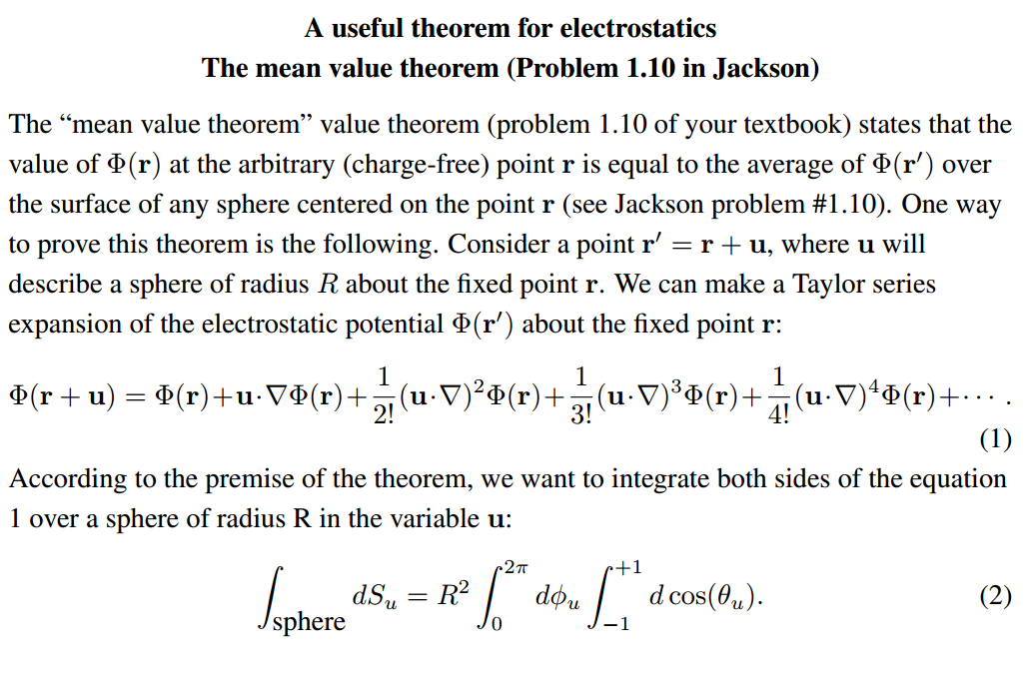
Notes:
Changing gears slightly -- discussion of the mean value theorem for electrostatics.

Slide 32
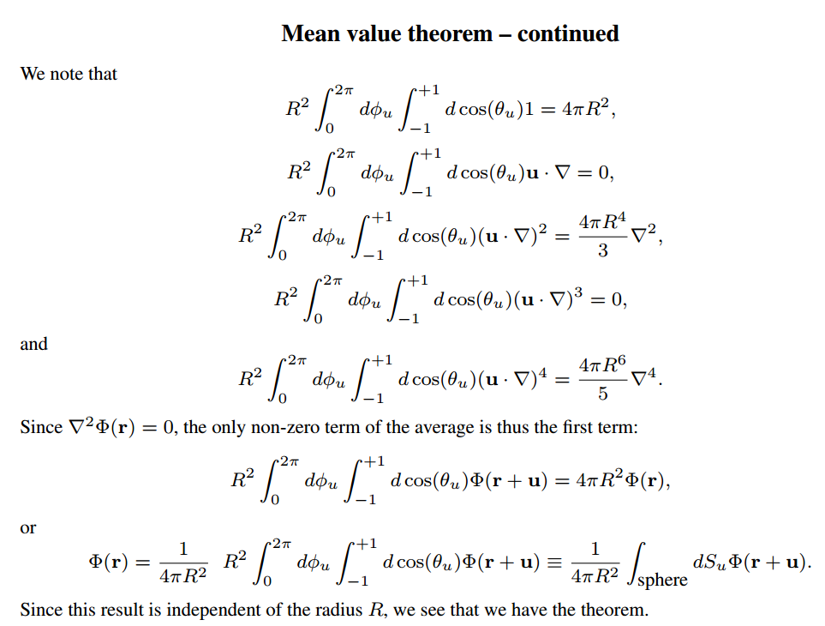
Notes:
Some details

Slide 33
Summary: Mean value theorem
Notes:
Summary of results.

