Slide 1
PHY 712 Electrodynamics
10-10:50 AM MWF Online
Plan for Lecture 7:
Start reading Chapter 3
Solution of Poisson/Laplace equation for special geometries –
Cylindrical
Spherical

Slide 2
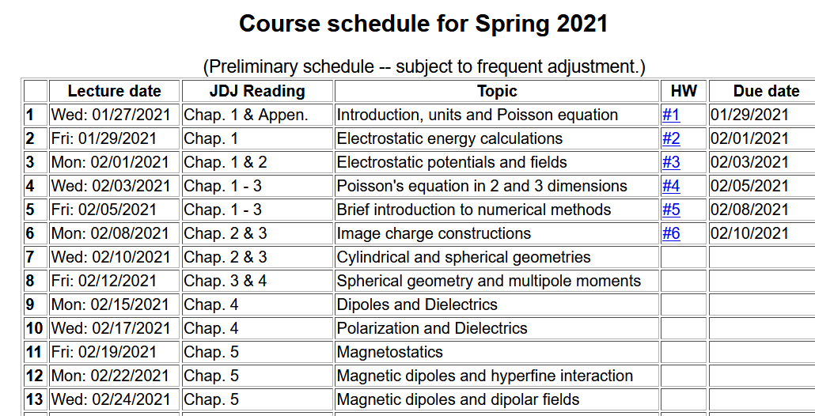

Slide 3
Tomorrow’s colloquium

Slide 4
Solution of the Poisson/Laplace equation in various geometries -- cylindrical geometry with no z-dependence (infinitely long wire, for example):
φ
ρ

Slide 5
Cylindrical coordinates with trivial z-dependence –
some details:
φ
ρ

Slide 6
Solution of the Poisson/Laplace equation in various geometries -- cylindrical geometry with no z-dependence (infinitely long wire, for example):
φ
ρ

Slide 7
Comments and details
φ
r

Slide 8
Example – uniform cylindrical shell:
z
Top view:
a
b
y
r
x

Slide 9
Some details

Slide 10
Example continued -- m=0 only --
Top view:
a
b

Slide 11
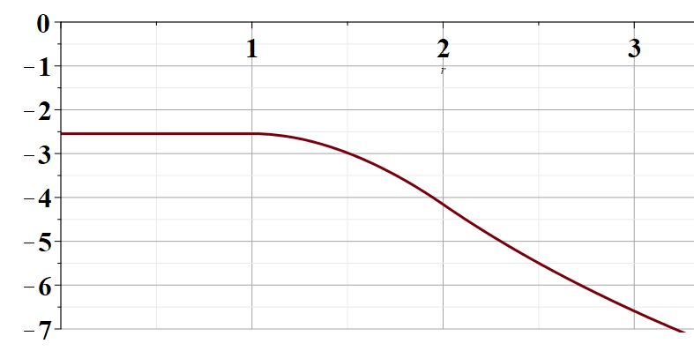
Example continued -- m=0 only --
a
b
r

Slide 12
Solution of the Poisson/Laplace equation in various geometries -- cylindrical geometry with z-dependence
φ
ρ
z

Slide 13
Cylindrical geometry continued:
φ
ρ
z

Slide 14
Cylindrical geometry continued:
φ
ρ
z

Slide 15
Solutions of Laplace equation inside cylindrical shape
Example with non-trivial boundary value at z=L
m=0
m=1
m=2
kρ

Slide 16
Solutions of Laplace equation inside cylindrical shape
Example with non-trivial boundary value at z=L

Slide 17
Solutions of Laplace equation inside cylindrical shape
Example with non-trivial boundary value at ρ=a
m=0
m=1
m=2
kρ

Slide 18
Solutions of Laplace equation inside cylindrical shape
Example with non-trivial boundary value at ρ=a

Slide 19
Green’s function for Dirchelet boundary value inside cylindar:

Slide 20
Comments on cylindrical Bessel functions
m=0
K₀
I₀/50
J₀
N₀

Slide 21
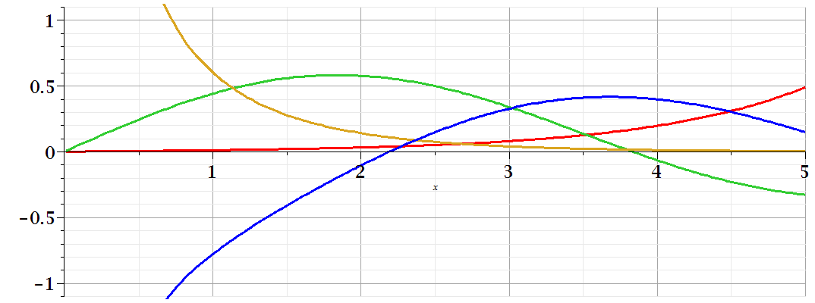
Comments on cylindrical Bessel functions
K₁
m=1
I₁/50
J₁
N₁

Slide 22
Some useful identities involving cylindrical Bessel functions

Slide 23
Poisson and Laplace equation in spherical polar coordinates
http://www.uic.edu/classes/eecs/eecs520/textbook/node32.html

Slide 24
Poisson and Laplace equation in spherical polar coordinates -- continued

Slide 25
Properties of spherical harmonic functions

Slide 26
Useful identity:

Slide 27
Example -- continued

Slide 28
Useful identity:

Slide 29
Useful identity:

Slide 30
Some spherical harmonic functions:

