Slide 1
PHY 712 Electrodynamics
10-10:50 AM MWF Online
Class notes for Lecture 7:
Start reading Chapter 3
Solution of Poisson/Laplace equation for special geometries –
Cylindrical
Spherical

Slide 2
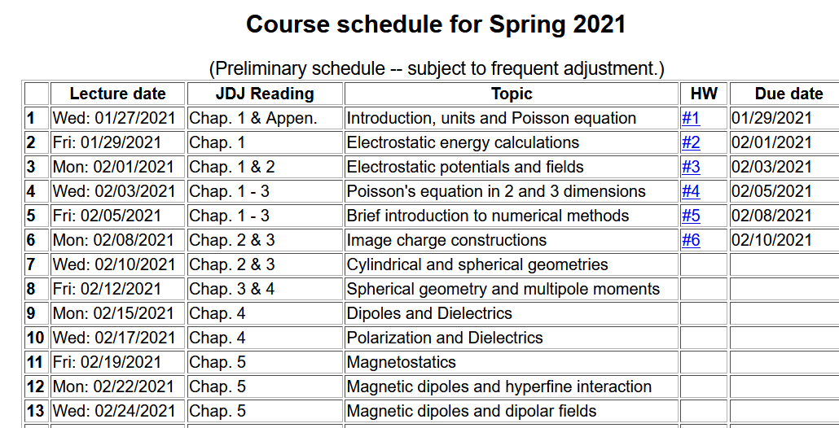

Slide 3
Tomorrow’s colloquium

Slide 4
Your questions –
From Tim -- Could you go over how we came to the equation G(p,p',phi, phi') on slide 6?
From Gao – After solving Laplace equations in various geometries and with different boundary conditions, how can we get related Green functions? You have written them out, but according to what you did it? In page 10, 11, Why does only m=0 exist or you just wrote the expression for m=0? In some symmetric systems, or only in spherical symmetry systems, if rho vanishes for r is infinite, then the green function can be chosen as 1/(r-r')?

Slide 5
Solution of the Poisson/Laplace equation in various geometries -- cylindrical geometry with no z-dependence (infinitely long wire, for example):
φ
ρ

Slide 6
Cylindrical coordinates with trivial z-dependence –
some details:
φ
ρ

Slide 7
Solution of the Poisson/Laplace equation in various geometries -- cylindrical geometry with no z-dependence (infinitely long wire, for example):
φ
ρ

Slide 8
Questions: How did we get this Green’s function
Comment: Jackson very cleverly used the ideas we discussed for the two dimensional Cartesian case --

Slide 9
Green’s function construction -- continued

Slide 12
Comments and details
φ
r

Slide 13
Example – uniform cylindrical shell:
z
Top view:
a
b
y
r
x

Slide 14
Question – Why only m=0 for this case?

Slide 15
Some details

Slide 16
Example continued -- m=0 only --
Top view:
a
b

Slide 17
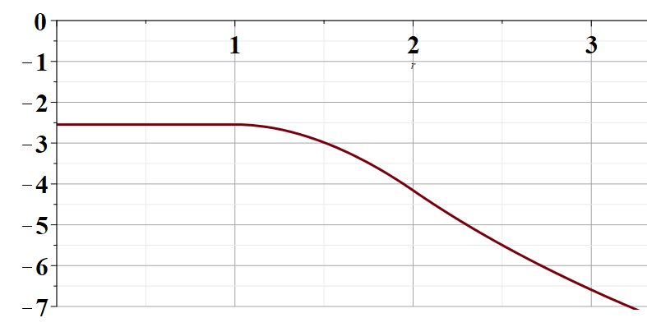
Example continued -- m=0 only --
a
b
r

Slide 18
Solution of the Poisson/Laplace equation in various geometries -- cylindrical geometry with z-dependence
φ
ρ
z

Slide 19
Cylindrical geometry continued:
φ
ρ
z

Slide 20
Cylindrical geometry continued:
φ
ρ
z

Slide 21
Solutions of Laplace equation inside cylindrical shape
Example with non-trivial boundary value at z=L
m=0
m=1
m=2
kρ

Slide 22
Solutions of Laplace equation inside cylindrical shape
Example with non-trivial boundary value at z=L

Slide 23
Solutions of Laplace equation inside cylindrical shape
Example with non-trivial boundary value at ρ=a
m=0
m=1
m=2
kρ

Slide 24
Solutions of Laplace equation inside cylindrical shape
Example with non-trivial boundary value at ρ=a

Slide 25
Green’s function for Dirchelet boundary value inside cylindar:

Slide 26
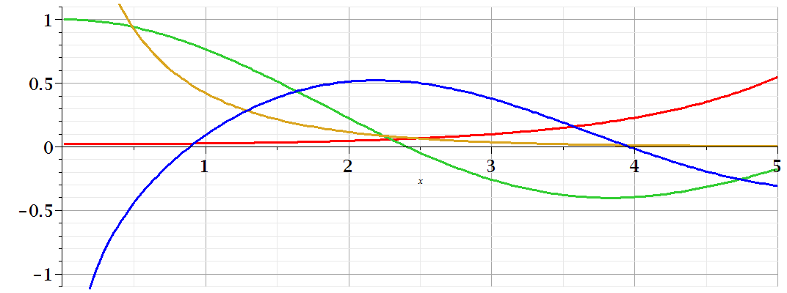
Comments on cylindrical Bessel functions
m=0
K₀
I₀/50
J₀
N₀

Slide 27
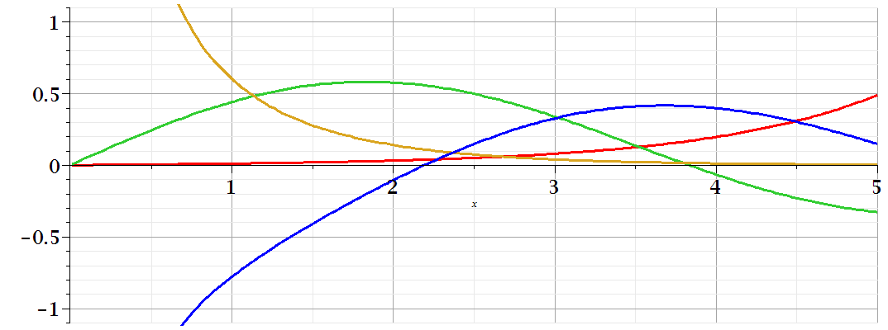
Comments on cylindrical Bessel functions
K₁
m=1
I₁/50
J₁
N₁

Slide 28
Some useful identities involving cylindrical Bessel functions

Slide 29
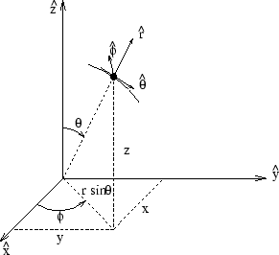
Poisson and Laplace equation in spherical polar coordinates
http://www.uic.edu/classes/eecs/eecs520/textbook/node32.html

Slide 30
Poisson and Laplace equation in spherical polar coordinates -- continued

Slide 31
Properties of spherical harmonic functions

Slide 32
Useful identity:

Slide 33
Example -- continued

Slide 34
Useful identity:

Slide 35
Useful identity:

Slide 36
Some spherical harmonic functions:

