Slide 1
PHY 712 Electrodynamics
10-10:50 AM MWF Online
Class notes for Lecture 8:
Finish reading Chap. 3 and start Chap. 4
Multipole moment expansion of electrostatic potential –
Spherical coordinates
Cartesian coordinates

Slide 2
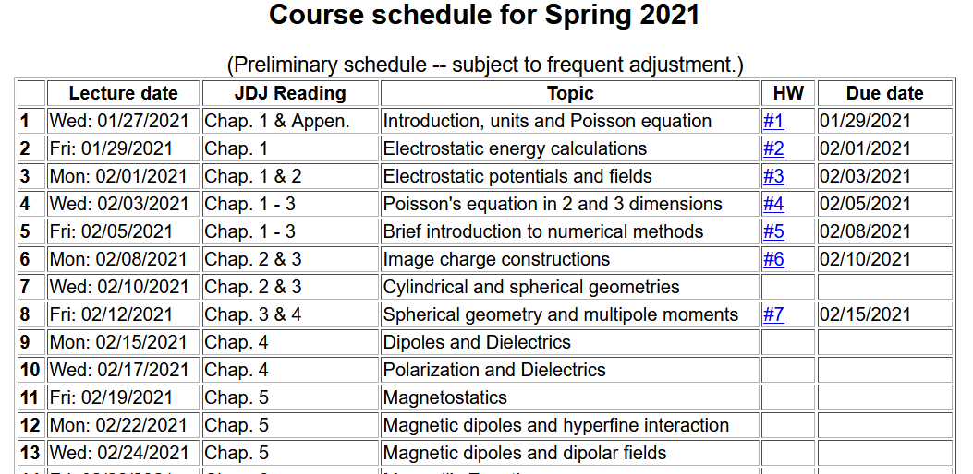

Slide 4
Your questions –
From Gao -- We bring up multipole moments for changing expression of Phi. What other purposes does it have?
From Tim -- So you say the equation on slide 7 is important. Is the method to describe your charge density (normally in factors of sines and cosines) into spherical harmonics such as Y_lm so that we can use the equation on slide 7?
From Nick -- On a different note from yesterday's lecture. When we are discussing the cylindrical shell, we say it only works for m=0 and I get cosine integral argument, but we have a factor of 1/m, so how can m=0?

Slide 5
Brief comment about cylindrical geometry case --

Slide 6
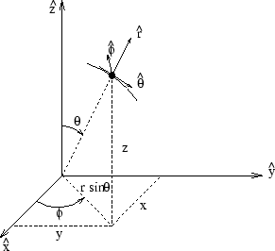
Poisson and Laplace equation in spherical polar coordinates
http://www.uic.edu/classes/eecs/eecs520/textbook/node32.html

Slide 7
Poisson and Laplace equation in spherical polar coordinates -- continued

Slide 8
Properties of spherical harmonic functions

Slide 9
Legendre and Associated Legendre functions

Slide 11
Some spherical harmonic functions:

Slide 13
Even more useful identity:

Slide 15
Example:

Slide 16
Example -- continued:

Slide 17
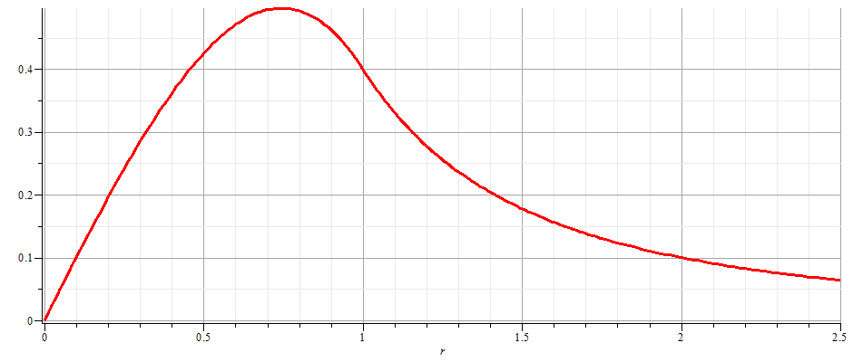
Example -- continued:
r = a

Slide 18
Notion of multipole moment:

Slide 19
Significance of multipole moments
q_{lm}

Slide 20
Multipole moments continued:
Relationship between spherical harmonic and Cartesian forms of multipole moments:

Slide 21
Consider previous example:

Slide 22
General form of electrostatic potential in terms of multipole moments:

Slide 23
Example of multipole expansion in evaluating energy of a very localized charge density ρ(r) in a electrostatic field Φ(r) (such as an nucleus in the field produced by electrons in an atom).

Slide 24
Simple examples of multipole distributions
z
+q
y
x
-q
z
+q
-2q
y
x
+q

Slide 25
Another example of multipole distribution

Slide 26
Another example of multipole distribution -- continued

Slide 27
Another example of multipole distribution -- continued

Slide 28
Another example of multipole distribution -- continued

