Slide 1
PHY 712 Electrodynamics
10-10:50 AM MWF Online
Class for Lecture 9:
Continue reading Chapter 4
Dipolar fields and dielectrics
Electric field due to a dipole
Electric polarization P
Electric displacement D and dielectric functions

Slide 2
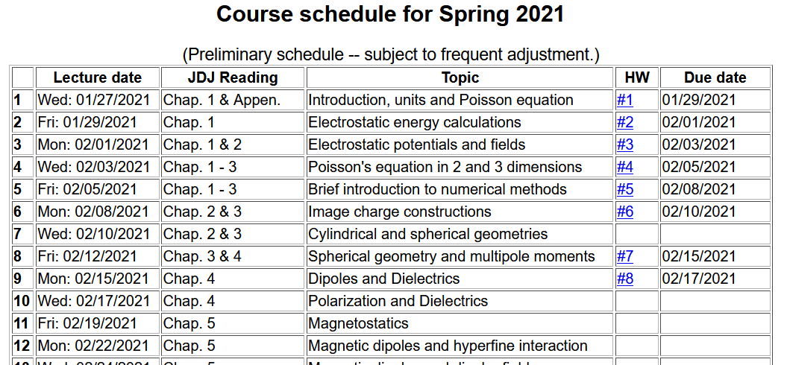

Slide 3
Your questions –
From Gao -- About boundary value, assuming the screen is the boundary surface, and for E1t=E2t, if E1t is in x direction and E2t is in y direction, of course E1t and E2t are in the same plane, the screen surface. Will the equation E1t=E2t still be correct?

Slide 4
Review: General results for a multipole analysis of the electrostatic potential due to an isolated charge distribution:
q_{lm}

Slide 5
Comment --
Acts like a projection operator

Slide 6
The the multipole analysis has the following general behavior for r→infinity:
Here q, p_{i}, and Q_{ij} are linearly proportional to the q_{lm} multipole values.

Slide 7
The multipole analysis also can be used to analyze the the electrostatic fields for r→0 as needed in the following example involving a very localized charge density ρ(r) in a electrostatic field Φ(r) (such as a nucleus in the field produced by electrons in an atom).
charge density within nucleus
electrostatic potential due to electrons near the nucleus.

Slide 8
Consider the following example of a charge distribution

Slide 9
Writing out the details of the potential from evaluating integrals

Slide 10
More details continued --

Slide 11
Another example of multipole distribution -- continued
Here q stands for the elementary charge
q=e=1.602176634x10⁻¹⁹C

Slide 12
Notion of multipole moment:

Slide 13
General form of electrostatic potential in terms of multipole moments:

Slide 14
Focus on dipolar contributions:

Slide 15
“Justification” of surprizing δ-function term in dipole electric field -- Assuming dipole is located at r=0, we need to need to evaluate the electrostatic field near r=0:

Slide 16
Some details:

Slide 17
More details

Slide 18
More details continued --

Slide 19
In summary --
Note: The lecture ran out of time at this slide. The discussion will continue on Wednesday.

Slide 20
Summary of key argument:
z
r₂
r₁
y
x

Slide 21
Coarse grain representation of macroscopic distribution of dipoles:

Slide 22
Coarse grain representation of macroscopic distribution of dipoles -- continued:

Slide 23
Coarse grain representation of macroscopic distribution of dipoles -- continued:

Slide 24
Coarse grain representation of macroscopic distribution of dipoles -- continued:
Boundary value problems in dielectric materials

Slide 25
Boundary value problems in the presence of dielectrics – example:
ε₁
ε₂
E₁
E₂
D₁
D₂
For isotropic dielectrics:

Slide 26
Boundary value problems in the presence of dielectrics – example:
E₀
a
E
θ
z
ε
ε₀

Slide 27
Boundary value problems in the presence of dielectrics – example -- continued:

Slide 28
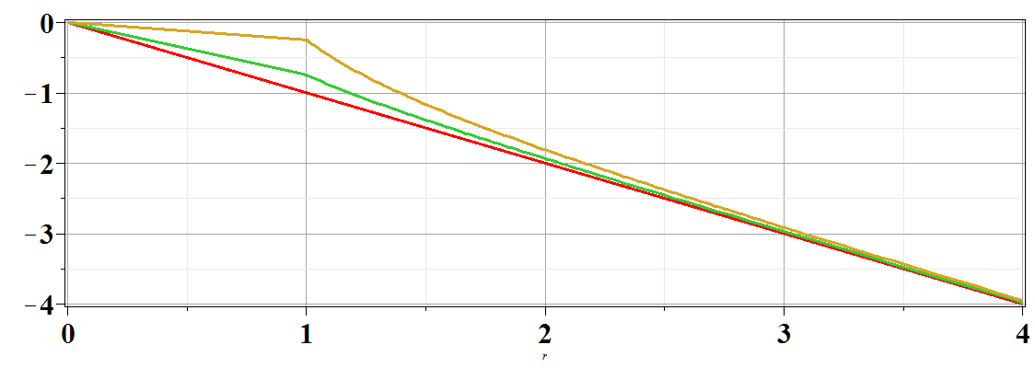
Boundary value problems in the presence of dielectrics – example -- continued:
Φ(r,θ=0)
ε/ε₀=
10
2
1
r/a

