Slide 1
PHY 712 Electrodynamics
11-11:50 AM MWF in Olin 103
Notes for Lecture 10:
    Reading Chapter 4 in JDJ -- Dipolar fields and dielectrics
        Electric field due to a dipole
        Electric polarization P
        Electric displacement D and dielectric functions

Slide 2
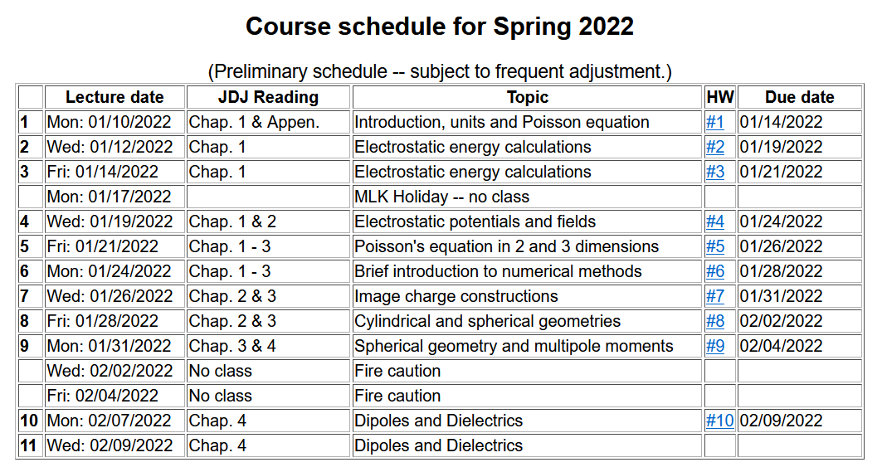

Slide 3
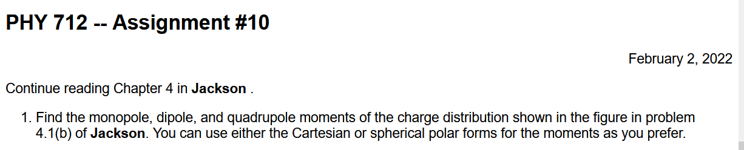

Slide 4

Colloquium schedule and other important events –
On Friday 2/11/2022 -- http://users.wfu.edu/shapiro/WIS.html

Slide 5
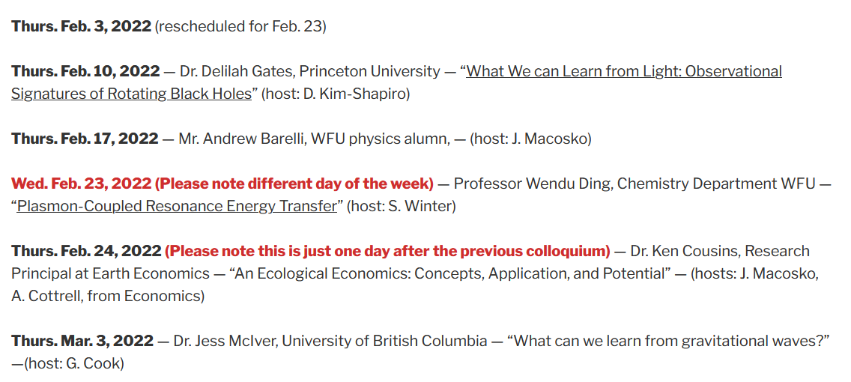
Changes to colloquium schedule --

Slide 6
Review: General results for a multipole analysis of the electrostatic potential due to an isolated charge distribution:
q_{lm}

Slide 7
Comment --
Acts like a projection operator

Slide 8
The the multipole analysis has the following general behavior for r→infinity:
Here q, p_{i}, and Q_{ij} are linearly proportional to the q_{lm} multipole values.

Slide 9
The multipole analysis also can be used to analyze the the electrostatic fields for r→0 as needed in the following example involving a very localized charge density ρ(r) in a electrostatic field Φ(r) (such as a nucleus in the field produced by electrons in an atom).
charge density within nucleus
electrostatic potential due to electrons near the nucleus.

Slide 10
The following results were presented on Monday and are summarized here for a more complicated charge distribution:

Slide 11
Writing out the details of the potential from evaluating integrals

Slide 12
More details continued --

Slide 13
Example of multipole distribution continued --
Here q stands for the elementary charge
q=e=1.602176634x10⁻¹⁹C

Slide 14
Summary -- Notion of multipole moment:

Slide 15
General form of electrostatic potential in terms of multipole moments:

Slide 16
Focus on dipolar contributions:

Slide 17
“Justification” of surprising δ-function term in dipole electric field -- Assuming dipole is located at r=0, we need to need to evaluate the electrostatic field near r=0:

Slide 18
Some details -- amplifying discussion in JDJ:

Slide 19
More details

Slide 20
More details continued --

Slide 21
In summary --

Slide 22
Summary of key argument:
z
r₂
r₁
y
x

Slide 23
Coarse grain representation of macroscopic distribution of dipoles:

Slide 24
Coarse grain representation of macroscopic distribution of dipoles -- continued:

Slide 25
Coarse grain representation of macroscopic distribution of dipoles -- continued:

Slide 26
Coarse grain representation of macroscopic distribution of dipoles -- continued:
Boundary value problems in dielectric materials

Slide 27
Boundary value problems in the presence of dielectrics – example:
ε₁
ε₂
E₁
E₂
D₁
D₂
For isotropic dielectrics:

Slide 28
Boundary value problems in the presence of dielectrics – example:
E₀
a
E
θ
z
ε
ε₀

Slide 29
Boundary value problems in the presence of dielectrics – example -- continued:

Slide 30
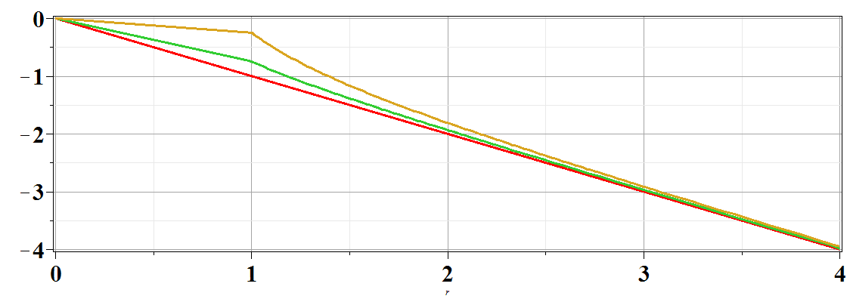
Boundary value problems in the presence of dielectrics – example -- continued:
Φ(r,θ=0)
ε/ε₀=
10
2
1
r/a

