Slide 1
PHY 712 Electrodynamics
11-11:50 AM MWF in Olin 103
Class notes for Lecture 13:
Continue reading Chapter 5
Examples of magnetostatic fields
Magnetic dipoles
Hyperfine interaction

Slide 2
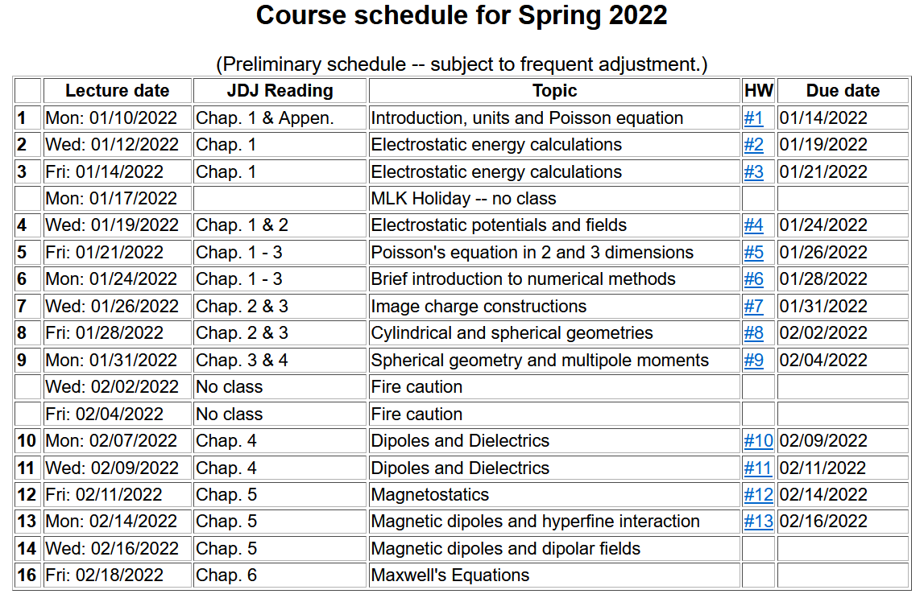

Slide 3
Comment – in class, we will discuss a similar problem with a model current density is due to a rotating uniformly charged sphere
For HW 13 the model current density is due to a rotating charged spherical shell:

Slide 4
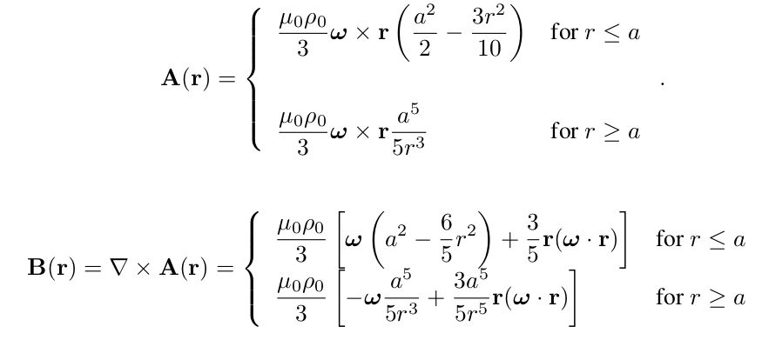
For the model current density --

Slide 5
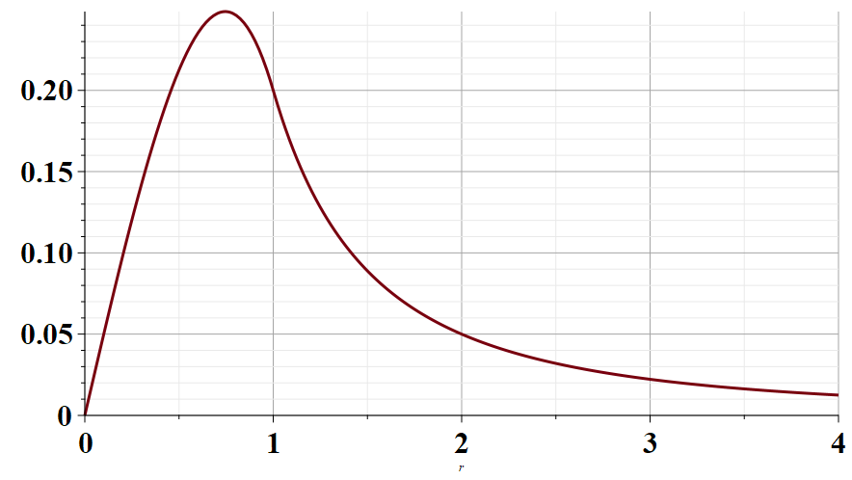
Radial part of A(r)
r/a →

Slide 6
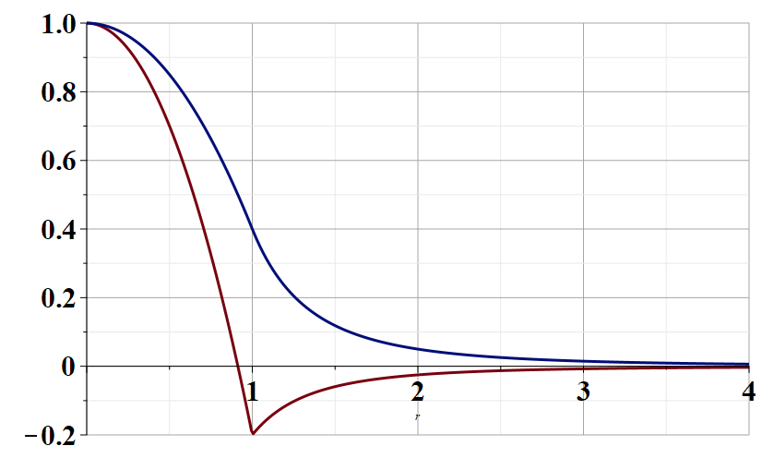
r parallel to ω
Radial part of B(r)
r/a →
r perpendicular to ω

Slide 7
Comment about spherical polar coordinates
Ref: https://www.cpp.edu/~ajm/materials/delsph.pdf

Slide 8
Various forms of Ampere’s law :

Slide 9
Other examples of current density sources:

Slide 10
Details of the electron orbital magnetic dipole moment
Note that:

Slide 11
Summary of magnetic field generated by point magnetic dipole moment discussed in the detailed notes:

Slide 12
