Slide 1
PHY 712 Electrodynamics
11-11:50 AM MWF in Olin 103
Lecture Notes for Lecture 15:
Start reading Chapter 6
Maxwell’s full equations; effects of time varying fields and sources
Gauge choices and transformations
Green’s function for vector and scalar potentials

Slide 2
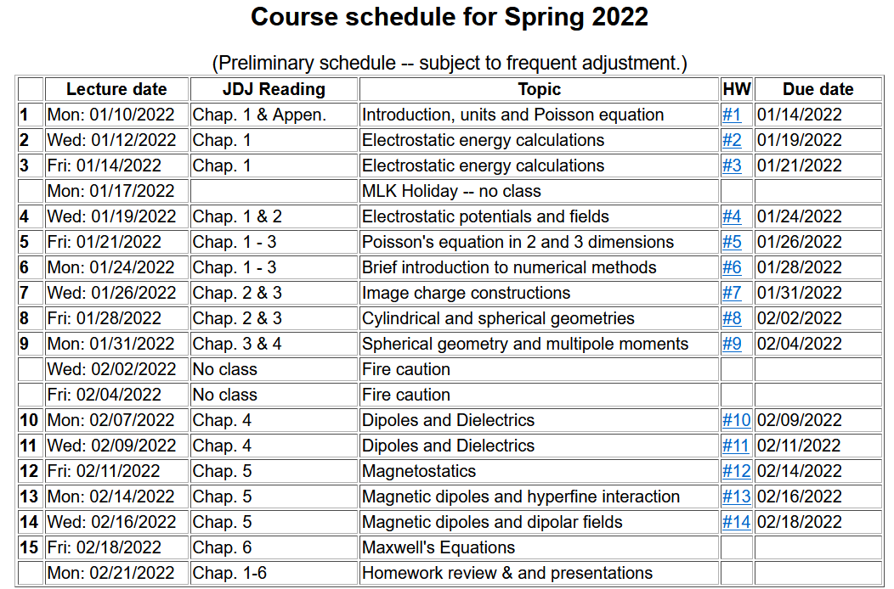

Slide 3
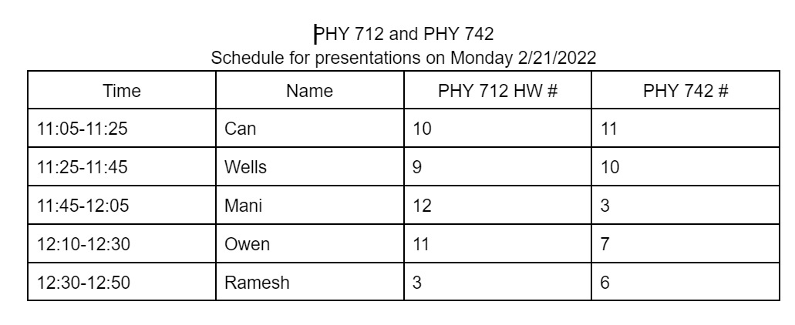
Plan for Monday 2/21/2022 --

Slide 4
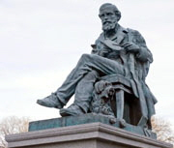
Full electrodynamics with time varying fields and sources
Maxwell’s equations
"From a long view of the history of mankind - seen from, say, ten thousand years from now - there can be little doubt that the most significant event of the 19th century will be judged as Maxwell's discovery of the laws of electrodynamics"
Richard P Feynman
Image of statue of James Clerk-Maxwell
(1831-1879) in Edinburgh
http://www.clerkmaxwellfoundation.org/

Slide 5
Maxwell’s equations

Slide 6
Maxwell’s equations

Slide 7
Formulation of Maxwell’s equations in terms of vector and scalar potentials

Slide 8
Formulation of Maxwell’s equations in terms of vector and scalar potentials -- continued

Slide 9
Formulation of Maxwell’s equations in terms of vector and scalar potentials -- continued

Slide 10
Formulation of Maxwell’s equations in terms of vector and scalar potentials -- continued

Slide 11
Formulation of Maxwell’s equations in terms of vector and scalar potentials -- continued

Slide 12
Formulation of Maxwell’s equations in terms of vector and scalar potentials -- continued

Slide 13
Solution of Maxwell’s equations in the Lorentz gauge

Slide 14
Solution of Maxwell’s equations in the Lorentz gauge -- continued

Slide 15
Solution of Maxwell’s equations in the Lorentz gauge -- continued

Slide 16
Solution of Maxwell’s equations in the Lorentz gauge -- continued

Slide 17
Solution of Maxwell’s equations in the Lorentz gauge -- continued

Slide 18
Solution of Maxwell’s equations in the Lorentz gauge -- continued

Slide 19
Solution of Maxwell’s equations in the Lorentz gauge -- continued

Slide 20
Solution of Maxwell’s equations in the Lorentz gauge -- continued
Liènard-Wiechert potentials and fields --
Determination of the scalar and vector potentials for a moving point particle (also see Landau and Lifshitz The Classical Theory of Fields, Chapter 8.)
Consider the fields produced by the following source: a point charge q moving on a trajectory R_{q}(t).
R_{q}(t)
q

Slide 21
Solution of Maxwell’s equations in the Lorentz gauge -- continued
We performing the integrations over first d³r’ and then dt’
making use of the fact that for any function of t’,
where the ``retarded time'' is defined to be

Slide 22
Solution of Maxwell’s equations in the Lorentz gauge -- continued
Resulting scalar and vector potentials:
Notation:

Slide 23
Comment on Lienard-Wiechert potential results

Slide 24
Comment on Lienard-Wiechert potential results -- continued

Slide 25
Summary of results for fields due to moving charge –
Liénard Wiechert potentials
Resulting scalar and vector potentials:
Notation:

